Slide 1

Understanding Transcriptional Regulation by ChIP-seq Data Analysis
Chao Cheng
Computational Biology and Bioinformatics Program
Molecular Biophysics and Biochemistry
Yale University
February 6, 2012

Slide 2
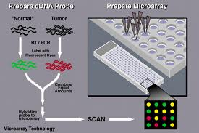
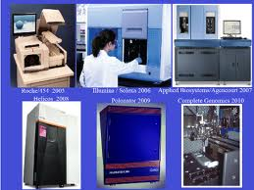

From Microarray to Sequencing
Microarray
2nd –Generation Sequencing
My Ph. D studies were focused on Microarray data analysis

Slide 3
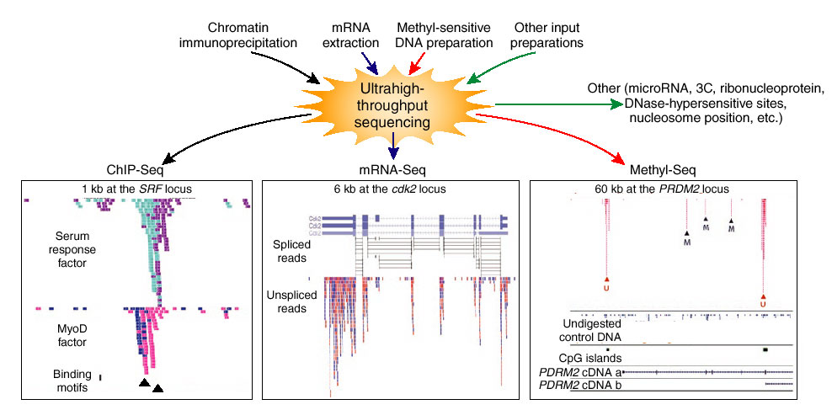
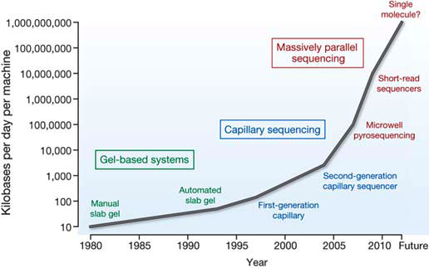
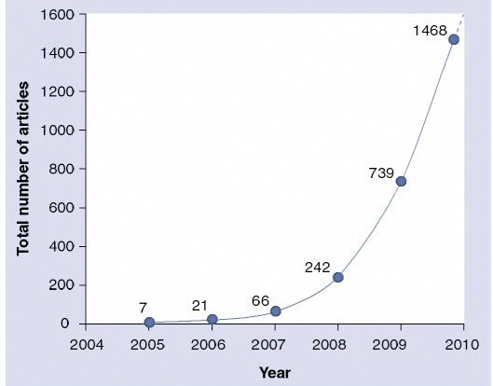
High-throughput sequencing has revolutionized biological studies
Wold et al., 2008
Sequencing rate
# Publications

Slide 4
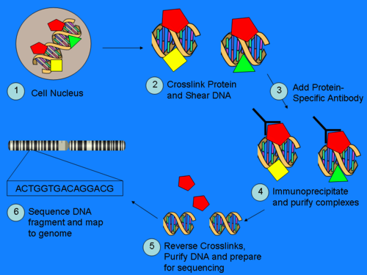
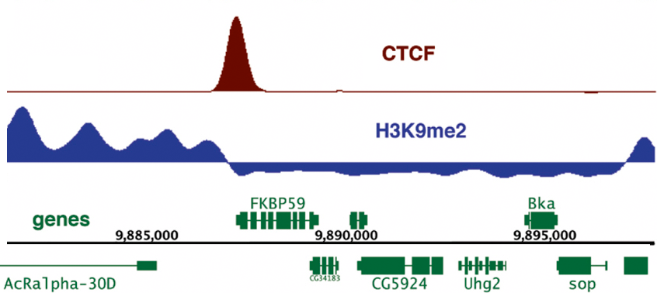
ChIP-seq Experiment & Data analysis
ChIP-seq
Map reads to genome
Peak calling
TF binding peaks
Histone modification peaks
http://en.wikipedia.org/wiki/Chip-Sequencing
Goal: How gene expression is regulated by TFs and HMs?

Slide 5
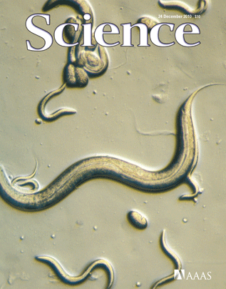

ENCODE and modENCODE
TIP: Cheng et al., Bioinformatics, 2011
Enhancer: Yip, Cheng et al., Genome Biology, 2012, Submitted
Chrom model: Cheng et al., Genome Biology (a), 2011
TF & Chrom model: Cheng et al., Nucleic Acids Res., 2011
TF target prediction: Cheng et al., Genome Biology (b), 2011
Network: Cheng et al. PlOS Computational Biology, 2011
modENCODE
modENCODE: Gerstein et al., Science, 2011
Cis-regulatory map: Negre et al. Nature, 2011
ENCODE: The ENCODE consortium, Nature, 2012 submitted
ENCODE Network: Gerstein et al. Nature, 2012, submitted
ENCODE

Slide 6
Outline: transcriptional regulation
Proximal regulation
- How to determine target genes of TFs?
Distal regulation: enhancer
- How to identify enhancers?
Relation between TF binding/HM signals and gene expression
- How much gene expression do TF binding and histone modification account for?
Regulatory Network
- How genes are regulated by the regulatory network?
Part I: A probabilistic model for identifying TF target genes from ChIP-seq data
Part II: Predicting TF binding sites and enhancers using histone model
Part III: Relating gene expression with TF binding and histone modification signals
Part IV: Integrated regulatory network analysis

Slide 7


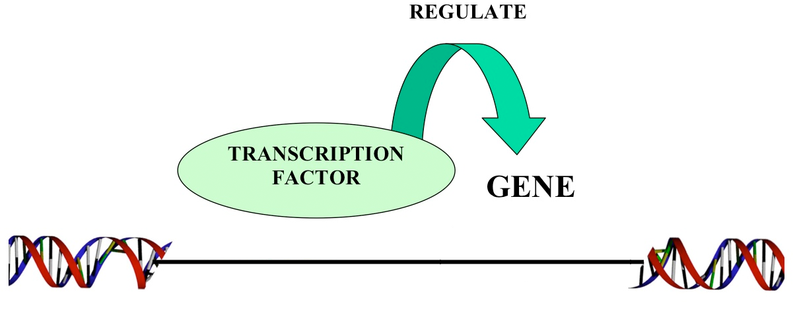
Part I: A probabilistic model for identify TF target genes from ChIP-seq data
ChIP-seq of P53
TSS
P53 target genes

Slide 8
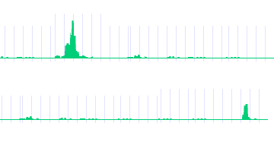
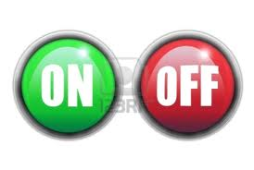
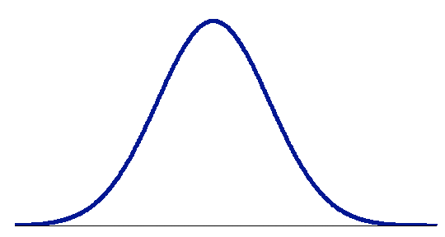
Conventional way to identify TF target genes
P53
TF binding and TF→gene regulation is NOT binary but quantitative
Gene A
P53 → A
Gene B
P53 X B
-2kb TSS 2kb
Limitations of peak-based method:
Low Medium High
- sensitive to # binding peaks
- sensitive to cut-off value (1, 2 or 5 kb of TSS?)
-- no significance estimation
Regulatory score

Slide 9
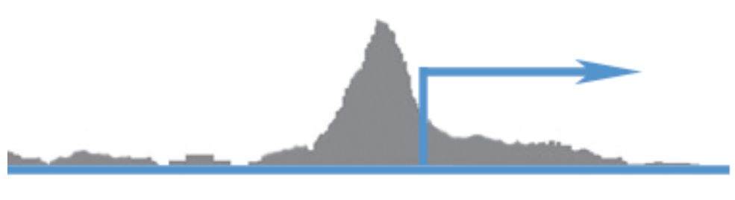
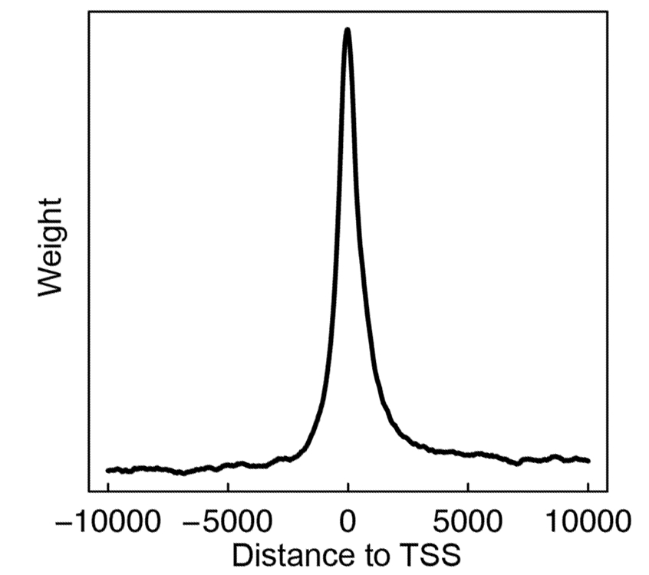

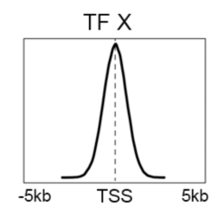

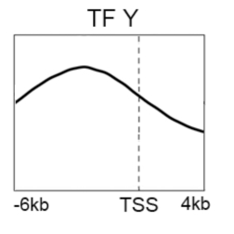
Target Identification with a Probabilistic model (TIP)
-10000 0 10000
S_{i}(g): the signal of a TF at nucleotide i of gene g
Binding signal: S_{i}(g)
Avg. profile: w_{i}
-- TF binding signal at different position contribute differently
Distance from TSS
binding preference of a TF
P-value & FDR
Calculate regulatory score and p-value for all genes
Avg binding signal across all genes
Cheng et al. 2011, Bioinformatics

Slide 10
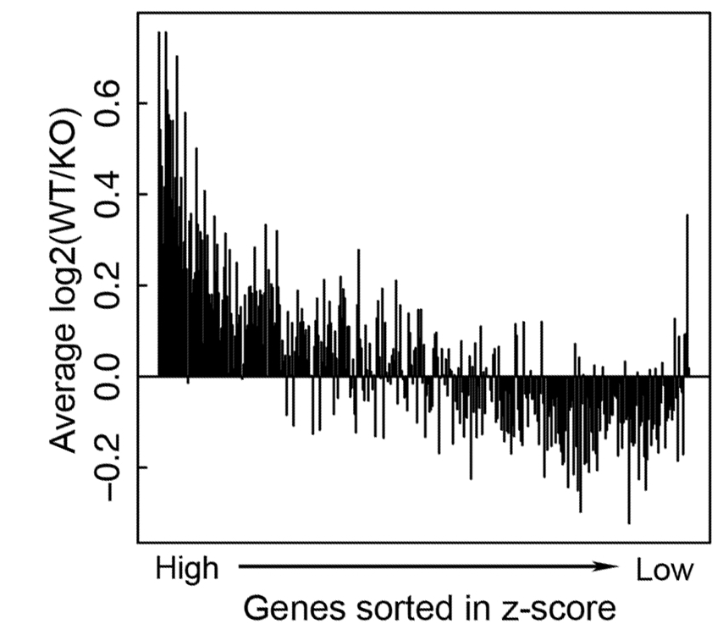
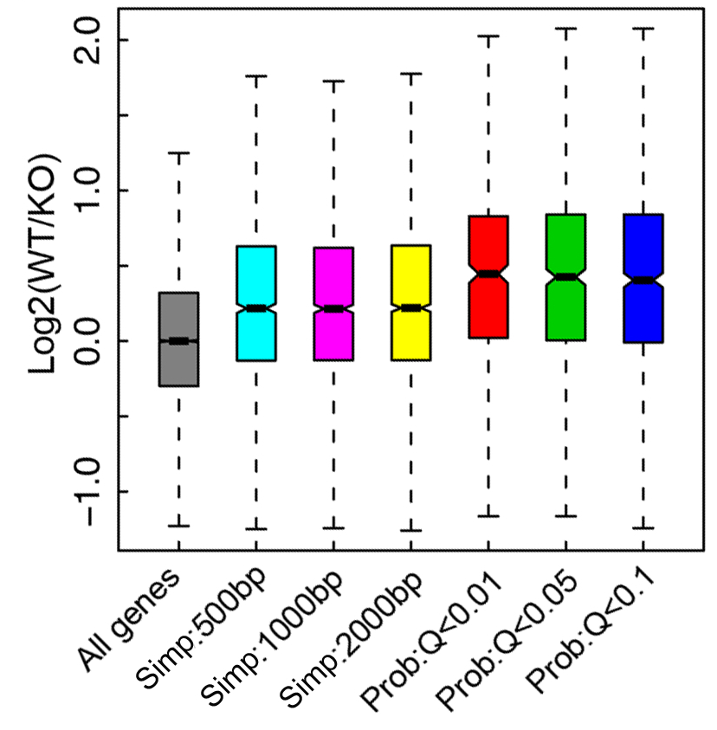
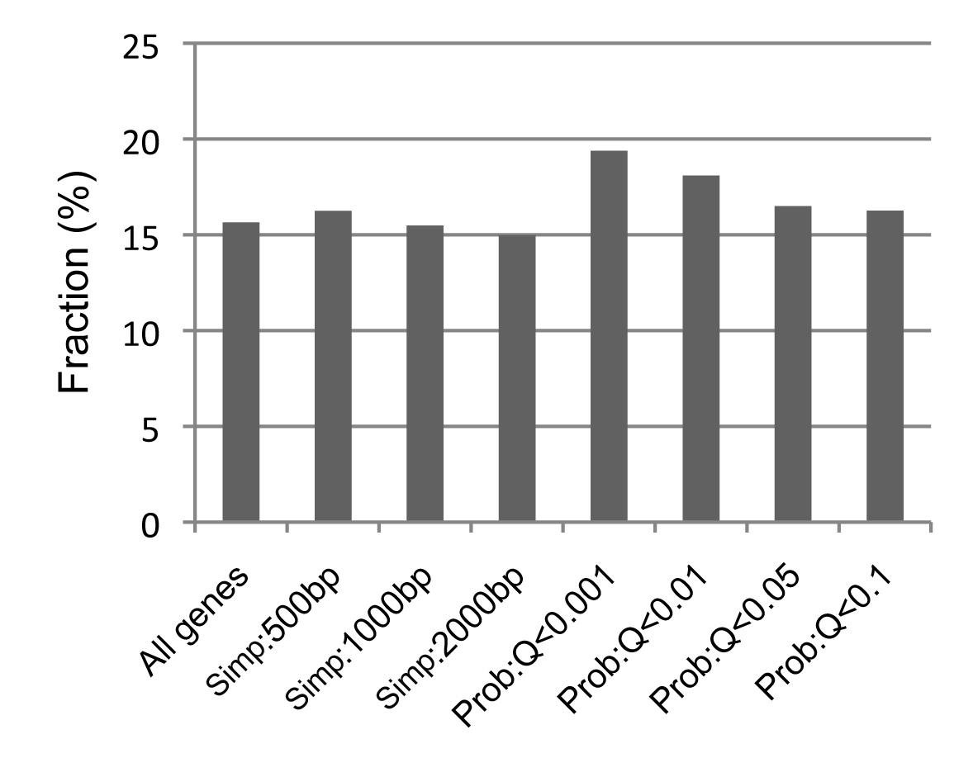
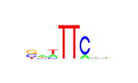
Example 1: STAT4 targets identified by TIP are more down-regulated in STAT4 KO
Peak
TIP
Data
ChIP-seq data:
Stat4 binding in Th1 cell
Gene expression:
STAT4KO + WT mice
Wei et al., 2010
Target
Non-target
TIP
STAT4 binding motif are more enriched in targets identified by TIP
Peak
STAT4 motif

Slide 11
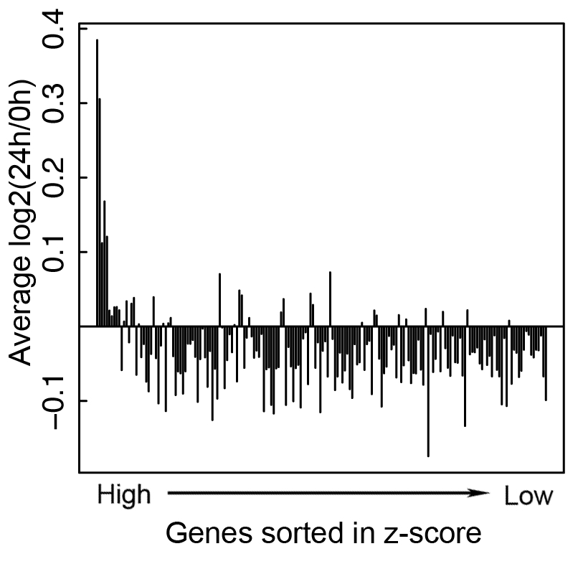
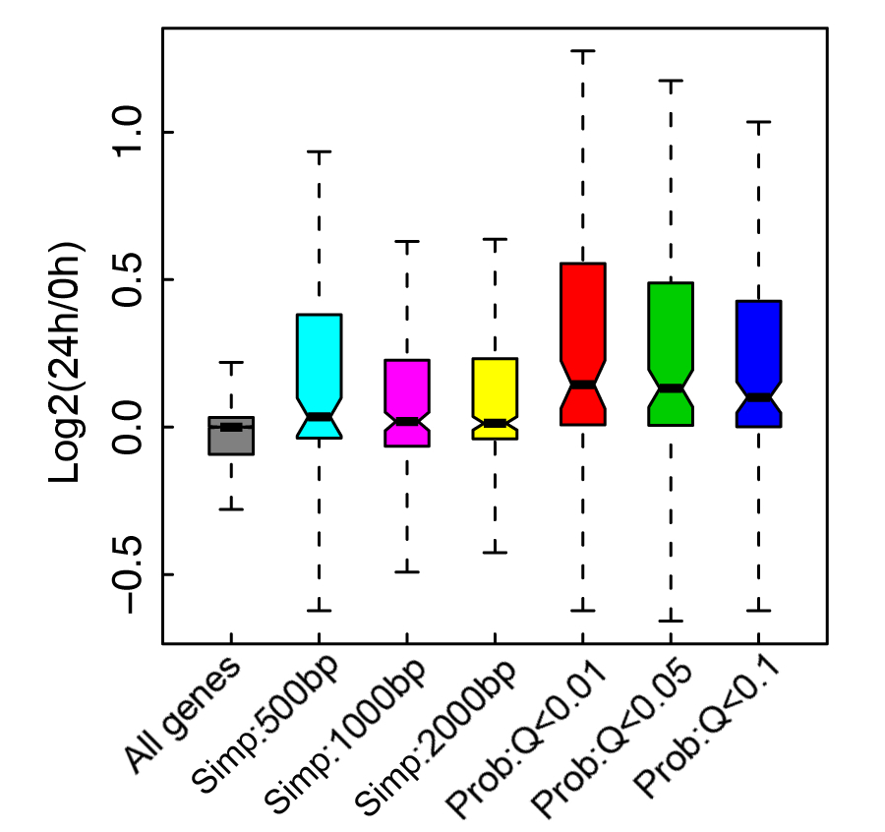
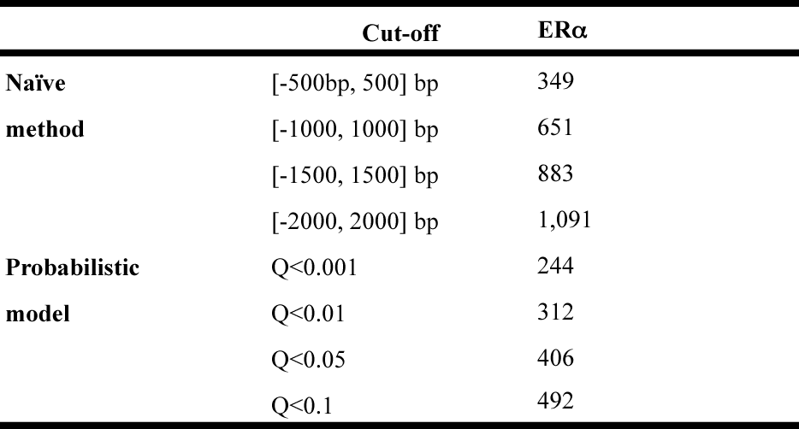
Example 2: ERα targets identified by TIP are more responsive to estrogen treatment
Data
E2 responsive genes
Peak
TIP
ChIP-seq data:
ERα binding in MDA-MB-231 cell line
Gene expression:
before and after E2 treatment
Stender et al., 2010
Target
Non-target
# target genes

Slide 12
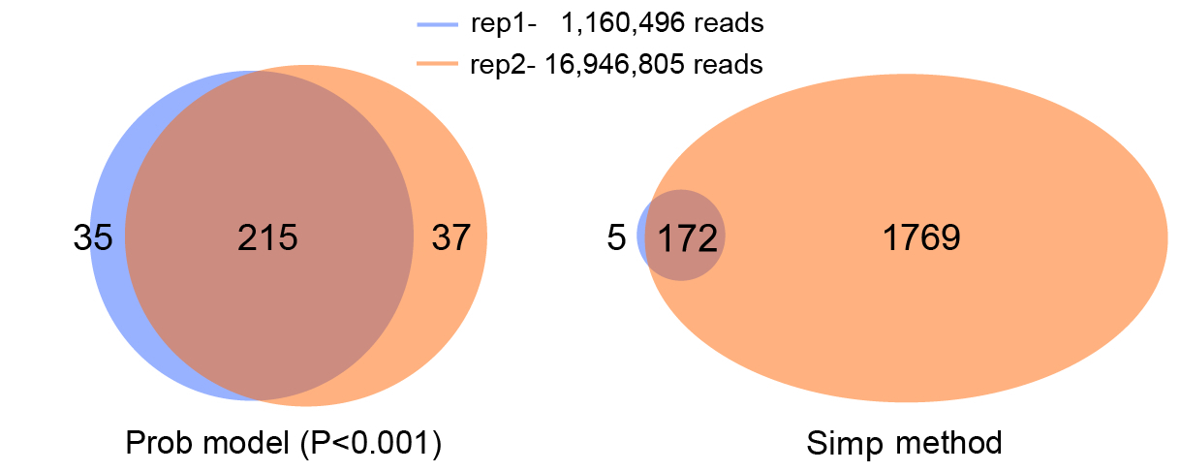
TIP is insensitive to sequencing depth
TCF4: Mokry et al., 2010
TIP (P<0.001)
Peak based method
TIP is cost-effective-- do not require high read-depth for target gene identification!
Notes:
Another advantage of TIP is that it is not sensitive to the read depth. We applied the method to the TCF4 CHIP-seq data with two replicates. The two replicates have 10-fold of difference in number of sequencing reads. Usually, the number of binding peaks identify by peak calling method will increase if more reads are sequenced. As a consequence, the numbers of target genes identified by the peak-based method are substantially different between the two replicates. However, the numbers by TIP are very similar and consistent. This is very useful. Because, you don’t have to sequence into a very high read-depth.

Slide 13
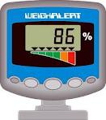
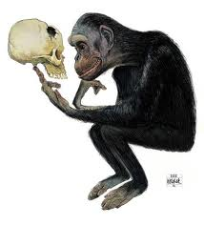

Summary: TIP
TIP measures TF-gene regulatory relationships quantitatively
Target genes identified by TIP are more biologically meaningful
-- more down-regulated expressed in TF KO mouse
-- more responsive to signal molecules
-- more enriched in TF binding motifs in their promoters
TIP is robust to read-depth and cost-effective
Cheng et al. 2011, Bioinformatics

Slide 14
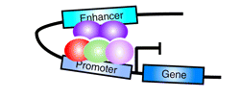

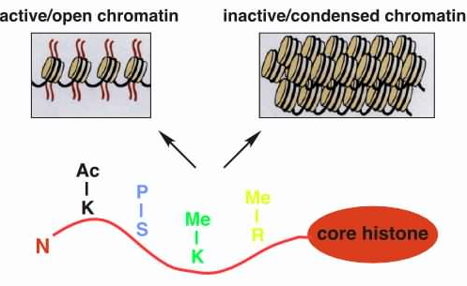
Part II: Predicting TF binding sites and enhancers using Chromatin model
Different elements (e.g. enhancer, promoter) are associated with different histone modification patterns in the genome.
Ernst et al. 2011
Borok et al. 2010
http://www.imt.uni-marburg.de/bauer/research.html

Slide 15
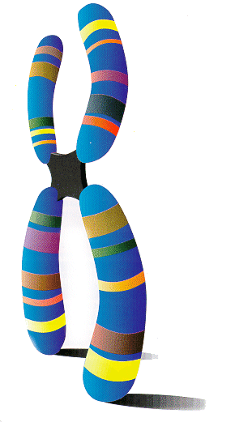
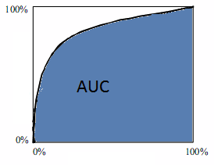
Chromatin model: link histone modification patterns to TF binding
ChIP-seq Data
Predictors (HM)
TF binding site?
Bin 1 (100bp)
Bin 2
 | HM1 | HM2 | HM3 | ……
Bin1 | 0.2 | 0.4 | 0.6 | …
Bin2 | 0.3 | 0.3 | 0.2 | …
Bin3 | 0 | 0.2 | 2.1 | …
Bin4 | 0.4 | 0.4 | 0 | …
Bin5 | 0.3 | 1.2 | 0.5 | …
Bin6 | 1.2 | 3.1 | 2.1 | …
Bin7 | 3.4 | 2.4 | 0.8 | …
Bin8 | 1.5 | 1.2 | 0.9 | …
……. | … | … | … | …
 | TF1 | TF2 | ……
Bin1 | 0 | 0 | …
Bin2 | 0 | 0 | …
Bin3 | 1 | 0 | …
Bin4 | 1 | 0 | …
Bin5 | 0 | 1 | …
Bin6 | 0 | 0 | …
Bin7 | 0 | 1 | …
Bin8 | 1 | 0 | …
……. | … | … | …
…
+
divide into DNA bins
ROC curve
Machine Learning Method (SVM et al.)
TPR (sensitivity)
Predictors (HM)
TF binding site
FPR (1-specificity)

Slide 16
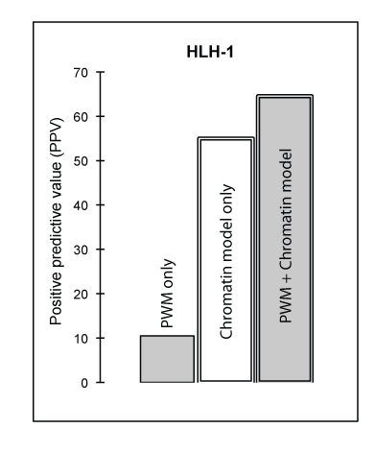
Relating the Chromatin Model to TF Binding Sites in worm
Model Predicts Sites Fairly Accuracy
Accuracy improved when coupled with PWM
Chrom+PWM
Chrom model
AUC
Gerstein et al. 2010, Science

Slide 17
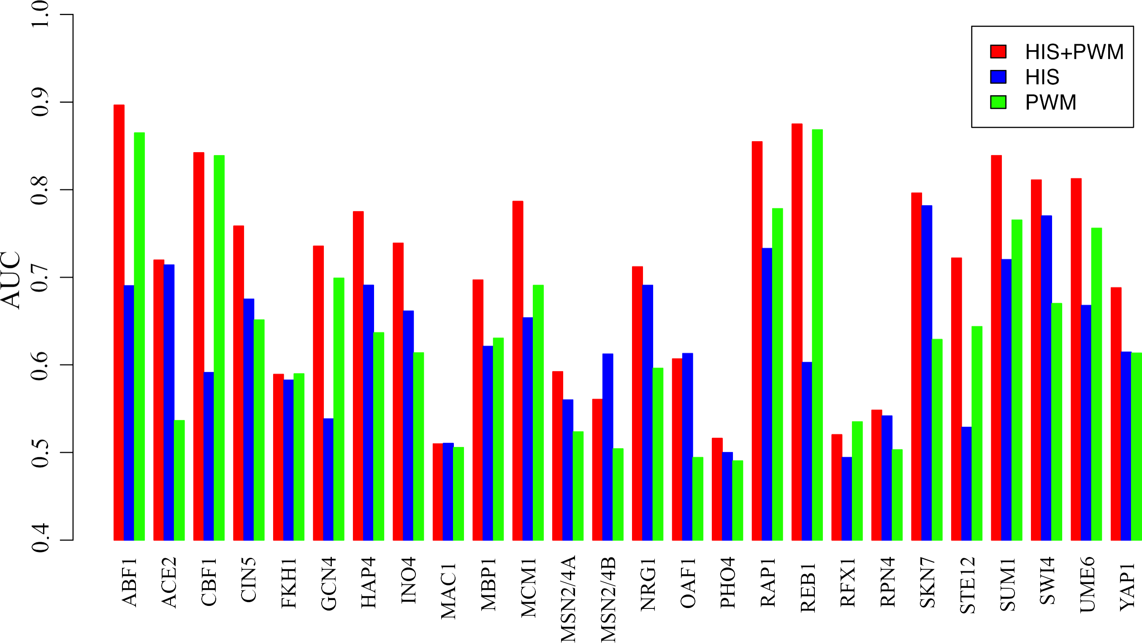
HIS+PWM leads to higher accuracy for predicting yeast TF target genes
his-sensitive
his-insensitive
Cheng et al. Genome Biol. (‘11) 12:R111

Slide 18
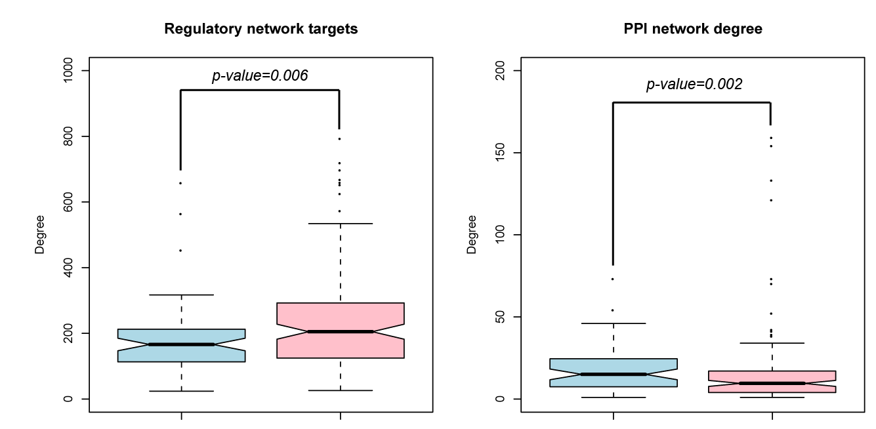
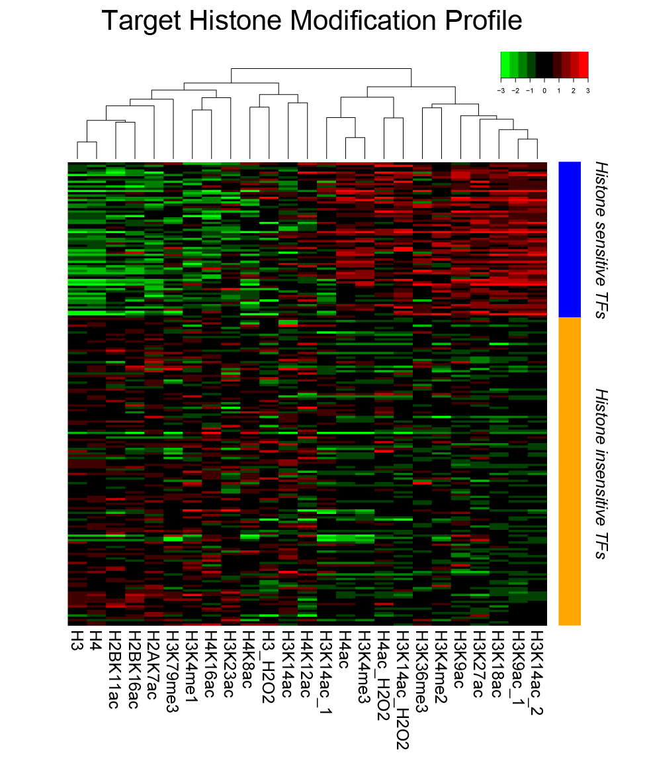
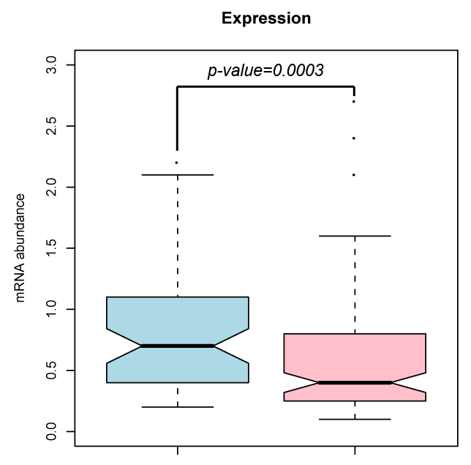
Histone-sensitive vs. -insensitive TFs

Slide 19
Predict human tissue specific enhancers
Step 1: Predict open chromatin regions-- binding active regions (BAR+)
Step 2: Search BAR+ regions for tissue specific TF motifs.
-- e.g. motifs of embryo specific TFs (Oct, Sox families) for embryo specific enhancers
Step 3: Select conserved distal (5kb away from TSS) predictions
Validation: choose 6 for experimental validation in mouse model.
Step 1
BAR+
BAR+
Step 2
BAR+
BAR+
Sox motif
Step 3
Conserved?
Distal?
Candidate enhancers

Slide 20
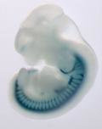
Validation in mouse embryo model
Clone predicted enhancer (~500bp) into LacZ vector with a minimal promoter
Injected into fertilized eggs
Stained at 11.5d
-- by Pennacchio Lab
5/6

Slide 21
Summary: TFBS & enhancer prediction
Histone modifications are informative for determining TF binding sites
Combining histone modification data with TF motif information can predict tissue specific enhancers
Cheng et al. 2011, Genome Biology (b)
Gerstein et al. 2010, Science

Slide 22

Part III: Relating gene expression with histone modification and TF binding signals
“Input”
To what extent the gene expression levels are determined by TF binding/ HM modification?
Histone modification
TF Binding signal
Predictive models
Gene expression levels
“Output”

Slide 23
Histone Modification (HM) model
TSS
TTS
Gene k
40
1
80
120
81
4 …
41 ….44
121
160
Bin 40-1
(TSS-4kb to TSS)
Bin 41-80
(TSS to TSS+4kb)
Bin 120-81
(TTS-4kb to TTS)
Bin 121-160
(TTS to TTS+4kb)
RNA-Seq data
Chromatin features:
Histone modifications
Prediction target:
Gene expression level
Predictors
~10000 refseq genes
HM1, 2, 3, ……
……
Bin 1
Bin 2
Bin160

Slide 24
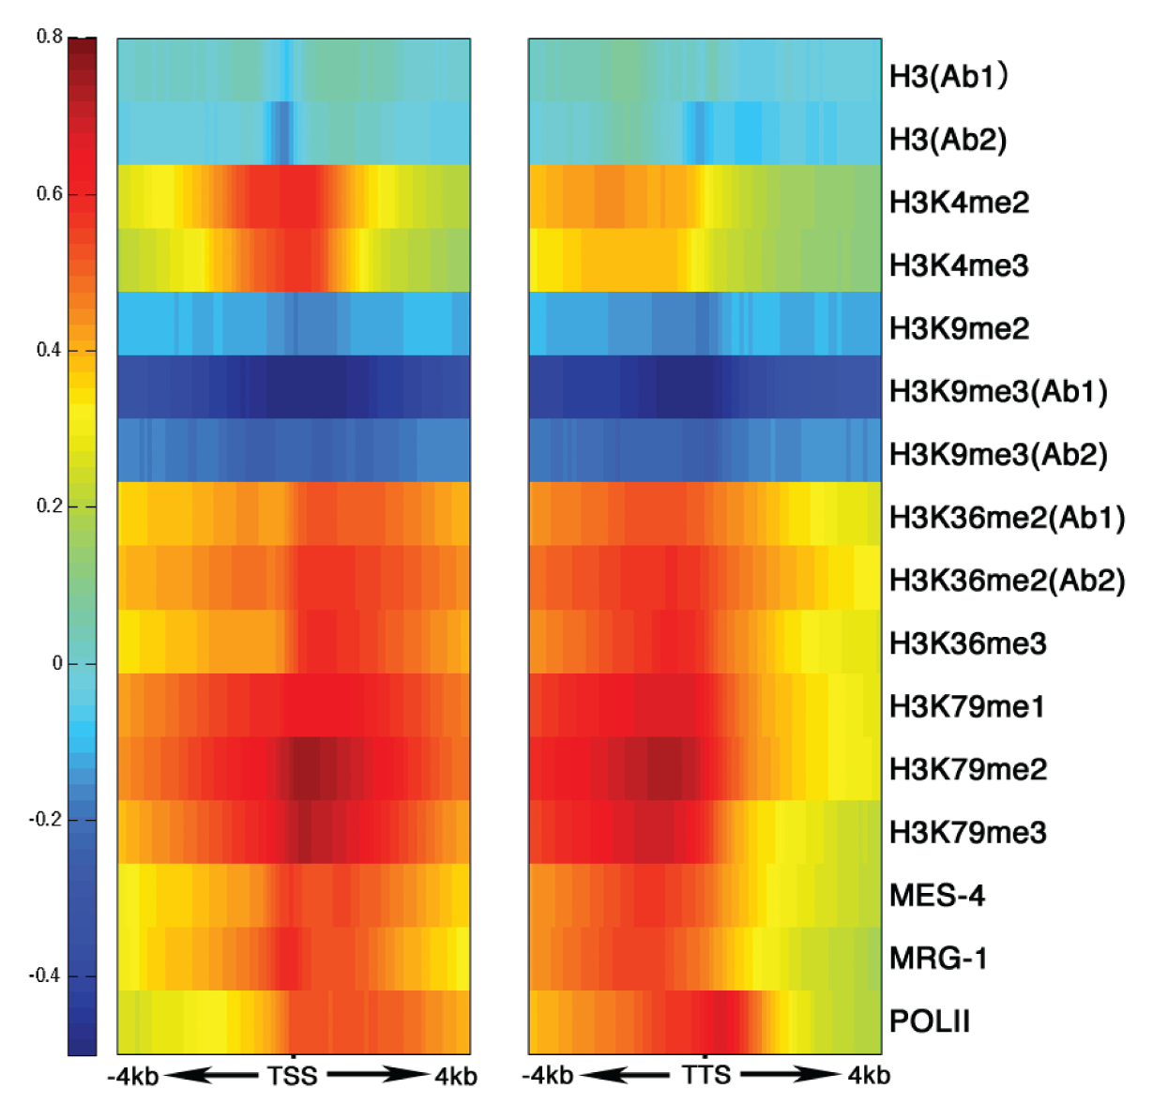
His. mods around TSS & TTS are clearly related to level of gene expression, in a position-dependent fashion
START
STOP
TTS
Gerstein et al. 2010, Science
Correlation between Signal and expression

Slide 25
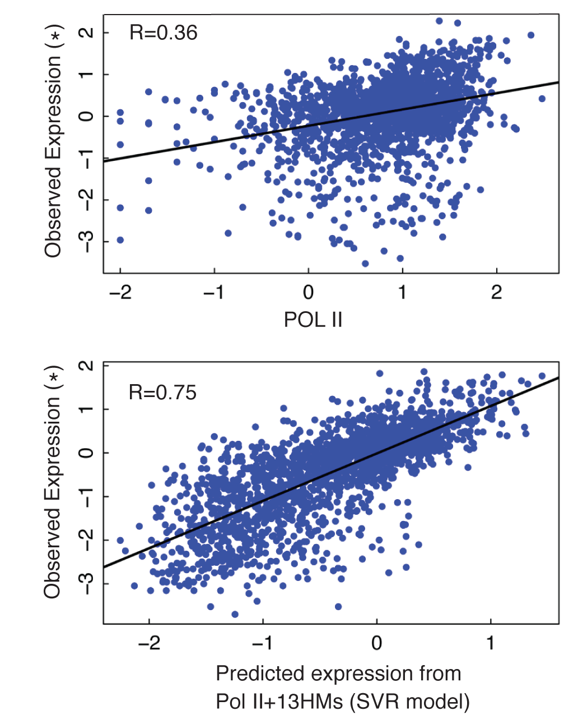
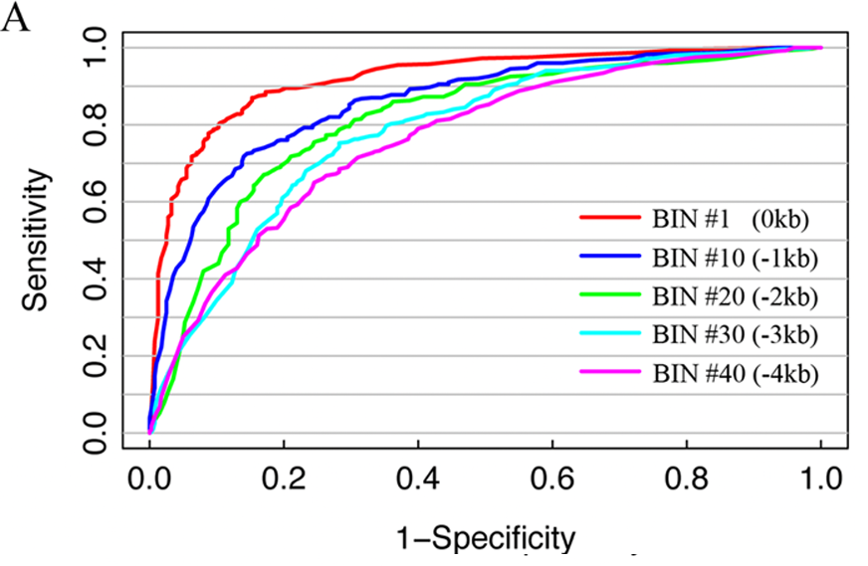
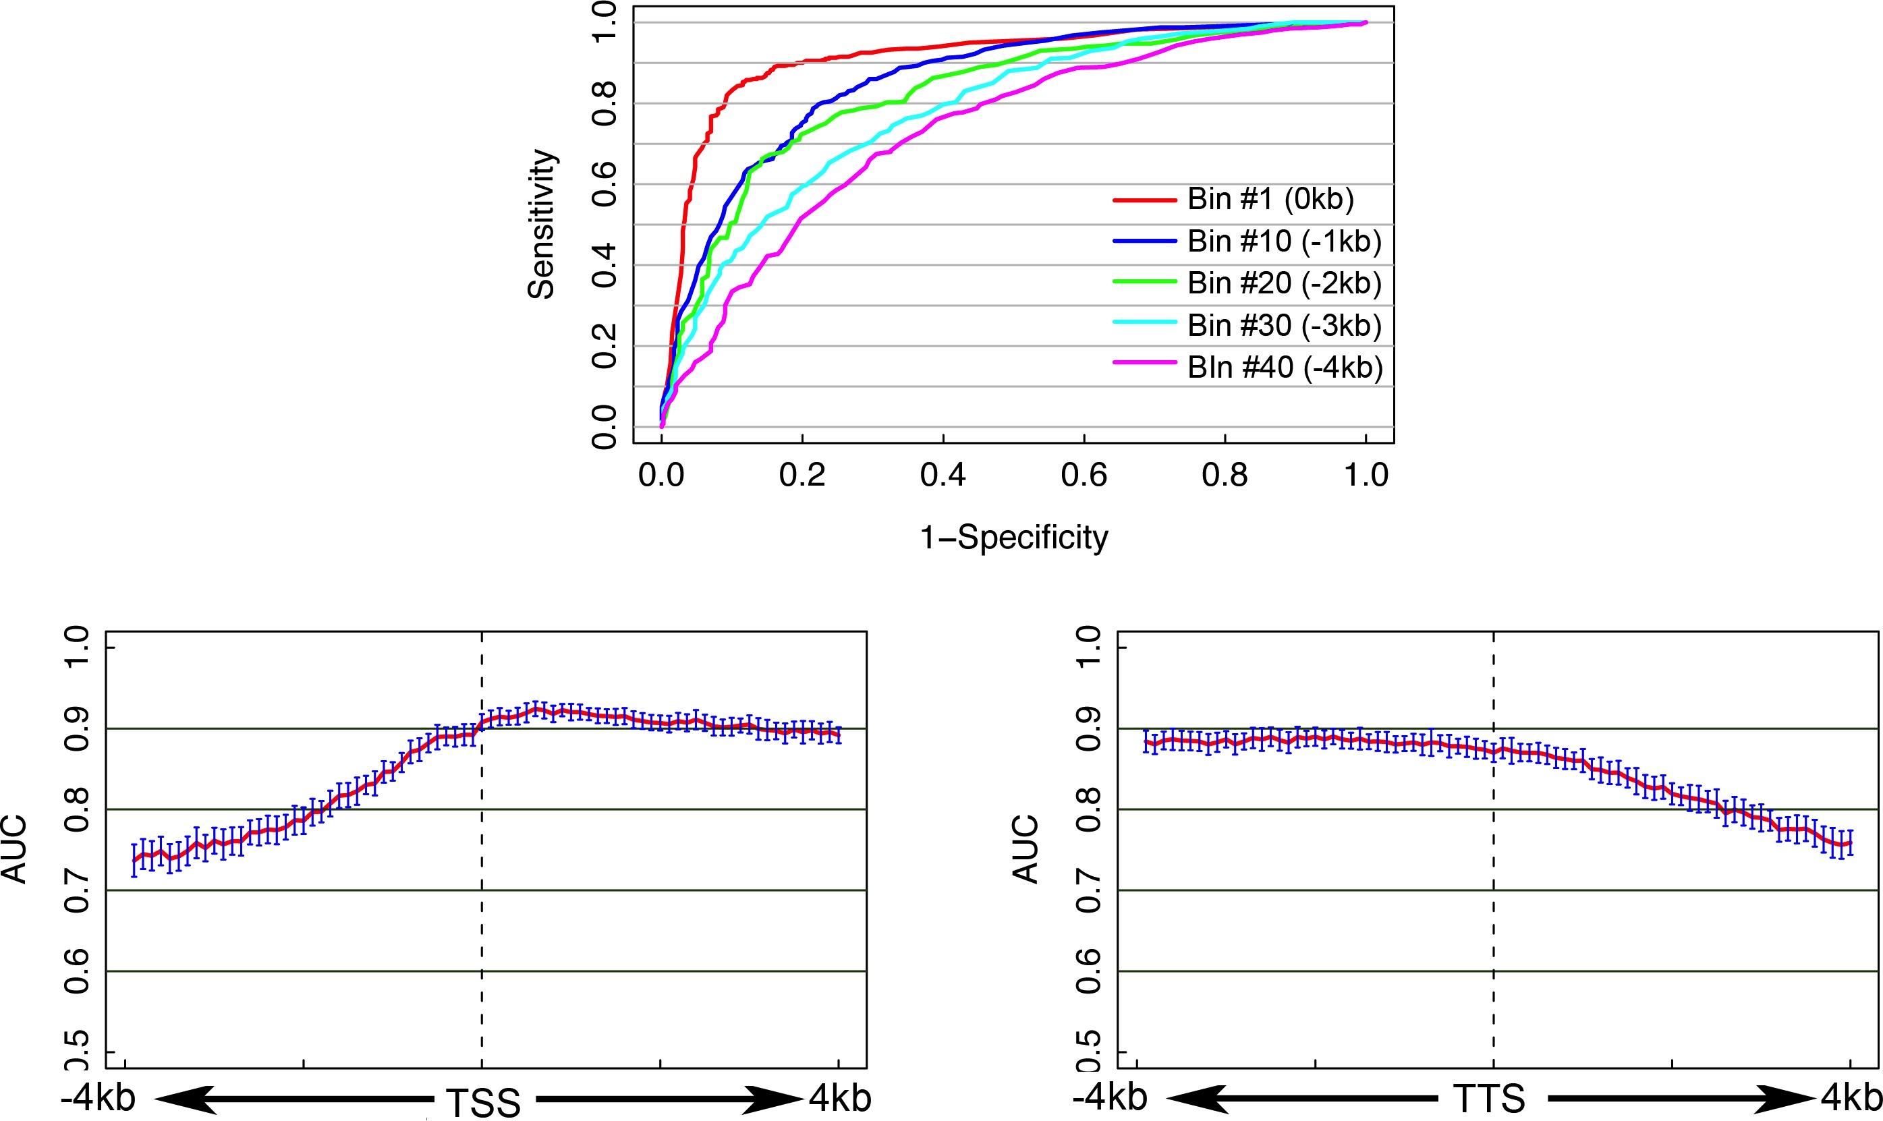
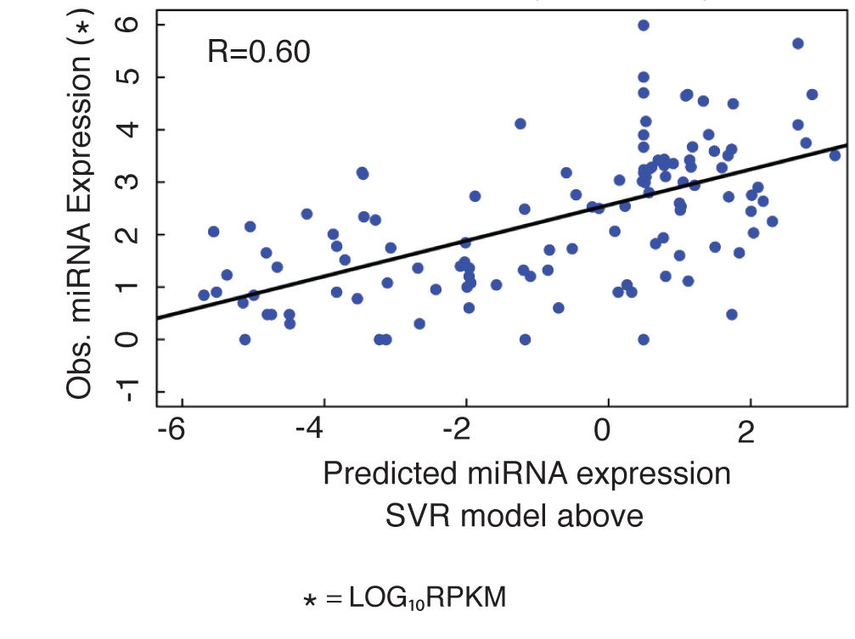
Integrate all histone modifications to predict gene expression levels
Classify H/L genes (SVM)
Predict expression values
#Bin1
Magnitude of Prediction from a “bin” around the TSS

Slide 26
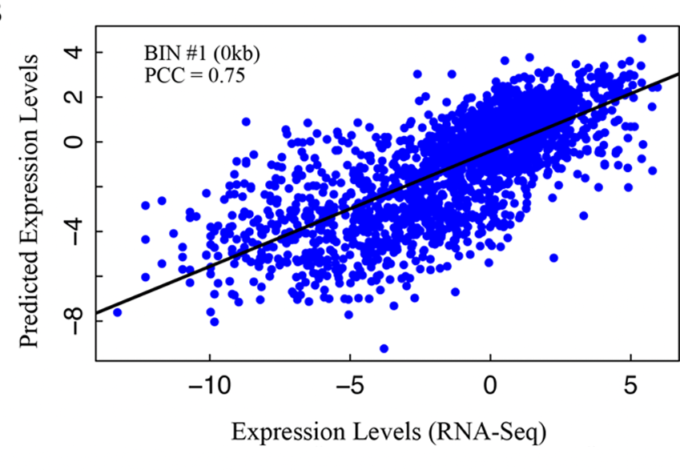
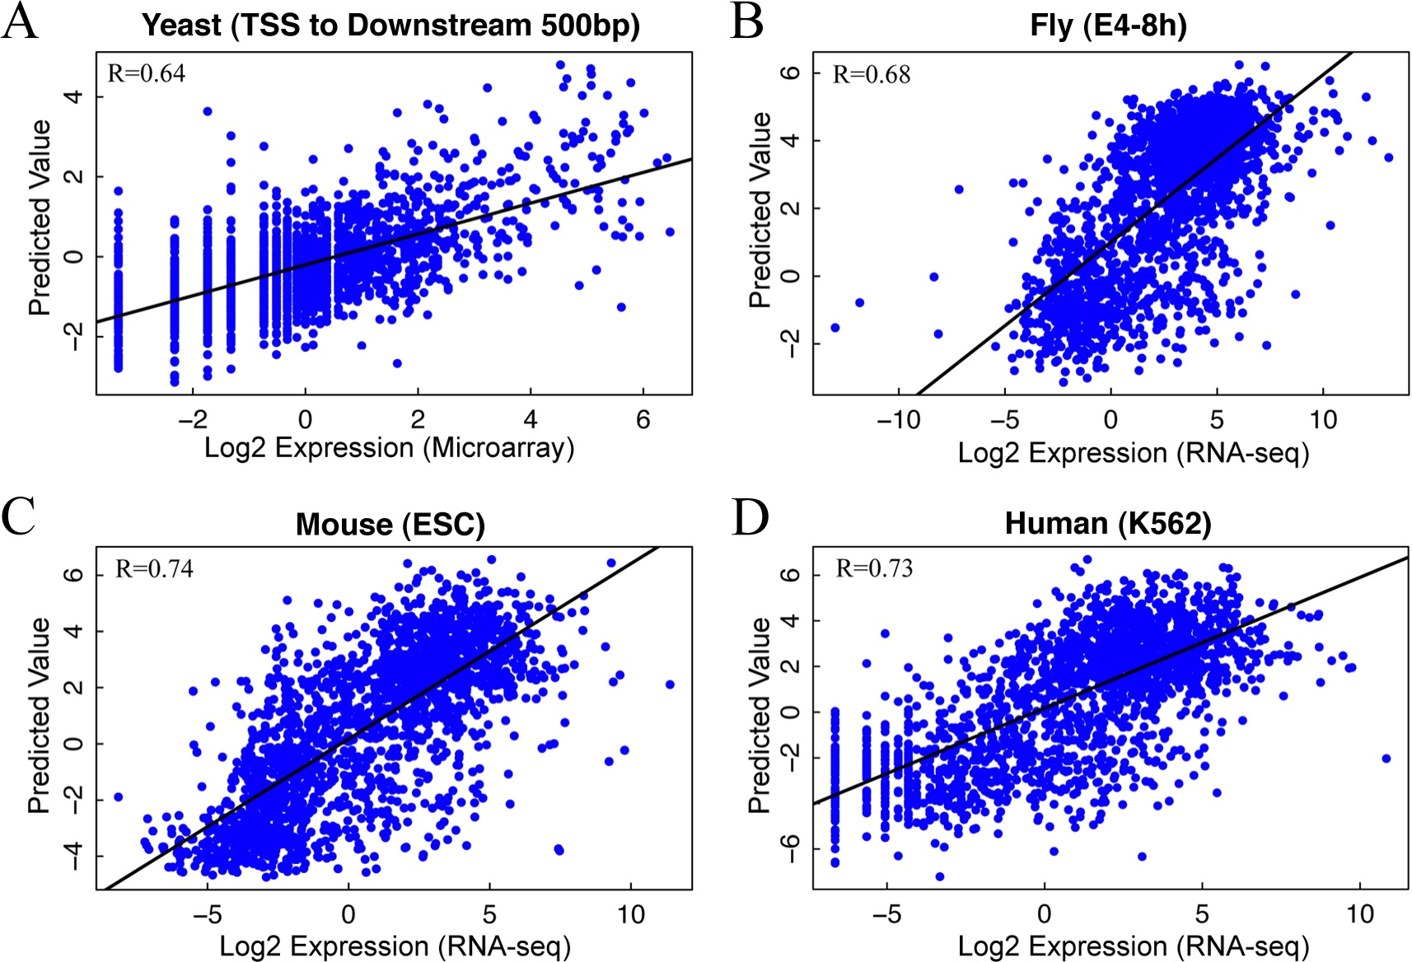
Application of HM model in 5 species:
Consistent Performance
Worm (L3)
>50% of variation of expression levels can be explained by HMs
Cheng et al. 2011, Genome Biology (a)

Slide 27
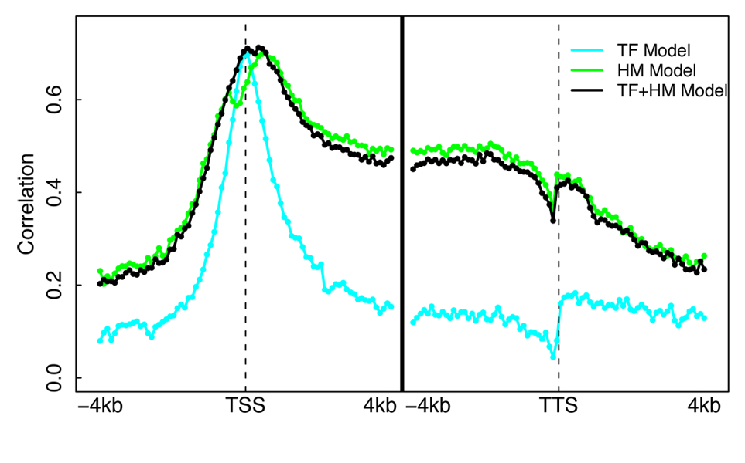
Mouse ESC Models Illuminates Different Regions of Influence for TFs vs HMs
Datasets
  ChIP-Seq for 12 TFs
  (Chen et al. 2008)
  ChIP-Seq for 7 HMs
  (Meissner et al.’08; Mikkelsen et al. ’07)
  RNA-Seq (Cloonan et al. 2008)
A TF+HM model that combine TF and HM features does NOT improve accuracy!
Cheng et al. 2011, Nucleic Acids Res.

Slide 28
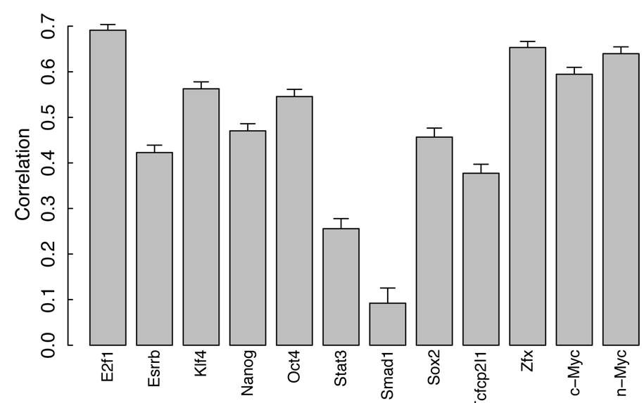
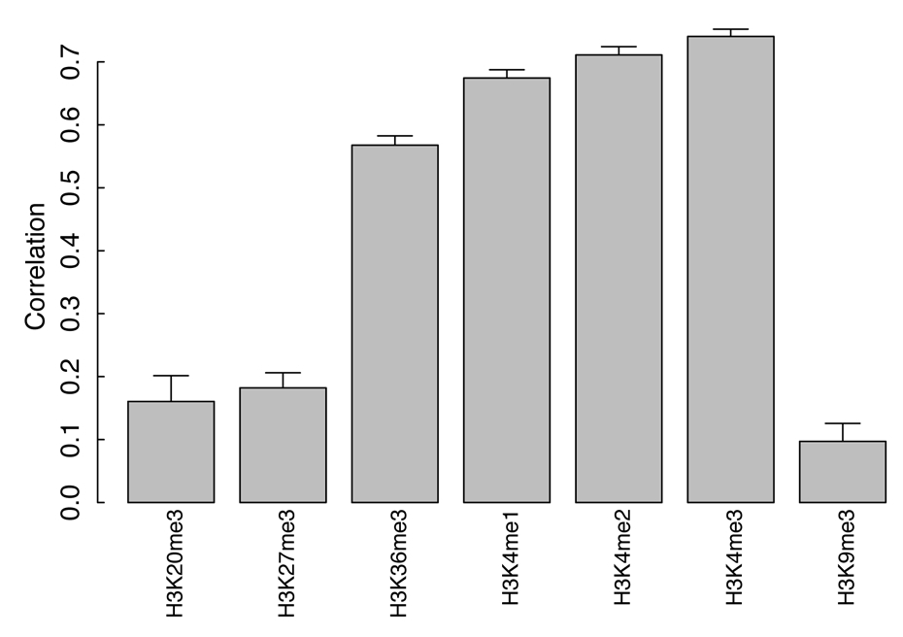
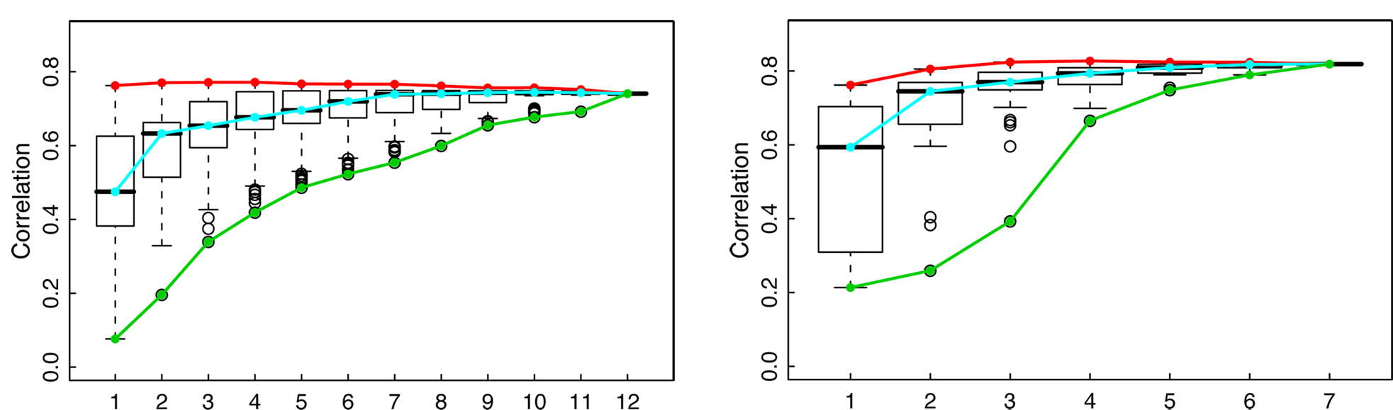
Which TF/HM are important for expression prediction?
Select a subset (n) of TFs/HMs, n=1,2,…12

Slide 29
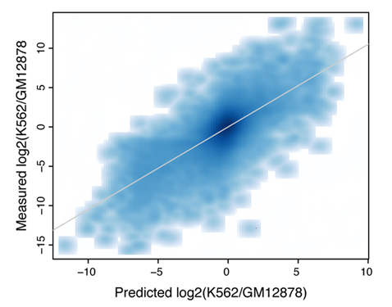
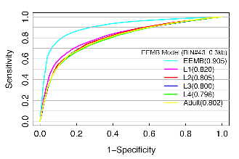
TF and HM models are tissue specific
PCC=0.73
HM model-- Best prediction is achieved by using histone modification and expression data from the same developmental stage
TF model– differential TF binding signals are predictive of differential expression levels between two human cell lines
Cheng et al. 2011, Genome Biology (a)

Slide 30
Summary: relate TF/HM signals with expression
TF/HM signals are highly predictive to gene expression
TF and HM signals are redundant for ‘predict’ gene expression
TF and HM models are tissue/cell line specific
microRNA expression can also be predicted
Gerstein et al. 2010, Science
Cheng et al. 2011, Nucleic Acids Res.
Cheng et al. 2011, Genome Biology (a)

Slide 31
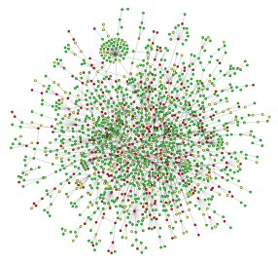

Part IV: Integrative regulatory network analysis
Understanding transcriptional regulation from a network perspective

Slide 32


Combining networks forms an ideal way of integrating diverse information
Metabolic pathway
Transcriptional regulatory network
Physical protein-protein Interaction
Co-expression Relationship
Part of the
TCA cycle

Slide 33
Construction of an
Integrated Network

Slide 34

Integrated worm regulatory network

Slide 35

Relating Worm TF Hierarchy with Gene Properties
miRNAs
miRNAs
-- TFs in the top are more tissue specific
-- TFs in the bottom tend to be ubiquitously expressed and have more PPI partners
-- TFs in the middle are more regulated by miRNAs
miRNAs
Also in-
Fly: Nègre et al, Nature, 2011
Human: Gerstein et al. Nature 2012, submitted
Cheng et al. 2011, PLoS Computational Biology

Slide 36







Network Motifs
7 Motifs
Over-represented
FFL involving
miRNA & 2 TFs
All Motifs

Slide 37
Summary: integrated network
Transcriptional regulation is organized as a network with TF, miRNA and other genes as nodes.
ChIP-seq data is useful to construct such a network.
TF-TF regulatory network can be visualized as a hierarchical network. TFs at different levels show different features.
Some regulatory patterns (network motifs) are favored and being enriched in the network.
Cheng et al. 2011, PLoS Computational Biology

Slide 38

Acknowledgements
Yale University
-- Mark Gerstein, Sherman Weissman, Koon-Kiu Yan, Chong Shou, Renqiang Min, Joel Rozowsky, Kevin Yip, Roger Alexander, Ekta Khurana, Nitin Bhardwaj, Pedro Alves, Mihali Felipe, Arif Harmanci, Mengjie Chen
Univ. of Southern California
-- Lei Li, Valter Longo, Fengzhu Sun, Xiaotu Ma, Paola Fabrizio, Min Wei, Huanying Ge,
Weng Lab (UMASS)
-- Zhiping Weng, Xianjun Dong
Qian Lab (Johns Hopkins University)
-- Jian Qian, Woochang Hwang
Snyder Lab (Stanford University)
-- Michael Snyder, Wei Niu
White Lab (Univ. of Chicago)
-- Kevin White, Lijia Ma
Pennacchio Lab (Lawrence Berkely National Laboratory)
Birney Lab (EBI)
Waterson Lab (Univ. of Washington)
Lieb Lab (Univ. of North Carolina)
Gingeras Lab (CSHL)
Consortium
ENCODE
modENCODE

Slide 39
Thank you!

Slide 41

TIP equations

Slide 42

Two-layer model
Layer 1: predict expression in bin
Layer 2: combine predictions from all bins

Slide 43
Which TF/HM are important for expression prediction?
Select a subset (n) of TFs/HMs, n=1,2,…12

Slide 44



CpG content and predictive models

Slide 45

HCP and LCP

Slide 46

Positive and negative regulators

Slide 47

Distribution of R-scores

