Slide 1
Arabidopsis Network Evolution
Gerstein Nets Subgroup Meeting
Darryl Reeves
2/02/2012

Slide 2
Goal
Investigate network changes between two closely related species

Slide 3
Background
Arabidopsis thaliana
Genome size: ~125 Mb
27,025 genes
self-compatible (capable of self-pollination) annual
Arabidopsis lyrata
Genome size: ~206 Mb
32,670 (predicted) genes
self-incompatible perennial
Diverged about ~10 million years ago

Slide 4
Method
Downloaded protein sequences for A. thaliana and A. lyrata (Phytozome)
Identified orthologous genes using InParanoid software based on protein sequences (22,103)
Identified A. thaliana network genes without orthologs:
PPI Network
TF Network
Metabolic Pathway Network
Generated network visualizations

Slide 5
Data
Data Type | Source | Size
A. Thaliana
PPI | TAIR/BIOGRID | 8,993 interactions
Pathways | AraCyc | 4,996 pathway enzymes
Transcription Regulation | AGRIS - AtRegNet | 765 (confirmed) TF-gene interactions

Slide 6
Node/edge differences
 | PPI Network Interactions | TF Regulatory Network Nodes | Metabolic Network Nodes
Arabidopsis thaliana | 1331 | 715 | 2100
Missing in A. lyrata | 90 | 50 | 198
Biological significance of missing network components?

Slide 7
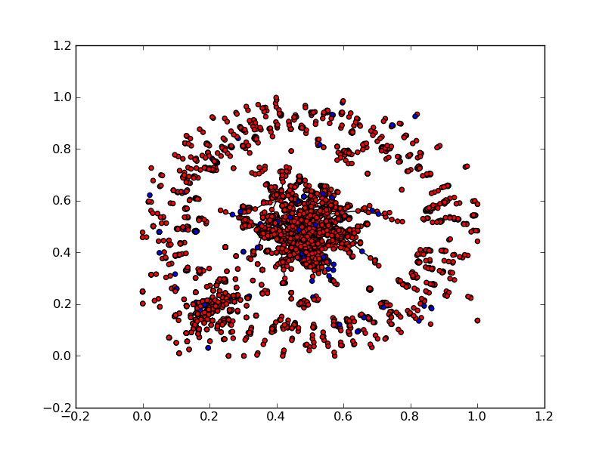
PPI Network

Slide 8
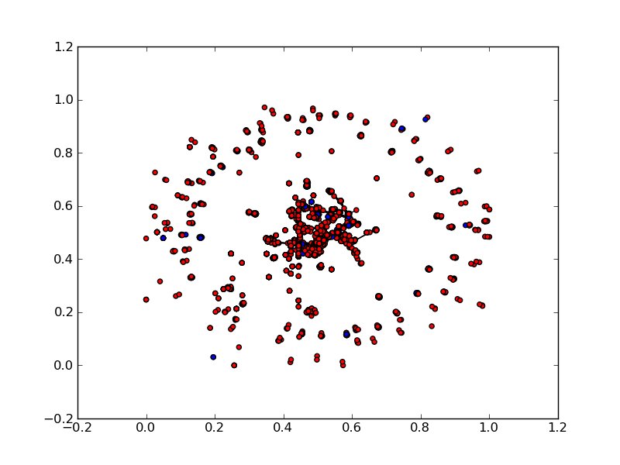
Metabolic Pathway Network

Slide 9
Next Steps
Duplicate analysis using Hu’s orthologs
Look into identities of missing nodes

