Slide 1

Understanding Transcriptional Regulation by ChIP-seq Data Analysis
Chao Cheng
Molecular Biophysics and Biochemistry
Yale University
February 6, 2012
Notes:
Good morning. I am Chao Cheng from Yale. Thanks for inviting me to present here. Today I will talk about some work in my post-doc studies at Yale. The topic is about understanding transcriptional regulation by ChIP-seq data analysis.

Slide 2
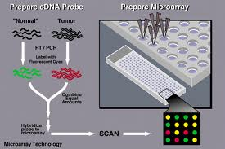


From Microarray to Sequencing
Microarray
2nd –Generation Sequencing
My Ph. D studies were focused on Microarray data analysis
Notes:
Before 2007, microarray is the most popular technology in biological studies. However, in the past few years, the second generation sequencing has replaced microarray and become the most powerful technology. In my PhD studies, I focused on developing methods for microarray data analysis. After I graduated and come to Gerstein Lab at Yale, I changed my research direction to the sequencing data analysis. It is amazing to experience this technology revolution event.

Slide 3
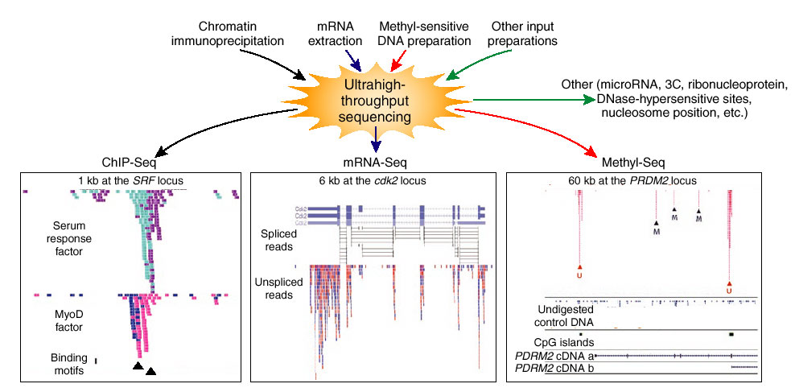
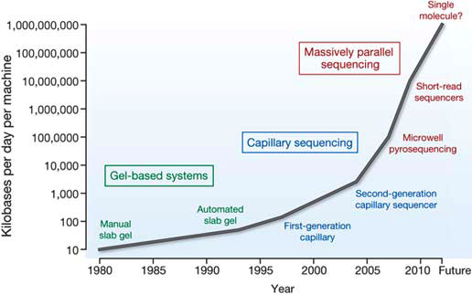
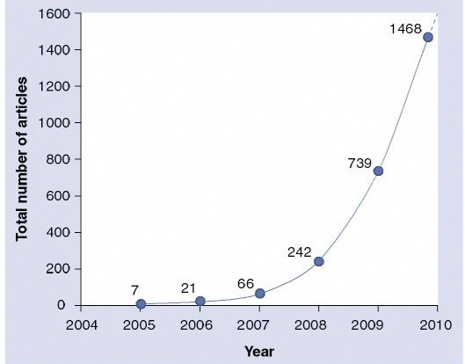
High-throughput sequencing has revolutionized biological studies
Wold et al., 2008
Sequencing rate
# Publications
Notes:
The high-through sequencing technology has revolutionized biological studies in many fields. You can use RNA-seq to measure gene expression levels, with a much high resolution and accuracy than microarrays. You can use methy-seq to study DNA methylation. You can use Chip-seq to determine genome-wide TF binding and histone modification patterns.
I fact, the sequencing rate was increasing exponentially in the past 30 years, particularly after the invention of the 2nd generation sequencing technologies. At the same time, the publications based on sequencing data has increased dramatically in the past few years.

Slide 4
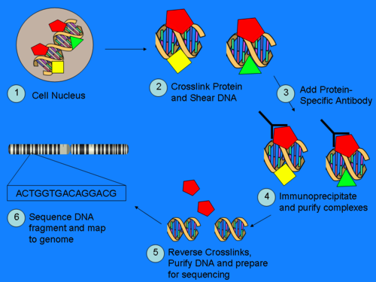
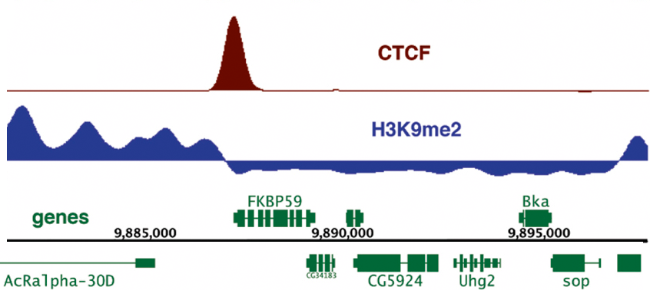
ChIP-seq Experiment & Data analysis
ChIP-seq
Map reads to genome
Peak calling
TF binding peaks
Histone modification peaks
http://en.wikipedia.org/wiki/Chip-Sequencing
Goal: How gene expression is regulated by TFs and HMs?
Notes:
Today I will mainly focus on analysis of ChIP-seq data, basically two data types: TF binding data and histone modification data. The left shows the protocol for a typical ChIP-seq experiment. In brief, you use protein specific antibody to immunoprecipitate the protein. Meanwhile, the DNA fragments binding with the protein will also be extracted. Then you sequencing these DNA fragments to obtain millions of reads.
For data anlysis, you will map the reads to the reference genome, and run peak calling program to identitfy binding peaks for TFs or DNA regions with strong histone modification signals. With the ChIP-seq data, I am particularly interested in this question: How gene expression is regulated by TFs and histone modifications.

Slide 5
Outline: transcriptional regulation
Proximal regulation
- How to determine target genes of TFs?
Distal regulation: enhancer
- How to identify enhancers?
Relation between TF binding/HM signals and gene expression
- How much gene expression do TF binding and histone modification account for?
Regulatory Network
- How genes are regulated by the regulatory network?
Part I: A probabilistic model for identifying TF target genes from ChIP-seq data
Part II: Predicting TF binding sites and enhancers using histone model
Part III: Relating gene expression with TF binding and histone modification signals
Part IV: Integrated regulatory network analysis
Notes:
To answer this question, I divide my work into 4 parts, each provides the answer from a different perspective. Proximal regulation: I will talk about a probabilistic model to identify TF target genes based on their ChIP-seq data. Distal regulation: I will talk about a method that predict enhancers based on histone modification patterns in the genome. In part 3, I will use a quantitative model to relate gene expression levels with TF binding and histone modification signals. In the last part, I will talk about gene expression regulation from a network perspective.

Slide 6


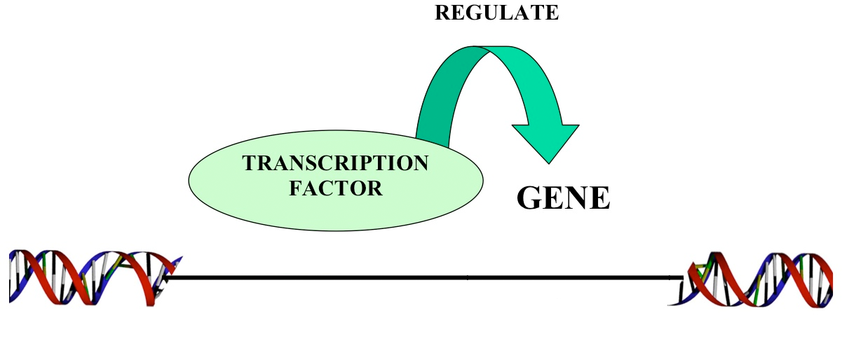
Part I: A probabilistic model for identify TF target genes from ChIP-seq data
ChIP-seq of P53
TSS
P53 target genes
Notes:
Now. First part, suppose you have done the ChIP-seq experiment for P53, how can you determine P53 target genes?

Slide 7
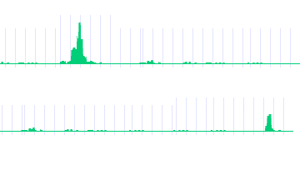
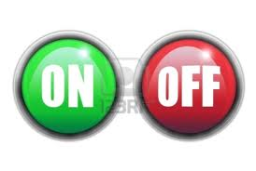
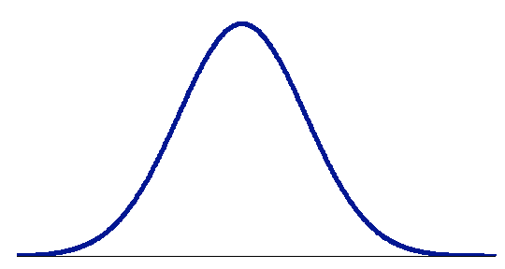
Conventional way to identify TF target genes
P53
TF binding and TF→gene regulation is NOT binary but quantitative
Gene A
P53 → A
Gene B
P53 X B
-2kb TSS 2kb
Limitations of peak-based method:
Low Medium High
- sensitive to # binding peaks
- sensitive to cut-off value (1, 2 or 5 kb of TSS?)
-- no significance estimation
Regulatory score
Notes:
Conventionally, you will check whether there is a binding peak around the transcription start site of a gene. In this example, we will say gene A is P53 target, but gene B is not.
this peak-based method is simple and easy to be implemented. But there several limitations: 1, it is sensitive to the number of binding peaks, which is determined by data quality, peak calling methods and so on. 2, it is sensitive to the definition of promoter. In previous publications, some used 1kb, other used 2kb or 5kb. This will result in quite different target gene set. 3, there is no significance estimation. You don’t know how confident a gene is regulated by the TF.
Moreover, the peak based method assume the TF binding and TF-gene regulation are binary event. That is you assume a gene is either regulated or not regulated by a TF. In reality, the TF gene regulation relationship should be quantitative. A TF can bind and regulate a gene strongly or weakly.

Slide 8
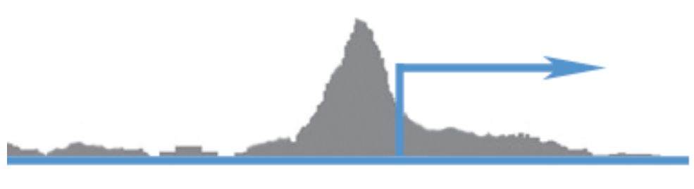
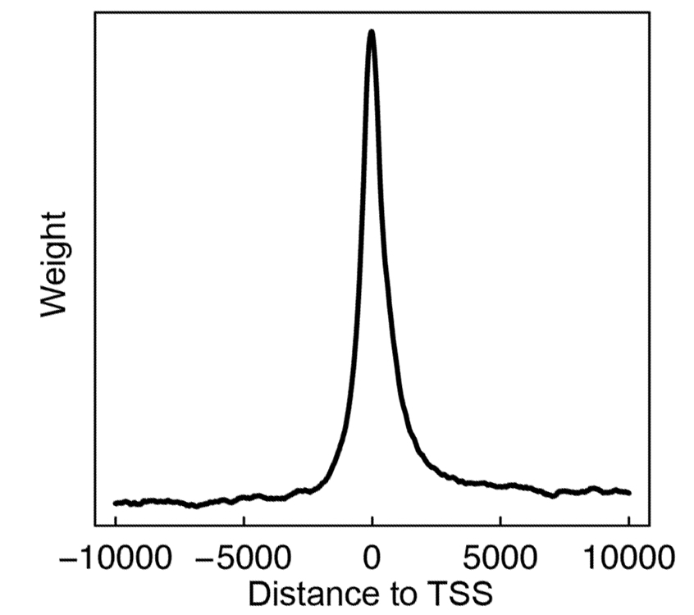

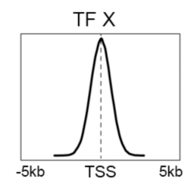

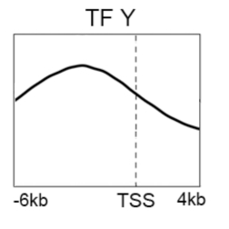
Target Identification with a Probabilistic model (TIP)
-10000 0 10000
S_{i}(g): the signal of a TF at nucleotide i of gene g
Binding signal: S_{i}(g)
Avg. profile: w_{i}
-- TF binding signal at different position contribute differently
Distance from TSS
binding preference of a TF
P-value & FDR
Calculate regulatory score and p-value for all genes
Avg binding signal across all genes
Cheng et al. 2011, Bioinformatics
Notes:
Based on this idea, we develop a new method named TIP. We don’t rely on binding peaks. Instead, I consider the binding signal Si(g), at each position i around the TSS of a gene g. I assume that TF binding signal at different position contribute differently to the TF targeting. The importance of a position depend on the its relative distance to the TSS as well as the binding preference of the TF. For example, some TFs prefer to binding a narrow regions around the TSS, while the others show strong binding signals even in distant regions.
I therefore use the binding profile of the TF as the weight, and calculate the weighted summation of binding signals as the regulatory score. The regulatory scores are then normalized into z-scores, and p-values are calculated. So, our result is a ranked gene list, ordered by the regulatory scores and p-values. Genes at the top of the list are more likely to be target genes of the TF.

Slide 9
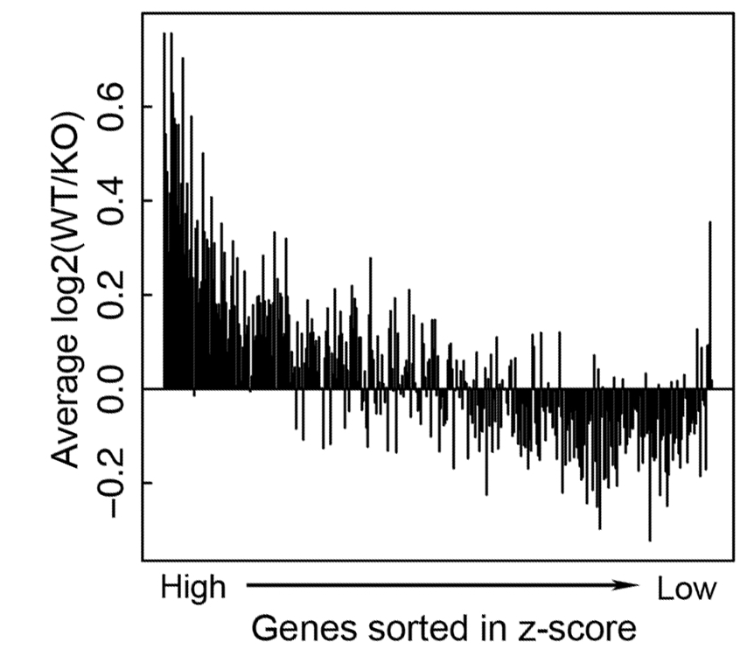
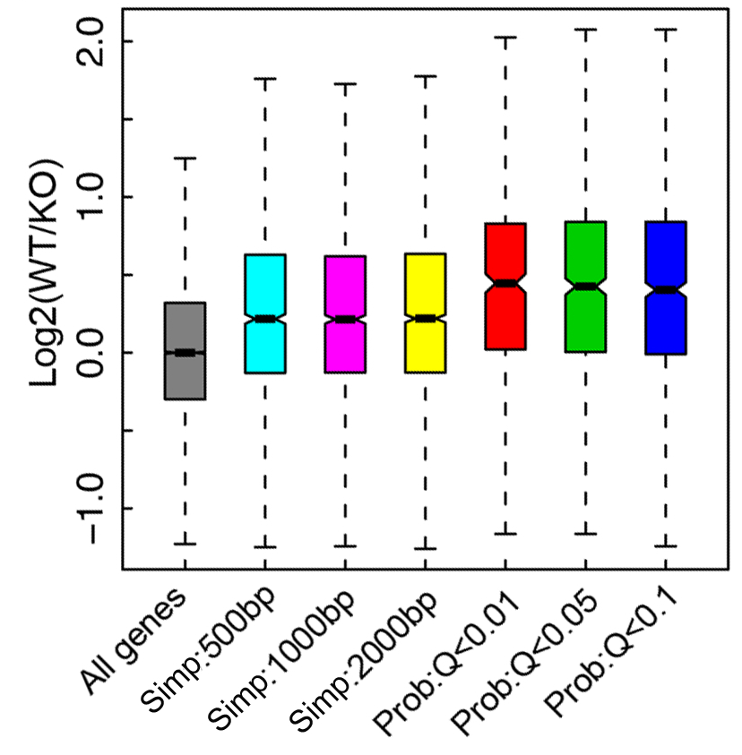
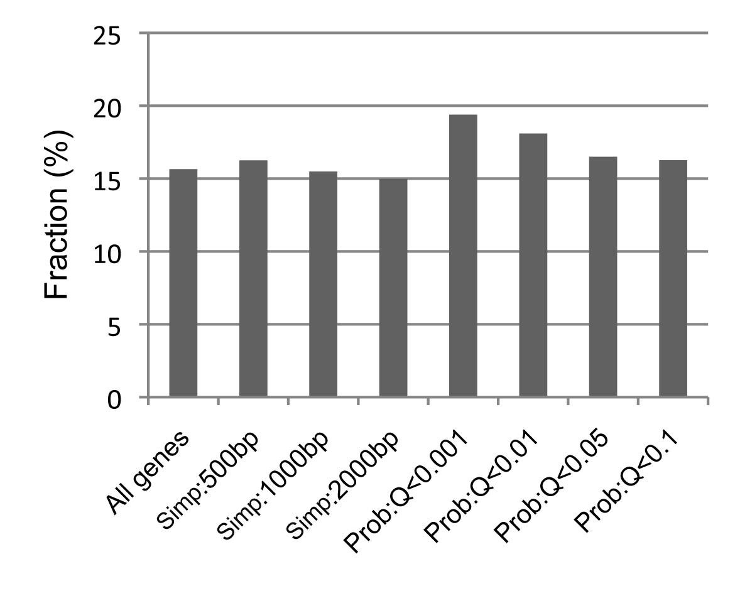
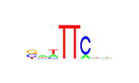
Example 1: STAT4 targets identified by TIP are more down-regulated in STAT4 KO
Peak
TIP
Data
ChIP-seq data:
Stat4 binding in Th1 cell
Gene expression:
STAT4KO + WT mice
Wei et al., 2010
Target
Non-target
TIP
STAT4 binding motif are more enriched in targets identified by TIP
Peak
STAT4 motif
Notes:
To show the advantage of our method, we applied it to the STAT4 knock-out data from a previous publication. In the data, the CHIP-seq was performed for STAT4. Expression levels of all genes were measured in the wild-type as well as in the STAT4 KO mice. So you can evaluate the quality of target genes by examining the expression changes in KO versus wt.
As shown here, the genes with high regulatory score tend to be more down-regulated in knock out relative to the wild-type. When compared to the peak-based method, target genes identified by TIP are more down-regulated.
In addition, if you check the existence of STAT4 motifs in the promoters of target genes, you will find the target genes identified by TIP contains more STAT4 motifs.

Slide 10
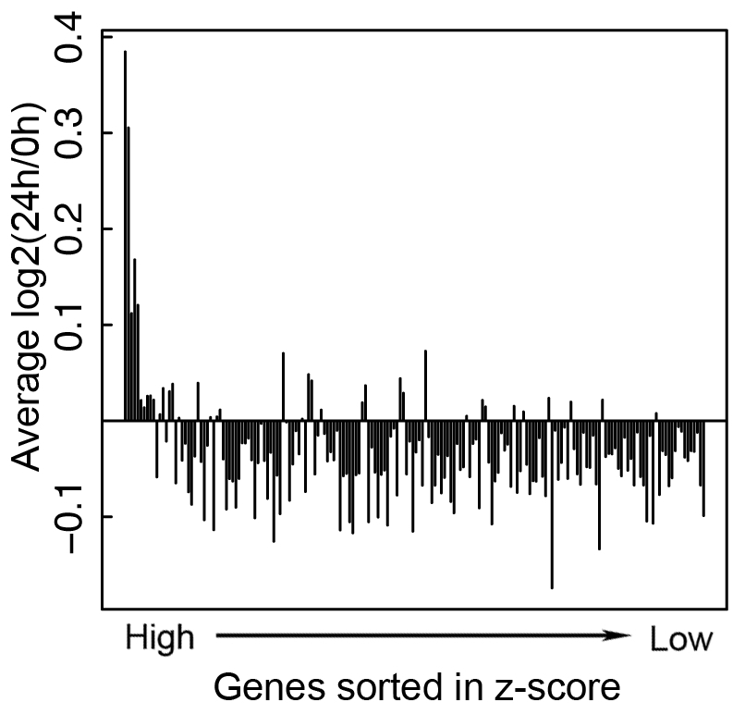
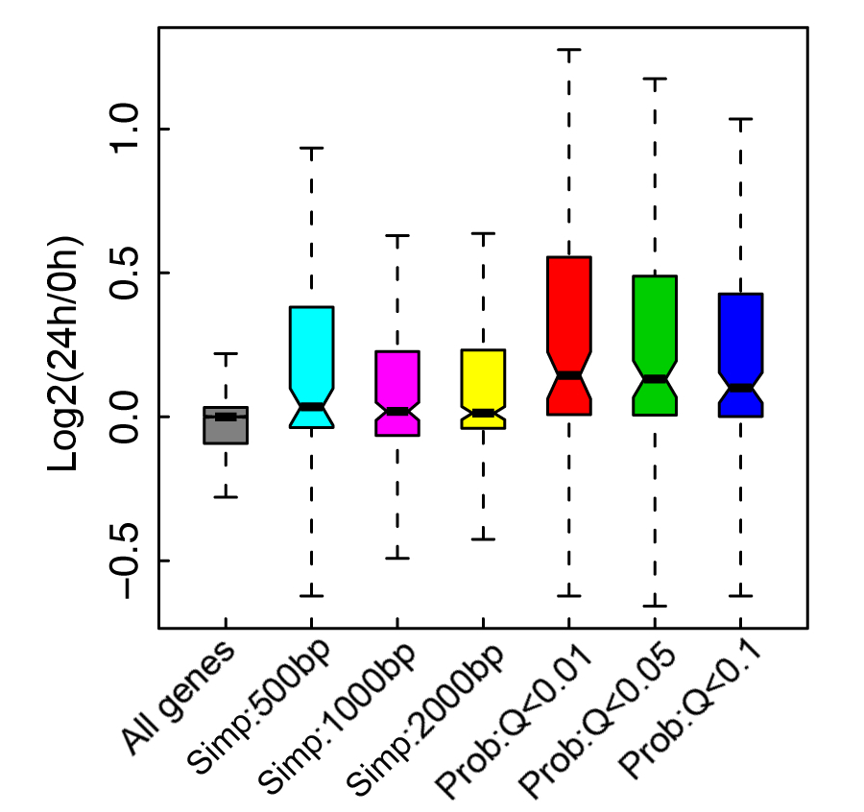
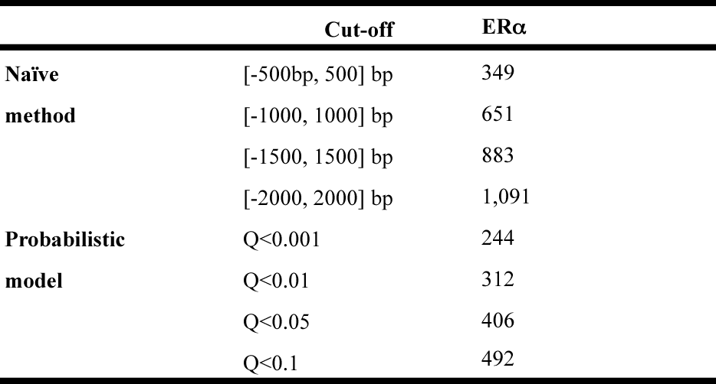
Example 2: ERα targets identified by TIP are more responsive to estrogen treatment
Data
E2 responsive genes
Peak
TIP
ChIP-seq data:
ERα binding in MDA-MB-231 cell line
Gene expression:
before and after E2 treatment
Stender et al., 2010
Target
Non-target
# target genes
Notes:
The better performance of TIP is also shown in another example. As shown, ER alpha target genes identified by TIP are more responsive to the treatment of E2, which activates ER alpha.
As shown here, the number of target genes identified by the peak-based method changes dramatically when different cut-off values are used for defining promoter region.

Slide 11
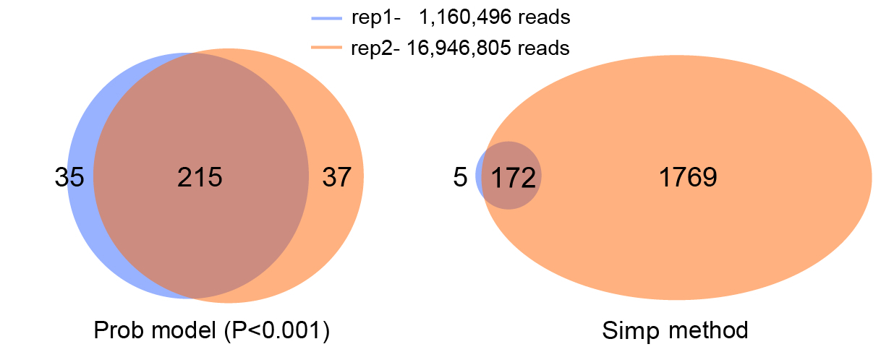
TIP is insensitive to sequencing depth
TCF4: Mokry et al., 2010
TIP is cost-effective-- do not require high read-depth for target gene identification!
Notes:
Another advantage of TIP is that it is not sensitive to the read depth. We applied the method to the TCF4 CHIP-seq data with two replicates. The two replicates have 10-fold of difference in number of sequencing reads. Usually, the number of binding peaks identify by peak calling method will increase if more reads are sequenced. As a consequence, the numbers of target genes identified by the peak-based method are substantially different between the two replicates. However, the numbers by TIP are very similar and consistent. This is very useful. Because, you don’t have to sequence into a very high read-depth.

Slide 12
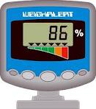
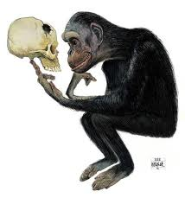

Summary: TIP
TIP measures TF-gene regulatory relationships quantitatively
Target genes identified by TIP are more biologically meaningful
-- more down-regulated expressed in TF KO mouse
-- more responsive to signal molecules
-- more enriched in TF binding motifs in their promoters
TIP is robust to read-depth and cost-effective
Cheng et al. 2011, Bioinformatics
Notes:
In summary, we develop a new method to identify TF target genes based on its ChIP-seq data. It measures TF-gene regulatory relationship quantitatively. In comparison to the peak-based method, target genes identify by this TIP are more biologically meaningful. Finally, it is const-effective.

Slide 13
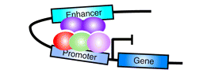

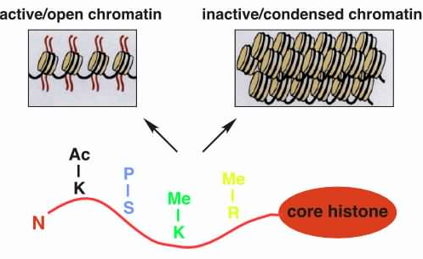
Part II: Predicting TF binding sites and enhancers using Chromatin model
Different elements (e.g. enhancer, promoter) are associated with different histone modification patterns in the genome.
Ernst et al. 2011
Borok et al. 2010
http://www.imt.uni-marburg.de/bauer/research.html
Notes:
Different functional element, such as enhancer and promoter, is associated with different histone modification patterns. Motivated by this fact, I developed the method to predict TF binding sites and enhancers by using histone modification data.

Slide 14
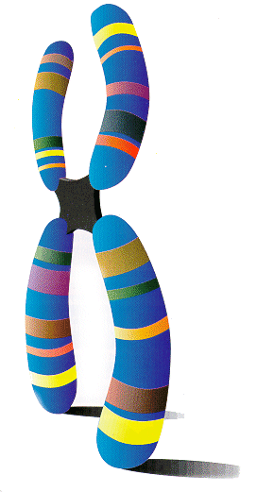
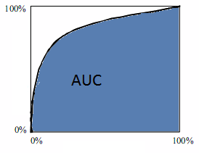
Chromatin model: link histone modification patterns to TF binding
ChIP-seq Data
Predictors (HM)
TF binding site?
Bin 1 (100bp)
Bin 2
 | HM1 | HM2 | HM3 | ……
Bin1 | 0.2 | 0.4 | 0.6 | …
Bin2 | 0.3 | 0.3 | 0.2 | …
Bin3 | 0 | 0.2 | 2.1 | …
Bin4 | 0.4 | 0.4 | 0 | …
Bin5 | 0.3 | 1.2 | 0.5 | …
Bin6 | 1.2 | 3.1 | 2.1 | …
Bin7 | 3.4 | 2.4 | 0.8 | …
Bin8 | 1.5 | 1.2 | 0.9 | …
……. | … | … | … | …
 | TF1 | TF2 | ……
Bin1 | 0 | 0 | …
Bin2 | 0 | 0 | …
Bin3 | 1 | 0 | …
Bin4 | 1 | 0 | …
Bin5 | 0 | 1 | …
Bin6 | 0 | 0 | …
Bin7 | 0 | 1 | …
Bin8 | 1 | 0 | …
……. | … | … | …
…
+
divide into DNA bins
ROC curve
Machine Learning Method (SVM et al.)
TPR (sensitivity)
Predictors (HM)
TF binding site
FPR (1-specificity)
Notes:
Here is what we did. We divide the genome into continuous small bins, each of 100 bp in size. In each bin, we calculated the average signals of all histone modification types. At the same, we determined whether a bin is bound by a TF by examining its overlap with TF binding peaks.
Then we use machine learning method to link the histone data to TF binding site data. Namely, we predict whether a bin is bound by a TF based on the histone modification pattern. The performance of the model can be shown by the ROC curve, which is a plot of FPR versus TPR. The area under the curve, called AUC, is often used to represent the model accuracy. A AUC of 1 means perfect prediction. A value of 0.5 indicates random prediction.

Slide 15
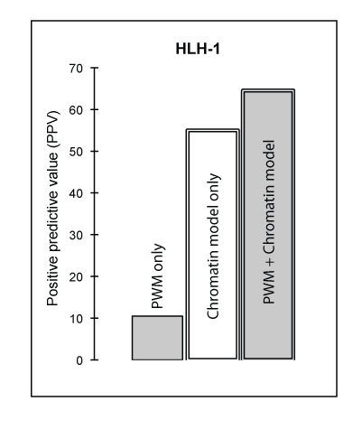
Relating the Chromatin Model to TF Binding Sites in worm
Model Predicts Sites Fairly Accuracy
Accuracy improved when coupled with PWM
AUC
Gerstein et al. 2010, Science
Notes:
Before applied to human, we have tested our model I the C.elegans data. As shown here, if you predict TF binding based on just a single histone mark, the AUC is not high. However, if you combine all types of histone marks by the chromatin model, you get very good prediction.
Let’s use the TF HLH1 as the example. As shown here, if you make predictions based on the existence of HLH1 binding motif, namely the PWM only, you get very low positive rate. In comparison, the chromatin model result in a much higher accuracy. When you couple the chromatin model with PWM, you can further improve the positive rate.

Slide 16
Predict human tissue specific enhancers
Step 1: Predict open chromatin regions-- binding active regions (BAR+)
Step 2: Search BAR+ regions for tissue specific TF motifs.
-- e.g. motifs of embryo specific TFs (Oct, Sox families) for embryo specific enhancers
Step 3: Select conserved distal (5kb away from TSS) predictions
Validation: choose 6 for experimental validation in mouse model.
Step 1
BAR+
BAR+
Step 2
BAR+
BAR+
Sox motif
Step 3
Conserved?
Distal?
Candidate enhancers
Notes:
Now, we go to human enhancer prediction using ENCODE data. Here I summarized the whole prediction procedure into a 3-steps. First, we applied the chromatin model to predict open chromatin regions, defined as TF binding active regions (BAR). These BAR+ regions are supposed to be accessible to TF binding. Second, we scanned the BAR+ regions for the existence of tissue specific TF motifs. For example, for predict embryo specific enhancer, we focus on motifs of TFs highly expressed in embryo cells. Finally we obtain the candidate enhancer by further filtering out non-conserved DNA regions. The predicted enhancers were tested by experiment in mouse model.

Slide 17
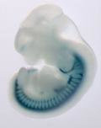
Validation in mouse embryo model
Clone predicted enhancer (~500bp) into LacZ vector with a minimal promoter
Injected into fertilized eggs
Stained at 11.5d
-- by Pennacchio Lab
5/6
Notes:
In the validation experiment, the predicted enhancer DNA regions were cloned into reporter vector, injected into fertilized mouse eggs and stained at day 11.5.
If you see the expression of the reporter gene, the blue colors, you know the predicted enhancer is active.
We send out 6 predictions for validation, and 5 of them were proved to be positive enhancers.

Slide 18
Summary: TFBS & enhancer prediction
Histone modifications are informative for determining TF binding sites
Combining histone modification data with TF motif information can predict tissue specific enhancers
Cheng et al. 2011, Genome Biology (b)
Gerstein et al. 2010, Science
Notes:
In summary, histone modifications are informative for determining TF binding sites, and can predict novel tissue specific enhancers with fairly high accuracy.

Slide 19

Part III: Relating gene expression with histone modification and TF binding signals
Input
To what extent the gene expression levels are determined by TF binding/ HM modification?
Histone modification
TF Binding signal
Predictive models
Gene expression levels
Output
Notes:
based on TF binding data and histone modification data, We have developed methods for identifying local target genes in Part I and distal regulatory elements in Part II. Now we wan relate TF binding and histone modification signals with gene expression. We want to know how much of the gene expression levels are determined by TF binding and histone modifications? We used predictive models to quantify the relationship between the Input and the output.

Slide 20
Histone Modification (HM) model
TSS
TTS
Gene k
40
1
80
120
81
4 …
41 ….44
121
160
Bin 40-1
(TSS-4kb to TSS)
Bin 41-80
(TSS to TSS+4kb)
Bin 120-81
(TTS-4kb to TTS)
Bin 121-160
(TTS to TTS+4kb)
RNA-Seq data
Chromatin features:
Histone modifications
Prediction target:
Gene expression level
Predictors
~10000 refseq genes
HM1, 2, 3, ……
……
Bin 1
Bin 2
Bin160
Notes:
To investigate the relationship between gene expression and histone modifications, we focus on 4kb upstream to 4kb down-stream of the TSS and TTS regions.
Again, we divide these regions into small bins of 100 bp. There are a total of160 bins for each gene, 80 around TSS, 80 around TTS.
In each bin, we calculate the signals of all histone modification types for all genes, and obtain a matrix like this.

Slide 21
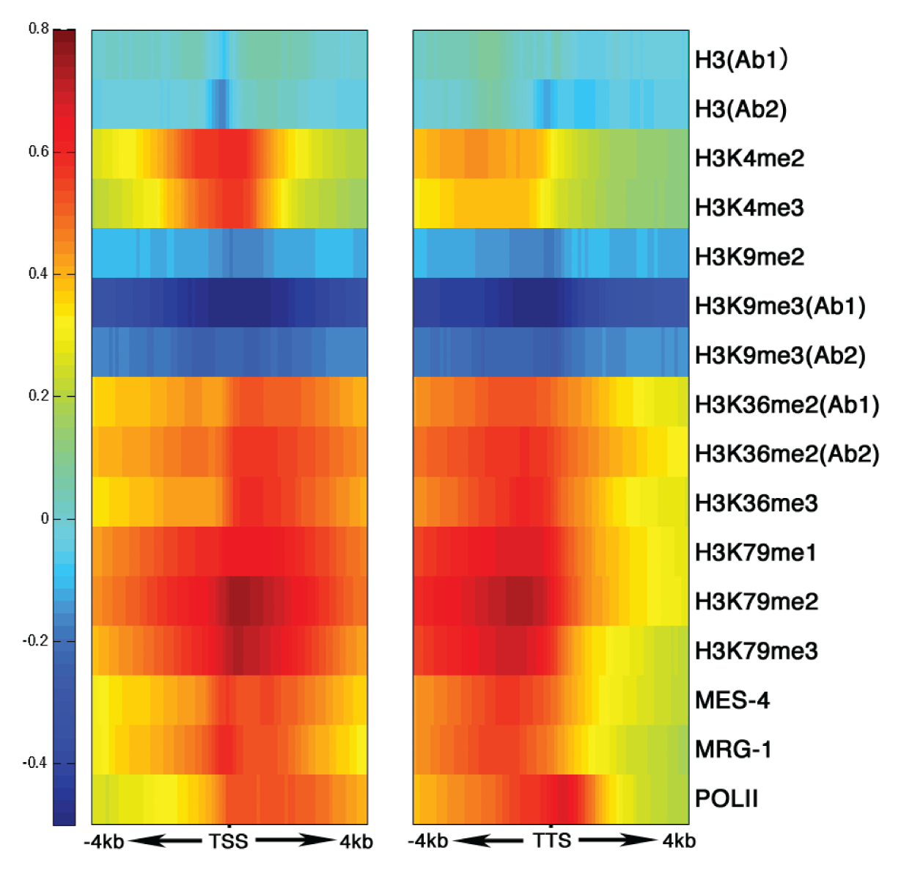
His. mods around TSS & TTS are clearly related to level of gene expression, in a position-dependent fashion
START
STOP
TTS
Gerstein et al. 2010, Science
Correlation between Signal and expression
Notes:
Individually, there is a clear relationship between histone modifications and gene expression levels. For example, if we compare the average H3K4me2 signals for top 20% highly expressed and lowly expressed genes, you will see that highly expressed genes have stronger signals around TSS and TTS.
The correlations between gene expression of histone modification around TSS and TTS show a pattern like this. From this figure, you can see that there are active marks, and repressive marks. Some marks are promoter marks , like H3K4me2, which have strong correlation around the TSS. Some marks like H3K36me2, are correlated with expression in the whole transcribed region.

Slide 22
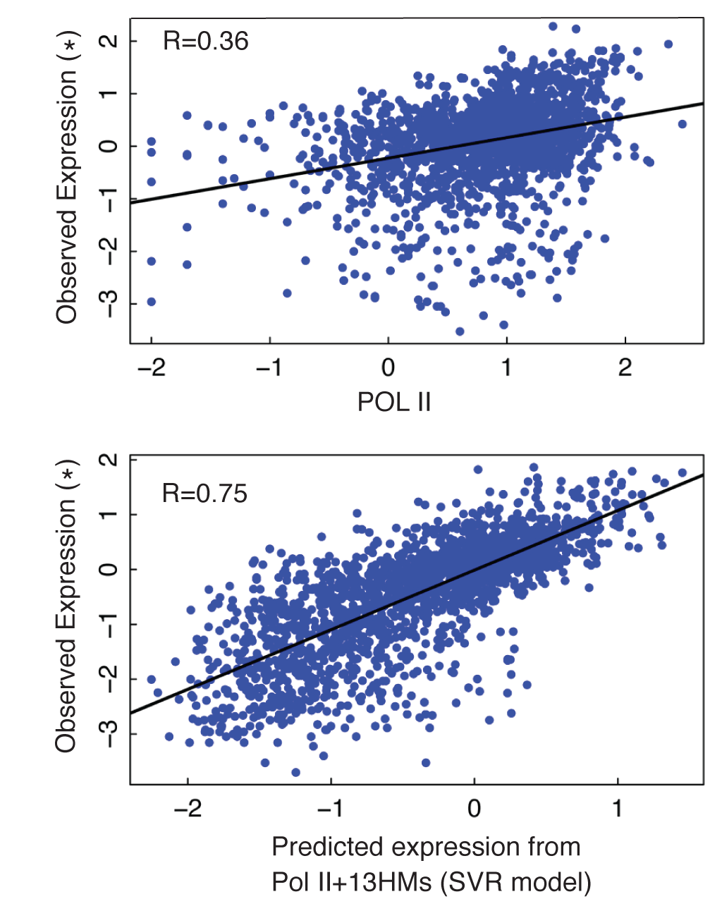
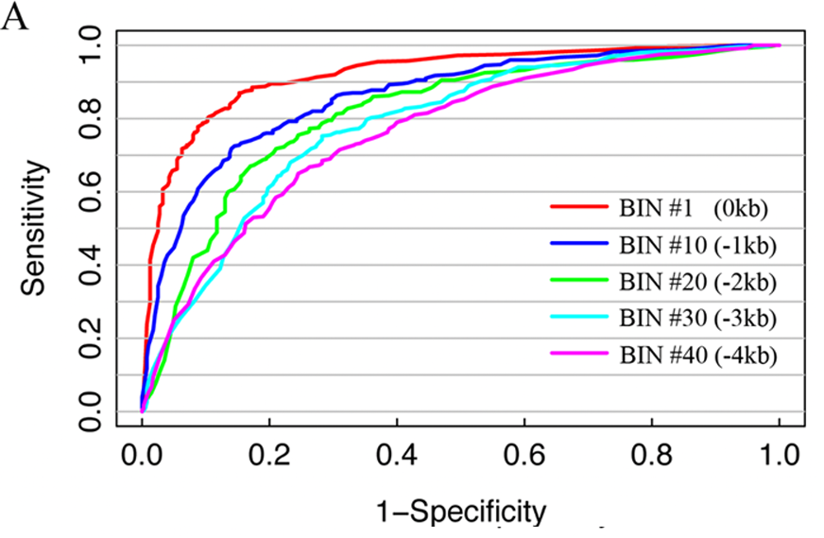
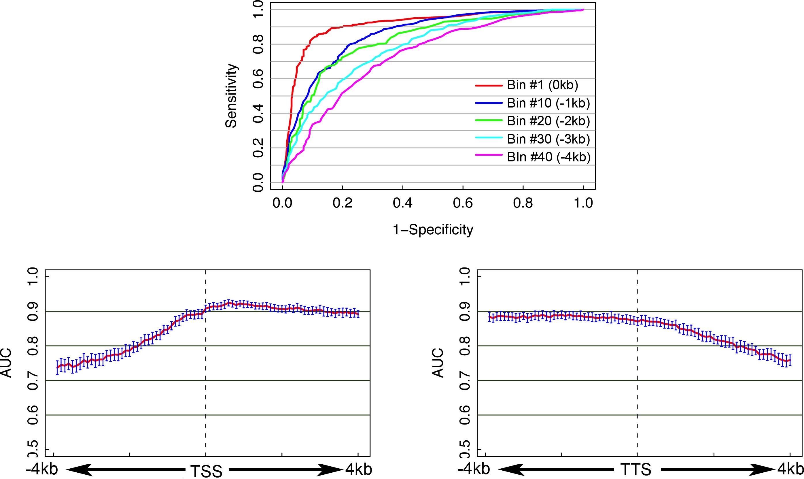
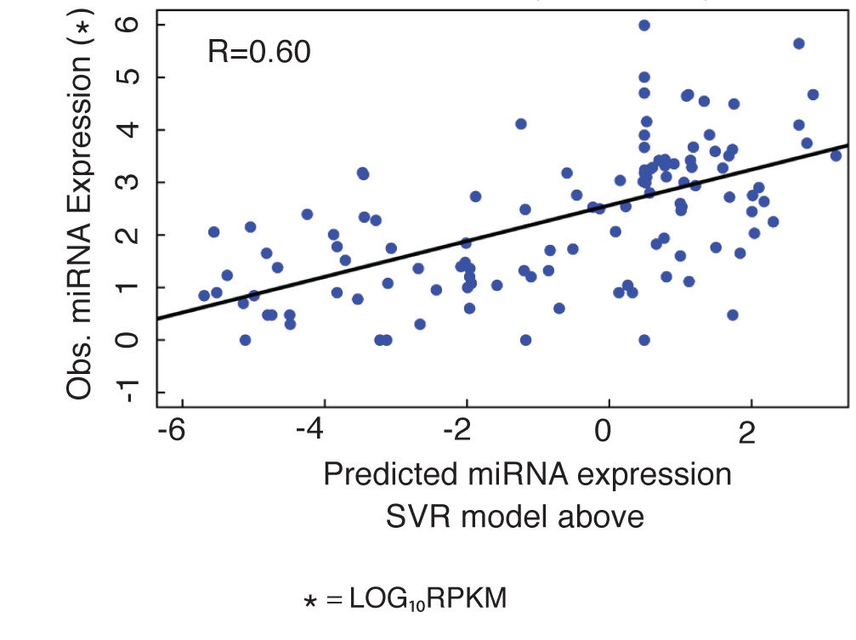
Integrate all histone modifications to predict gene expression levels
Classify H/L genes (SVM)
Predict expression values
#Bin1
Magnitude of Prediction from a “bin” around the TSS
Notes:
We now integrate all histone modifications types and examine how accurate they can predict gene expression collectively.
First we combine all these histone modifications to classify genes into highly and lowly expressed. We found that signals at different positions show different capabilities for predicting gene expression. Overall, regions right after TSS are highly predictive.
We also use the model to predict gene expression levels as shown in the right side. By using a model with 13 histone modifications, we achieved a high prediction accuracy. As shown by the high correlation between between the predicted expression values and the real experimental values.
More interesting, you can also applied the model to predict expression levels of microRNAs and achieve fairly good accuracy. This implies that miRNA and protein-coding genes might have similar regulatory mechanisms.

Slide 23
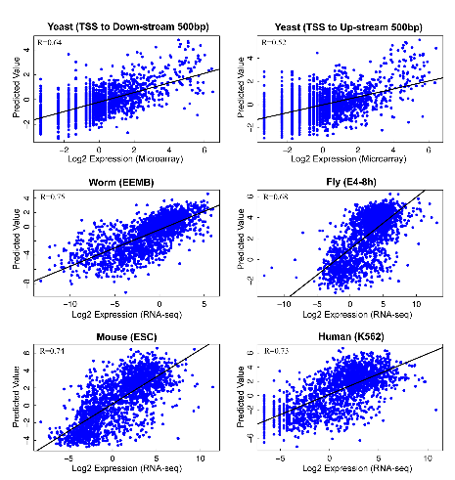
Application of HM model in 5 species:
Consistent Performance
>50% of variation of expression levels can be explained by HMs
Cheng et al. 2011, Genome Biology (a)
Notes:
We also applied the histone model to data sets from 5 different species from yeast to human. And we achieved consistent performance. Overall more than 50% of gene expression levels can be explained by histone modifications.

Slide 24
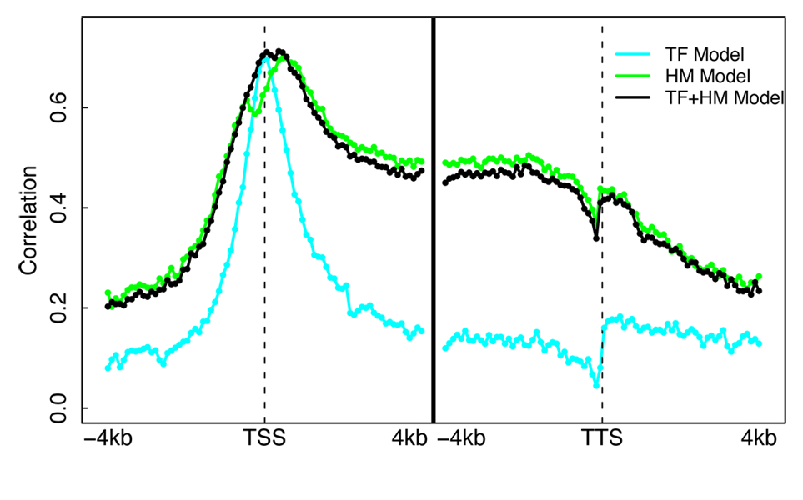
Mouse ESC Models Illuminates Different Regions of Influence for TFs vs HMs
Datasets
  ChIP-Seq for 12 TFs
  (Chen et al. 2008)
  ChIP-Seq for 7 HMs
  (Meissner et al.’08; Mikkelsen et al. ’07)
  RNA-Seq (Cloonan et al. 2008)
A TF+HM model that combine TF and HM features does NOT improve accuracy!
Cheng et al. 2011, Nucleic Acids Res.
Notes:
In mouse, we collected TF binding, histone modification and gene expression data from the matched cell line. Thus we constructed HM model and TF model for predicting gene expression levels.
Overall the TF model and the HM model achieve comparable accuracy. Each of them account for more than 50% of variation of expression levels.
But the two models show quite different predictive patterns. As shown here, the TF binding signal can only predict gene expression in a narrow DNA regions, right nearby the TSS. In contrast, histone signals achieve high prediction in a wide region.
Moreover, combining TF and HM signals does not improve the predictive power, indicating that they are redundant in terms of predicting gene expression.

Slide 25
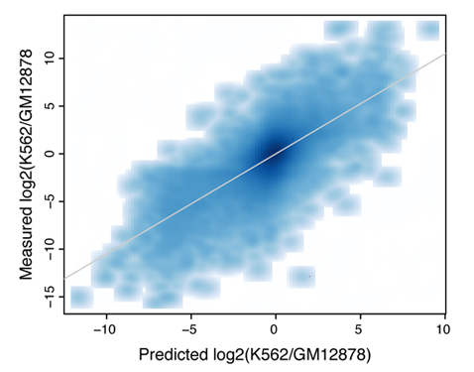
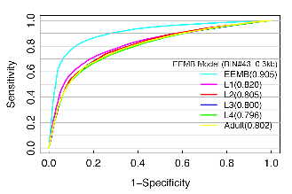
TF and HM models are tissue specific
PCC=0.73
HM model-- Best prediction is achieved by using histone modification and expression data from the same developmental stage
TF model– differential TF binding signals are predictive of differential expression levels between two human cell lines
Cheng et al. 2011, Genome Biology (a)
Notes:
We also find that the TF model and HM model are tissue specific.
For example, when histone data from early embryo stage are used to predict gene expression at different developmental stages. The best accuracy is achieved when histone data and expression are matched.
Since the models are tissue specific, we would expect to predict differentially expression of genes between two samples based on the their difference in TF binding. And as shown here, this is true.

Slide 26
Summary: relate TF/HM signals with expression
TF/HM signals are highly predictive to gene expression
TF and HM signals are redundant for ‘predict’ gene expression
TF and HM models are tissue/cell line specific
microRNA expression can also be predicted
Gerstein et al. 2010, Science
Cheng et al. 2011, Nucleic Acids Res.
Cheng et al. 2011, Genome Biology (a)
Notes:
As a summary, I showed that TF and HM signals are predictive to gene expression levels, but they are redundant. Both the TF and the HM models are tissue specific. And the models can also be used for miRNA expression prediction.

Slide 27
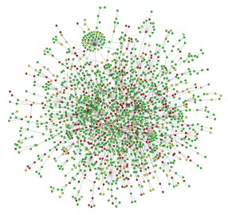

Part IV: Integrative regulatory network analysis
Understanding transcriptional regulation from a network perspective
Notes:
In the last part, I construct an integrated regulatory network and shown how do we understand transcriptional regulation from a network perspective.

Slide 28
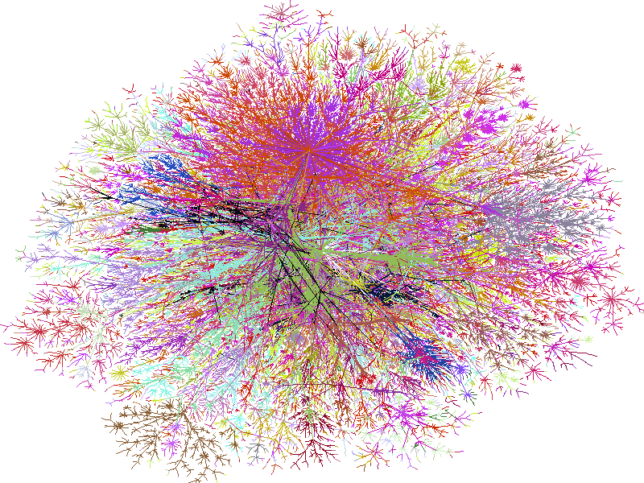
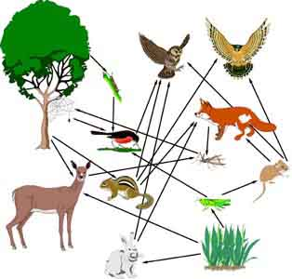
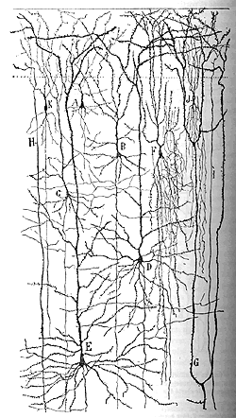

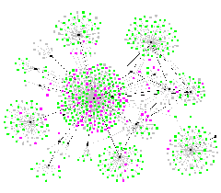
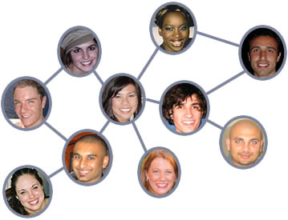
Networks as a universal language
Internet
[Burch & Cheswick]
Electronic
Circuit
Food Web
Disease Spread
[Krebs]
Neural Network
[Cajal]
Protein
Interactions
[Barabasi]
Social Network
Notes:
We do this, because we think network is a universal language.

Slide 29
Construction of an
Integrated Network
Notes:
Here is the framework we used to constructed the network from different data sources.
We used ChIP-seq data to determine TF-gene regulatory relations.
We predicted miRNA-gene regulatory relations by using TargetScan.
We also integrated protein-protein interactions and gene expression information.
To understand the integrated network, we performed hierarchical analysis and network motif analysis.

Slide 30
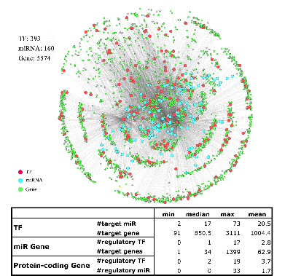
Integrated worm regulatory network
Notes:
This is the integrated regulatory network in c. elegans.

Slide 31
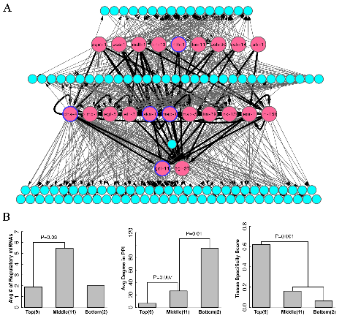
Relating Worm TF Hierarchy with Gene Properties
miRNAs
miRNAs
-- TFs in the top are more tissue specific
-- TFs in the bottom tend to be ubiquitously expressed and have more PPI partners
-- TFs in the middle are more regulated by miRNAs
miRNAs
Cheng et al. 2011, PLoS Computational Biology
Notes:
Based on the regulatory relationships between TFs, we determined such a hierarchical structure. The top level TFs are master regulators. Bottom layer TFs are effectors. The two layers are connnected by Tfs in the mddle. The hierarchy is mainly for visualization, but we do observed interesting relationship between hieararchy and TF properties. Basically, TFs in the top are more tissue specific. TFs in the bottom tend to more uniformly expressed and interacted with more partners. TFs in middle are on average regulated by more miRNAs.

Slide 32
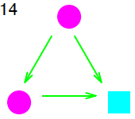
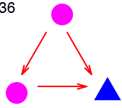
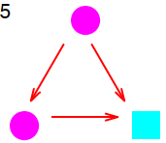




Network Motifs
7 Motifs
Over-represented
FFL involving
miRNA & 2 TFs
All Motifs
Notes:
In the network motif analysis, we enumerate all regulatory patterns with 3 nodes. We find 7 of them are enriched in the real network with respect to the random networks.
Here I just use pattern 99 as the example. It is a feed-forward loop involving a miRNA and two TFs.
This motif tell us that if you want to shut down a gene, you shut down both the regulator and the target. This is more efficient than just shut down the target.
Why use miRNA? Because miRNAs function at the post-transcriptional level. It shut the target gene by degradig mRNA or inbibiting translation. This represent a faster way for shutting down genes. In the usage of miRNA, it blocks the translation of TF protein without destroying the TF mRNA. This is economical.
5 and 14 coherent FFL
36.. Same but replace by MIR
88 49, toggle switch

Slide 33
Summary: integrated network
Transcriptional regulation is organized as a network with TF, miRNA and other genes as nodes.
ChIP-seq data is useful to construct such a network.
TF-TF regulatory network can be visualized as a hierarchical network. TFs at different levels show different features.
Some regulatory patterns (network motifs) are favored and being enriched in the network.
Cheng et al. 2011, PLoS Computational Biology

Slide 34

Acknowledgements
Yale University
-- Mark Gerstein, Sherman Weissman, Koon-Kiu Yan, Chong Shou, Renqiang Min, Joel Rozowsky, Kevin Yip, Roger Alexander, Ekta Khurana, Nitin Bhardwaj, Pedro Alves, Mihali Felipe, Arif Harmanci, Mengjie Chen
Univ. of Southern California
-- Lei Li, Valter Longo, Fengzhu Sun, Xiaotu Ma, Paola Fabrizio, Min Wei, Huanying Ge,
Weng Lab (UMASS)
-- Zhiping Weng, Xianjun Dong
Qian Lab (Johns Hopkins University)
-- Jian Qian, Woochang Hwang
Snyder Lab (Stanford University)
-- Michael Snyder, Wei Niu
White Lab (Univ. of Chicago)
-- Kevin White, Lijia Ma
Pennacchio Lab (Lawrence Berkely National Laboratory)
Birney Lab (EBI)
Waterson Lab (Univ. of Washington)
Lieb Lab (Univ. of North Carolina)
Gingeras Lab (CSHL)
Consortium
ENCODE
modENCODE

Slide 35
Thank you!

Slide 37

TIP equations

Slide 38

Two-layer model
Layer 1: predict expression in bin
Layer 2: combine predictions from all bins

Slide 39



Which TF/HM are important for expression prediction?
Select a subset (n) of TFs/HMs, n=1,2,…12

Slide 40



CpG content and predictive models

Slide 41

HCP and LCP

Slide 42

Positive and negative regulators

Slide 43

Distribution of R-scores

