Slide 1
How Ψgenes are related to cell cycle
Alexej Abyzov,
February 3, 2012

Slide 2
Cell cycle
Hypothesis: pseudogenization happens at the end of M phase and beginning of G1 phase

Slide 3
GO enrichment
Discovered Ψgenes
Ψgenes in reference GENCODE
Hypothesis: pseudogenization happens at the end of M phase and beginning of G1 phase

Slide 4
GO enrichment for Ψgenes
Category | Enrichment | P-value
Ribosome & ribonucleoprotein | 40.35 | 4.1E-59
Lumens, nucleoplasm, nucleolus | 19.99 | 2.7E-25
Mitochondrion | 16.82 | 1.3E-25
RNA processing & splicing | 10.66 | 2.3E-12
RNA & nucleotide binding | 9.64 | 3.6E-22
Chaperone & folding | 8.99 | 3.3E-11
Ribonucleoprotein complex biogenesis | 6.92 | 1.9E-12
Mitochondrion | 6.81 | 1.3E-25
Ubl conjugation | 6.48 | 4.1E-6
Translation initiation | 5.61 | 5.8E-9
Cellular macromolecule catabolic process | 5.03 | 8.4E-5
Olfaction | 4.97 | 6.3E-21
Mitotic cell cycle, M phase, nuclear division | 4.85 | 4.0E-7
Ubiquitin-protein ligase activity | 4.78 | 1.7E-6

Slide 5
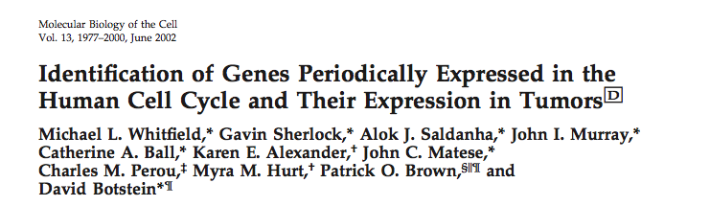

Slide 6
Analyzing average gene expression

Slide 7
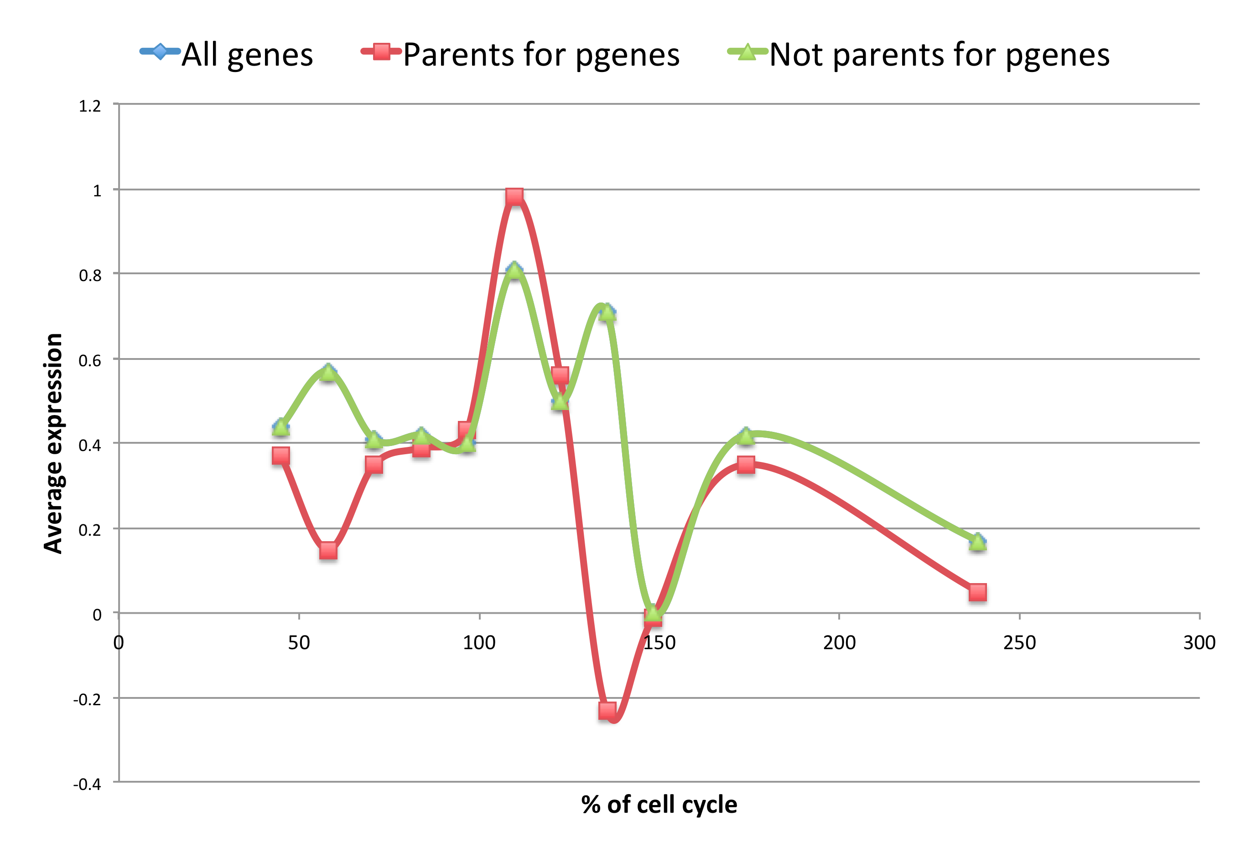
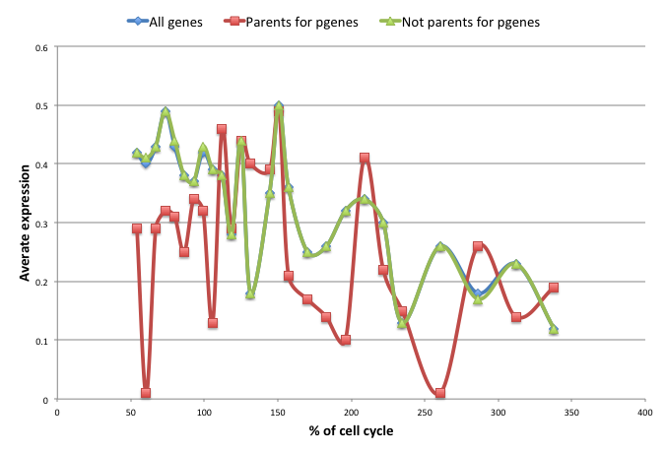
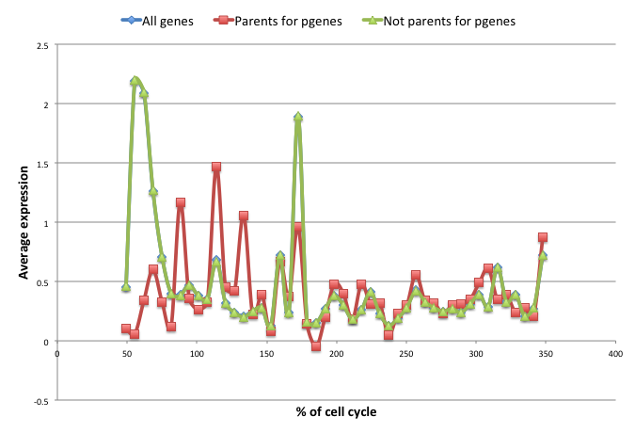
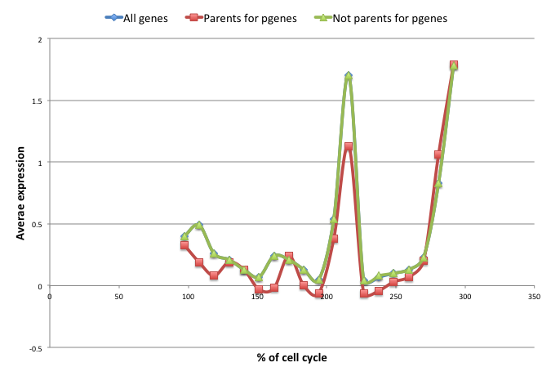
New Ψgenes

Slide 8
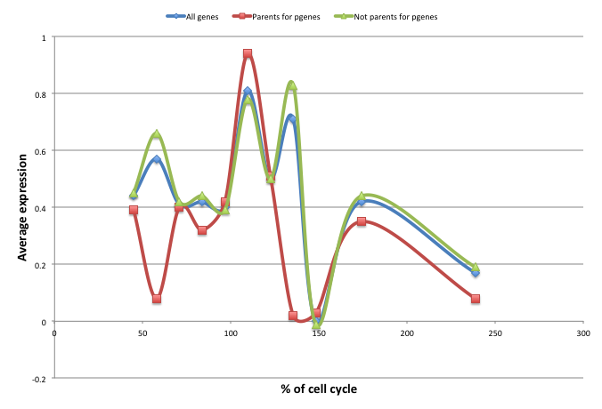
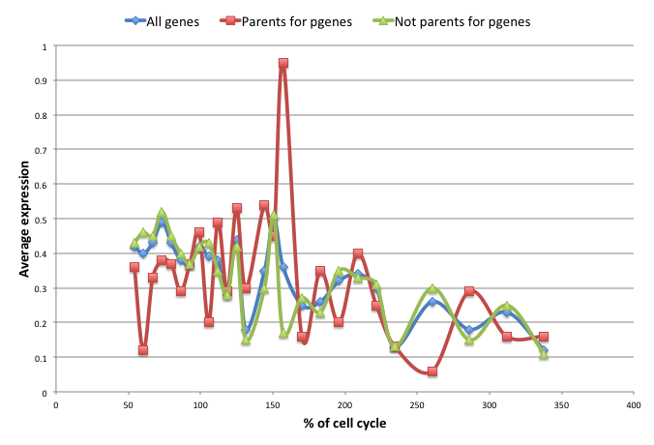
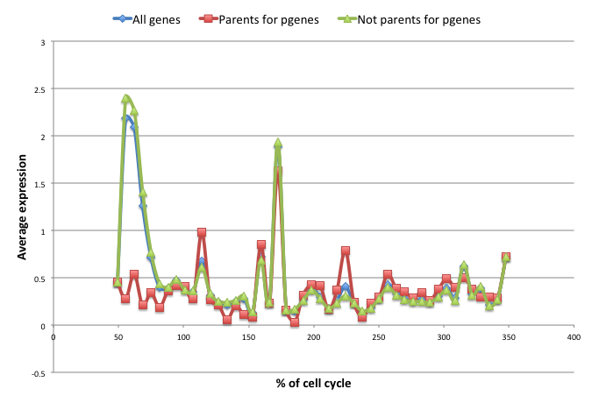
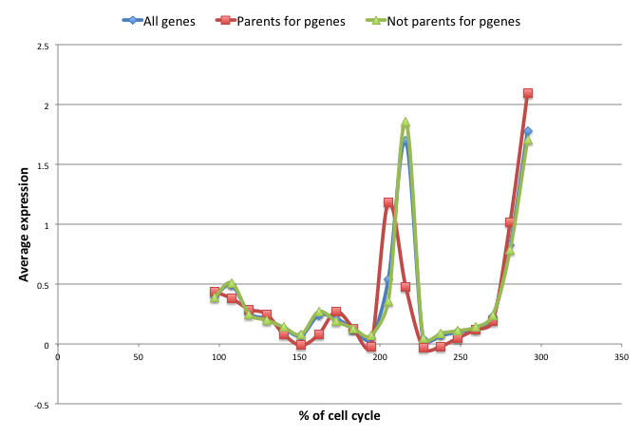
Ψgenes in the reference (GENCODE)

Slide 9
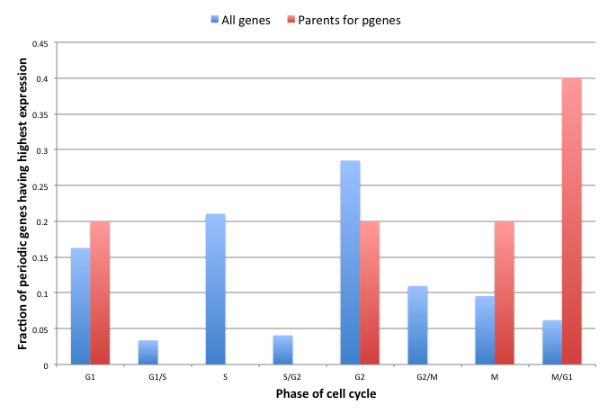
New Ψgenes
5 gene, p-val = 0.02 (chi2 test)

Slide 10
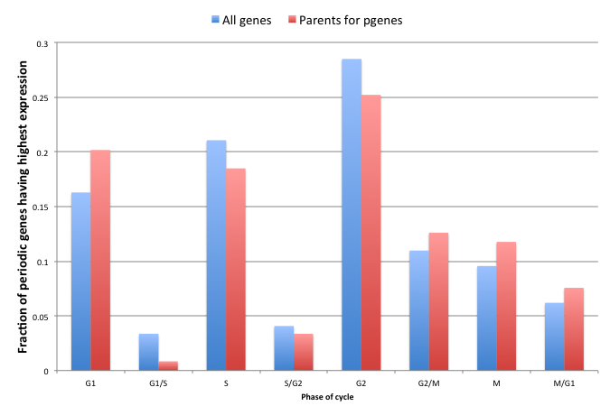
Reference Ψgenes
119 genes, p-val = 0.59 (chi2 test)

