Slide 1
Arabidopsis Network Evolution
Gerstein Nets Subgroup Meeting
Darryl Reeves
1/24/2012

Slide 2
Goals
Find evidence for positive selection in Arabidopsis network evolution
Analyze network changes between two species

Slide 3
Background
Arabidopsis thaliana
  Genome size: ~125 Mb
  27,025 genes
  self-compatible (capable of self-pollination) annual
Arabidopsis lyrata
  Genome size: ~206 Mb
  32,670 (predicted) genes
  self-incompatible perennial
Diverged about ~10 million years ago

Slide 4
Method
Downloaded protein sequences for A. thaliana and A. lyrata (Phytozome)
Identified orthologous genes using InParanoid software based on protein sequences (22,103)
Filtered orthologous genes to include only those found in A. thaliana networks (3,564)
Aligned amino acid sequences translated from coding sequences using Needleman-Wunsch
Used alignment to codon-align coding sequences
Estimated dn/ds ratio using Li-Wu-Luo method based on Kimura two-parameter model

Slide 5
Data
Data Type | Source | Size
A. Thaliana
PPI | TAIR/BIOGRID | 8,993 interactions
Pathways | AraCyc | 4,996 pathway enzymes
Transcription Regulation | AGRIS - AtRegNet | 765 (confirmed) TF-gene interactions

Slide 6
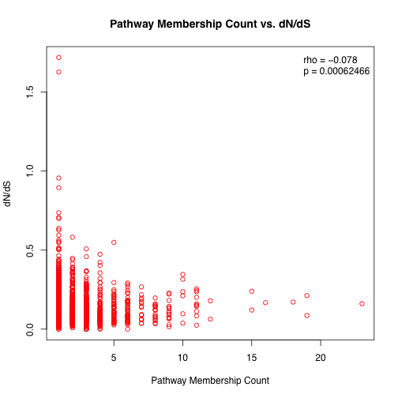

Slide 7
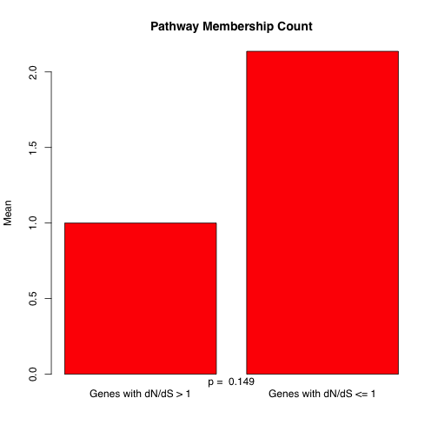

Slide 8
Node/edge differences
 | PPI Network Interactions | TF Regulatory Network Nodes | Metabolic Network Nodes
Arabidopsis thaliana | 1331 | 715 | 2100
Arabidopsis lyrata | 1250 | 668 | 1910
Biological significance of missing network components?

