Slide 1
Biological Networks: construction, topology and dynamics
Koon-Kiu Yan
Department of Molecular Biophysics and Biochemistry
Yale University

Slide 2
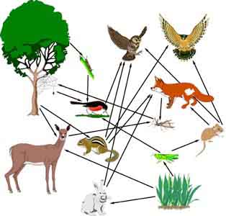
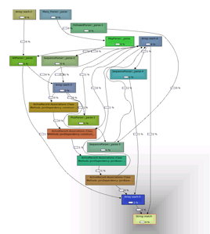
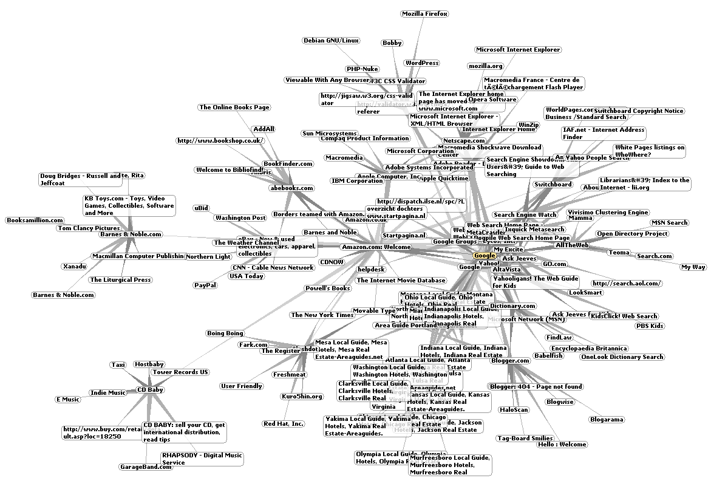
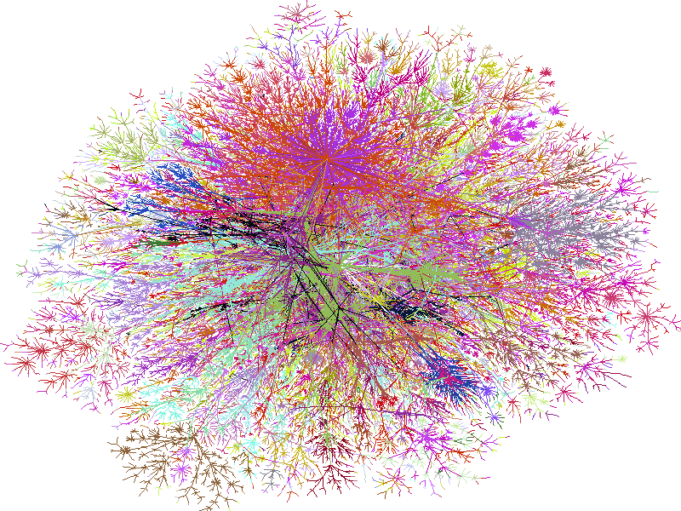
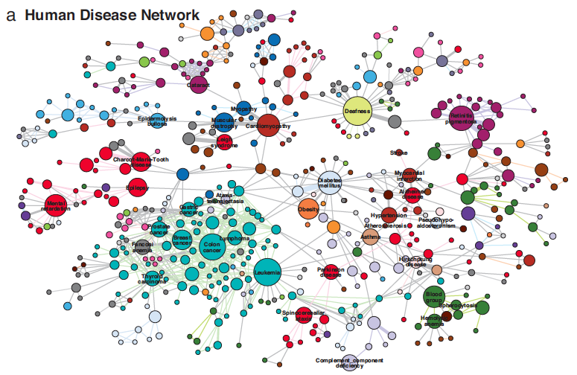
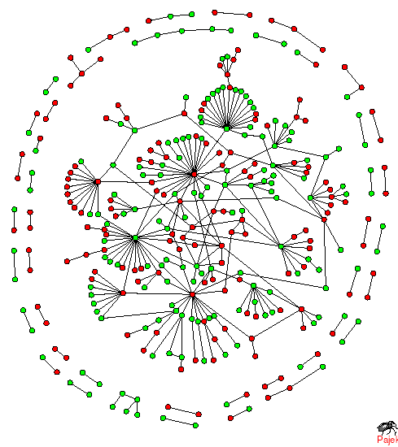

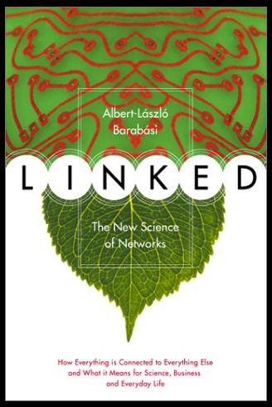
Networks as a common framework of complex interacting systems
Food Web
WWW
Software call graph
Disease
network
Goh. et.al. 2007
Internet
Burch & Cheswick
Molecular
network
Social
Network
2
Notes:
My research interest, back to some of the stuffs I did in graduate school, broadly follows the regime of networks. I believe the audiences are not new to the idea of networks. Indeed, the term “network” has already penetrated into many different fields, and many aspects of our daily life. Why?
As suggested by the title of this book, “LINKED”,
we are living in a complex world, where individual components are interacting
Probably the most famous one is social network
A few examples of technological networks
more biologically motivated networks
MN: our focus
The point of this slide, is not just to show you nice pictures, I want to emphasize that, by capturing who is interacting with whom, networks therefore serve naturally as a common framework to study many complex systems. BUT, what can we really say if we are given a network?

Slide 3
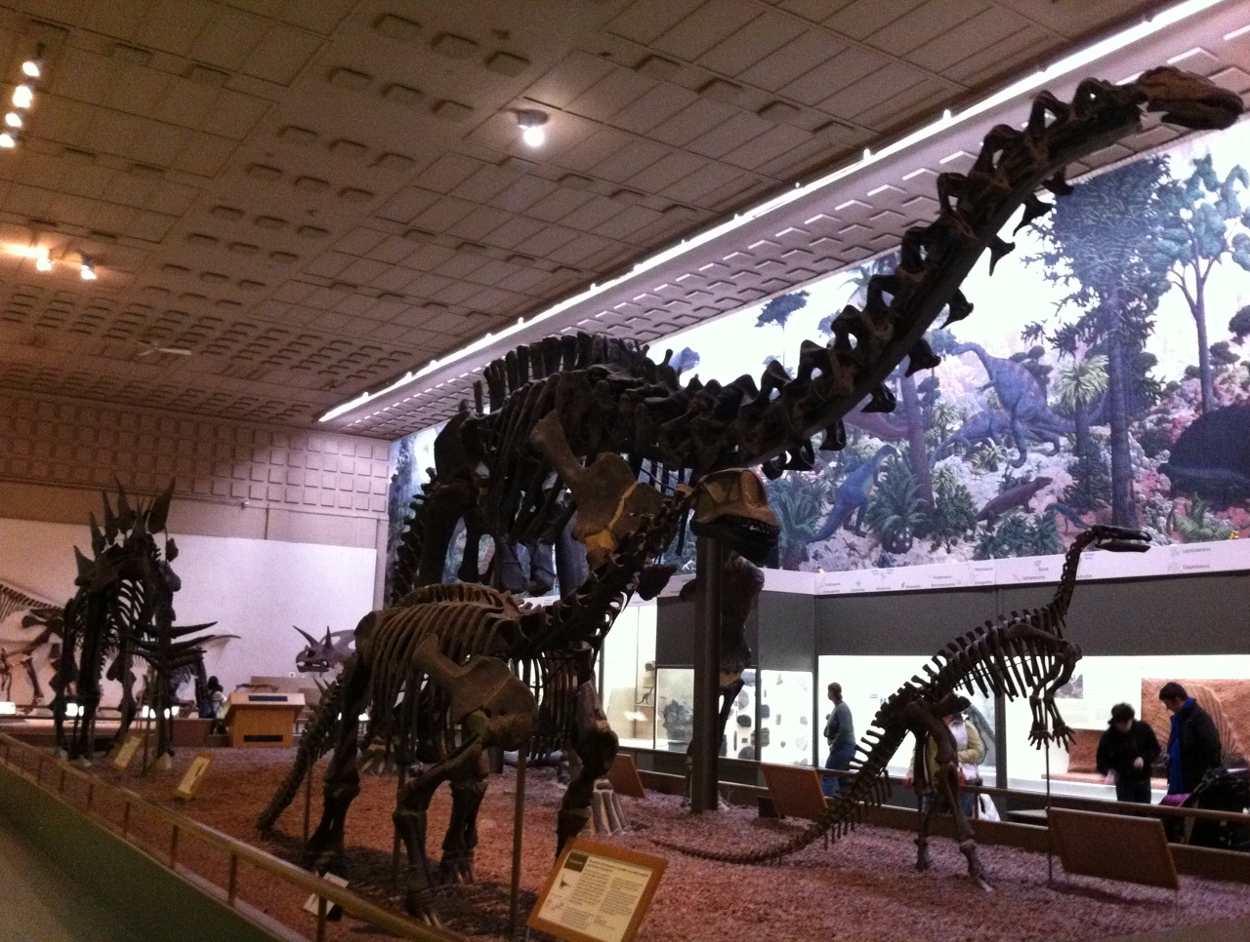
Studying networks is like doing Paleontology
Notes:
The network serves only as a skeleton of the complex system. Yes, looking at the skeleton sheds light on the system; It is a bit similar to paleontology. By looking at the bones of an ancient organism, we picture and speculate what’s going on in the organism, how smart they are? Their diet? If 2 skeletons look similar, we might say they have similar behavior. By the same token, we want to nourish our understanding of certain complex systems by looking at the underlying network organization. Of course, we have to bear in mind that the there are many things we can figure out by looking at the skeleton, say skin color, so on the top of network organization, we have to integrate many more information,, evolution, dynamics.

Slide 4
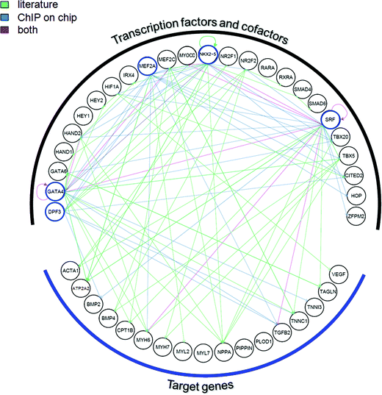
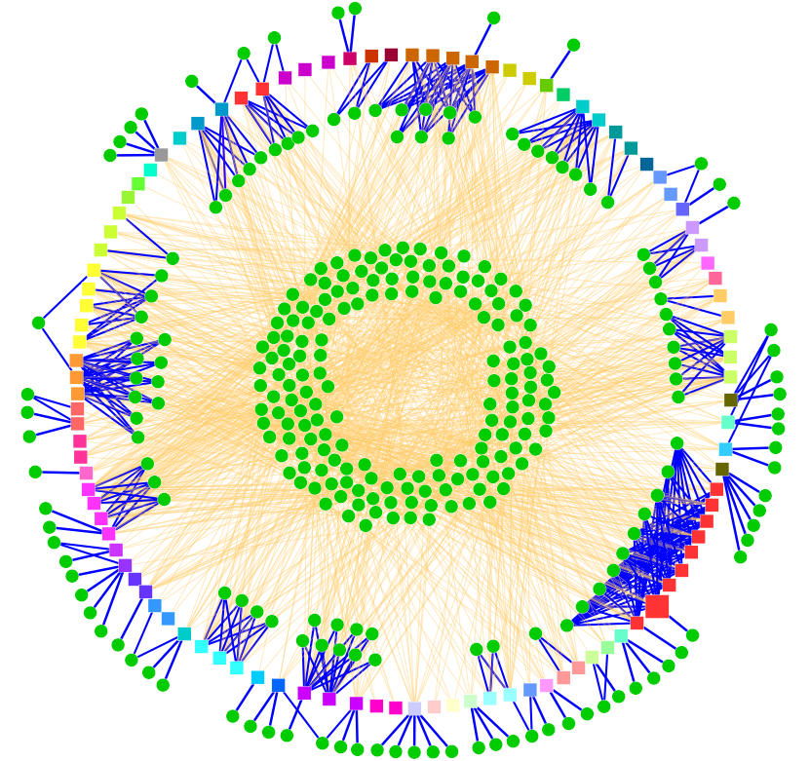
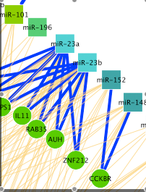
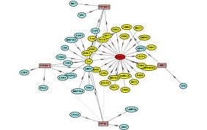
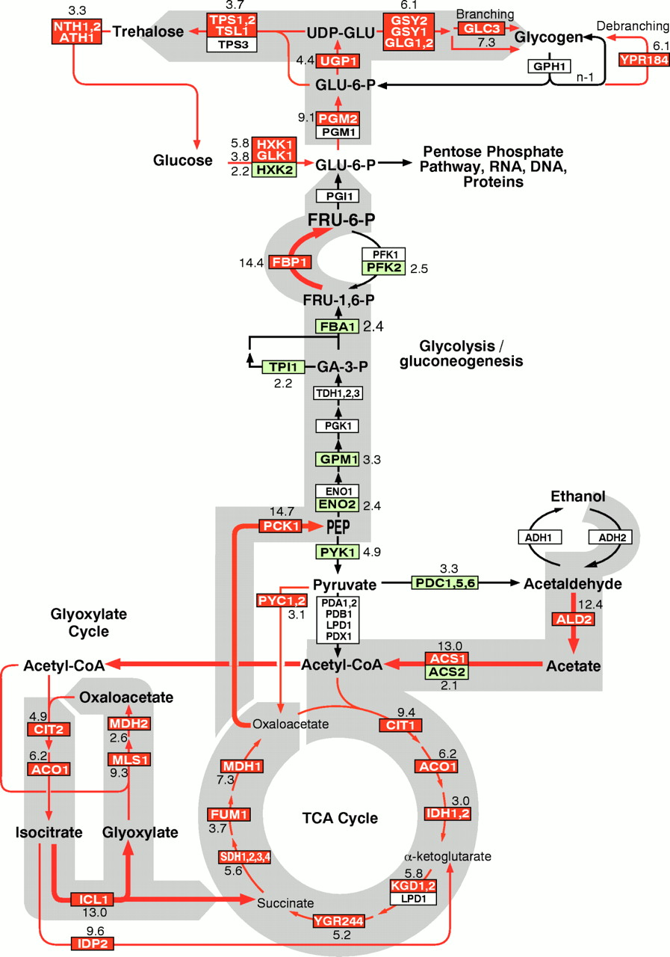
Molecular Networks
Phosphorylation networks
TF-target-gene Regulatory networks
miRNA-target networks
Protein-protein Interaction networks
Metabolic pathways
4
Notes:
In this talk, I will focus on a few biological networks, molecular networks. They are transcriptional regulatory network, how TFs bind and regulate target genes. miRNA-target network, how miRNA target mRNA, phosphorylation network, how kinases phos. target proteins. We look at protein-protein interaction networks, where 2 proteins are connected if they are found to be physically interacting. There’s one I wouldn’t really touch in this talk, but I have some future thoughts on, the metabolic pathways. How metabolites are decomposed or synthesized via various enzymes.

Slide 5
Outline
Organization principles of biological regulatory networks in comparison with commonplace networks
Construction and analysis of multi-level regulatory networks in higher eukaryotes via systematic data integration
Fluctuations and dynamics in protein binding network
Notes:
Make a pictures…

Slide 6
Organization principles of biological regulatory networks in comparison with commonplace networks
Yan KK et.al. Gerstein M, PNAS 2010
Bhardwaj N, Yan KK, Gerstein M. PNAS 2010

Slide 7
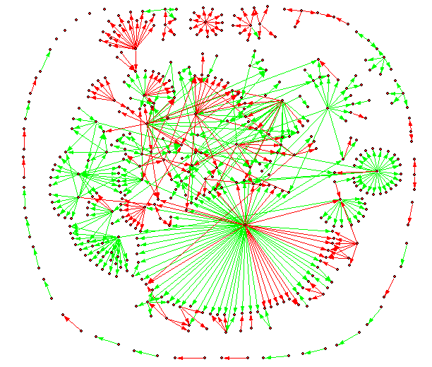
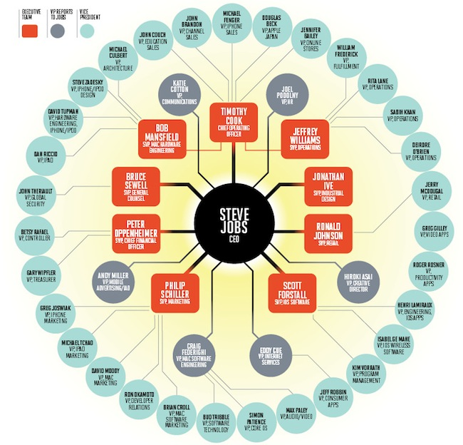
Preferred directionality in networks
7
Notes:
Many complex networks have a preferred direction. True for both biological and non-biological systems. Phos. Signaling network, there is a clear direction. Something binds to the receptor, then trigger a cascade of changes, and the information is transmitted to the nucleus. Similarly for transcriptional regulatory network, a cascade of transcription regulation results at the execution of certain functions. Food web, plant usually at the bottom, deer eats the grass, and carnivore at the top. Of course, I want to say that’s a preferred direction, all kinds of feedback loops in molecular network, A eats B, B eats C, C eats A. Similar organization in non-biological network, In a company organization, direction passes from the CEO, to middle managers, and down to smaller department. a software call graph, functions or subroutines call one another. Main function, call simple function responsible for simple execution like printing.

Slide 8
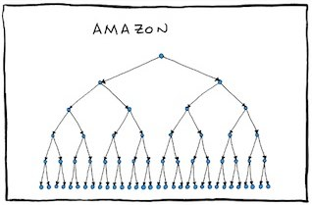
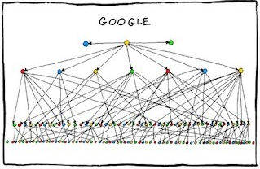
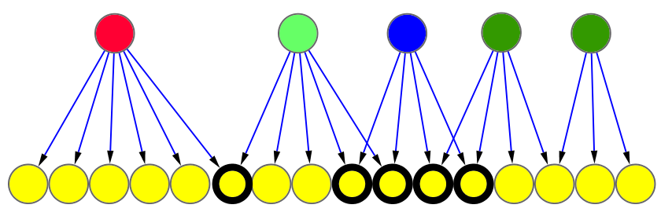
Collaboration among nodes in a hierarchical organization
autocratic
democratic
http://www.bonkersworld.net/
Autonomous
Collaborative
regulator:
Degree of Collaboration
1/6=0.16
4/4=1
8
Notes:
The existence of a preferred direction suggests a hierarchical organization, meaning we would classify nodes at the top, nodes at the bottom. But there are still different types of hierarchy. It is easier to think about from a management hierarchy standpoint. Some companies have a very strict, ordered management tree: autocratic. Some, groups are more adhoc, lots of collaboration in making decison: democratic. To quantify the degree between these extremes, we define for each regulator, a degree of collaboraton. How many of the targets are shared by other co-regulators? Give examples.

Slide 9
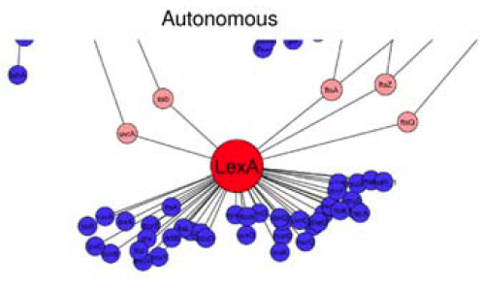
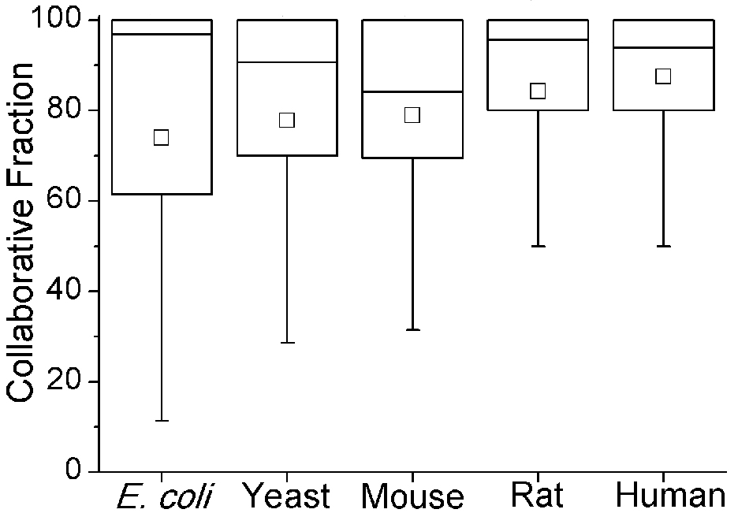
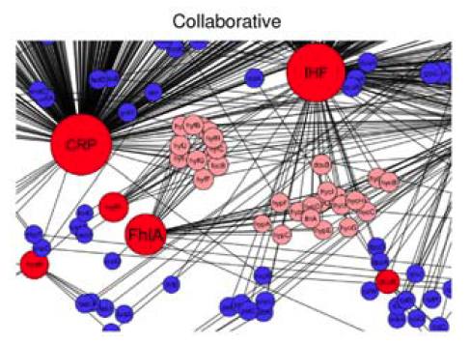
Higher species have more collaborative nodes
9

Slide 10
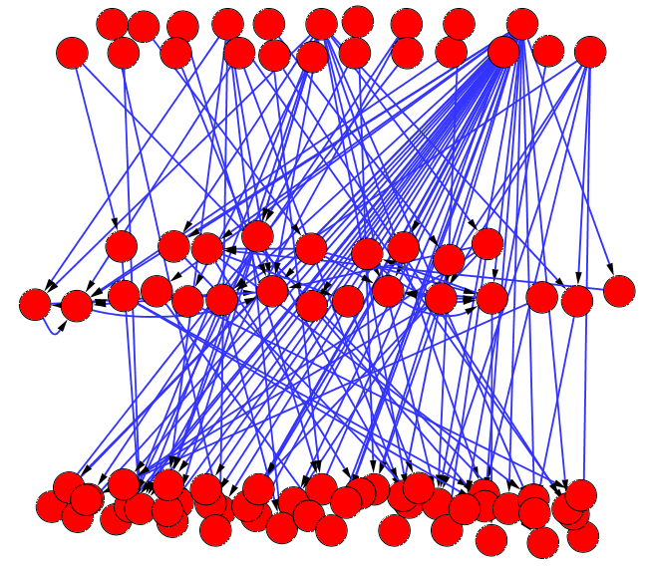
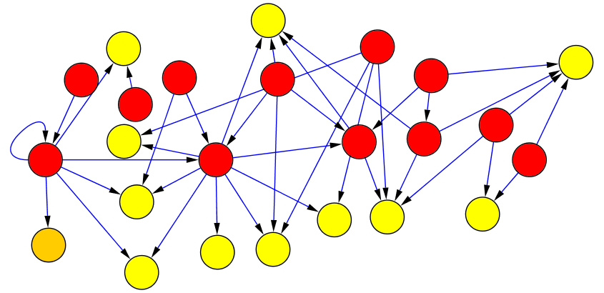
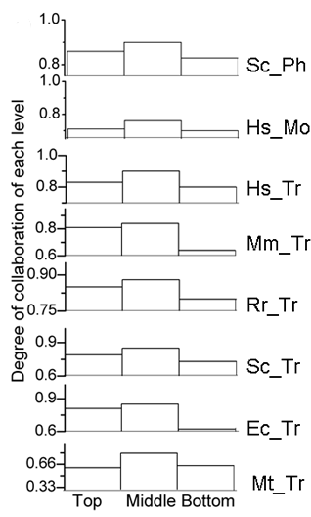
Collaborative Nature of individual Levels
one way to construct a hierarchy
no incoming edges
regulated by other regulators
and regulate other genes
only regulate other genes
Level L
= 0.1 0.3 0.2 0.4
10

Slide 11

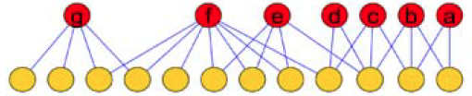
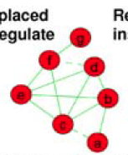
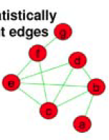
Collaborative Nature between Levels
Co-regulation (Partnership)
L
Edges placed if there
is a partnership
Statistically insignificant
edges are removed
11

Slide 12
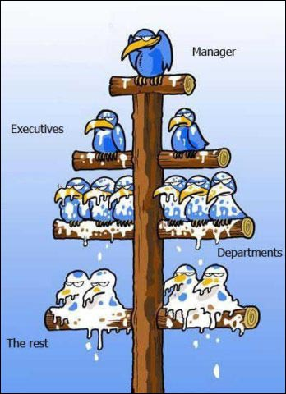
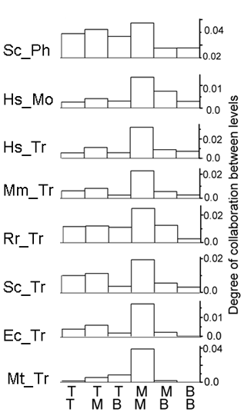
Higher species have more collaborative nodes
www.gagful.com
Middle Managers Interact the Most in Efficient Corporate Settings
12

Slide 13
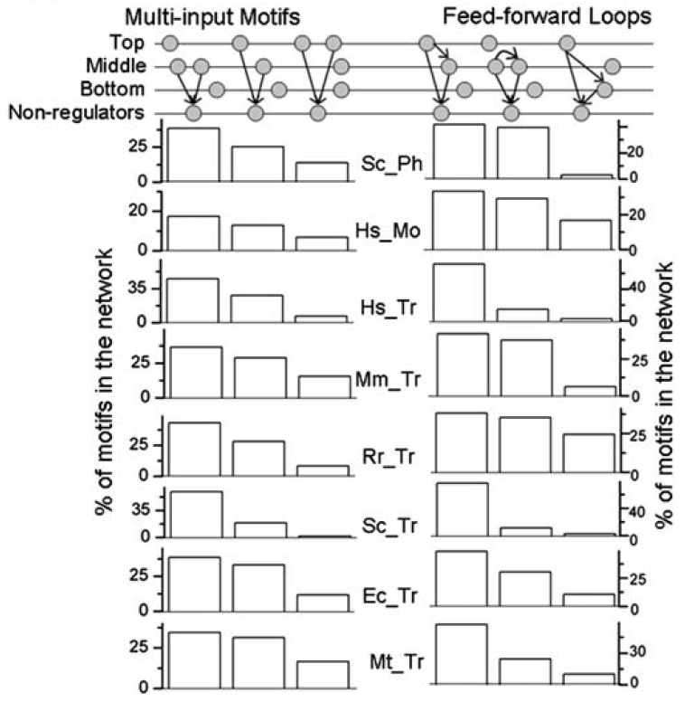
Co-regulation instantiates certain network motifs
13
Notes:
Explain motifs first
MIM, FFL….

Slide 14
Summary
Biological regulatory networks exhibit a hierarchical organization with collaborative nature, lie between autocratic and democratic
Collaborative fraction increases with organism complexity
Middle managers most collaborative, and most interaction occur between two middle managers
Reminiscent of efficient corporate hierarchies
14

Slide 15
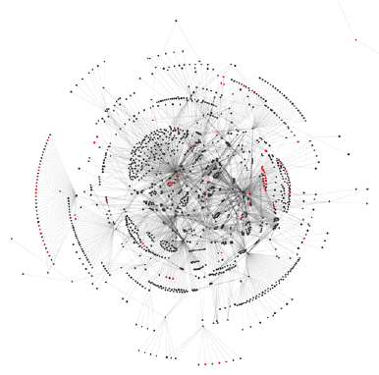
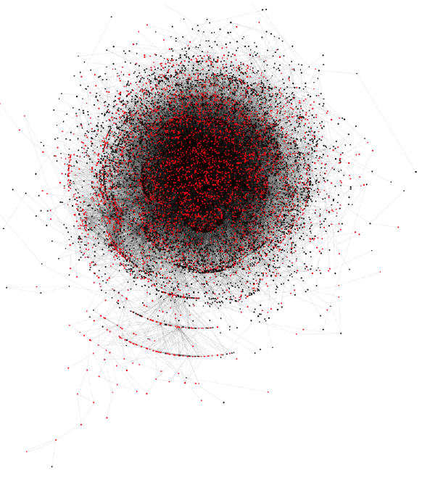
Complex adaptive systems
A system change change its organization / behavior in response to the success
or failure of previous behaviors when a given event occurs
 | E. coli transcription regulatory network | Linux call graph
Nodes | Genes (TFs and targets) | Functions (subroutines)
Edges | Transcriptional regulation | Function calls
External constraints | Natural environment | Hardware architecture, customer requirements
Persistent components | Persistent genes | Persistent functions
Origin of evolutionary changes | Random mutation and natural selection | Designers’ fine tuning
15
Notes:
Network to probe complex systems
A particular important complex system
Bio. System vs technological system: changes + performance with def
Compare 2 systems side by side nourish our understanding of 2 systems
Back to dinosaur,. One organism: weigh the bones, angles. Couldn’t learn much.
Head of a size, big or small?
Two organisms: open a new dimension, bone A corresponds to B. Especially land vs sea. Ask Q
Along this line, compare the networks … is a very natural thing to do
As, Examples 2 networks

Slide 16
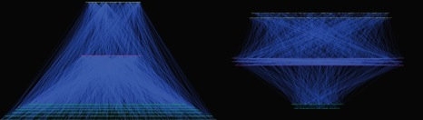
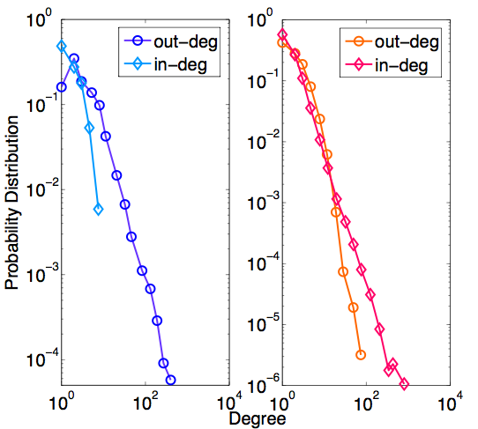
Hierarchical organization
Pyramidal vs Top-heavy
master regulator
Middle manager
workhorse
E. coli transcriptional regulatory network
the Linux call graph
Degree distribution
Roles of hubs
 | % in E. coli regulatory network | % in Linux call graph
master regulator | 4.6 | 29.6
middle manager | 5.1 | 58.2
workhorse | 90.2 | 12.3
out-degree hubs
e.g. “crp”
in-degree hubs
e.g. “printk”
16
Notes:
Preferred direction
Construct hierarchy
Number
Hierarchy is related to the degree dist
Broad out, narrow in BUT
Explain.. Hubs…examples
Why this is related to hierarhcy

Slide 17
Organization of modules
M1
M2
M3
Modules are labeled by master regulators:
TFs, high-level starting functions
Overlap(M2,M3)=
reuse=2/3
reuse=1/3
 | E. Coli TRN | Linux call graph
# of modules | 64 | 3665
Average overlap | 4.3% | 80.7%
Maximum node reuse | 15.6% | 87.5%
Average node reuse | 3.5% | 8.4%
TRN:
modules overlap little,
components are
less generic: “ompF”
Call graph:
modules overlap,
Functions are highly
reused (generic): “printk”
17
Notes:
Both bio + tech systems use modules.
Each module corr. Fct
Simple minded way to define..
Define reuse, give ex
Define overlap
Cf table, overlap and reuse
Relate to hierarchy
Give examples

Slide 18
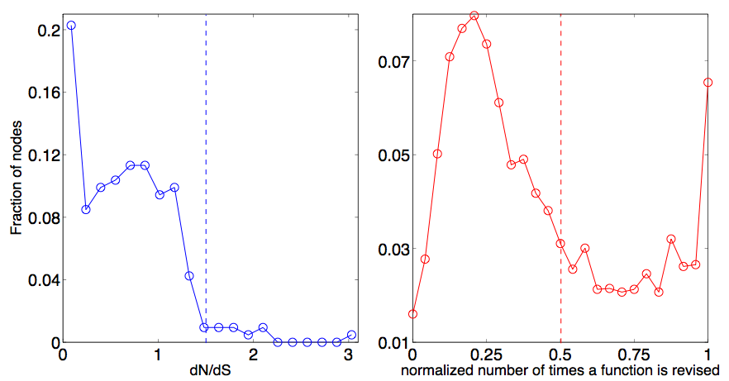
Tradeoff between reuse and robustness
reusability (cost-effective)
independent
modules
overlapping
modules
robustness
purifying selection
adaptive evolution
purifying selection
adaptive
evolution
E. coli
Linux
Higher reuse
e.g. dnaA
e.g. strlen
e.g. mempool_alloc
Persistent genes evolve slowly
Two classes of persistent functions
Notes:
Reuse and Overlap between modules suggest a design principle
2 extremes, 2 systems, breakdown of 1 guy kill the system
Ind. Vs overlap
Advantages
To examine closer, look at evolutionary rate persistence components of two systems: persistence genes, persistence components
E. Coli by dnds, most slow, give ex
Fct, number of times fct updated , 2 classes, give ex
Tinkering vs design
When a component has to be reused, everytime u introduce a new usage, affect the systems
Price for reusuable is a const update . This is ok for design
Bio. Can’t afford the price, indep..

Slide 19
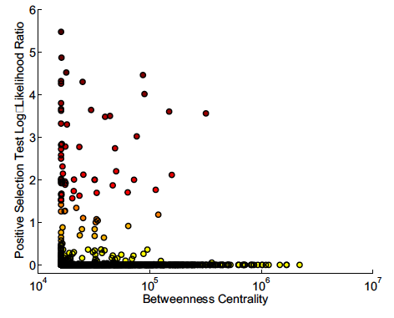
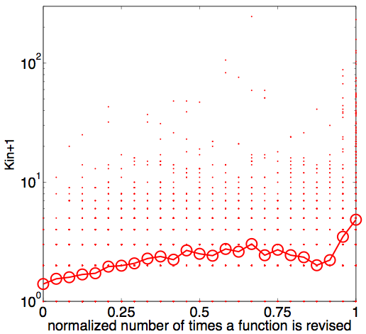
Tinkering versus Design
Spearman correlation
r=0.26
P<10⁻⁷⁵
Hub proteins are more difficult to evolve
  Reusable components need to be
  constantly fine-tuned
(Kim et.al. and Gerstein PNAS 2007)
Notes:
Further look cf the relationnship between ev. Rate vs net top
Took from this paper, rate vs between centrality, (what’s that, very much related to degree)
Many interface, low degree of freedom, can’t evolve quick
Hubs. Ev is faster, more useful more often to fine tune

Slide 20
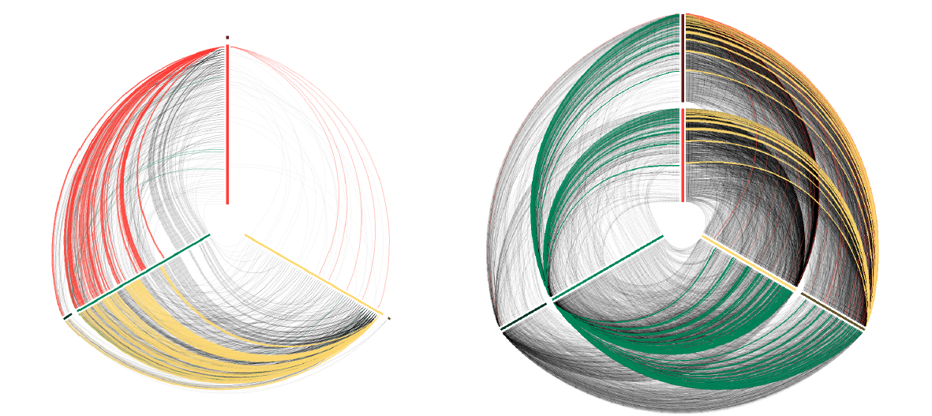
Bottom up versus Top down
E. coli
Linux
Persistent genes
enriched at the bottom
Image courtesy:
Martin Krzywinski
Notes:
E. coli / Relatively few nodes are classiﬁed as persistent (outer segments on each axis)
Linux / Each axis contains a near-equal mix of node types. Note that the most connected workhorse is non-persistent (inner segment), whereas the most connected manager is persistent (outer segment)
N: master reg
SE: middle
SW: workhorse
Label T M B,

Slide 21
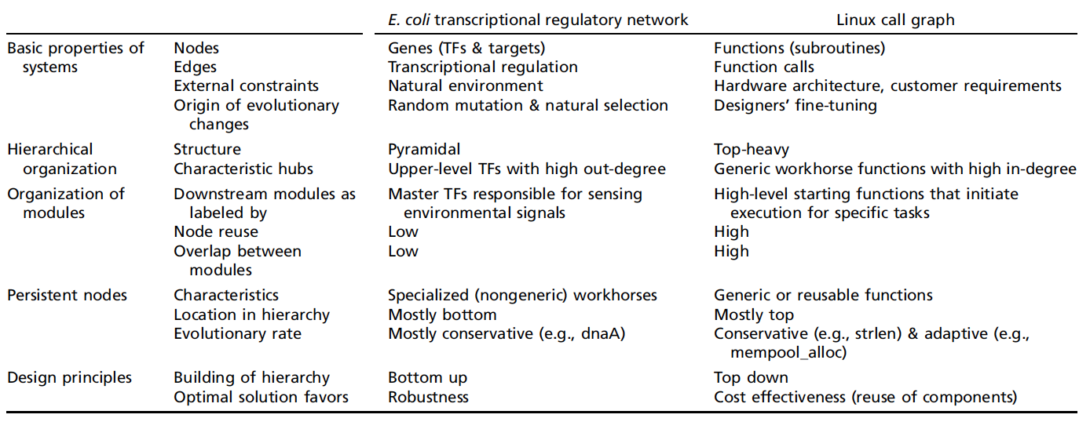
Summary
Notes:
Think about overhead
Think about reuse in bacteria too…

Slide 22
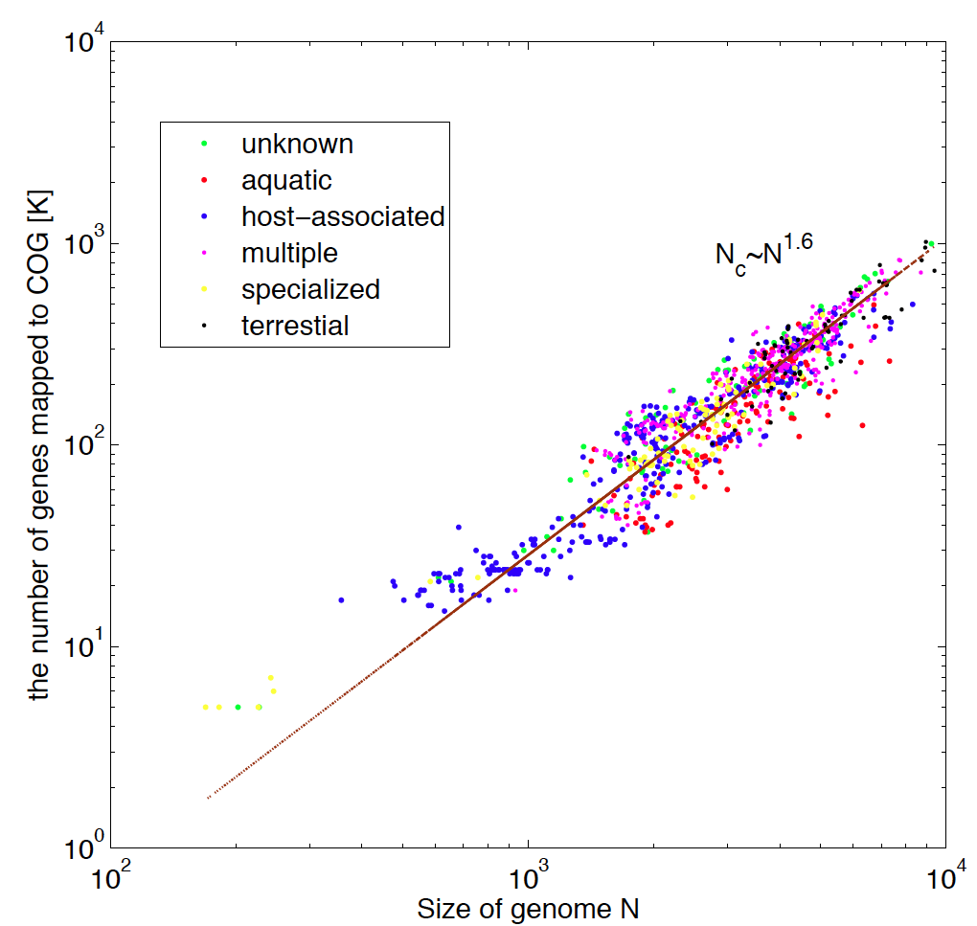
van Nimwegen, TIG 2003
Konstantinidis, PNAS 2003
Maslov et.al. PNAS 2008
Notes:
Scaling, proposed by, superlinear
Recently redo the analysis, and habitat
Reuse, TF: a source, adigest..
Genome: enz
Number of enz grow sublinearly with food source
Another way to ;ook, relate to corpate hierarchy, overhead
Brochsccy

Slide 23
Construction and analysis of multi-level regulatory networks in higher eukaryotes via systematic data integration
Cheng C, Yan KK et.al. Gerstein M PLoS Comp. Biol. 2011
Gerstein M et.al. Nature (submitted)

Slide 24
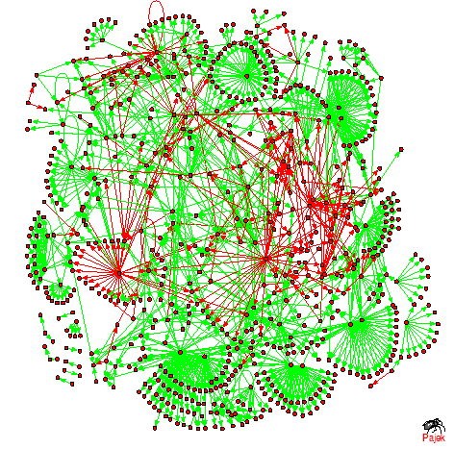
From simple organisms to higher eukaryotes
?
E. coli
S. cerevisiae: 200 TFs
human/worm: 1300TFs
Distal regulatory edges
Multi-level regulation: chromatin level (3D structure of chromosome), DNA level (transcription), mRNA level (miRNA), post-translation level (phosphorylation)
Notes:
Remove the spider

Slide 25
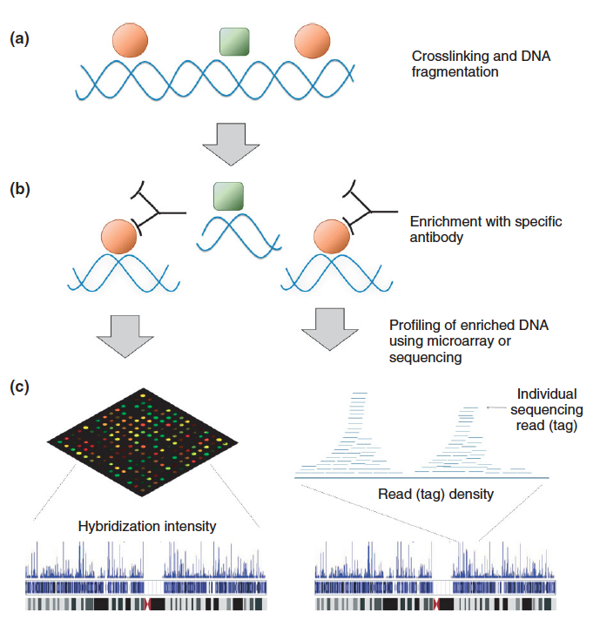
Genome-wide profiling of TF binding
Overview of ChIP-chip and ChIP-Seq
Kim TM and Park PJ (2011)
Notes:
ENCODE and modENCODE projects
The prefix mod stands for model organisms, we need
the annotation of other organisms for comparison. The model organisms picked are the worm and the fly.
Like this morning, 1000 genomes, The ENCODE and modENCODE projects generate tons of data.

Slide 26

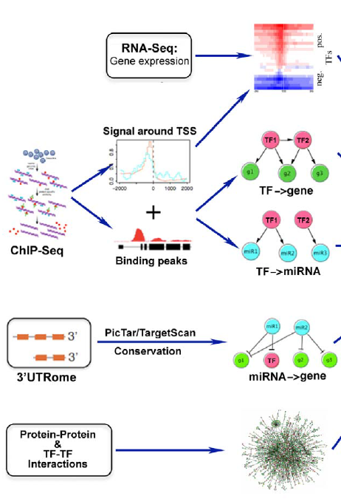
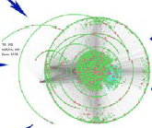

Systematic Data integration
chromatin
model
Distal
regulation
~ 100 TFs in human
~ 30TFs in C. elegans
meta-network

Slide 27
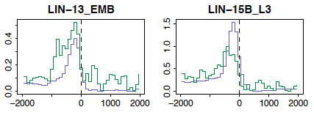

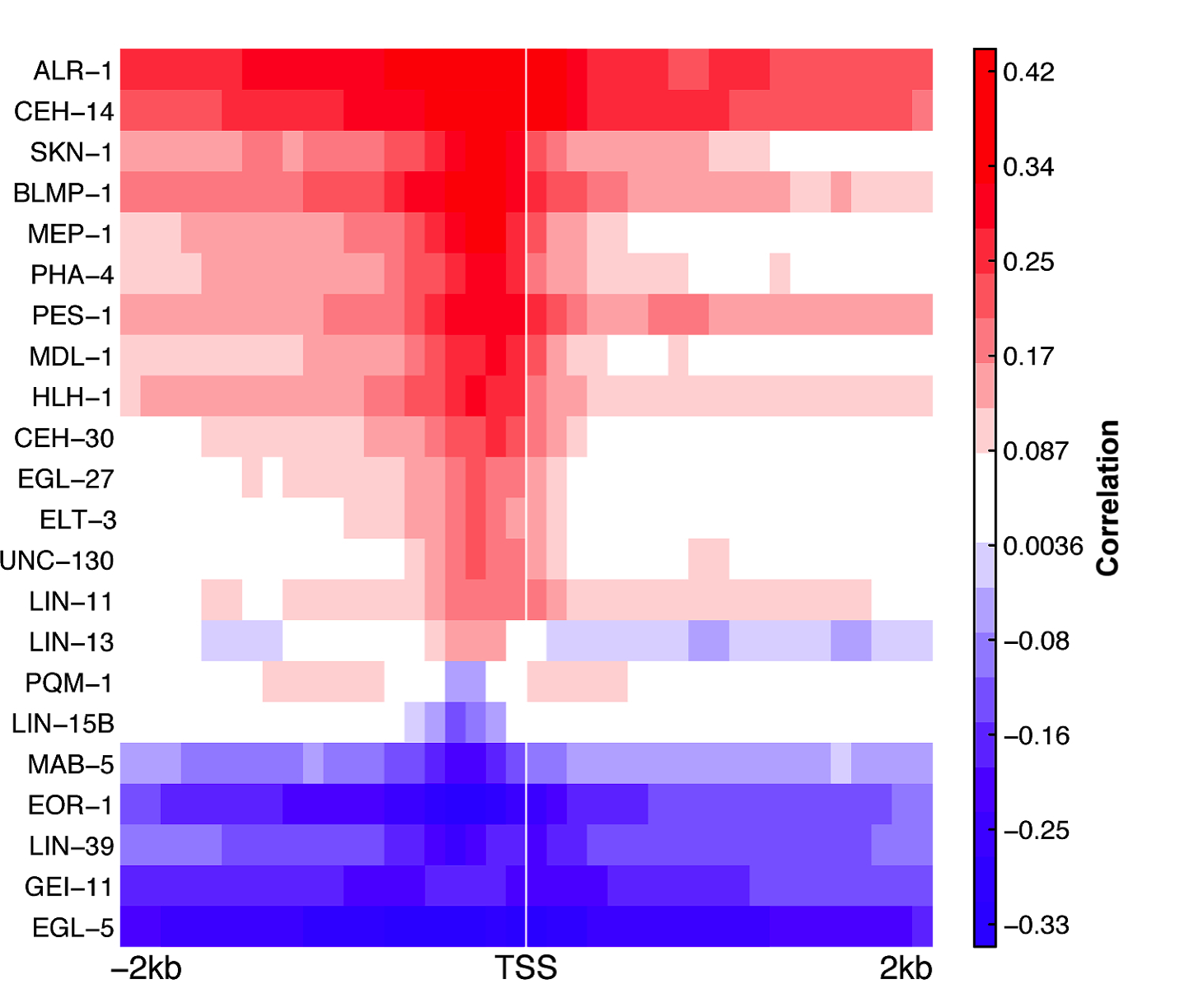
Relationship between binding and
target expression
Identification of binding targets

Slide 28
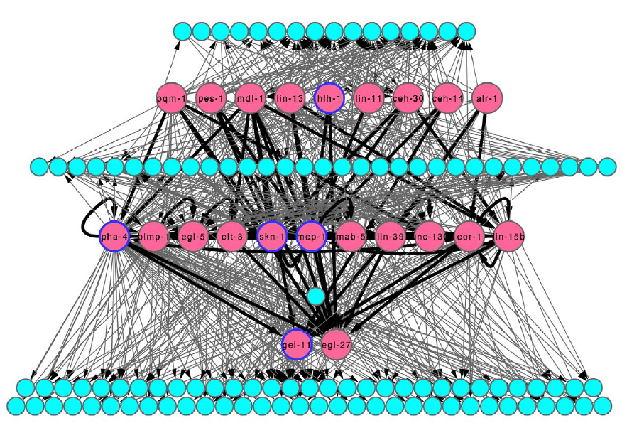
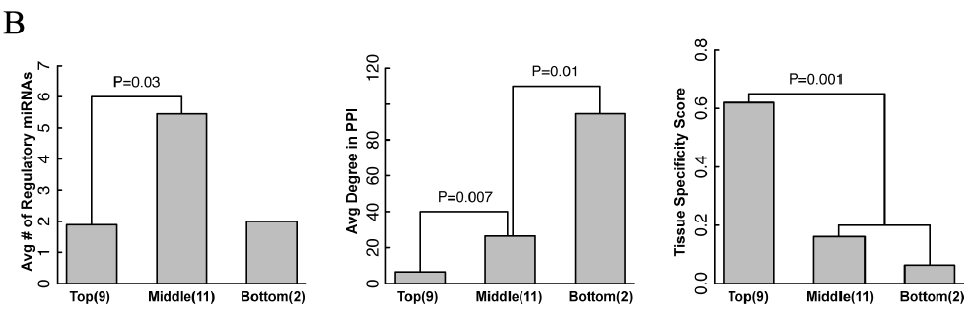
Constructed regulatory network of
C. elegans
Notes:
Labell…miRNA, TF

Slide 29
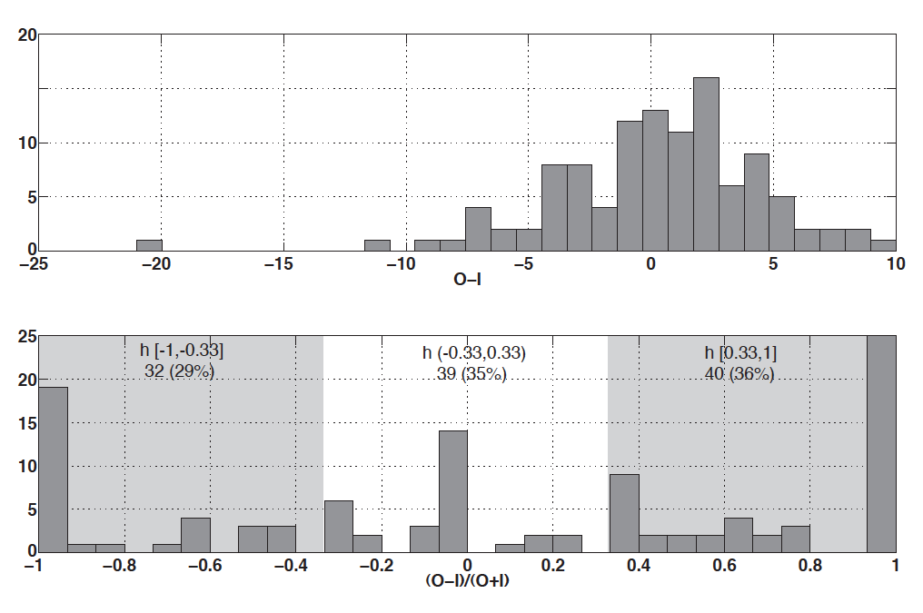
Preferred direction in
human regulatory network
O: out-degree
I: in-degree
Simulated annealing: 80% of edges are directed downward

Slide 30
More design principles
Promoter regulation
Distal regulation
Protein-protein interaction
Post-transcriptional regulation by miRNAs
Target genes
TFs
miRNAs
Multiple-input modules (MIMs)
Cross-talk suppression
enriched
(miR-128)
(miR-101)
(TAL1)
(SP1)
depleted
(FOS)
(RUNX)
(ABHD8)
Notes:
Global, small building blocks…

Slide 31
Summary
Recent developments in high-throughput sequencing facilitate a comprehensive identification of transcription factors
Systematic data integration probes the design principles behind the multi-level regulation
Generation of sufficient amounts of data in diverse conditions, tissue types and time points is still a great challenge

Slide 32
Networks: dynamics and fluctuations
Yan KK et.al. Phy. Rev. Lett. 2008
Notes:
So far, we have focused on the structure of network,
Network is a backbone of a complex system
Underlying process happens
An example
Genome wide protein binding network, dynamics and fluctuations

Slide 33
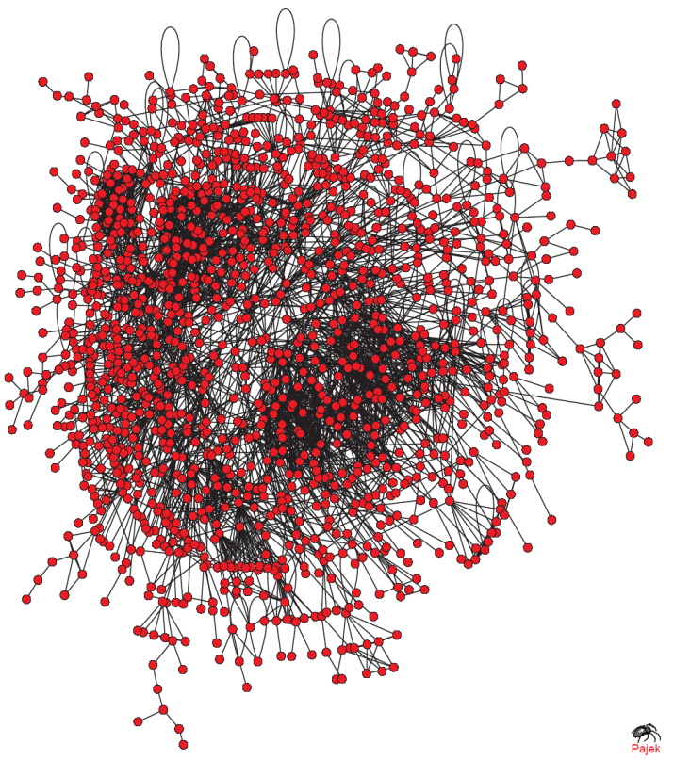

Cell is a crowded and interacting molecular environment
Map of reproducible (>2 publications) protein-protein interactions in yeast
>80% of proteins are all connected in a giant cluster of genome-wide protein-protein interaction network
~2000 protein types are
co-expressed co-localized in yeast cytoplasm
Notes:
I always find this textbook picture astonishing
(cell size 10um)
In scale how’s it look like inside a cell
Green: ribosome
Red: proteins
Crowded
Diverse: 2000 types
Difficult for signaling
Moreover, connected…
Giant
Remind us small world effect

Slide 34
The small-world effect in a cell
Median distance 6 steps in the giant PPI cluster
Robust to random failure of vertices. Good news in terms of cell signaling
Indiscriminate spread of perturbation
  Systematic changes in expression: large changes in concentrations of a small number of proteins (Maslov and Ispolatov, PNAS 2007)
  Noise: small changes in concentrations of a large number of proteins
Notes:
Alternate path
My contribution

Slide 35




Law of mass action equilibrium
Dynamical mixture of free proteins and dimers
Dissociation
constant
In equilibrium
Mass conservation
N+E nonlinear equations, N+E unknowns
C_{i} of all yeast proteins and subcellular localizations are experimentally known (group of Weissman @ UCSF)
Only reproducible independently confirmed protein-protein interactions for non-catalytic binding (kinase-substrate pairs~5%), : ~4000 heterodimers + ~1700 proteins
Neglect higher order interactions. ~100 multi-protein complexes (we assume no cooperative binding in complexes)
Use “evolutionary motivated” binding strength: K_{ij}=max(C_{i,} C_{j})/const, which is sufficient to bind considerable fraction of two proteins in a heterodimer, relevant average of dissociation constants K_{ij} ~10nM
assumptions:
Notes:
a node means one kind of protein.
many copies of the protein.
take into account is the protein concentration.
As a first approximation,
If there are N nodes and E edges in this network, we have N+E equations.
If C, K and the network is known,
E+N unknowns…: D and F
Math very complicated, can be done

Slide 36
Two types of fluctuations
in equilibrium concentrations
Spontaneous Fluctuations:
By the stochastic nature of binding, the network is not always in equilibrium. There are fluctuations away from equilibrium, described by equilibrium statistical physics.
Driven Fluctuations:
Small deviations in total concentration that arise as a result of:
1) Upstream noise in genetic regulation
2) Stochastic fluctuations in protein production/degradation mechanisms
The typical time-scale of these small fluctuations in total concentration
is minutes.
network
Driving fluctuations
Driven fluctuations
36
Notes:
The reason why we call drivem
Very fast off rate
Slower,
We can separate them in our analysis

Slide 37
Spontaneous fluctuations
Free energy G, for a given occupation state
Notes:
Eipslon: dimer binding
Binding energy + 2 entrop terms,
NB. F terms not independent variables…
1st der. Recover LMA
2nd
Fluctuation of a dimer link to other networks via the off-diagonal terms..
For each dimer, cf with iso-lated model, with the same F_i, F_j, D_ij, without connected…noise of this guy is 1/diag term

Slide 38

Collective Effects Amplify Spontaneous fluctuations
Collective effects significantly amplify (up to a factor of 20) spontaneous noise
Is there an upper bound to this amplification?
Notes:
As you can see collective effects lead to significant amplification of spontaneous noise

Slide 39



Spontaneous fluctuations:
alternate formalism
Example for two proteins:
Notes:
Poisson process

Slide 40



Driven fluctuations
Linear approximation
extrinsic noise
intrinsic noise
Notes:
Since we are dealing with small perturbation, we can linearize the dynamical equation
responsible to bring the system back to equilibrium
to a new equilibrium, which is given by the steady state of the equation
Set lhs=0, given a delta C -> delta F
Think about expressiom
Cross term. Not yet meaured
Correlated vs independent
We plot the relative change in free concentration for each proteins..
Two cases are dramatically different, 1st max 0.1, but 2nd can several folds 200%
Nature of the LMA binding
Picture is both expand, the cancel each other,,, intrinsic noise can really superpose ..

Slide 41

Driven fluctuations
Relaxation Matrix
HHT1
Maslov and Ispolatov, PNAS (2007)
Notes:
Of paricular interest, small ev
Eigenmode, collective slow decay…, channel of noise propagation…
Signal vs noise

Slide 42
Summary
We derived an analytical framework to quantify fluctuations (spontaneous, driven) in PPI network
Both spontaneous and driven fluctuations propagate along the network, intrinsic versus extrinsic noise
There are certain channels that favor noise (as well as signal) propagation. Is there any way to favor one but not another?

Slide 43


Conclusion
Systematic omics data integration,
Dynamics, intuition from common
place systems
Miller et.al. Nature 2008
Evolution history, design principles
Notes:
Beginning, network is backbone to study complex systems
Many networks look hairball, complexity of systems
Whole point, decipher the network, decipher the system
Bio-important…

Slide 44

Acknowledgement
ENCODE, modENCODE consortium
Notes:
PI: MG
Clique of Gerstein lab at Yale
NB, CC
SM
Noise Dylan

Slide 45


where:

Slide 46

Different levels have different GO categories
GO categories
for E. coli

Slide 47
Effects of protein knockout
Find the equilibrium concentrations of the system
Set the total concentration of a protein C_{j}=0, and recalculate the equilibrium concentrations
Protein susceptibility S
Notes:
With the machinery introduced, we do the following things.
Then we ask the following question. What will happen if we knockout one of the protein? In silico,
the equilibrium concentration of Fi in the absence of j.
a protein with high S means that it is easy to be perturbed by others.
A problem of strongly connected
Some kind of log-normal dist in S

Slide 48


Essential proteins are less susceptible despite their centrality
Notes:
Explain the dotted line
This is opposite to the pure topological point of view that they are more likely to be affected.
Cells want to protect them.
The probability that a random selection of the same number of proteins have a mean lower than the observed value.
It measures whether the lethal fraction in A is sig higher than that of B. Suppose p is prob of finding essential protein in the control, P is the prob of finding the observed number or more essential proteins in the test group.

Slide 49


Concentration gradient as a proxy of susceptibility
Notes:
We would like to understand why.
It turns out that a simple way to gauge susceptibility is to look at the concentration of neighbours.
We define a modified degree,
perturbation travels along concentration gradient.
If a protein has low concentration, it’s difficult to perturb its neighbours.

Slide 50

Comparison with null models
Notes:
Why the middle behave like this if topology does not matter? May be P-value.

