Slide 1
Ensembl Regulatory Build

Slide 2
Ensembl regulation Database
Regulatory features
Regulatory Segmentation
Other regulatory regions

Slide 3
Data Source of Regulatory features
Chip-Seq data & Dnase data
Roadmap epigenomics (human)
ENCODE (human)
ENCODE (mouse)
Peaking calling algorithms: SWEMBL and CCAT(broad peak calling)

Slide 4
Feature Construction
Core regions. Focus features: define potential binding sites, including transcription factors binding peaks and Dnase data.
Attribute features: do not defined binding sites, such as histone modification, Pol II, Pol III.

Slide 5
Feature Annotation
Core region
Gene feature
CTCF | BCL3 | EBF | PU1 | H3K27ME3 | H3K4ME1 | H3K9AC | Pol II | Pol III | ….
1 | 1 | 0 | 0 | 0 | 1 | 0 | 1 | 1 | ….
Focus features
Attribute features

Slide 6
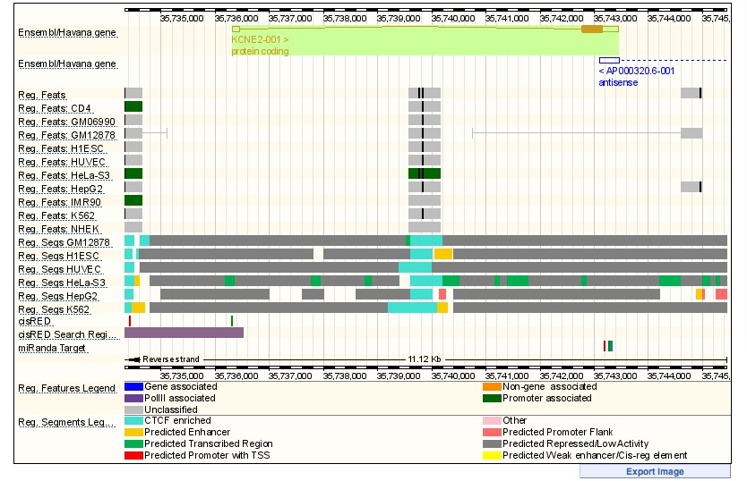

Slide 7
Regulatory Segmentation
Data: Encode. Open chromatin (Dnase & FAIRE); transcription factors (Pol II & CTCF); histone modification
Method: ChromHMM & Segway

Slide 8
Other regulatory regions
microRNA target predictions (miRanda)
Experimentally validated human non-coding fragment (VISTA Enhancer Browser)
Genome-wide regulatory module and element prediction from cisRED
Human DNA Methylation track

Slide 9
Questions
- Are the All Encode data in RB?
- where does the DNAse data fit?
- differences w/the segmentation (do we get all nucleotides annotated?)
- are motifs found in the focus features or in ChIP-seq
- ChIP-seq peaks from spp/peakseq? anywhere else?
- where do ncRNA’s fit in? are ncRNAs annotated? ncRNAs same as GENCODE? do they annotate noncoding transcribed regions?
- any RNAseq data used?
- TFBS called in conjunction in the first step first stage or called lastly?
VEP
- VEP question: what about SNPs in motifs?
- VEP question: Does the ens reg build include all the phase I SNPs?

