Slide 1
ENSEMBL Regulatory Segmentation
Cristina Sisu
Annotation 18th Jan 2011

Slide 2
Input Data
Cell lines: GM12878, K562, H1-hESC, HepG2, HeLa-S3 & HUVEC
Types:
Open chromatin --- DNase1 hypersensitivity and FAIRE
Transcription factors --- Pol2 and CTCF
Histone modifications --- H2k4me1
Combining 2 unsupervised segmentation methods (25 labels each):
ChromHMM
Segway
Segment Class | Description
CTCF | CTCF enriched element
WE | Predicted weak enhancer or open chromatin cis reg element
T | Predicted transcribed region
E | Predicted enhancer
PF | Predicted promoter flanking region
R | Predicted repressed or low activity region
TSS | Predicted promoter region including transcription start site

Slide 3
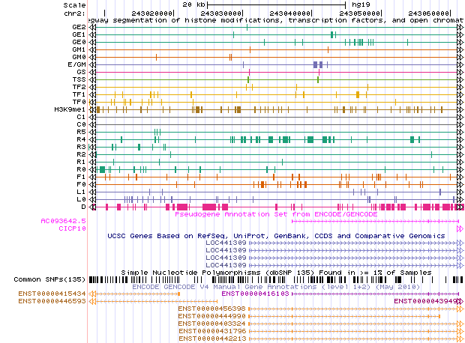
Genome Browser Chr2:243007681-243062019

Slide 4
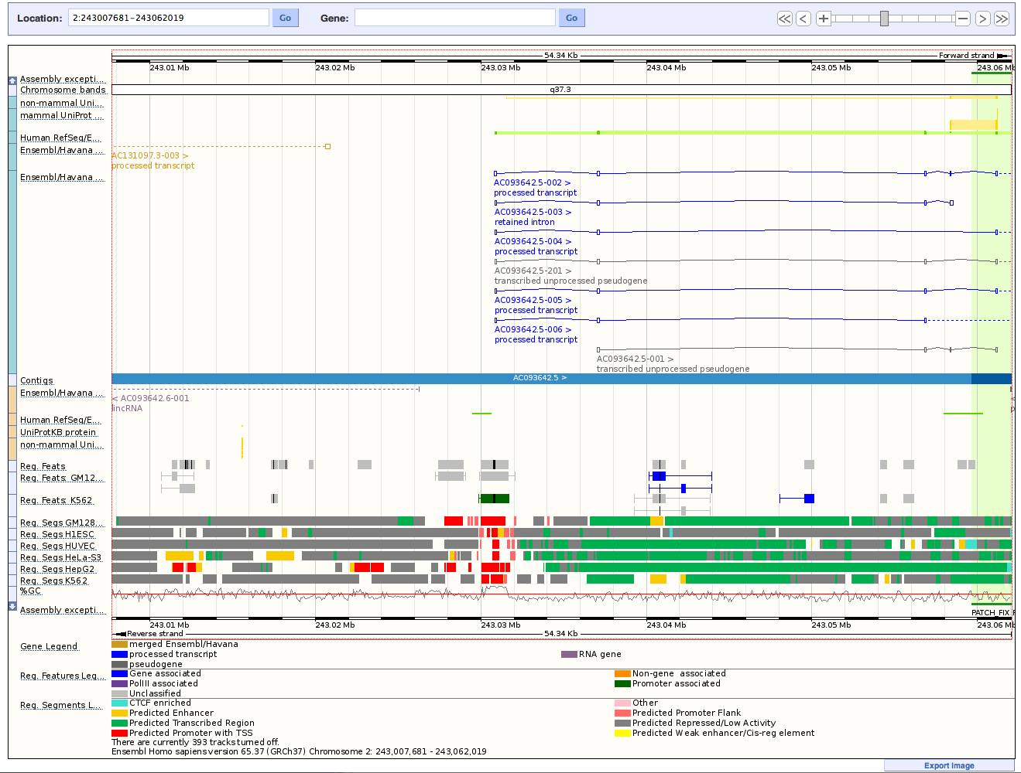
Ensembl Browser

Slide 5
Conclusions
 | Combined Segmentation | Segway
# Labels | 7 | 25
Analysis depth | higher level | detailed
Genome browser | Ensemble | UCSC
# Cell line visualized in GB | 6 | 1
Focus | regulatory elements | universal

Slide 6
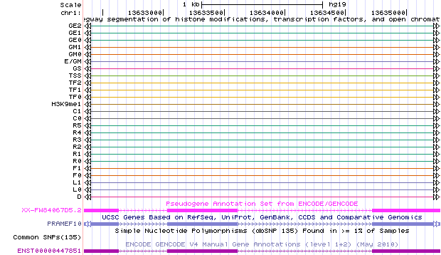
Genome Browser Chr1:13632346-13635279

Slide 7
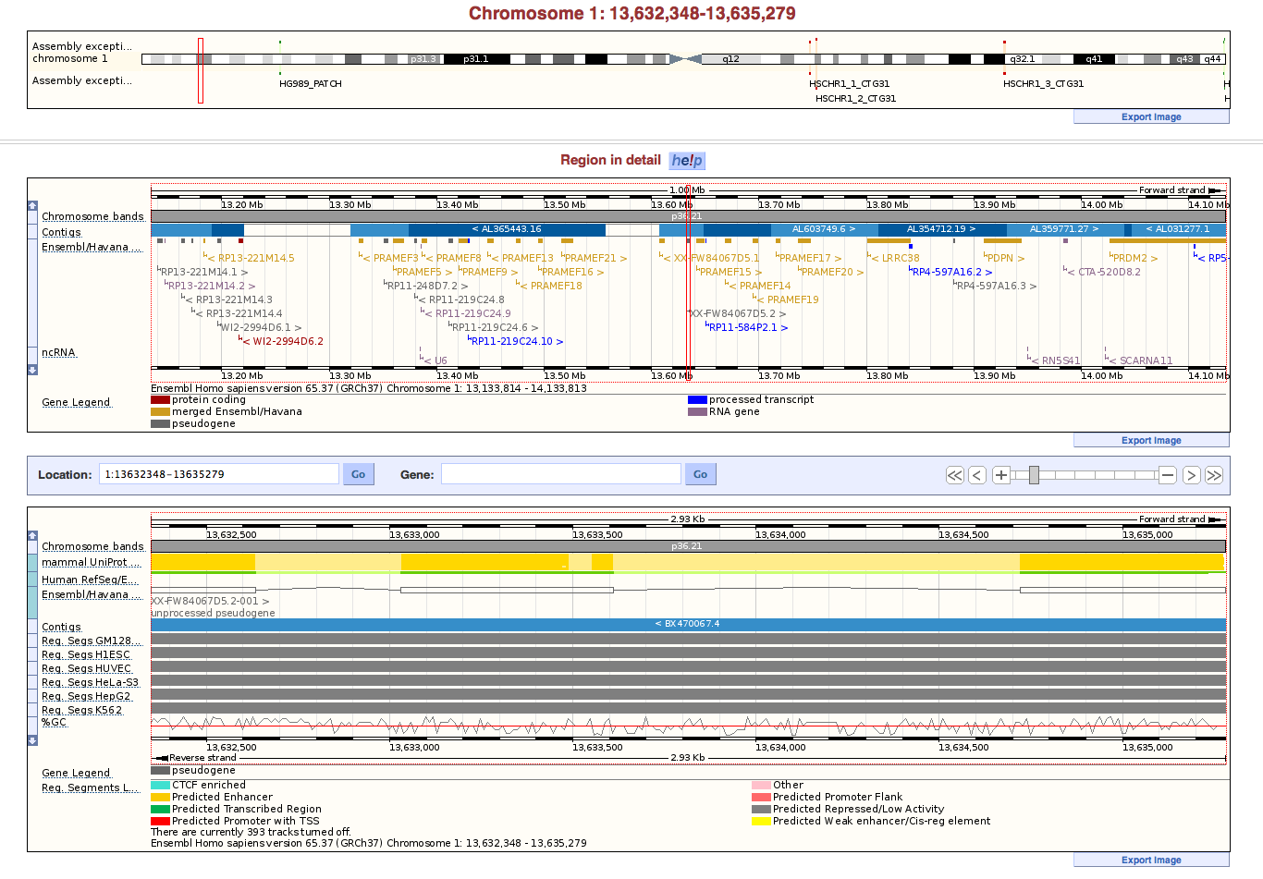
Ensembl Browser

