Slide 1
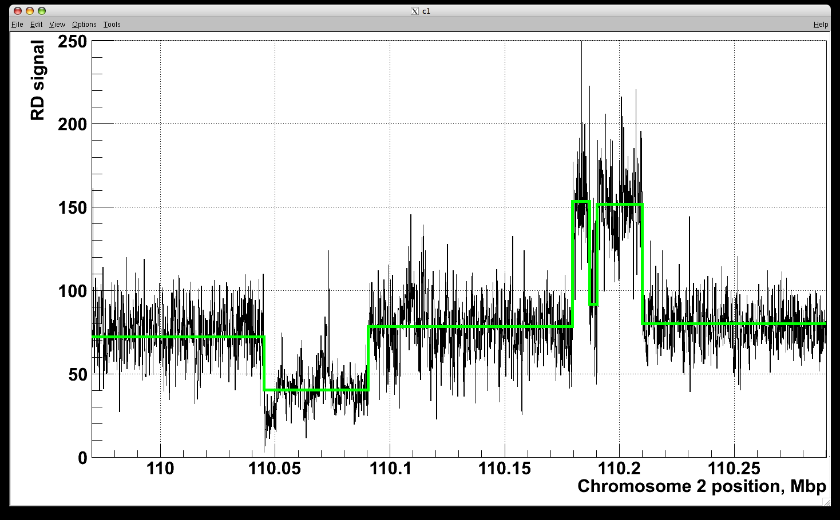
Using Sequencing for Detection and Analysis of Naturally Occurring and Somatic Genomic Structural Variations in Human Cells
Alexej Abyzov
Seminar at MSKCC
12/22/2011

Slide 2
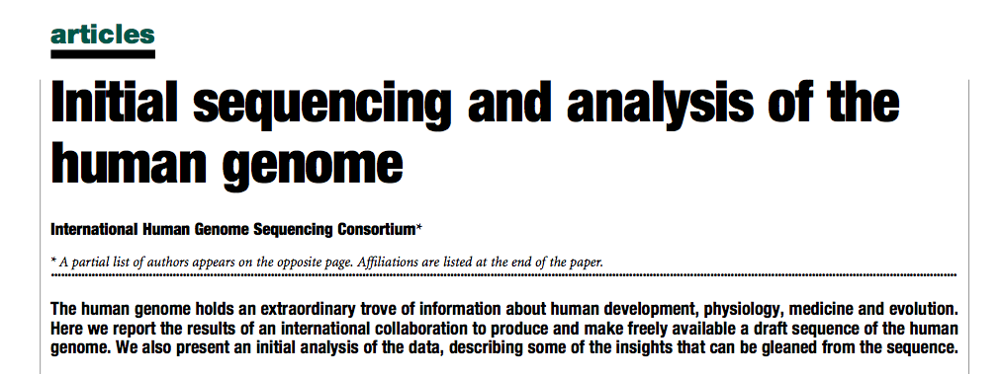





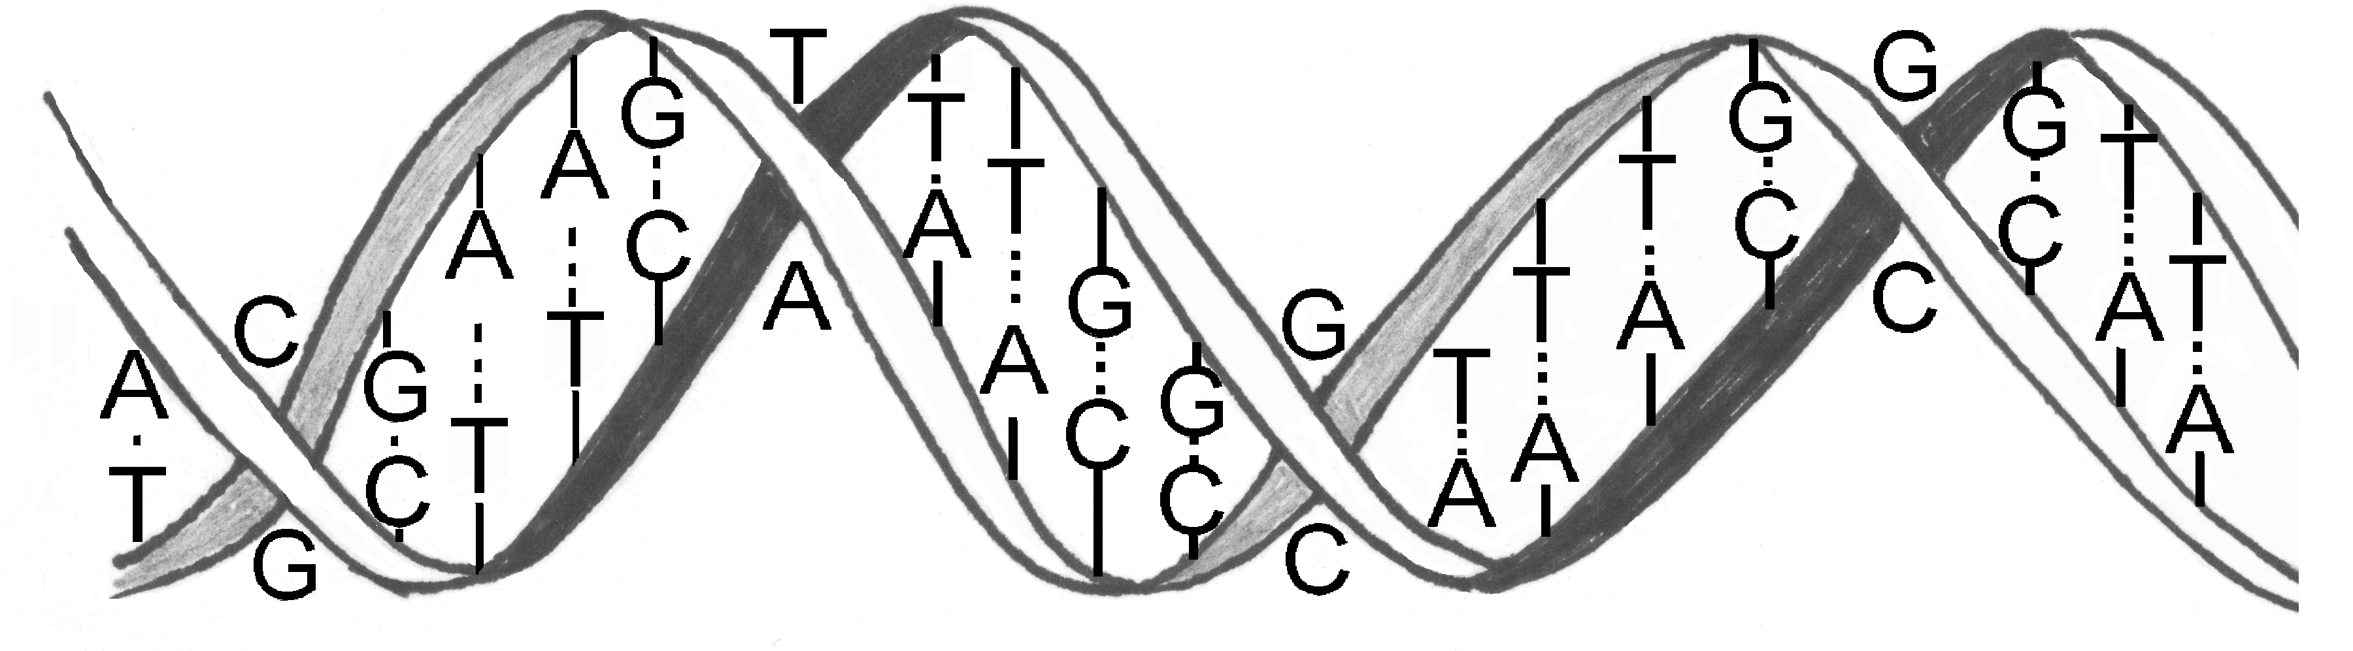
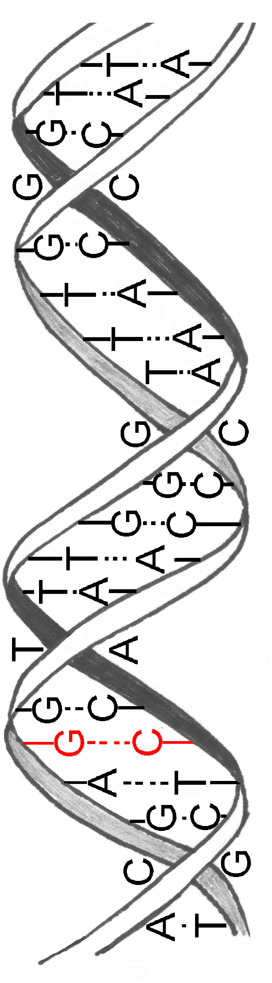
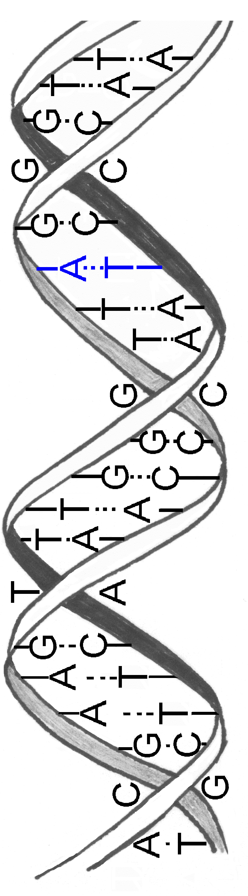
…

Slide 3
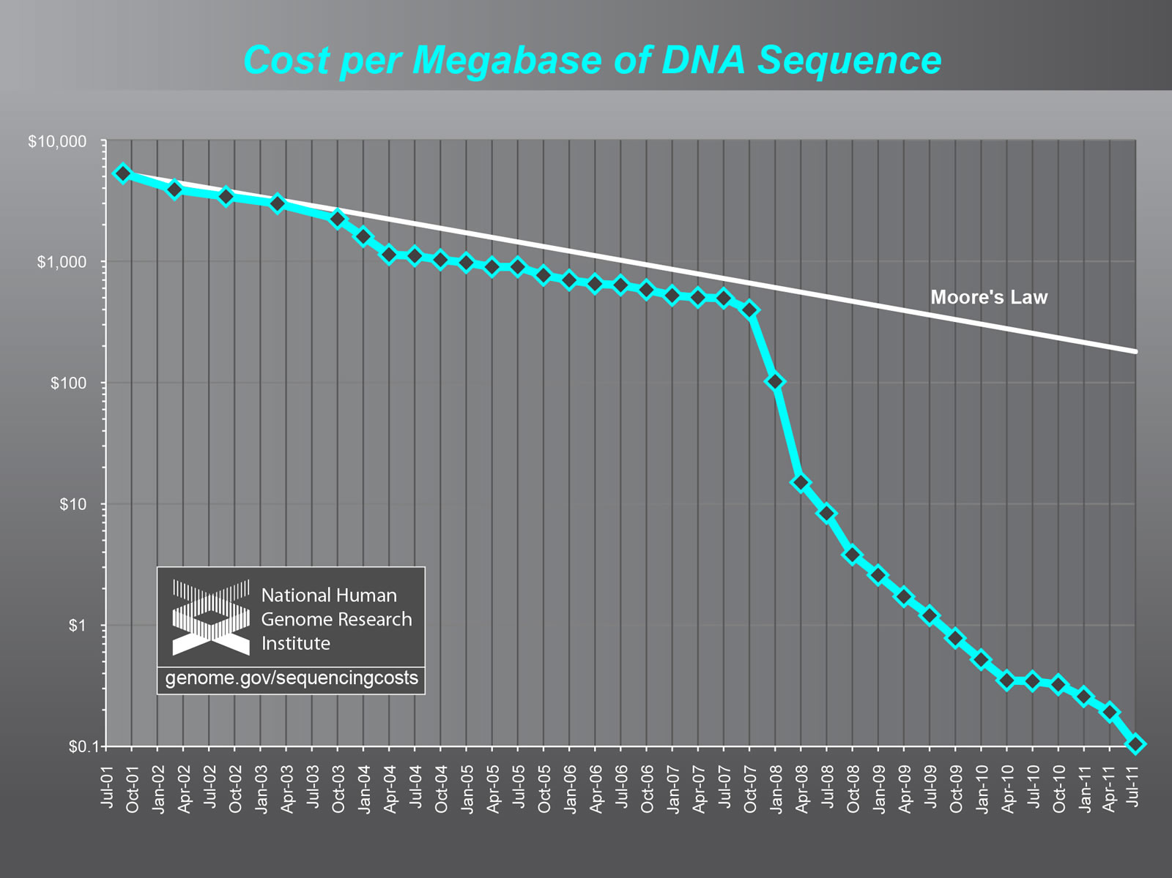

Slide 4
Outline
Discovering genomic structural variations (SV)
Personal genome
  allele-specific binding & expression
Extending SV discoveries, Ψgenes
CNVs in human iPSC and somatic variations

Slide 5
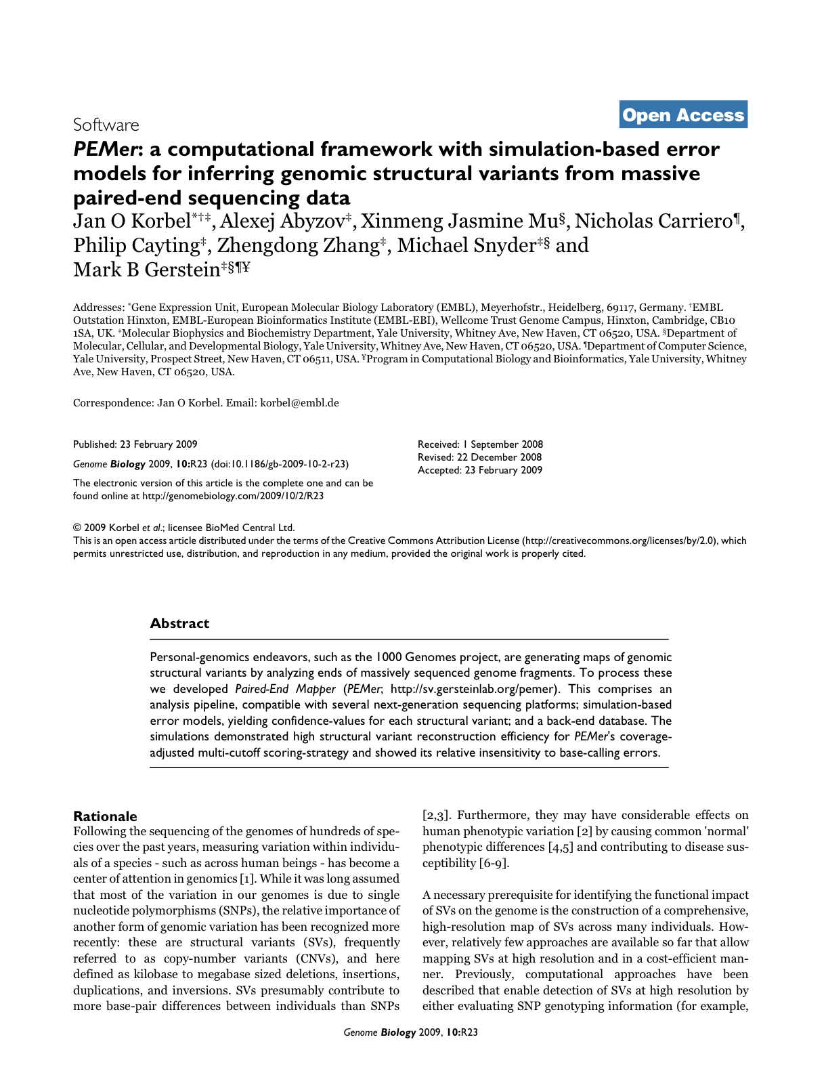
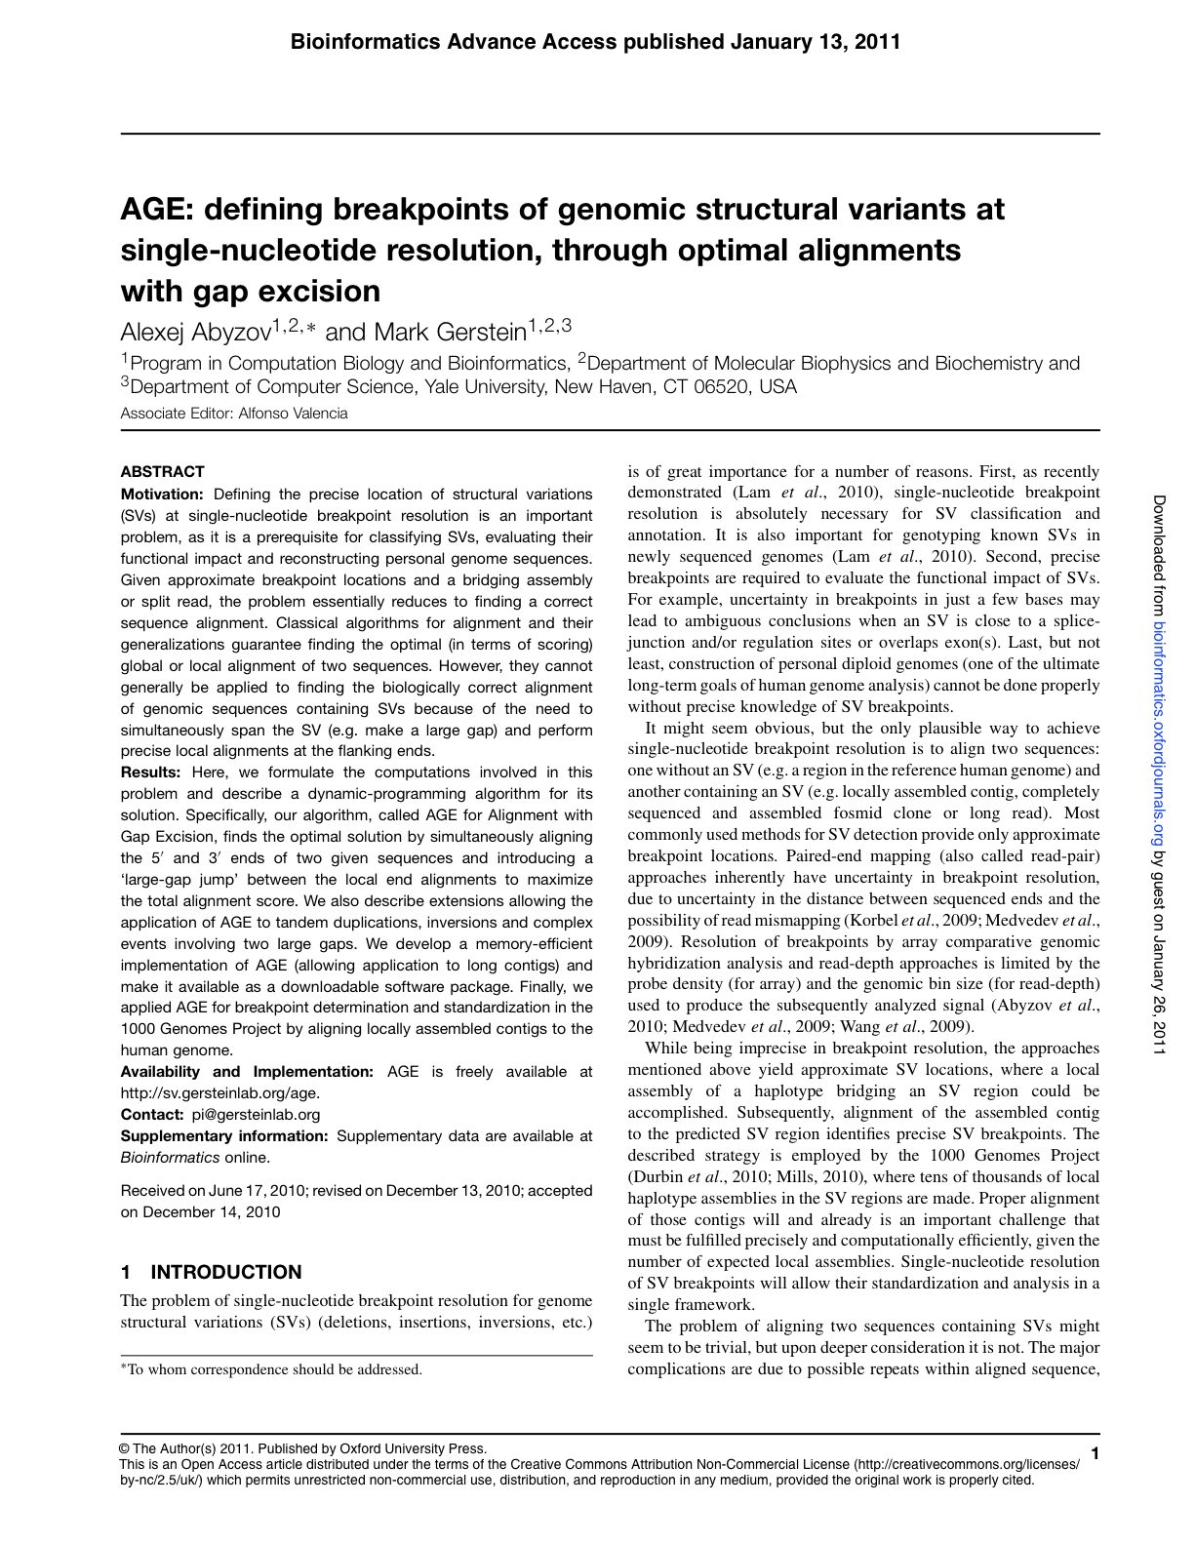
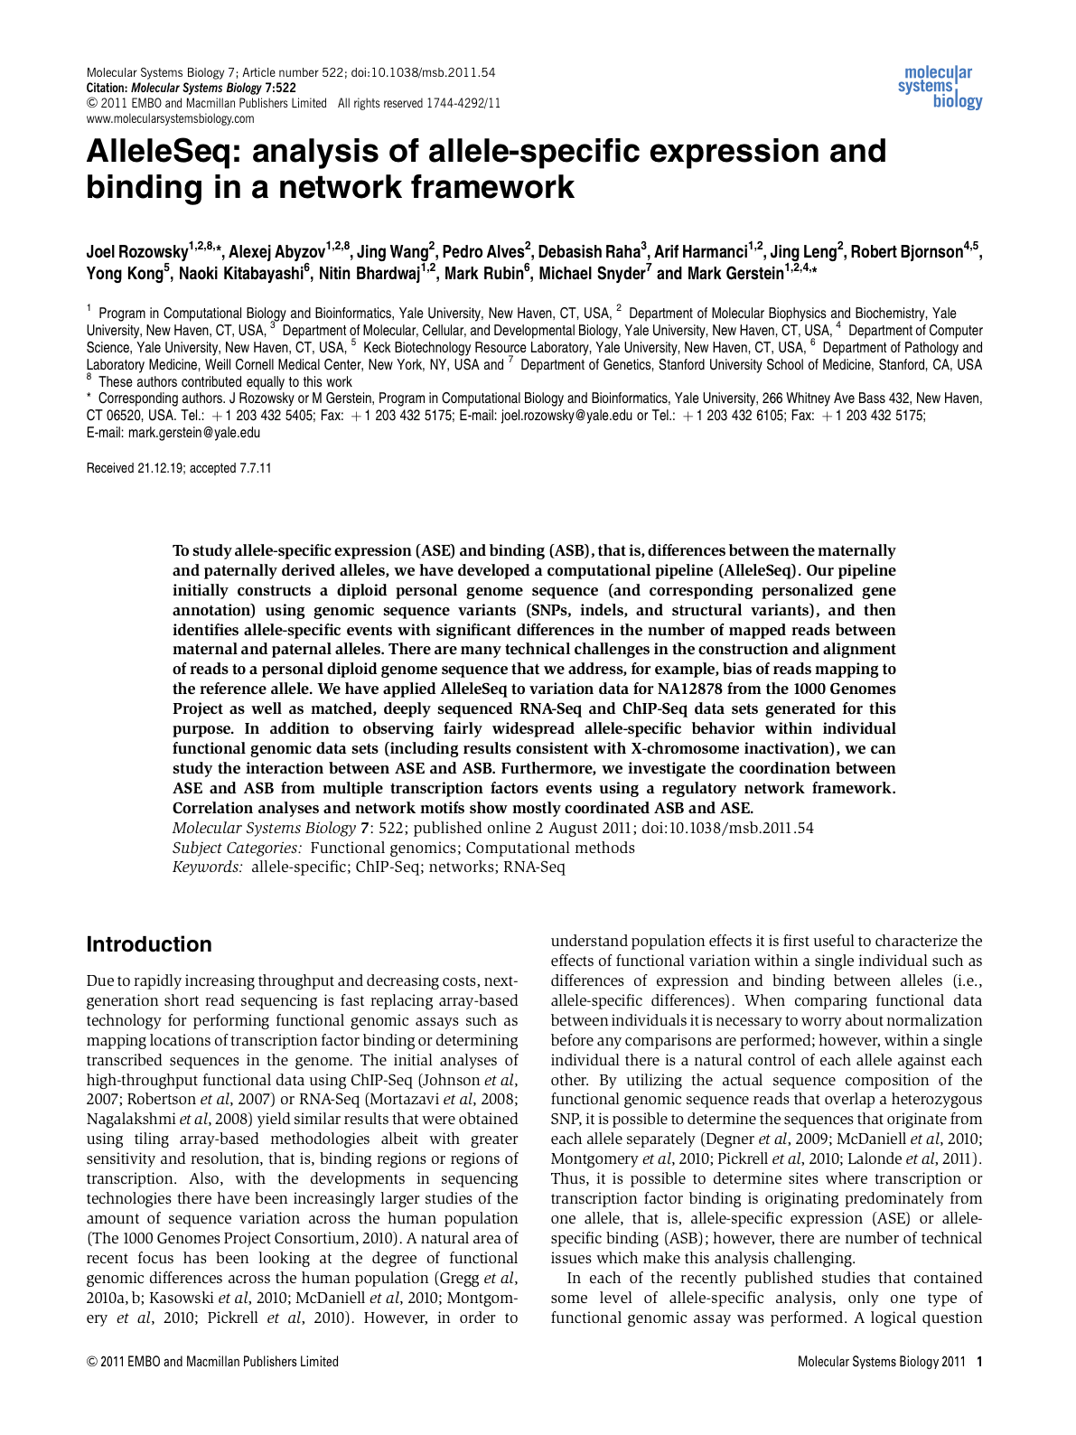
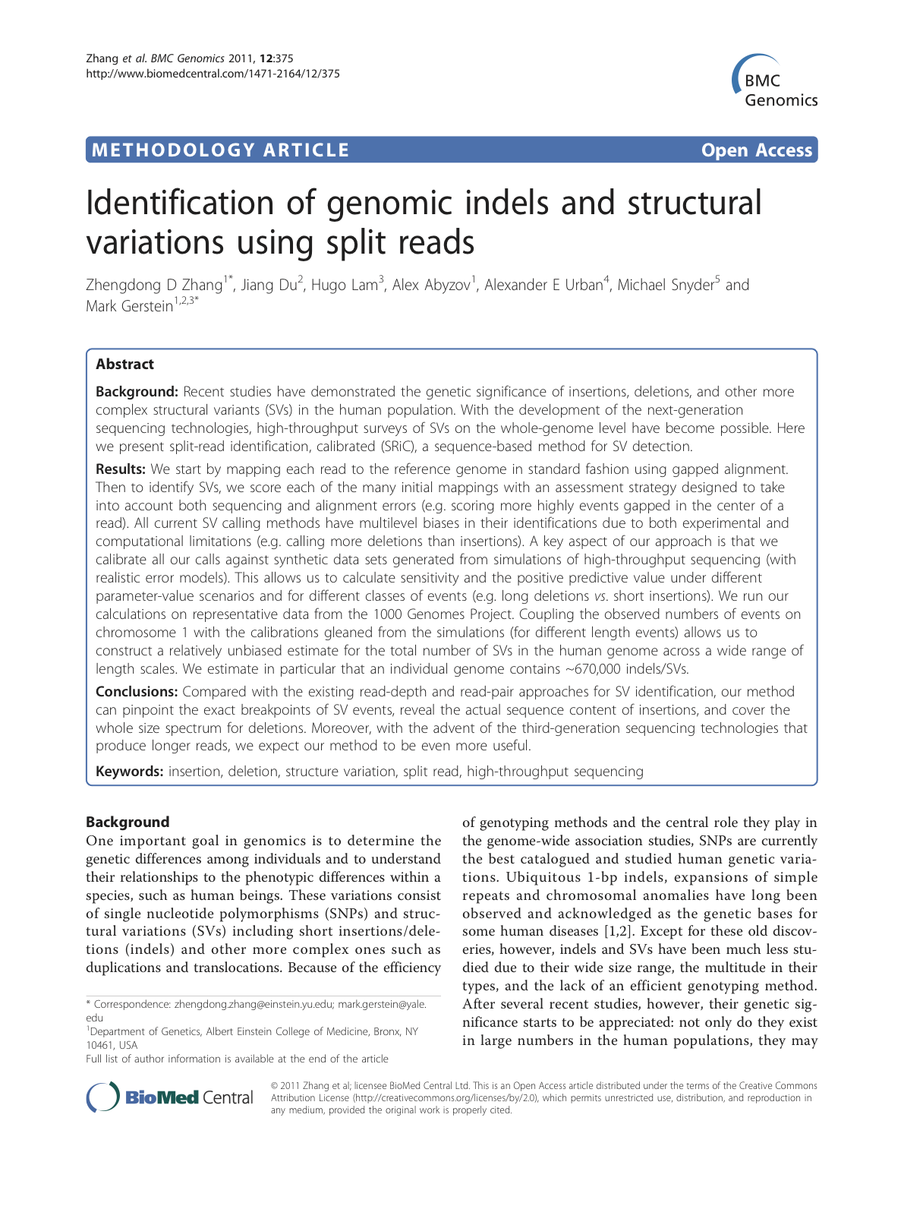
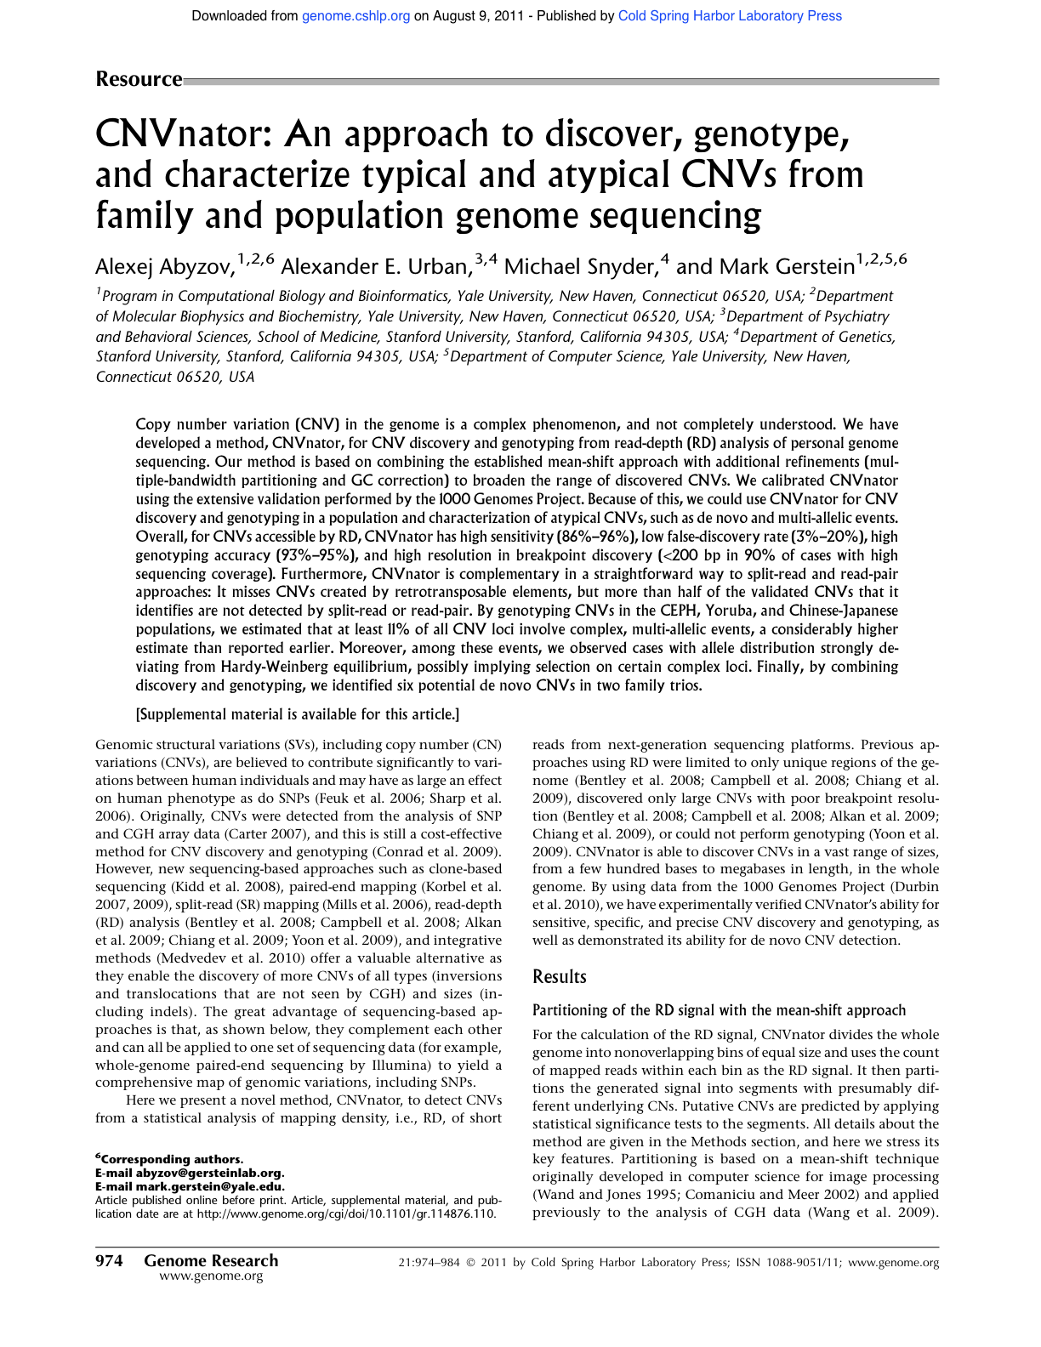
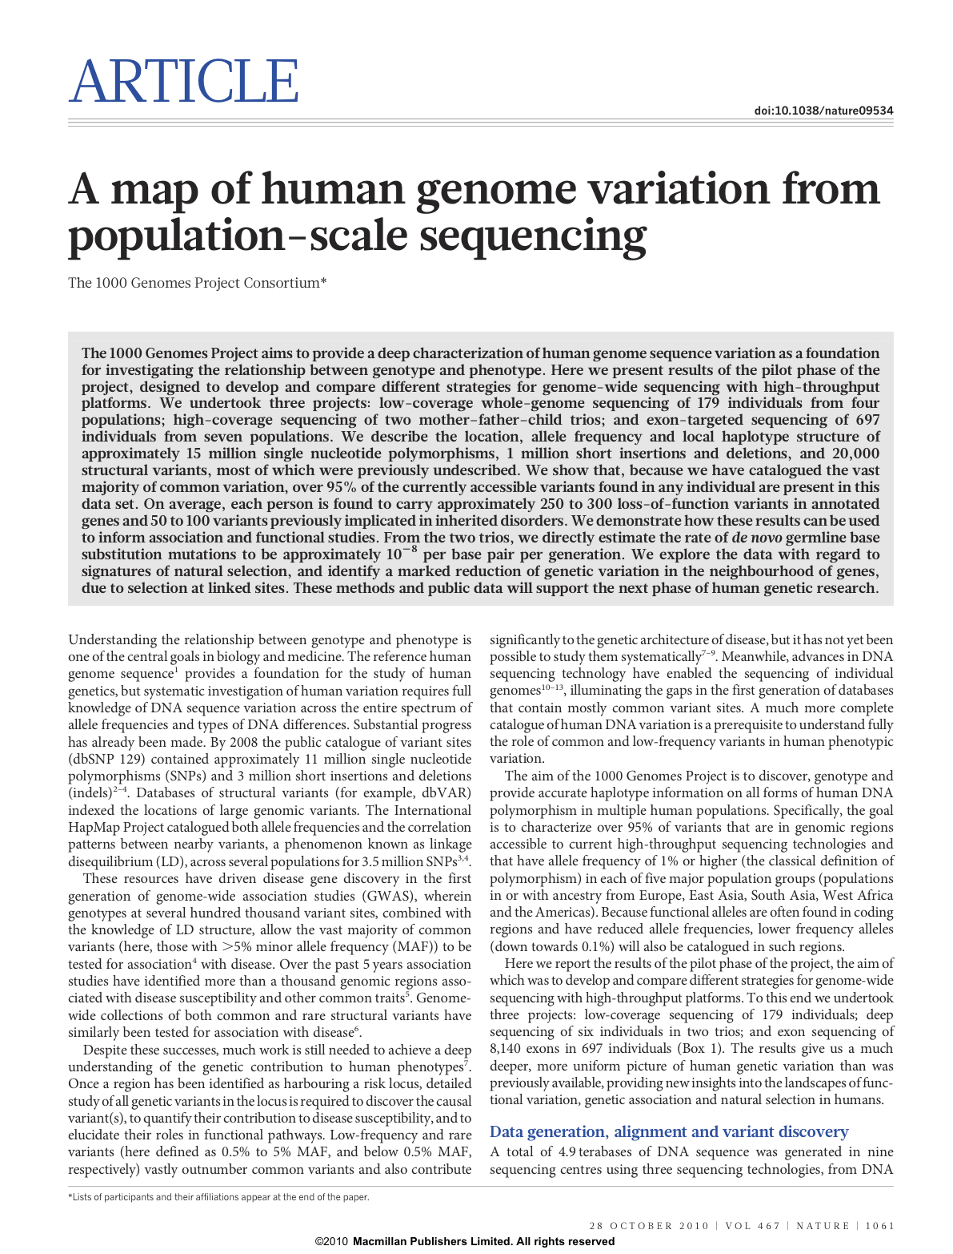
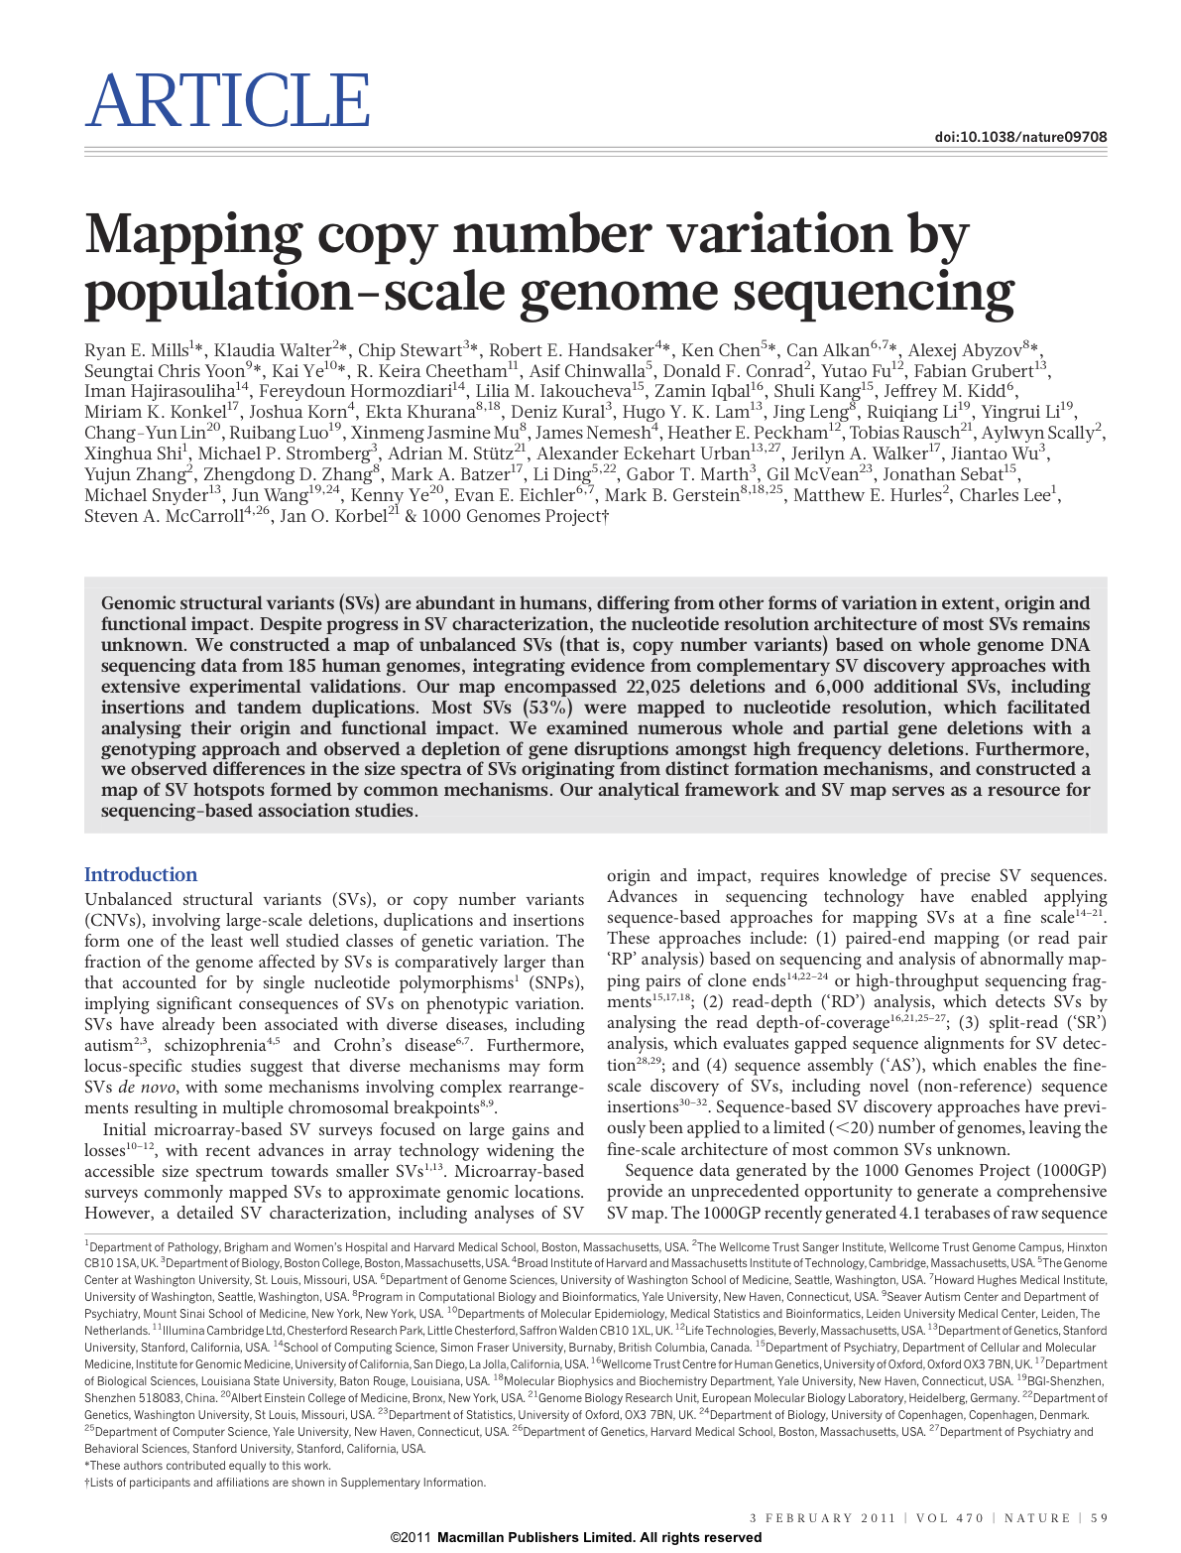

Slide 6
Outline
Discovering genomic structural variations (SV)
Personal genome
  allele-specific binding & expression
Extending SV discoveries, Ψgenes
CNVs in human iPSC and somatic variations

Slide 7

Paired-ends
Read sequencing
Studied genome
Deletion
Insertion
Tandem
duplication
Inversion
MEI
Reference genome
Read mapping
Split-read
ME
sequence
library
…
Read sequencing
Studied genome
Deletion
Insertion
Tandem
duplication
Inversion
MEI
Reference genome
Read mapping
Read-depth
Genotyping
Read sequencing
Studied genome
Deletion
Duplication
Deletion
Insertion
Reference genome
Mapped read count
Breakpoint
sequence
library
…

Slide 8
CNVnator (read depth)

Slide 9
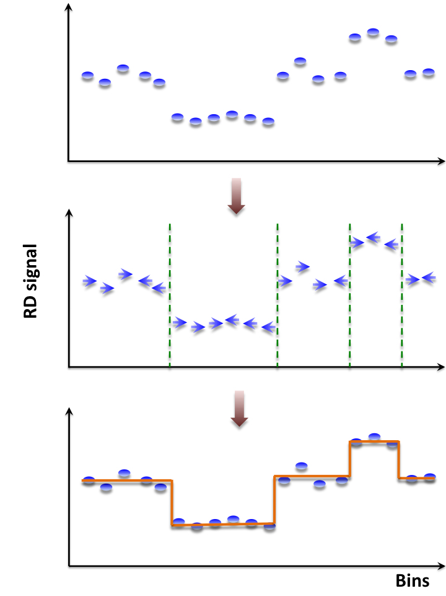
CNVnator, mean-shift approach
For each bin attraction (mean-shift) vector points the direction of bins with most similar RD signal
No prior assumptions about number, sizes, haplotype, frequency and density of CNV regions
Not model-based (e.g. like HMM)
with global optimization, distribution assumption & parameters (e.g. number of segments)
Achieves discontinuity-preserving smoothing
Derived from image-processing applications
1000 Genomes Consortium, Nature 467, 1061-1073 (2010)
Mills et al., Nature 470, 59-65 (2011) – companion article
Abyzov et al., Genome Res. 21, 974-84 (2011) – companion article

Slide 10
Example of application of CNVnator to RD data
NA12878
Solexa 36 bp paired reads
30x coverage
Abyzov et al., Genome Res. 21, 974-84 (2011)

Slide 11
Data from 1000 Genomes Project
Caucasian trio, > 20x ILLUMINA
Yoruba trio, > 20x ILLUMINA
NA12891
NA12892
NA19239
NA19238
NA12878
NA19240
+ >1000 individuals with 1-6x coverage in 14 population

Slide 12
CNVnator characteristics
High sensitivity, 86-96% (for discoverable CNVs larger than 1 kpb)
Low false-discovery rate, 3-20%
High genotyping accuracy, 93-95%
High fidelity in breakpoint resolution
Can be used for discovery of de novo and multi-allelic CNVs

Slide 13
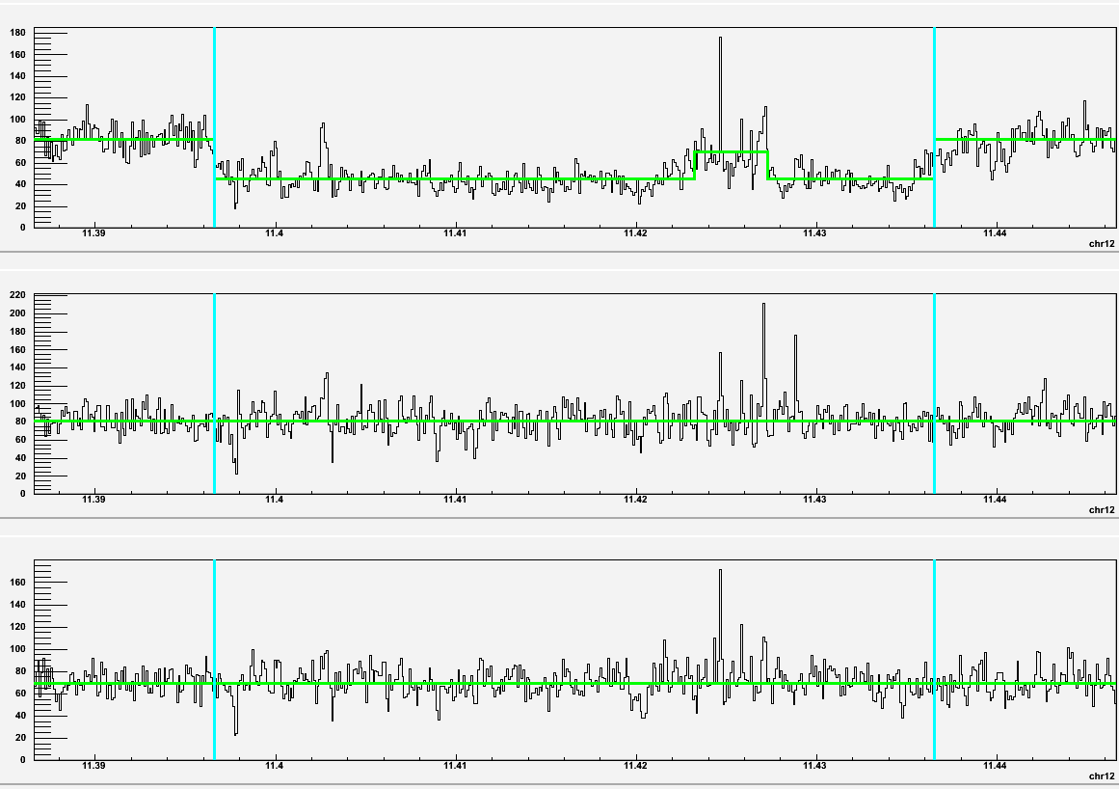
The best de novo candidate
(hg18_chr12:11396601-11436500 CEPH child)
Child
Mb
Father
Abyzov et al., Genome Res. 21, 974-84 (2011)
Mb
Mother
Mb

Slide 14
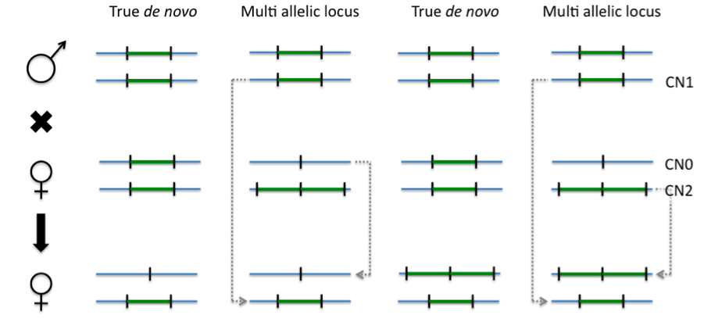
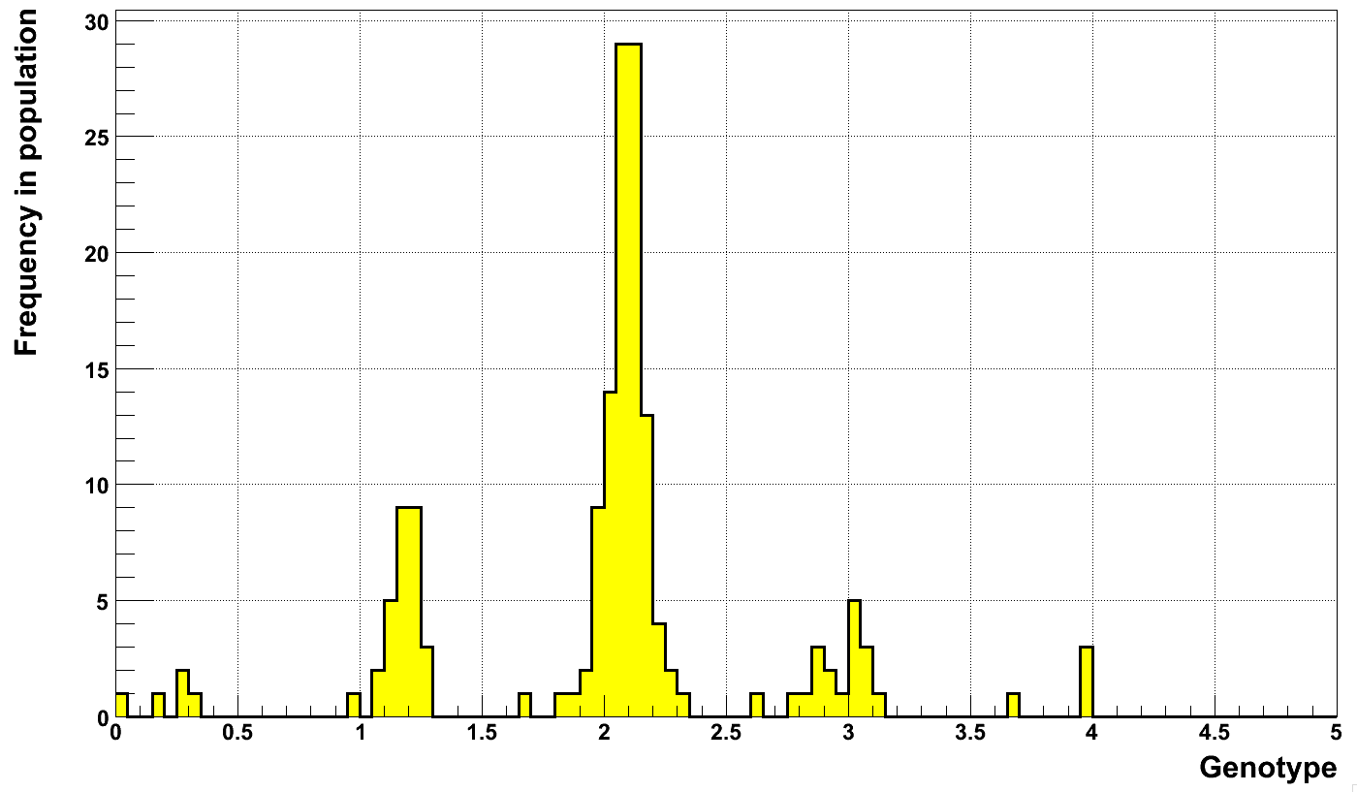
De novo CNV or multi-allelic locus?
Likely a multi-allelic locus
We estimate that >11% of CNV loci are multi-allelic
Neutral
hg18_chr12:11396601-11436500
Deletions
Duplications
Abyzov et al., Genome Res. 21, 974-84 (2011)

Slide 15
AGE (split read)

Slide 16
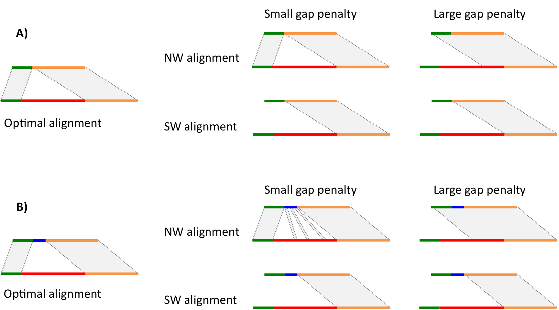
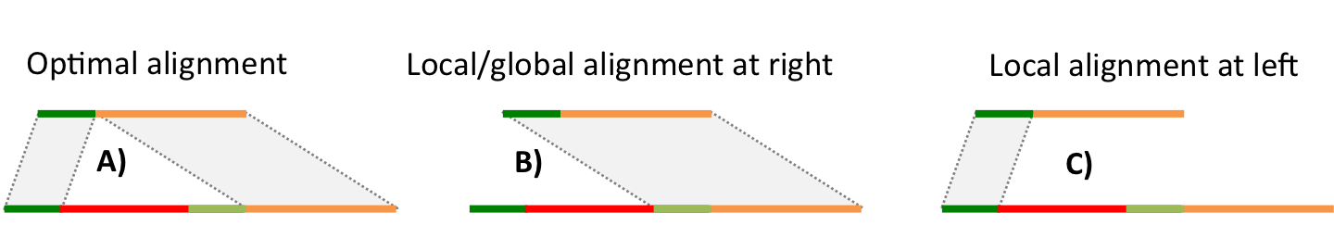
Difficulties in defining breakpoints
Abyzov et al., Bioinformatics 27, 595-603 (2011)

Slide 17
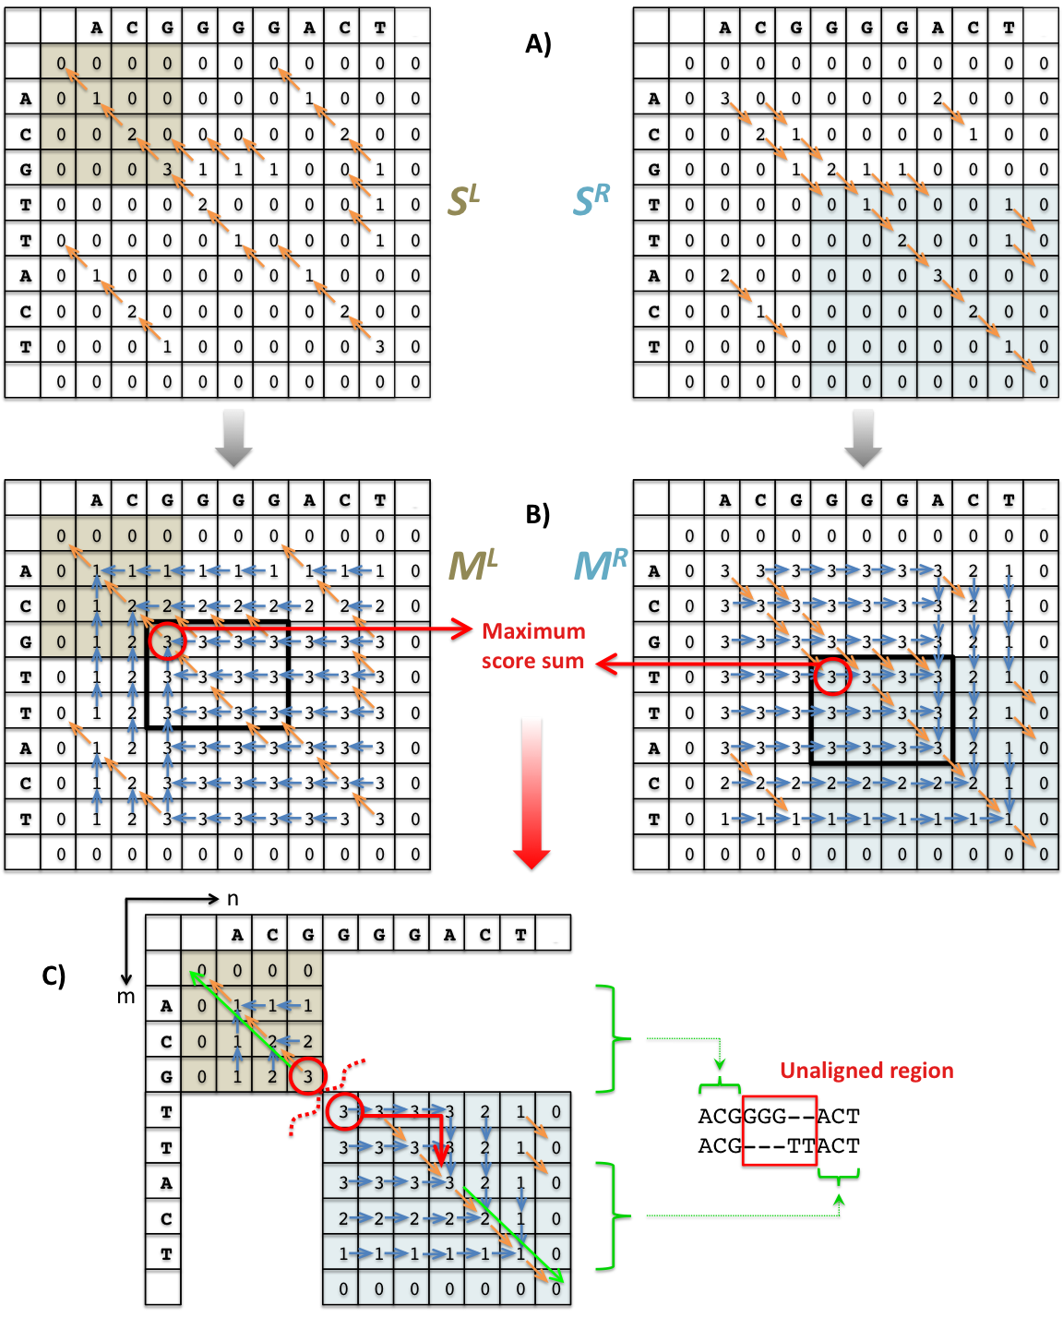
AGE
Alignment with Gap Excision
Given scoring scheme (match, mismatch, gap open, gap extend) find an optimal alignment of two sequences (i.e. with highest score) where ONE gap is NOT penalized
Abyzov et al., Bioinformatics 27, 595-603 (2011)

Slide 18
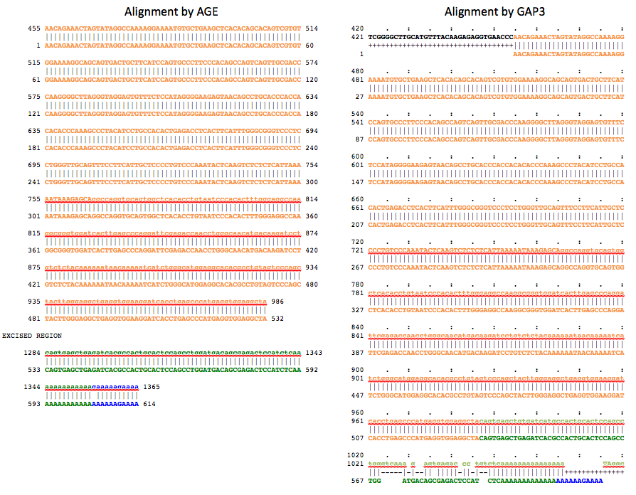
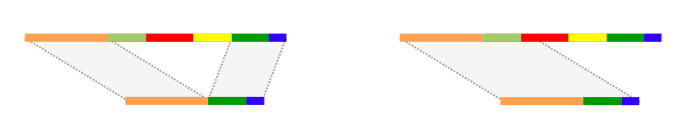
Abyzov et al., Bioinformatics 27, 595-603 (2011)

Slide 19
Outline
Discovering genomic structural variations (SV)
Personal genome
  allele-specific binding & expression
Extending SV discoveries, Ψgenes
CNVs in human iPSC and somatic variations

Slide 20
Read Pair
Read Depth
3822 (49%)
1947 (59%)
736
Split Read
Assembly
2095
21
501
30
1205 (27%)
209 (23%)
63
25
63
0
495
36
1000 Genome Project
(pilot phase)
Mills et al., Nature 470, 59-65 (2011)

Slide 21
Rozowsky et al., Mol Syst Biol. 7, 522 (2011)
ENCODE consortium, Nature (submitted)
Gerstein at al., Nature (submitted) – companion article
Notes:
Construction of personal genome by vcf2diplod tool is made by incorporating personal variants into the reference genome. Personal variants may require addition pre-processing, i.e., filtering, genotyping, and/or phasing. The output is the two (paternal and maternal) haplotypes of personal genome. During the construction step the reference genome is represented as an array of nucleotides with each cell representing a single base. Iteratively the nucleotides in the array are being modified to reflect personal variations. Once all variation have been applied a personal haplotype is constructed by reading though the array. Simultaneously, equivalence map (MAP-file) between personal haplotypes and reference genome is being constructed. Used by ENCODE consortium for analysis.

Slide 22
Allele-specific binding & expression

Slide 23
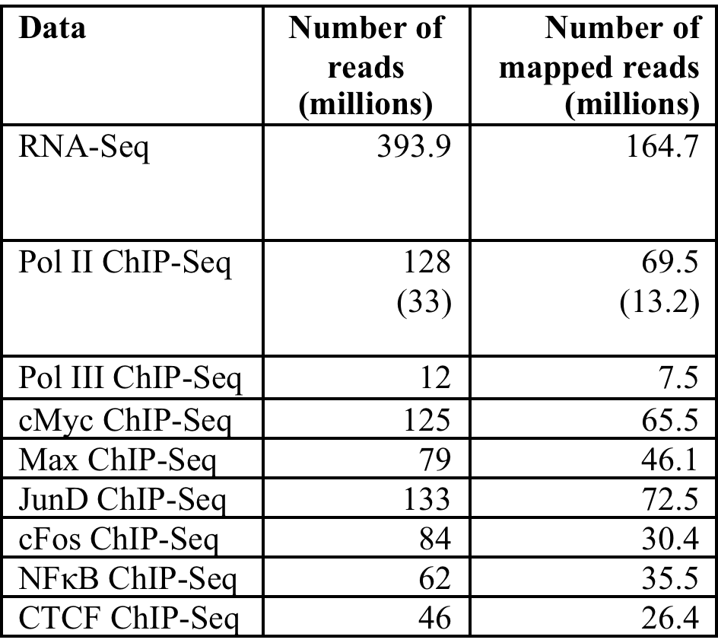
Data Sets Used
NA12878 is the immortalized lymphoblastoid cell-line, the daughter in deeply sequenced by 1000 Genomes Project trio
Rozowsky et al., Mol Syst Biol. 7, 522 (2011)

Slide 24
Reference Bias Revisited
Assessing Reference Bias for GM12878 RNA-Seq data using
Naïve reference mapping vs NA12878 mapping
Rozowsky et al., Mol Syst Biol. 7, 522 (2011)

Slide 25
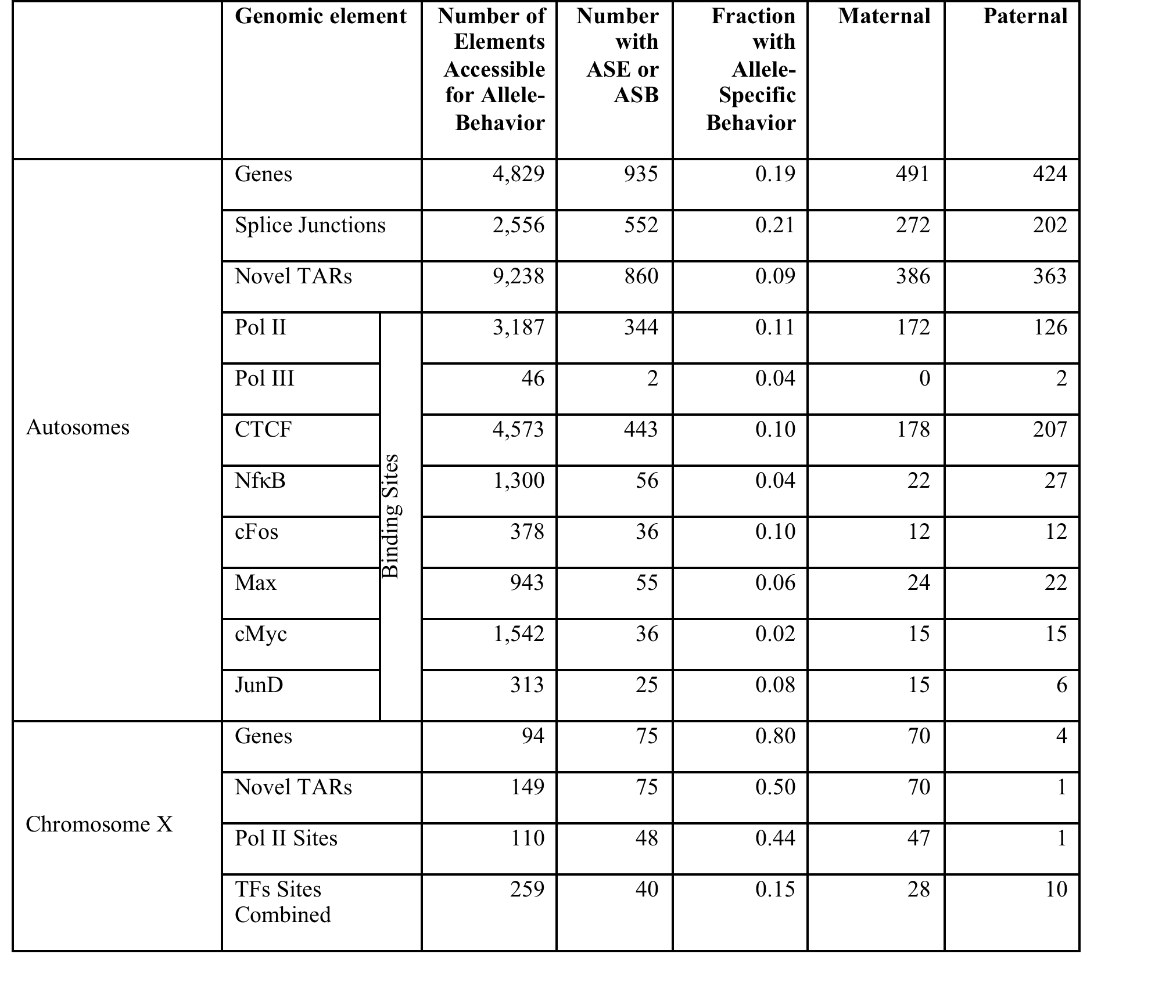
Allele-Specific Expression & Binding
~20% sites show ASE,
~10% show ASB;
equal betw. M & P,
except on X
Rozowsky et al., Mol Syst Biol. 7, 522 (2011)

Slide 26
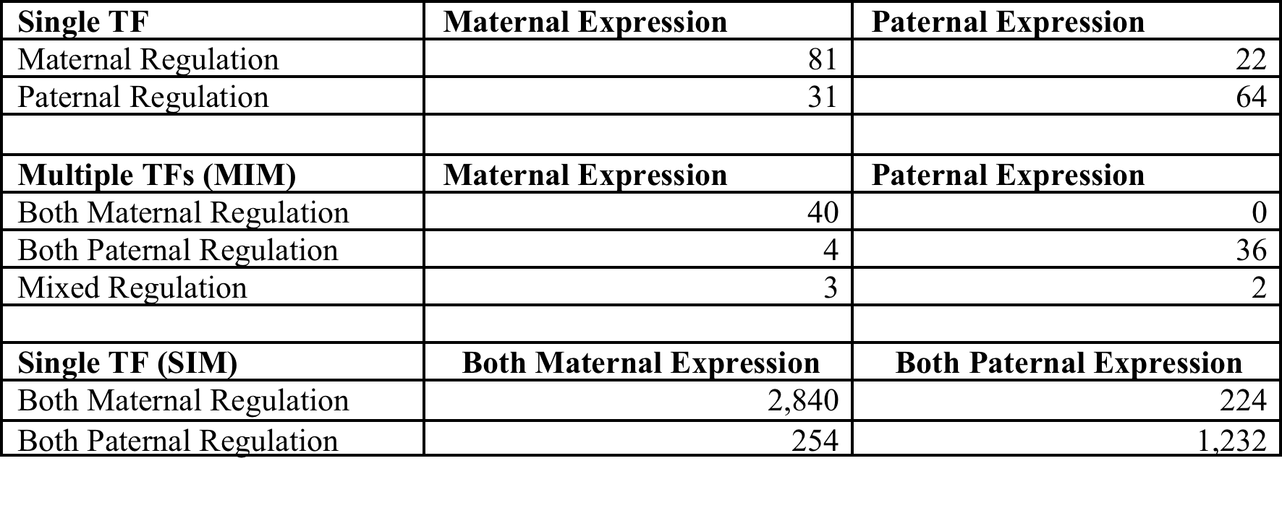
Allele-Specific Regulatory Network: coordination of ASE & ASB
Rozowsky et al., Mol Syst Biol. 7, 522 (2011)

Slide 27
Outline
Discovering genomic structural variations (SV)
Personal genome
  allele-specific binding & expression
Extending SV discoveries, Ψgenes
CNVs in human iPSC and somatic variations

Slide 28
Paired-ends
Read sequencing
Studied genome
Deletion
Insertion
Tandem
duplication
Inversion
MEI
Reference genome
Read mapping
Mobile
element
sequence
library
Split-read
…
Read sequencing
Studied genome
Deletion
Insertion
Tandem
duplication
Inversion
MEI
Processed Ψgenes
Reference genome
Read mapping
Read-depth
Genotyping
Read sequencing
Studied genome
Deletion
Duplication
Deletion
Insertion
Reference genome
Mapped read count
Breakpoint
sequence
library
…

Slide 29
Ψgenes
In collaborative with Charles Lee’s lab (Harvard Medical School)

Slide 30
What is processed Ψgene
Gene
Remote allele
Genome
mRNA
Genome
Gene
Ψgene
Notes:
Most of Ψgenes are processed

Slide 31
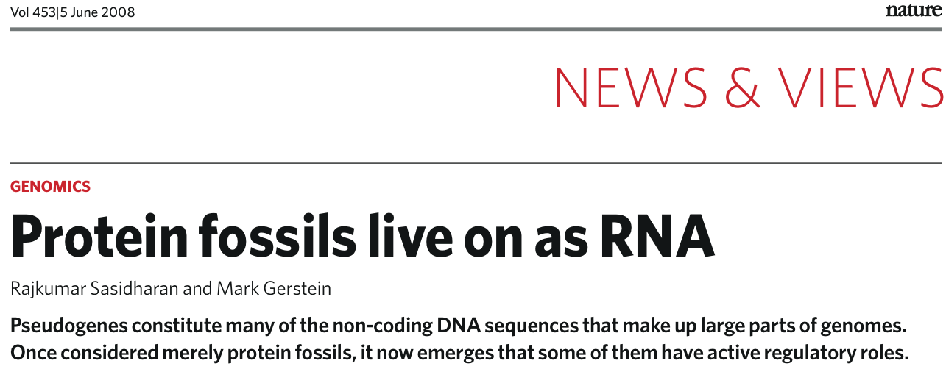
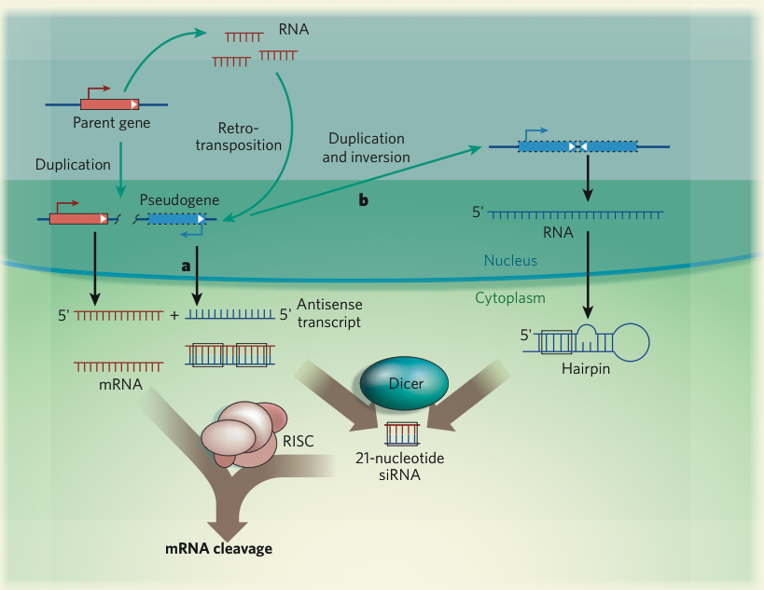

Slide 32
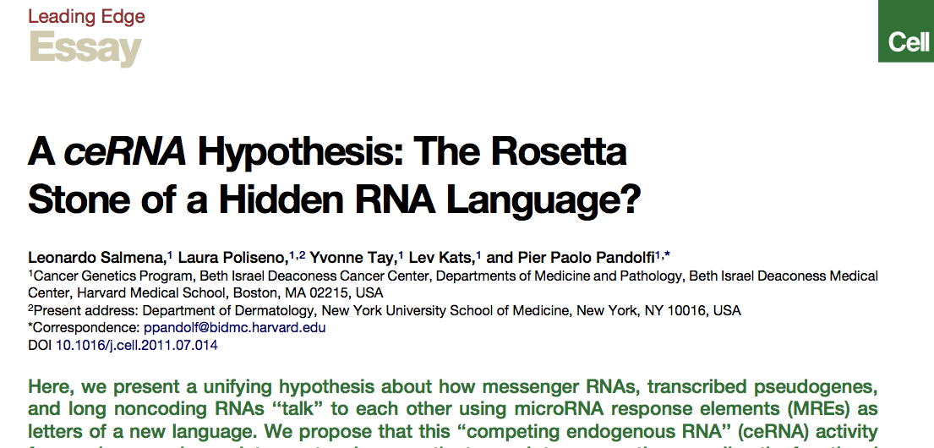

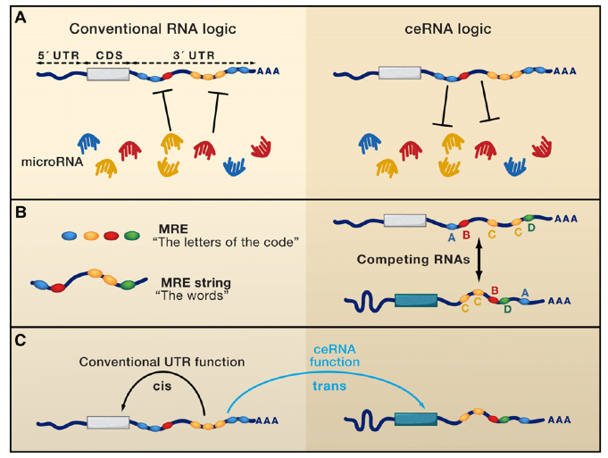

Slide 33
Variability in Ψgenes
Gene
Ψgene
Reference
Person 1
Known Ψgene
Person 2
Person 3
. . .
Reference
Person 1
Person 2
Unknown Ψgene
Person 3
. . .
Notes:
Most of Ψgenes are processed

Slide 34
Approaches
Gene
Unknown Ψgene
Person
( )
( )
( )
Splice junction
library
Unique sequences
Bowtie mapping
Genomic not mapped reads
Gene
Unknown Ψgene
Read sequencing
…
Person
Reference
…
Read mapping
Cluster
Notes:
Focus on splice-junction, find additional support from insertion point.

Slide 35
Empirical null model
Gene model
Shift
Null model
Normal
splice-junction
library
Null
splice-junction
library
Bowtie mapping
Bowtie mapping
Not mapped reads
Not mapped reads
Gene structure is preserved but coordinates are shifted
Aim at < 5% of false discovery rate

Slide 36
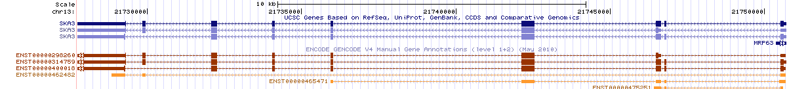
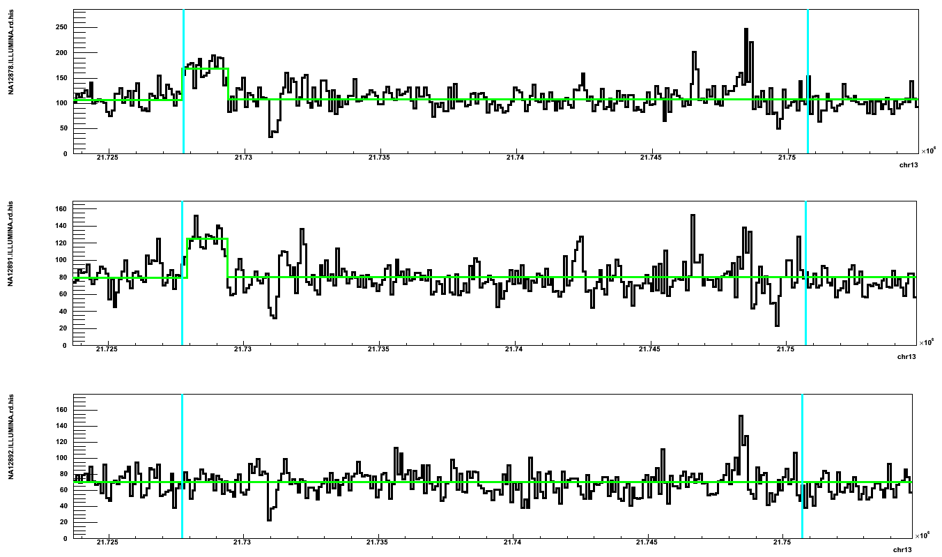
Predicting a Ψgene for SKA3 gene
Mother Father Daughter

Slide 37
Data from 1000 Genomes Project
Caucasian trio, > 20x ILLUMINA
Yoruba trio, > 20x ILLUMINA
NA12891
NA12892
NA19239
NA19238
NA12878
NA19240
+ >1000 individuals with 1-6x coverage in 14 population

Slide 38
Discovery in NA12878 (CEU)
Parent gene predicted to have an unknown Ψgene from mapping to splice-junctions | Additional support |  |  | PCR validation (preliminary)
 | Read depth support | Insertion point support | Found in Venter genome
CDC27 | Yes |  |  | N/A
BCLAF1 | Yes |  | Yes | No
LAPTM4B | Yes |  |  | N/A
MTCH2 |  |  |  | Yes
CBX3 | Yes | Yes | Yes | Yes
TMEM66 | Yes |  |  | Yes
TDG | Yes | Yes | Yes | Yes
BOD1 |  |  |  | Inconclusive
CACNA1B |  | Yes |  | Inconclusive
SKA3 | Yes | Yes |  | Yes
AP3S1 | Yes |  | Yes | No
AC131157.1 |  |  |  | N/A
AL590623.1 | Centromere

Slide 39
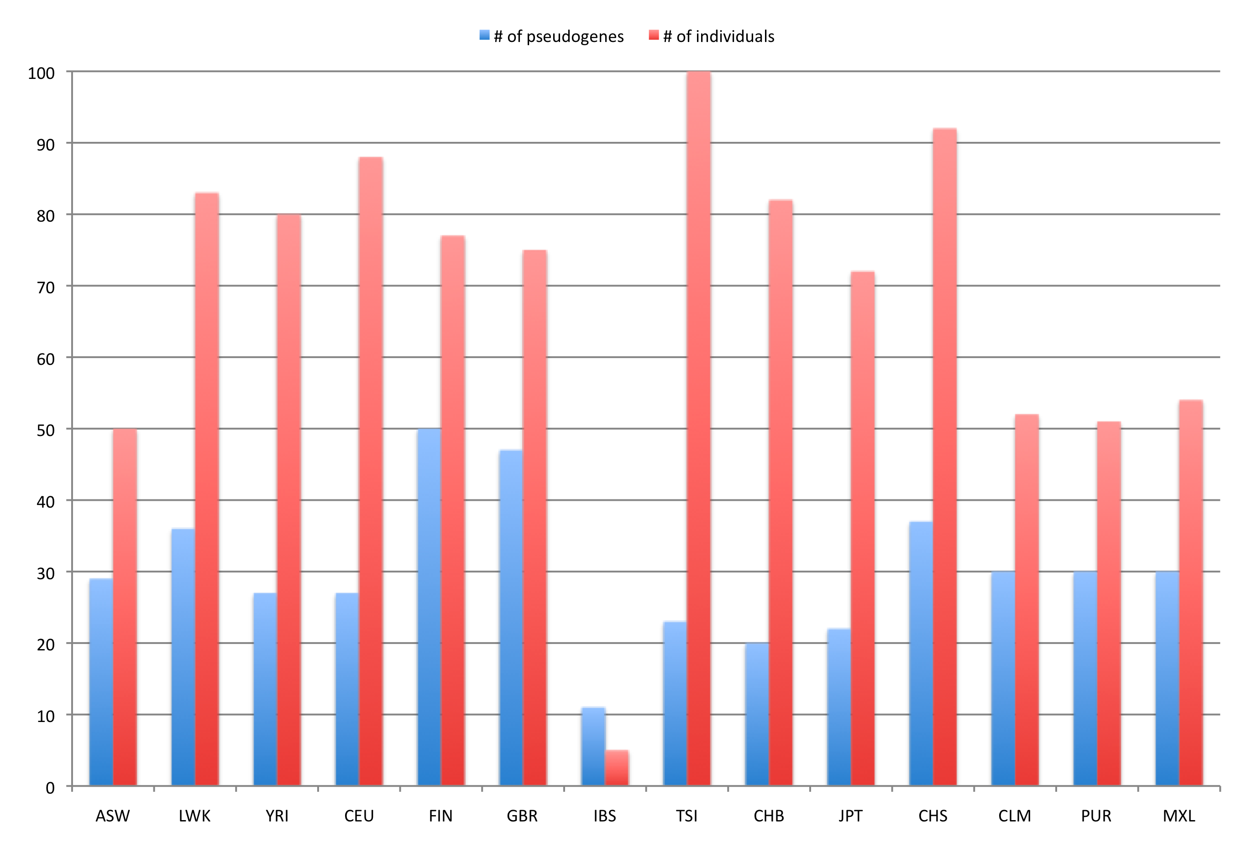
Ψgenes by population

Slide 40
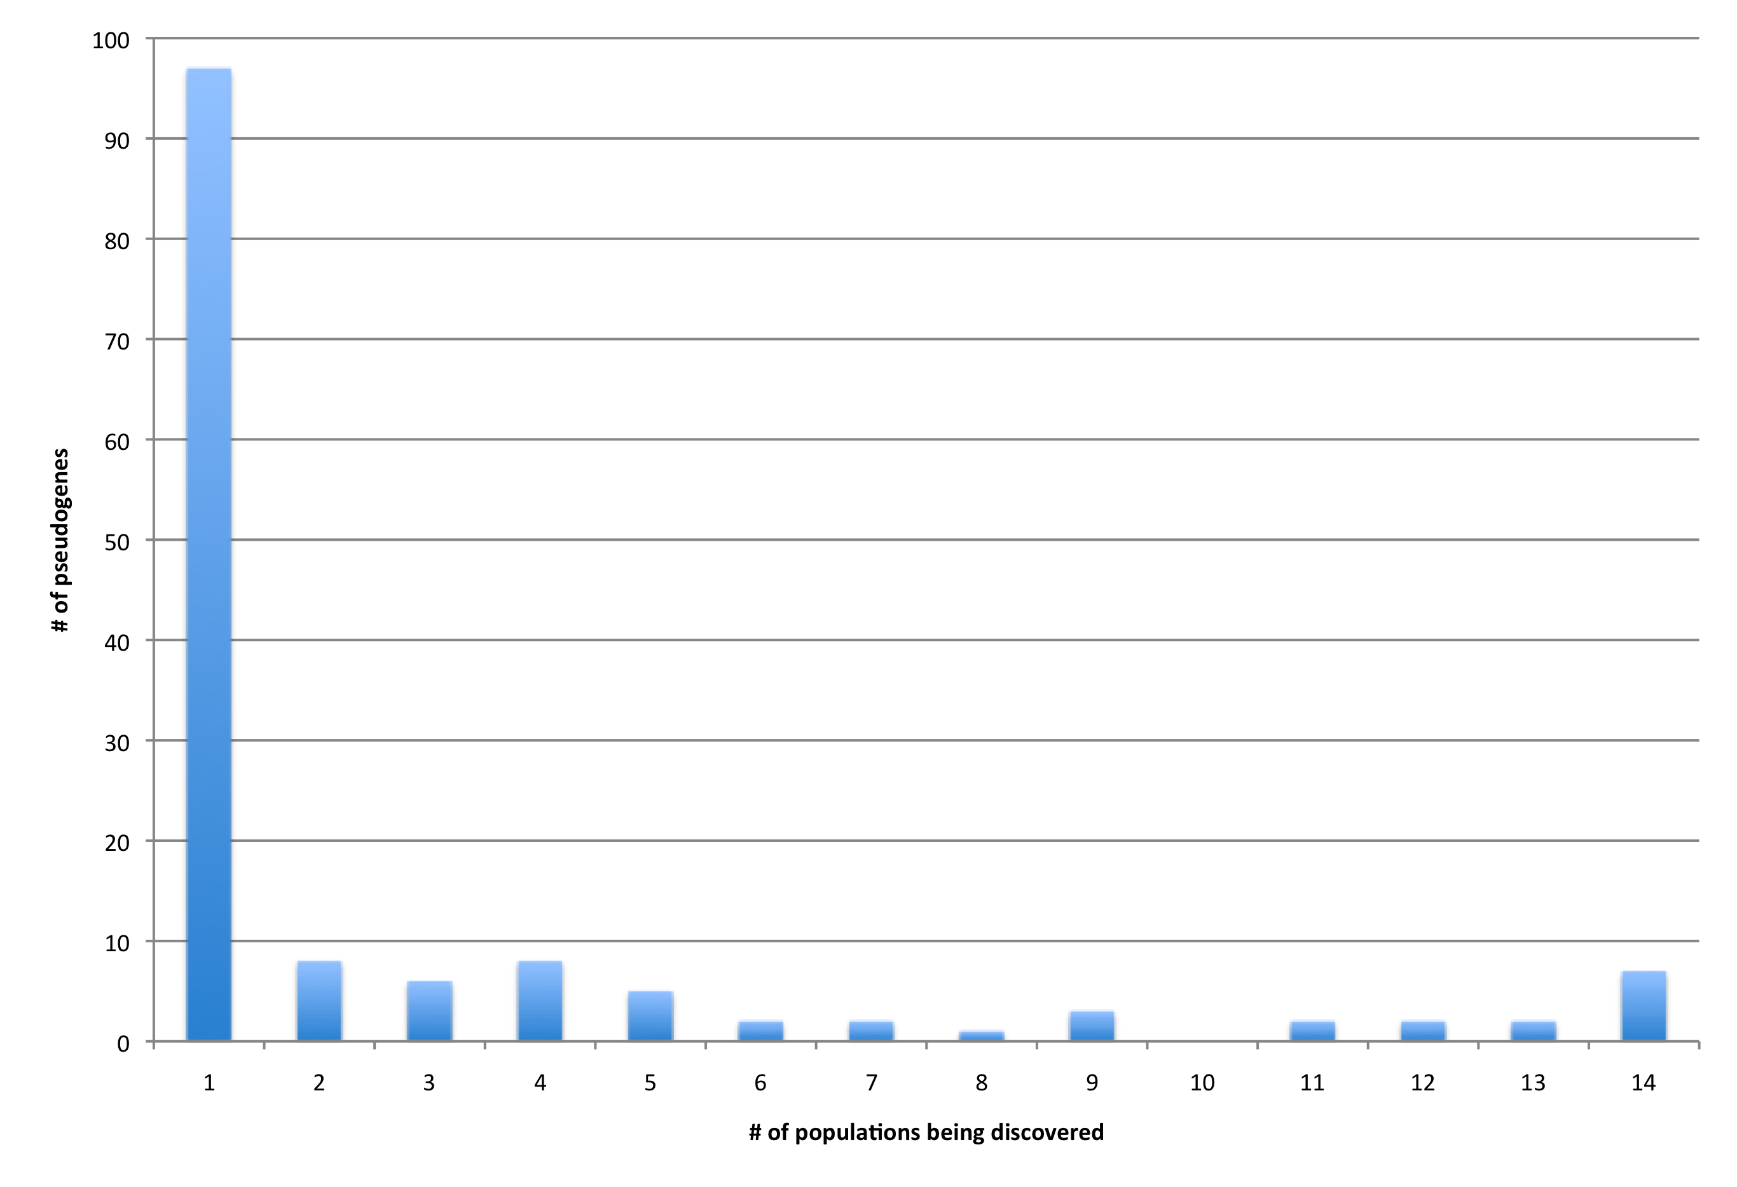
Frequency by populations
Total of 145 of parent genes
are predicted to have
unknown Ψgenes
# of parent genes with a Ψgene

Slide 41
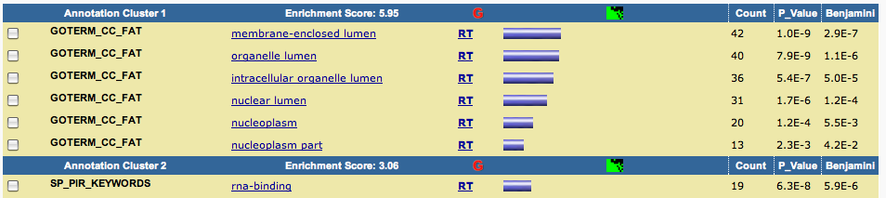
GO enrichment
All populations
Hypothesis: pseudogenization happens at the end of M phase beginning of G0/G1 phase

Slide 42
Outline
Discovering genomic structural variations (SV)
Personal genome
  allele-specific binding & expression
Extending SV discoveries, Ψgenes
CNVs in human iPSC and somatic variations
  In collaboration with Flora Vaccarino’s lab (Yale University School of Medicine)

Slide 43
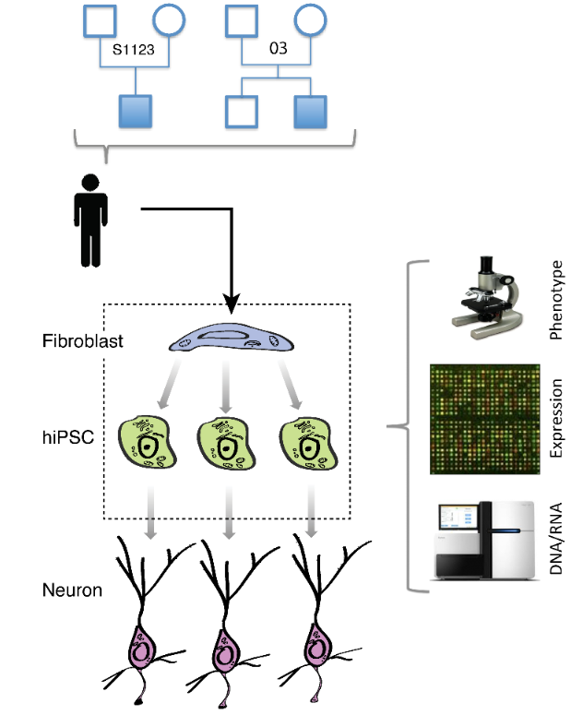
Experimental design and goal
Few previous studies reported large number of de novo CNVs in hiPSC
Is hiPSC genome stable during reprogramming?
What is the cause/origin of hPSC line-manifested CNVs (LM-CNVs)?
Abyzov et al. (submitted)

Slide 44
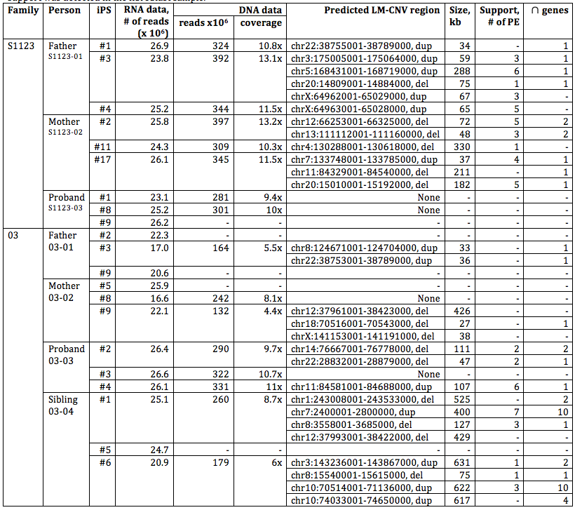
28 qPCR validated line manifested CNVs in 16 hiPSC
Abyzov et al. (submitted)

Slide 45
Example of LM-CNV
Gene in duplication has increased expression
Abyzov et al. (submitted)

Slide 46
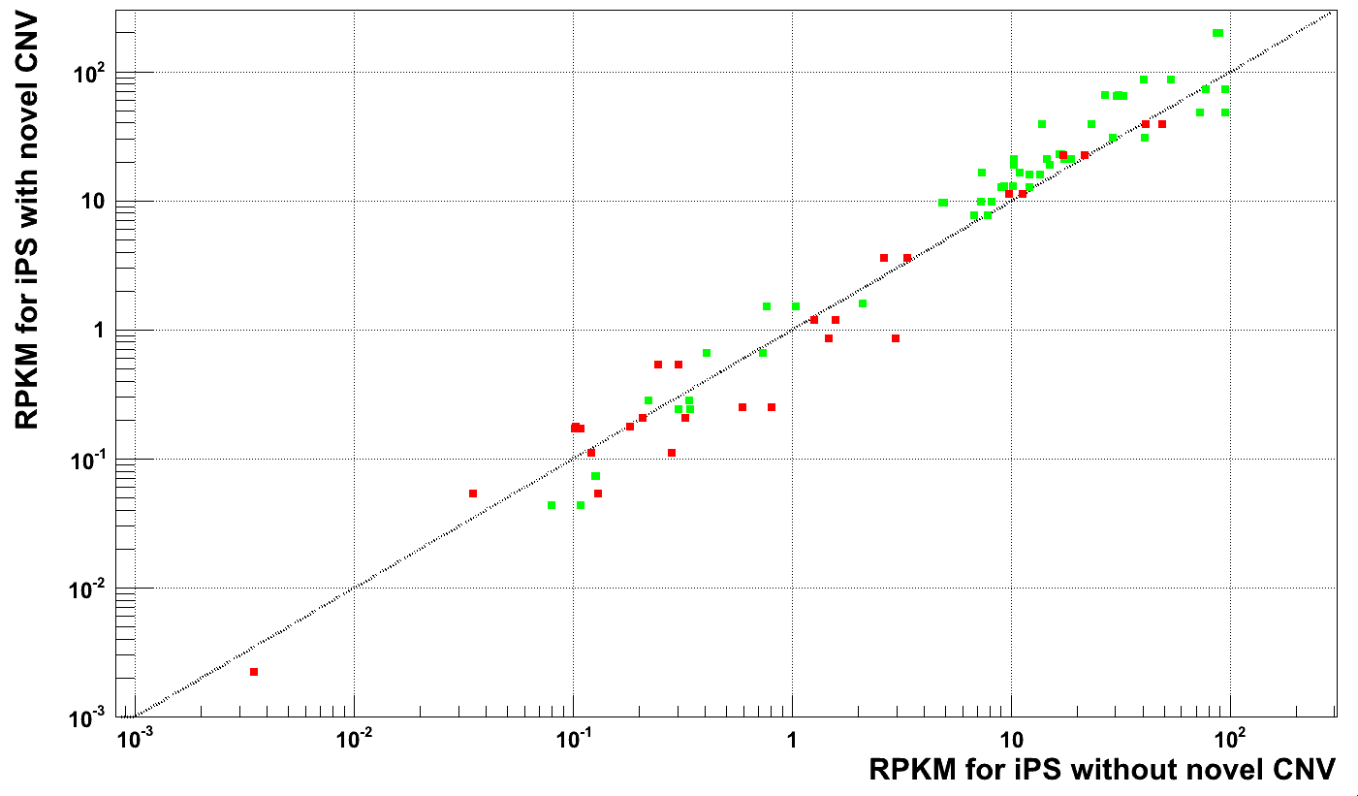
Gene expression is coupled to copy number
Genes in duplications
Genes in deletions
RPKM for hiPSC with LM-CNV
Fischer’s exact test
p-value = 0.02
RPKM in hiPSC without LM-CNV
Abyzov et al. (submitted)

Slide 47
What is the origin of LM-CNVs?

Slide 48
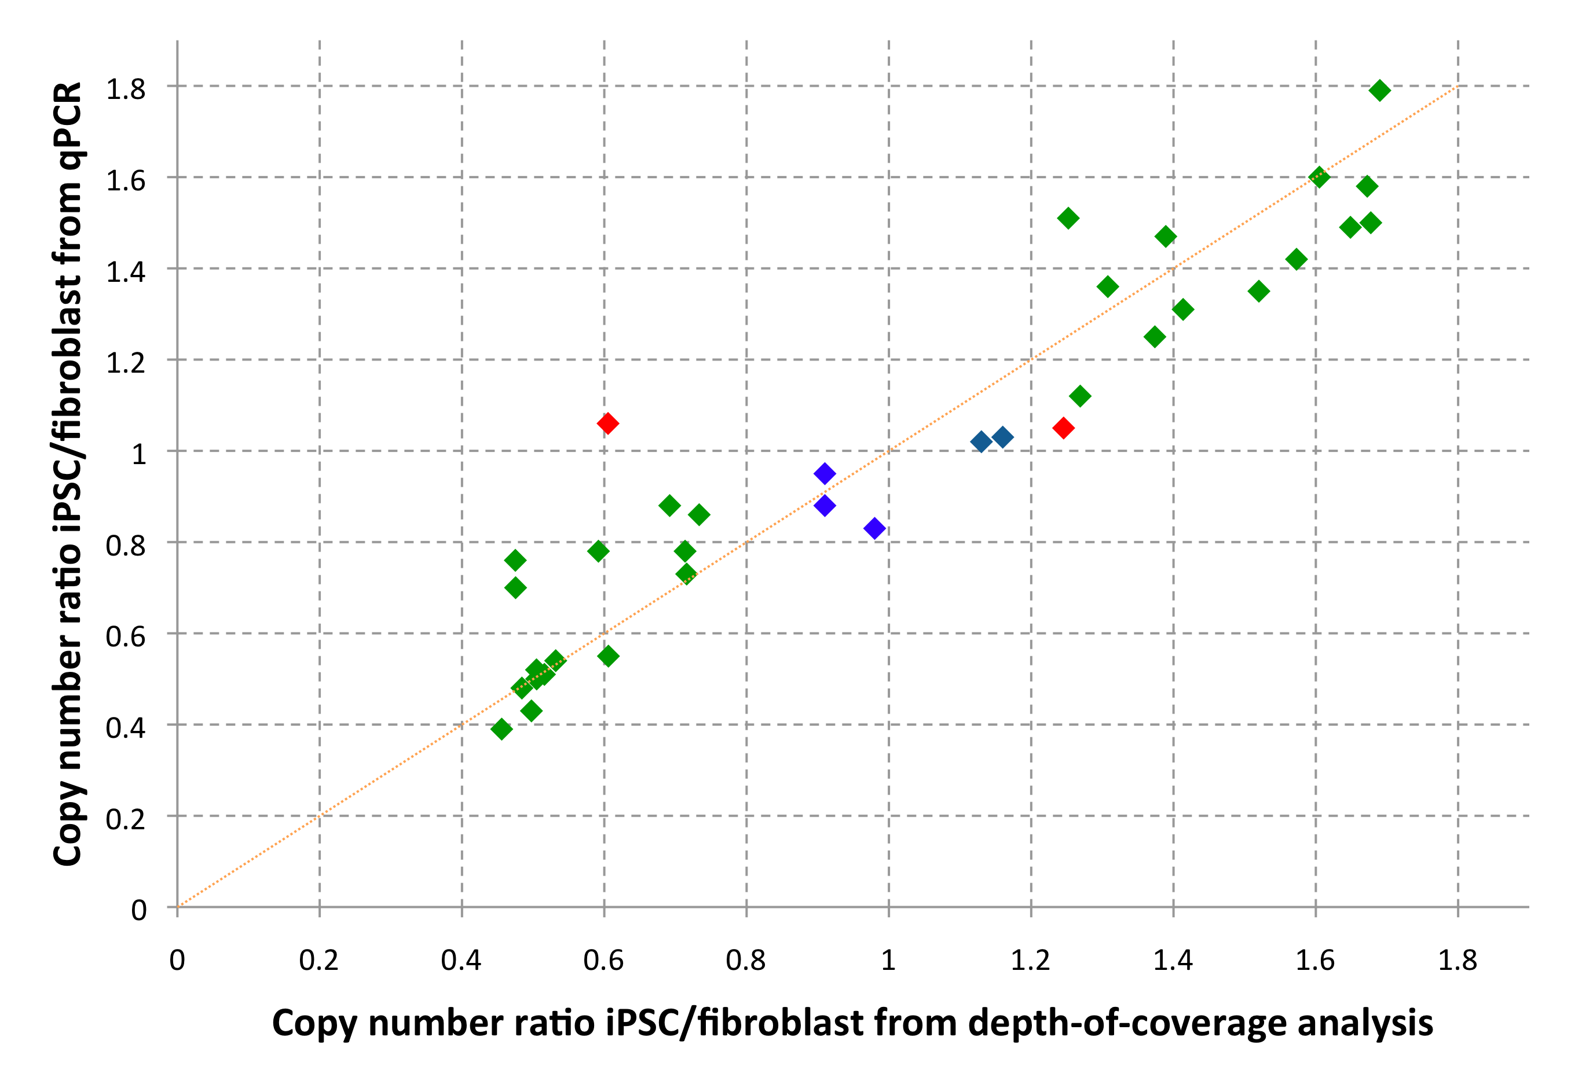
qPCR results
Person correlation 0.96
Validated
Invalidated
Negative control
Expected outcome for
homogeneous cell populations in
fibroblast and hiPSC
Abyzov et al. (submitted)

Slide 49
28 qPCR validated de novo CNVs in 16 hiPSC
Abyzov et al. (submitted)

Slide 50
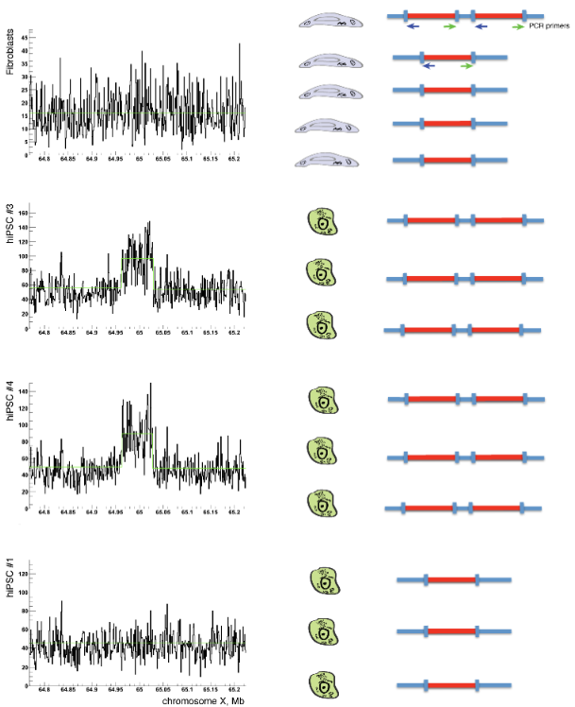


Hypothesis about somatic CNVs
1) Somatic CNVs present in few fibroblast cells (i.e., at low allele frequency) give rise to hiPSC
2) hiPSC colonies are derived from a single (just a few) fibroblast cell
Excess of DNA input from fibroblast
hiPSC #3 hiPSC #4 Fibroblast Control
Equal DNA input
hiPSC #3 hiPSC #4 Fibroblast Control
8 (53%) out of 15 CNVs tested are present in fibroblast
Abyzov et al. (submitted)

Slide 51
This suggests
50%-86% of LM-CNVs were somatic CNVs in fibroblast
38% of fibroblast cells carrying somatic CNVs (6 out of 16 hiPSC have somatic fibroblast CNVs)
Abyzov et al. (submitted)

Slide 52
What is personal genome?
…
…
…
Completeness
>95%
~50%
~25%
~0%

Slide 53
Acknowledgements
Gerstein lab, all and in particular:
Mark Gerstein
Ekta Khurana
Jan Korbel, EMBL
Xinmeng (Jasmine) Mu
Jing (Jane) Leng
Joel Rozowsky
Zhengdong Zhang, AECOM
Michael Wilson
Jing (Crystal) Wang
Mihali Felipe
Lukas Habegger
Pedro Alves
Arif Harmanci
Nitin Bhardwaj, BASF
Jiang Du, JP Morgan
Hugo Lam, Personalis
Philip Cayting, Stanford
Harvard Medical School:
Rebecca Iskow-Torene
Omer Gokcumen
Ryan Mills, UMich
Charles Lee
Yale university:
Dean Palejev
Lior Rosenberg Bellmaker
Ying Zhang
Jessica Mariani
Livia Tomasini
Anthony Ferrandino
Anna Szekely
Elena L. Grigorenko
Anita Huttner
Sherman Weissman
Flora M. Vaccarino
Rob Bjornson
Nicholas Carriero
Yong Kong
Stanford university:
Michael Snyder
Alexander Eckehart Urban
Michael Seamus Haney
Also
Chris Yoon, MSSM
Jonathan Sebat, UCSD

Slide 55
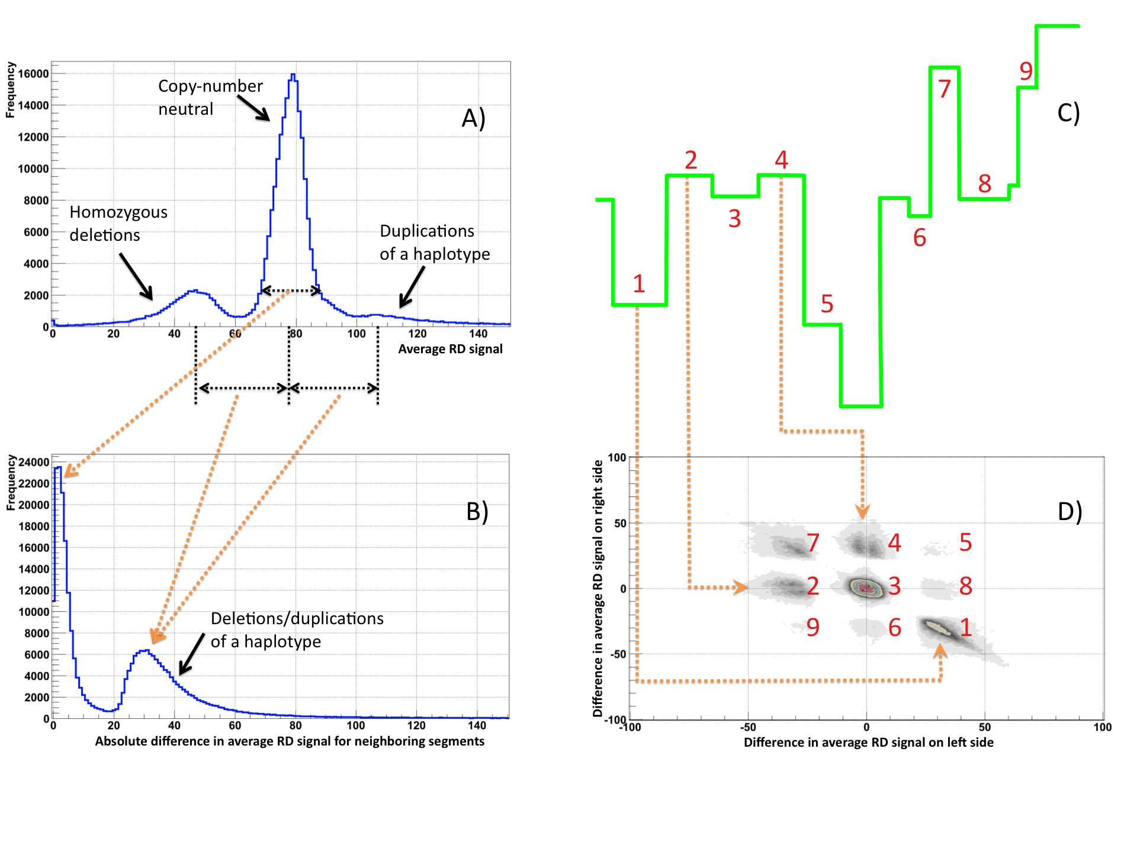
CNVnator, partitioning
Abyzov et al., Genome Res. 21, 974-84 (2011)

Slide 56
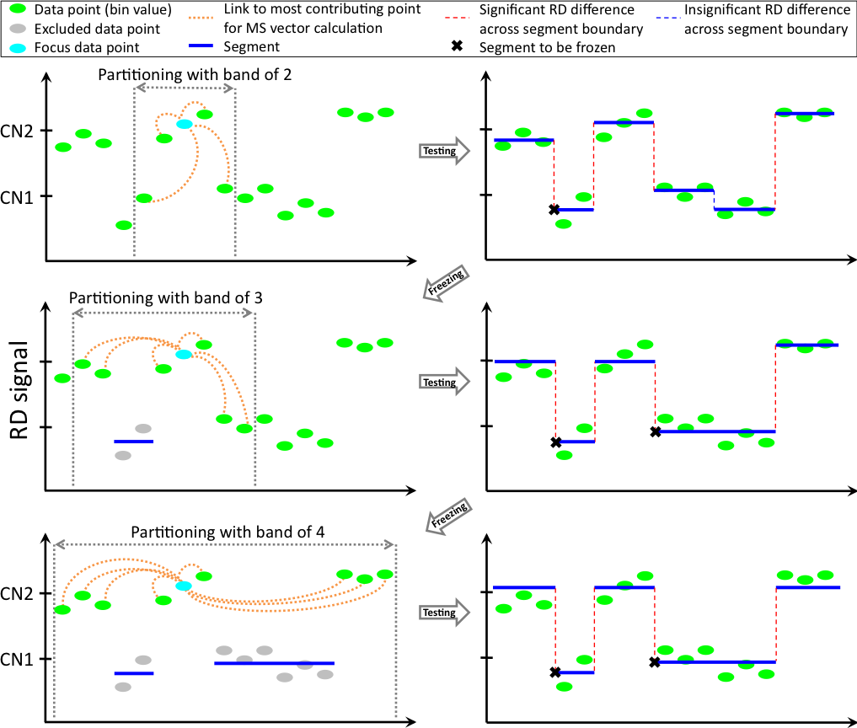
Abyzov et al., Genome Res. 21, 974-84 (2011)

Slide 57
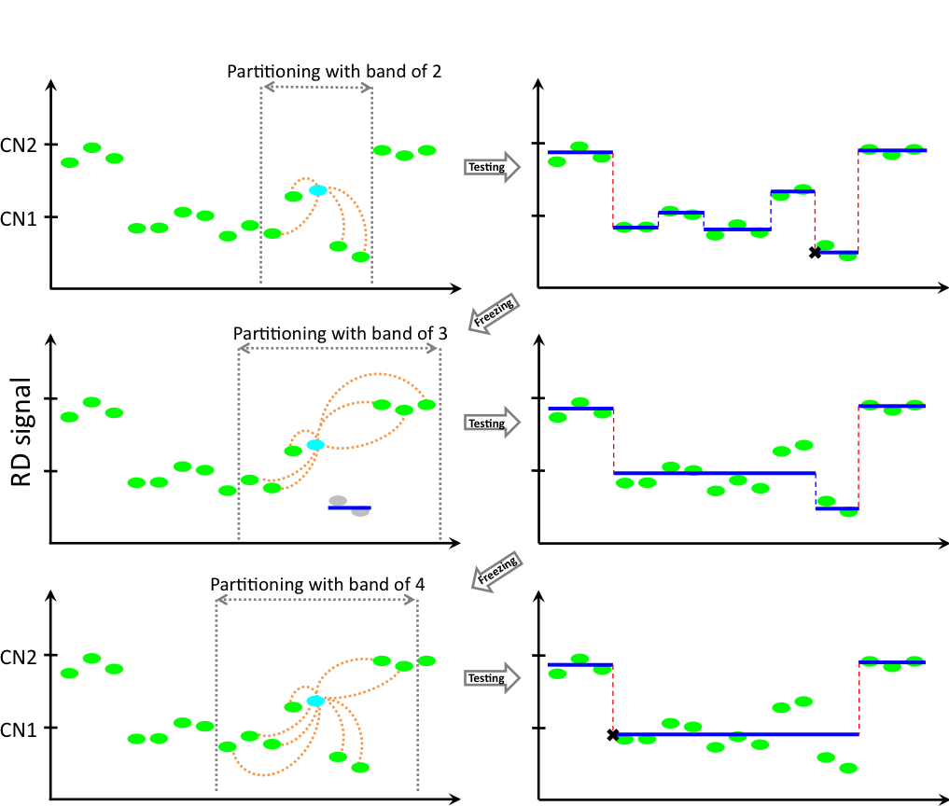
Abyzov et al., Genome Res. 21, 974-84 (2011)

Slide 58
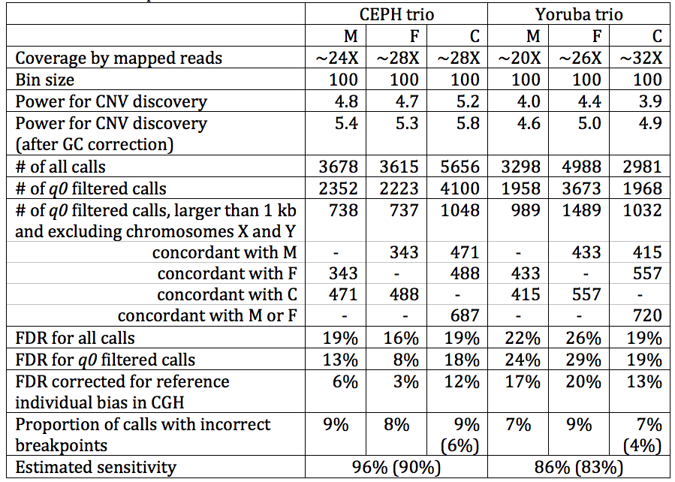
Trio deletion predictions
Abyzov et al., Genome Res. 21, 974-84 (2011)

Slide 59
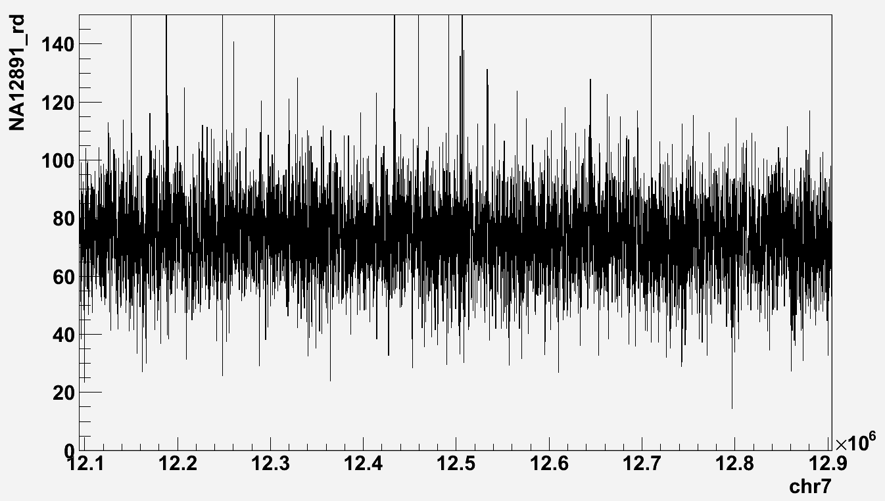
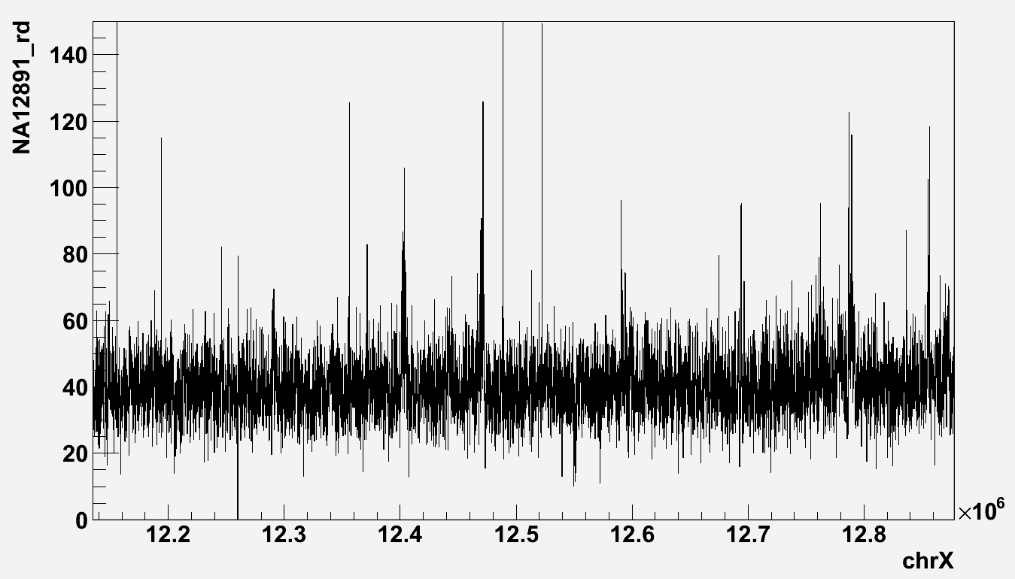
CNVnator performance (in simu)
Abyzov et al., Genome Res. 21, 974-84 (2011)

Slide 60
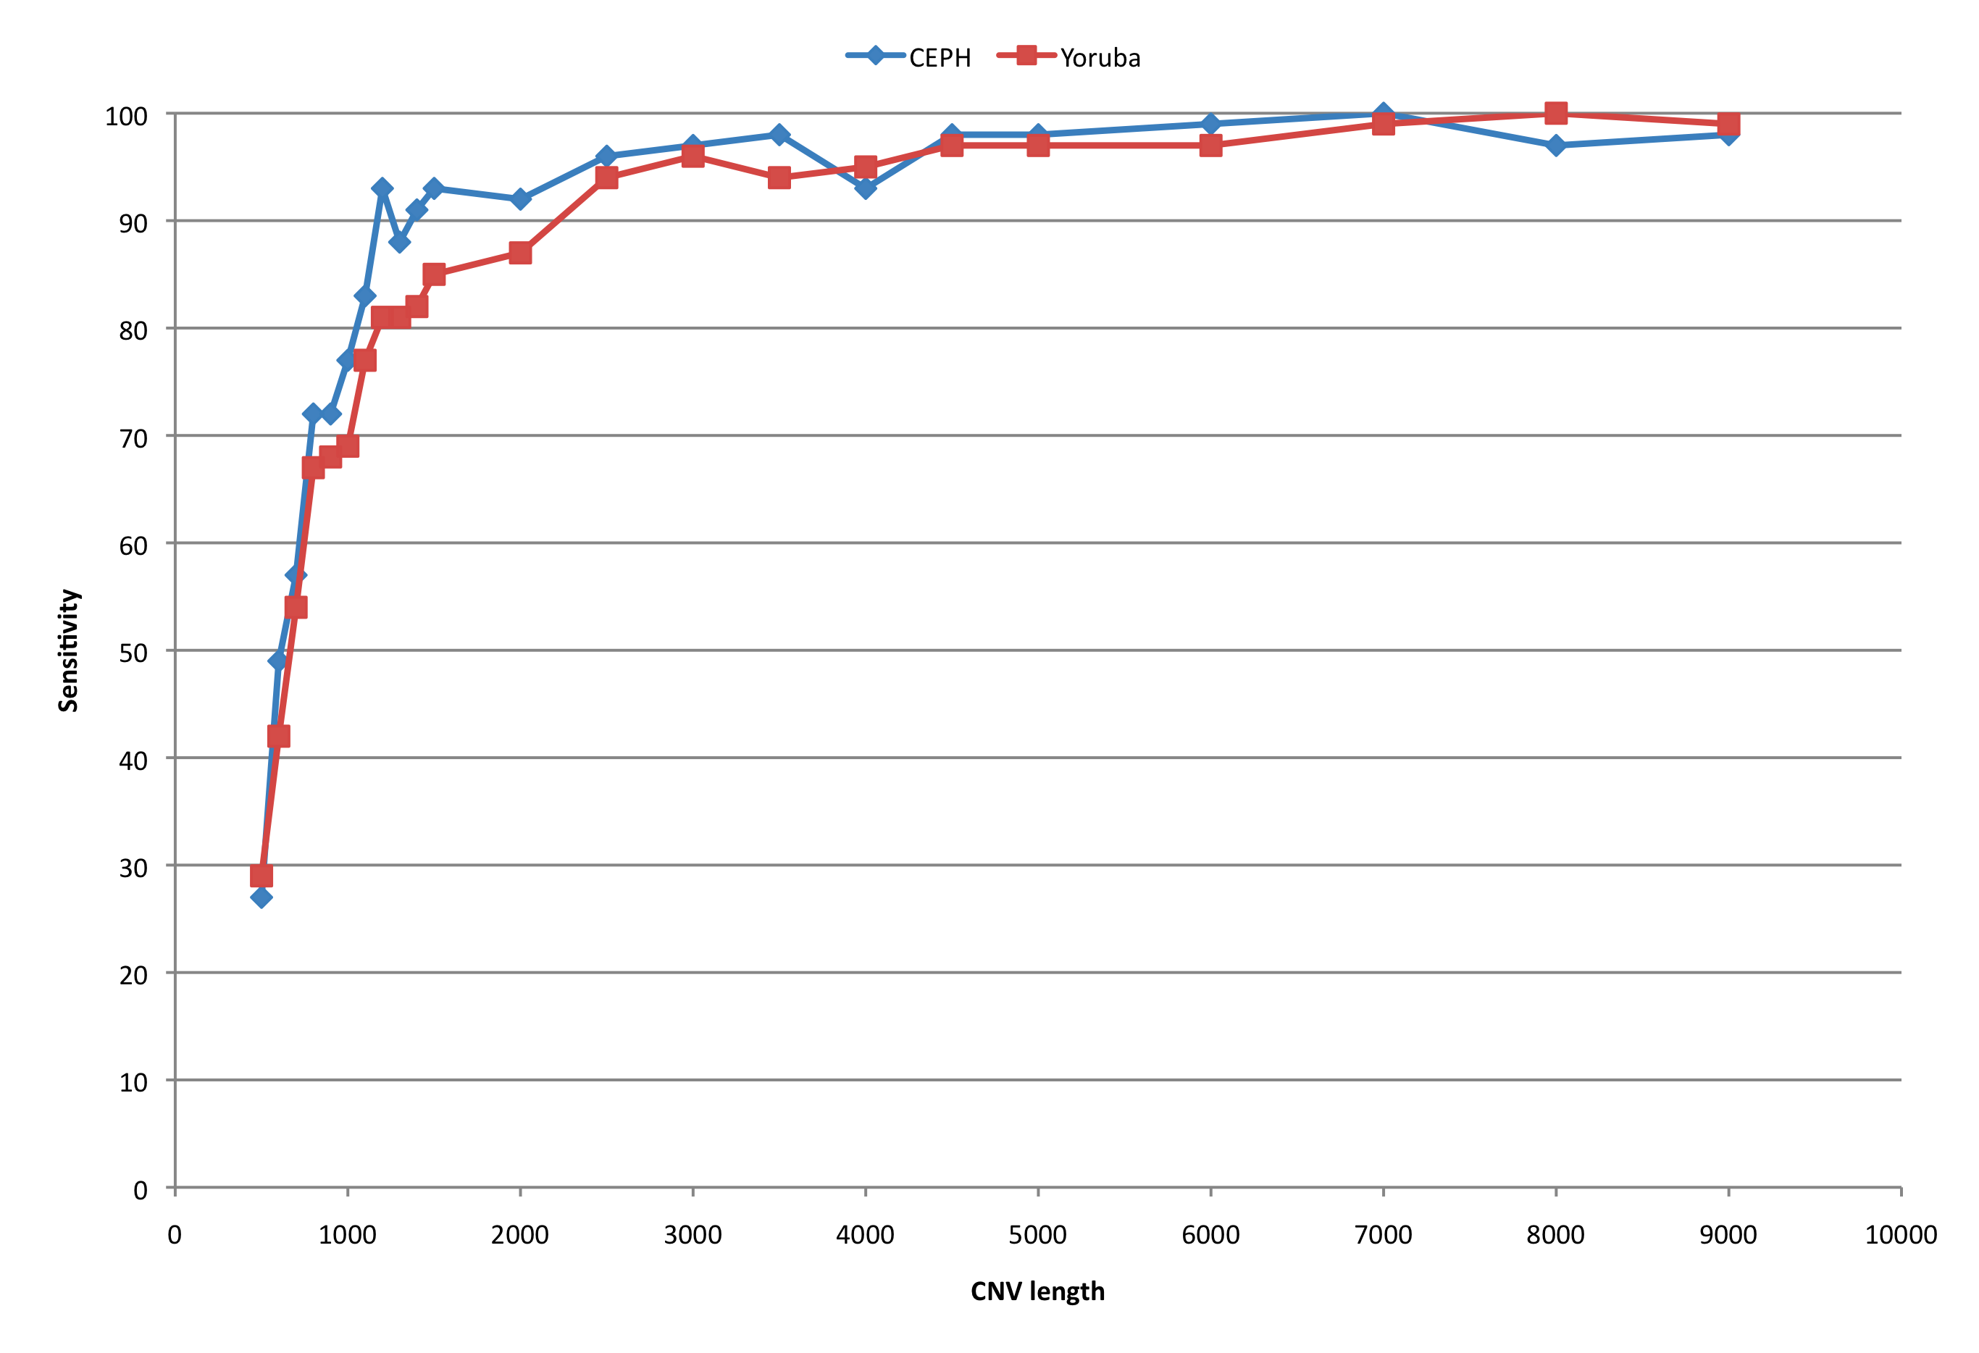
Discovery sensitivity (in simu)
Abyzov et al., Genome Res. 21, 974-84 (2011)

Slide 61
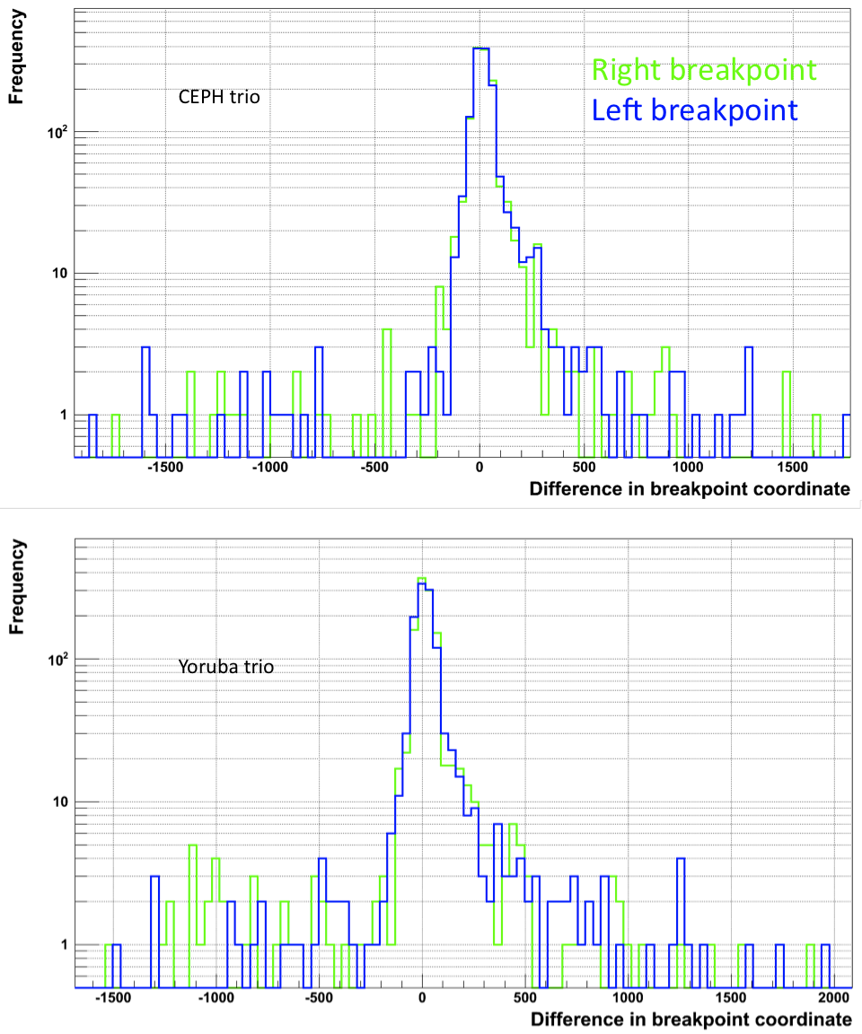
CNVnator, precision
Abyzov et al., Genome Res. 21, 974-84 (2011)

Slide 62
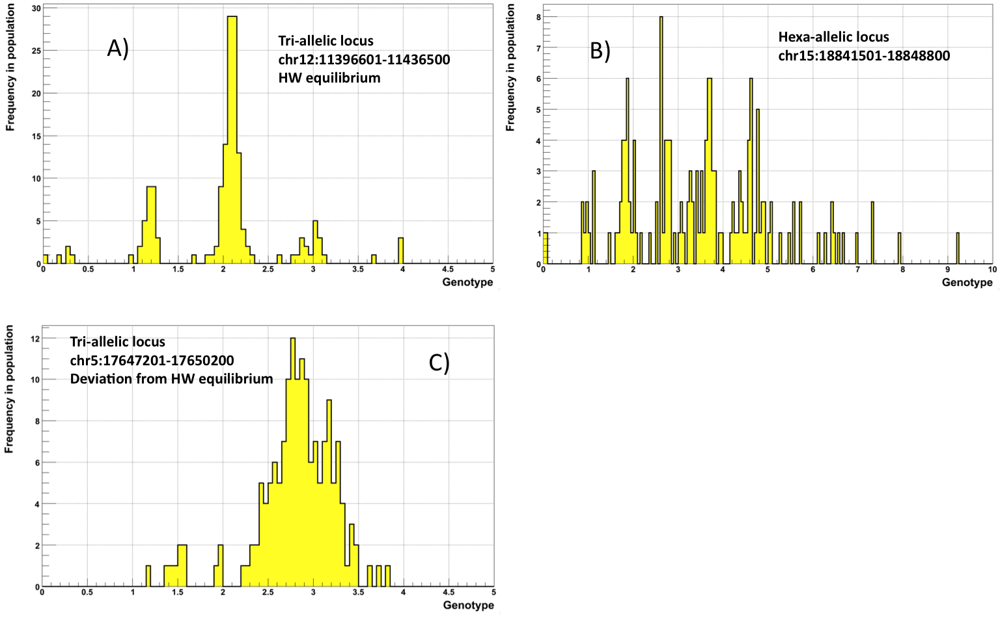
CNVnator, examples
Abyzov et al., Genome Res. 21, 974-84 (2011)

Slide 63
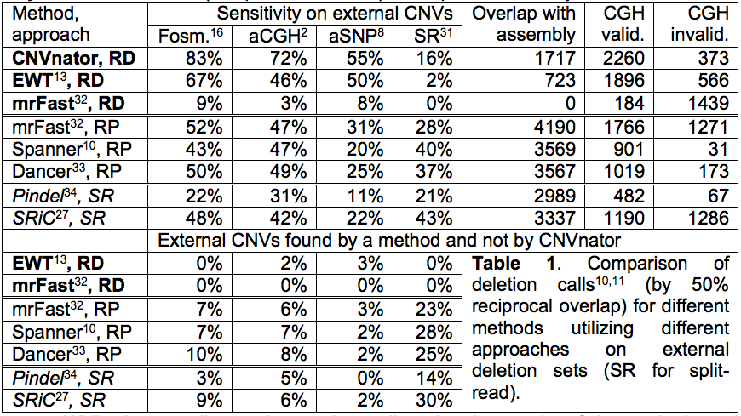
Comparison
By 50% reciprocal overlap
Abyzov et al., Genome Res. 21, 974-84 (2011)

Slide 64
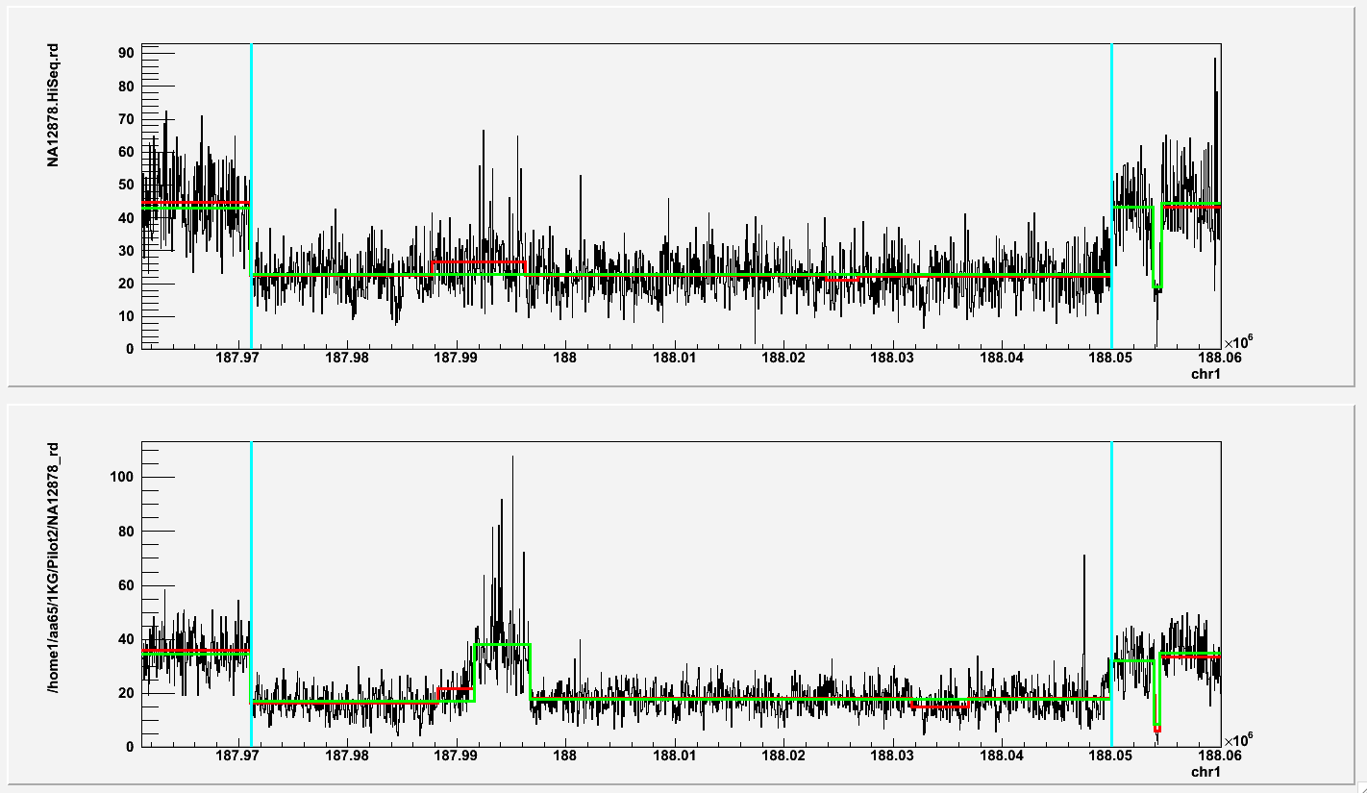
chr1:187971130-188049982
HiSeq
GAII

Slide 65

AGE for inversions and tandem duplications
Abyzov et al., Bioinformatics 27, 595-603 (2011)

Slide 66

Need for AGE
Abyzov et al., Bioinformatics 27, 595-603 (2011)

Slide 67



Supported slice-junctions
CDC27 gene
Known exons
Possible unknown exons
88 YRI samples 80 CEU sample NA12878 (CEU)
Chromosome 17, Mb
Histone marks
by ENCODE

Slide 68


Slide 69


Slide 70


hiPSC characterization
Abyzov et al. (submitted)

Slide 71

hiPSC characterization
Abyzov et al. (submitted)

Slide 72

Neurons from hiPSC
Abyzov et al. (submitted)

Slide 73

LM-CNVs are not burden
Abyzov et al. (submitted)

Slide 74

PE support
Abyzov et al. (submitted)

Slide 75

Two cycles of amplification
(S1123-01 #3)
Abyzov et al. (submitted)

Slide 76

Example (S1123-03 #17)
Abyzov et al. (submitted)

Slide 77

aCGH on chr11:84329001-84540000
(S1123-02 #17)
Abyzov et al. (submitted)

Slide 78

aCGH chr7:133748001-133785000
(S1123-02 #17)
Abyzov et al. (submitted)

Slide 79

aCGH chr20:15010001-15192000
(S1123-02 #17)
Abyzov et al. (submitted)

Slide 80

aCGH chr4:130288001-130618000
(s1123-02 #11)
Abyzov et al. (submitted)

Slide 81

aCGH chr12:66253001-66325000
(S1123-03 #2)
Abyzov et al. (submitted)

Slide 82

aCGH chr13:111112001-111160000
(S1123-02 #2)
Abyzov et al. (submitted)

