Slide 1
Phase I variants in non-coding annotations
Ekta Khurana, Cristina Sisu, Arif Harmanci, Mark Gerstein
Yale University
Dec 20, 2011

Slide 2
Decorated VCF file
Non-coding annotations that the variant intersects with are indicated by the "NAC" tag (for NonCoding Annotation Category)
Tags include : NAC=miRNA, snRNA, snoRNA, rRNA, lincRNA, misc_RNA, UTR, PGENE, TFPEAK, TFMOTIF
Accompanying BED files:
Chr chromStart=base_before_event chromEnd=last_base Name=VT_ID_of_NAC

Slide 3
Distribution of annotation categories
Log scale

Slide 4
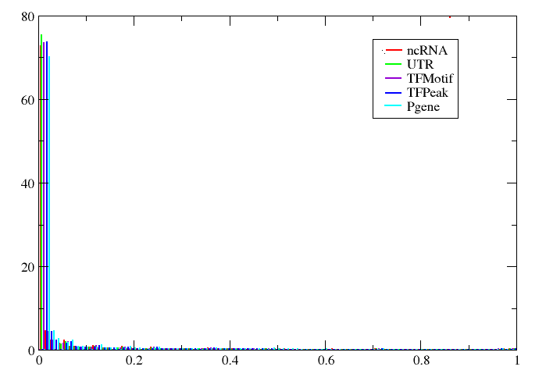
Allele freq distribution for SNPs

Slide 5
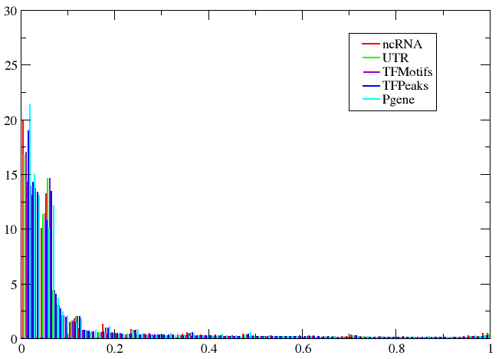
Allele freq distribution for Indels

Slide 6
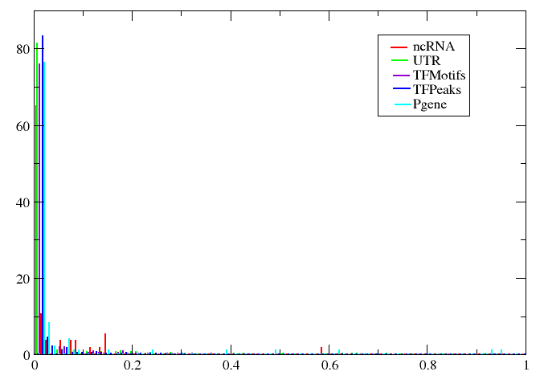
Allele freq distribution for SVs

Slide 7
To do
Incorporate enhancer annotations in VCF
Currently collecting a confident enhancer list by intersection of three methods: ChromHMM, Segway and discriminative training

