Slide 1
Pseudogene Activity in Worm and Human
Rebecca Robilotto & Cristina Sisu
Yale
Mark Gerstein Group
16th December 2011

Slide 2
Pseudogene Activity in Worm
Active pseudogene:
  Transcription evidence
  TFBS
  Active histone marks
  323 out of 1198
Partially active pseudogenes:
- No transcription evidence
- active histone marks
- under selection
- TFBS
- active histone marks

Slide 3
Methods
Examined 323 pseudognes
    TFBS of in C. elegans
207 pseudogenes show active TFBS in the upstream region
To Do’s:
    Check the 207 pseudogenes for :
      Active histone marks
      Active chromatin
    Compare to Human

Slide 4
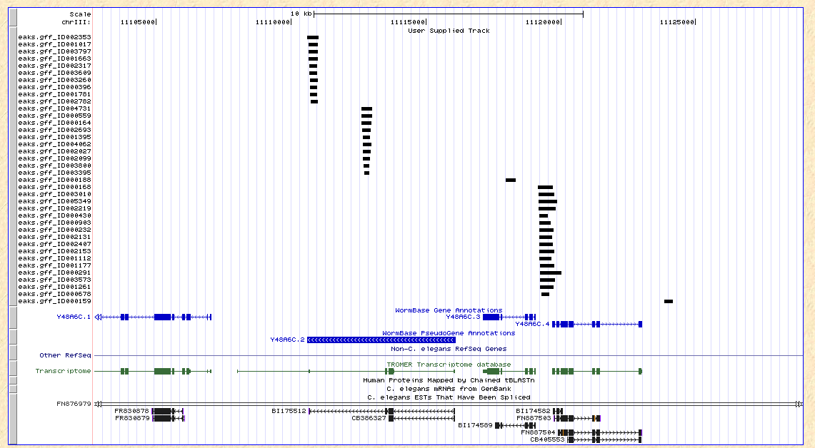
Examples of Pseudogenes with Marks of Activity
There is some evidence of binding sites indicating partial activity

