Slide 1
Deciphering Functions and Regulatory Programs of Coding Genes and ncRNAs using ENCODE Data
Renqiang (Martin) Min
In collaboration with
Chao Cheng and Mark Gerstein
Program in Computational Biology and Bioinformatics
Yale University
Dec 8, 2011

Slide 2
Building hierarchy (Chao Cheng and Koon-Kiu Yan)
To find the hidden intrinsic direction in the presence of cycles
Simple-minded method:
Divide TFs into 3-layers (Top, Middle, Bottom)
Divide TFs into layers based on whether they are regulating or being regulated by TFs at different levels
Minimize bottom-top directional edges

Slide 3
Functional Support (multi-tasker argument) (Thanks Pedro!)

Slide 4
Chromatin Organization and Chromatin Modification TFs Enriched in Top Level
ID Gene Name Species
CTCF CCCTC-binding factor (zinc finger protein) Homo sapiens
CTCFL CCCTC-binding factor (zinc finger protein)-like Homo sapiens
EP300 E1A binding protein p300 Homo sapiens
KAT2A K(lysine) acetyltransferase 2A Homo sapiens
SETDB1 SET domain, bifurcated 1 Homo sapiens
SMARCA4 SWI/SNF related, matrix associated, actin dependent regulator of chromatin, subfamily a, member 4 Homo sapiens
SMARCB1 SWI/SNF related, matrix associated, actin dependent regulator of chromatin, subfamily b, member 1 Homo sapiens
SMARCC1 SWI/SNF related, matrix associated, actin dependent regulator of chromatin, subfamily c, member 1 Homo sapiens
SMARCC2 SWI/SNF related, matrix associated, actin dependent regulator of chromatin, subfamily c, member 2 Homo sapiens
CHD2 chromodomain helicase DNA binding protein 2 Homo sapiens
HDAC2 histone deacetylase 2 Homo sapiens
IRF4 interferon regulatory factor 4 Homo sapiens
NFE2 nuclear factor (erythroid-derived 2), 45kDa Homo sapiens
NR3C1 nuclear receptor subfamily 3, group C, member 1 (glucocorticoid receptor) Homo sapiens
SUZ12 suppressor of zeste 12 homolog (Drosophila) Homo sapiens

Slide 5
Functional Analysis of TF Targets

Slide 6
Functional Analysis of TF Targets (2)

Slide 7
Too many peaks and targets!
We want to know whether or not TFs tend to collaborate each other during transcriptional regulation
Can we observe any obvious dependent binding patterns from ChIP-Seq data?
Kevin Yip did peak overlapping studies, but I found that almost everyone overlaps with any other TF, so they even used a z-score of 100 to eliminate noise (challenging)!
Better ideas? Filtering!

Slide 8
TIP (Cheng, Min, Gerstein, 2011)

Slide 9
Co-association: clustering TFs (1)

Slide 10
Co-association: clustering TFs (2)

Slide 11
Co-association: clustering TFs (3)

Slide 12
Dependencies between TF Bindings: Bayesian Networks!
Using a graph to represent dependencies between variables, in which nodes correspond to variables and edges correspond to dependencies between variables
Lack of edges represent conditional independency
Main theorem: p(V) = Product_c p(V_c| parents of V_c); Conditioned on its parents, each variable is independent of all the variables except its children and descendants
I have repeated 1 million times during group meetings, journal clubs, sub-group meetings! You are so bored of it, I know.

Slide 13
Bayesian Network for TF Binding Profiles from ENCODE
BRF2
TBP
SIN3A
BRF1
GTF2F1
MYC
USF1
USF2
MAX
RAD21

Slide 14
Bayesian Network (2)
BCLAF1
HMGN3
TAL1
GATA2
JUND
SIRT6
GATA1
FOS
JUN
NFYA
PBX3
SP1
SP2

Slide 15
TFs with the largest TF Out-degrees in Bayesian Net
SP1
BCL11A
BCLAF1
EP300
SMARCA4
USF2
GATA2
HMGN3
HNF4G
JUND
RXRA->SP1->[SP2 FOS IRF1 IRF3 NFYA SREBF1]
BCL11A->[BATF NFKB1 PAX5 RXRA TCF12]
BCLAF1->[MEF2A POU2F2 TAF7 TAL1 ]
EP300 ->[JUND RXRA TCF4 ZNF143]
SMARCA4->[BCL3 KAT2A SMARCB1 TAF7]
[BRF1 GTF2F1 USF1]->USF2->[ATF3 MAX NFE2 RAD21]

Slide 16
TFs with the largest TF In-degrees in Bayesian Net
FOS
JUN
MAX
RXRA
SP2
TBP
TCF12
TCF4
USF2
[GATA2 JUN NFYA PBX3 SP1]->FOS
[GATA2 JUND SIRT6]->JUN
[MYC USF1 USF2]->MAX
[BCL11A EP300 HNF4G]->RXRA
[NFYA PBX3 SP1]->SP2
[POLR3A TAF7]->TBP

Slide 17
Common Top-Layer TFs comparing BN to Hierarchy
EP300
HDAC2
HMGN3
HNF4G
PBX3
PPARGC1A
SETDB1
SMARCA4
SRF
STAT3
SUZ12
TFAP2C
ZBTB33

Slide 18
Why TF-ncRNAs?
Mark asked me to work on intersecting ncRNAs with indels, snps, deletions
I want to contribute to supporting the hierarchical network constructed and ENCODE-nets by looking at TF-ncRNA interactions, hoping to find novel results ☺

Slide 19
Overview of ncRNAs in ENCODE Data
We consider the following RNAs from Gencode v7 annotation as non-coding RNAs:
number avg. length
-microRNA: 1756 92
-misc-RNA: 1187 153
-snRNA: 1944 107
-snoRNA: 1521 110
-lincRNA: 1239 43970 (11828, median)
-processed transcript: 8401 26346 (6372, median)

Slide 20
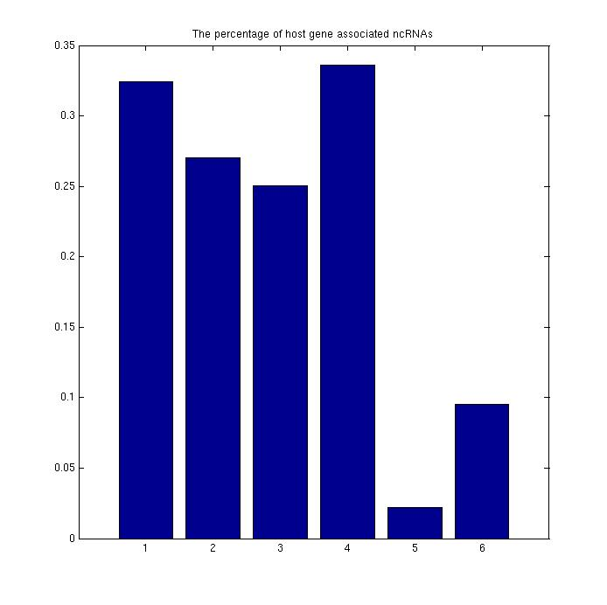
Host-Gene Associated ncRNAs
The ncRNAs that lie in the protein coding regions
miRNA
miscRNA
snRNA
snoRNA
lincRNA
pro_tran

Slide 21
ENCODE ChIP-Seq Data for ncRNAs
There are around 500 ChIP-Seq experiments for about 120 unique TFs
To identify ncRNA targets of TFs, I used 1.5 KB upstream region of the starting position as promoters of miRNAs, misc_RNAs, snRNAs, and snoRNAs
Because lincRNAs and processed transcripts are much longer, which are comparable or even longer than coding genes, I used 1.5KB upstream and 500B downstream of the starting position as promoters of lincRNAs and processed_transcript.

Slide 22
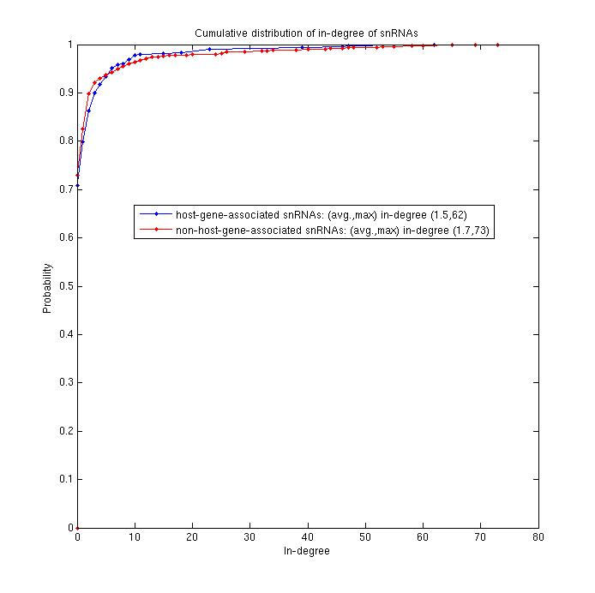
In-degree of snRNAs

Slide 23
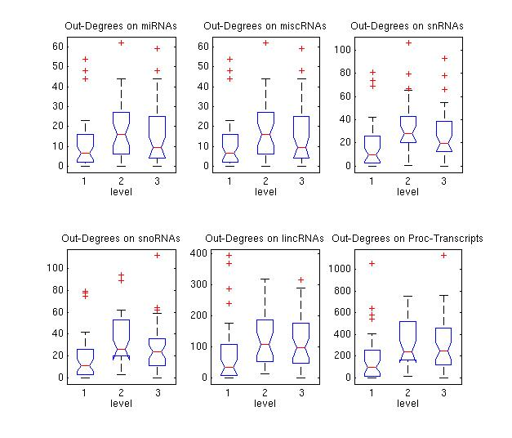
Box Plots of Out-Degrees of TFs in different levels on ncRNAs

Slide 24
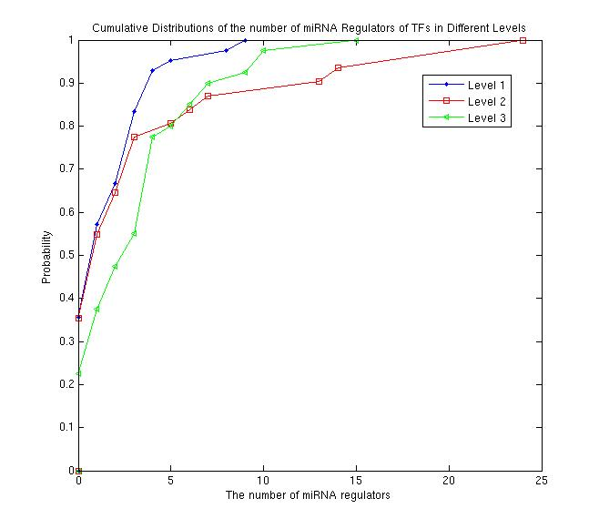
No. of miRNA Regulators

Slide 25
Thanks Nitin!

Slide 27
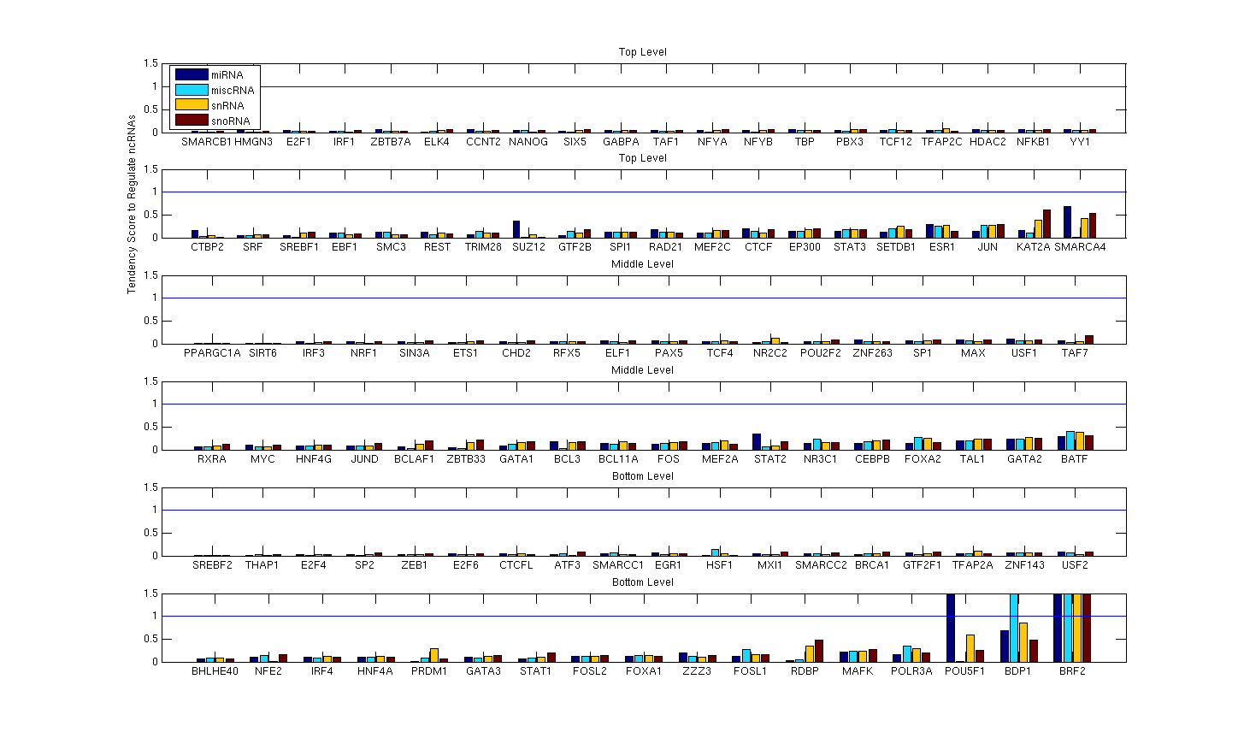

Slide 29
Significant TFs Focusing on Regulating ncRNAs Found
Comparing TF-ncRNA regulatory network to TF-protein coding gene regulatory network reveals known TFs and novel TFs that tend to focus on regulating different sub-classes of ncRNAs (including miRNAs).
BDP1, BRF1, BRF2, POU5F1, ZNF274 (P<0.067)
All these TFs that tend to focus on regulating short ncRNAs (including miRNAs) are from the bottom level of the hierarchy. (consistent with Pedro’s beautiful figure)

Slide 30
ncRNA Regulatory Network Motifs
TF
TF
miRNA
ncRNA
miRNA
snRNA
TF

Slide 31
Auto-regulating TFs regulating ncRNAs are enriched
Koon-Kiu also showed his enriched auto-regulating TFs for coding genes

Slide 34
All these are OLD and for ENCODE Nets
I wanted to present my new results on filtered TF-ncRNA network, TF binding profile comparison, clustering coding gene expression profile to annotate ncRNAs
But I stayed up working here last night without sleep, sorry!
Will do next time!

Slide 35
Acknowledgement
Mark Gerstein
Chao Cheng
Joel Rozowsky
Koon-Kiu Yan
Pedro Alves
Roger Alexander
Baikang Pei
Arif Harmanci
Jing Leng
Xinmeng Mu

Slide 36
Thank You!
Questions?

