Slide 1
Potential Figures to Support Pseudogene Part – U54 Grant
Mark Gerstein - Yale

Slide 2
Fig 1. PseudoPipe
Source:
Zhang et al. Bioinformatics (2006)
PMID: 16574694,
Zheng et al. Genome Biology (2006) PMID: 16925835

Slide 3
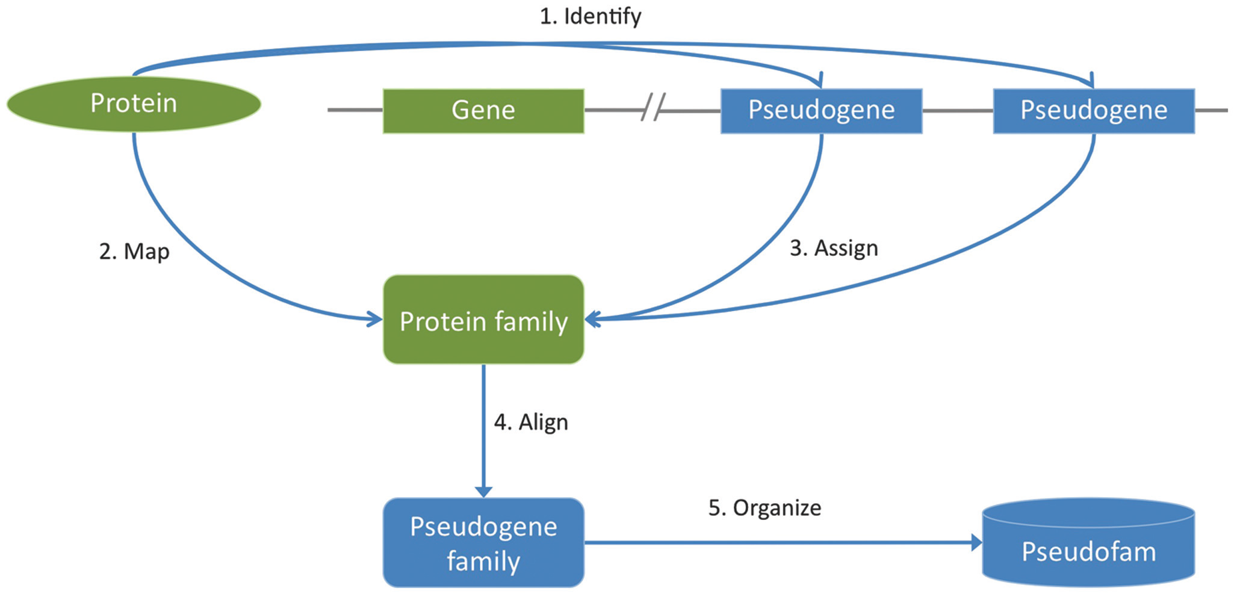
Fig 2. Generation of Pseudofam
Source:

Slide 4
Fig 3. Alignment of pseudogene family
Source:

Slide 5
Fig 4. Syntenic analysis on mouse and human genes
Source:

Slide 6
Fig 2.
Source:

