Slide 1
Pol II Update
Raymond Auerbach
December 1, 2011

Slide 2
Review of Antibodies
Pol2 (Snyder, Myers)
  Initiation phase (unphosphorylated form)
Pol2b (Broad, Farnham)
  Initiation and elongation (phosphorylated and phosphorylated form)
Pol2s2 (Snyder)
  Targets phosphorylated serine-2 (polymerase stalling)
  Questionable quality/peak calls
In general: All target same heptapeptide repeat on the largest subunit, but in different states.

Slide 3
Signal over Intron/Exon Interfaces
Using information from RefSeq, extract all introns. Keep those > 1000 bp
Aggregate Pol2b and Pol2s2 over 5’ and 3’ ends of introns
  +/- 500 bp on each side
Run the above for HeLa s3 and K562

Slide 4
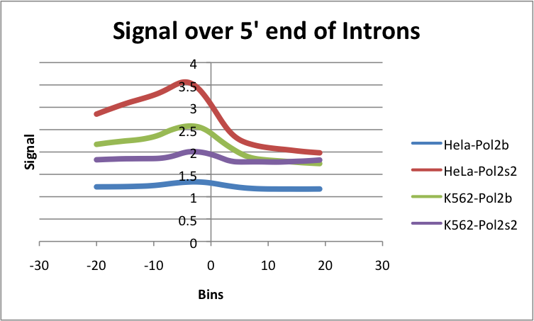
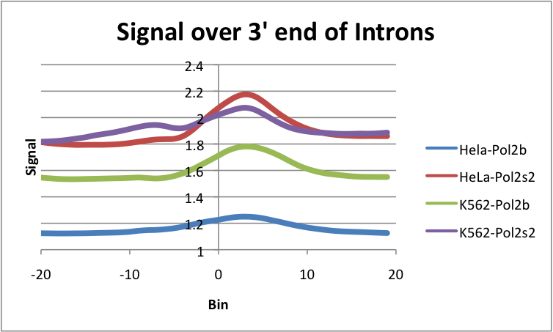
Aggregations

Slide 5
Shape characteristics
Generated four clusters for each using k-means
  Biological analysis not interesting. Still thinking about it, but won’t appear in this presentation.
Switched to representing peaks by their central moments [Σ(x – x_{mean})^{k}] for k^{th} moment
  Generated the first-fifth central moments for each Pol2 peak +/- 1kb
  K-means clustering with k = 4.

Slide 6
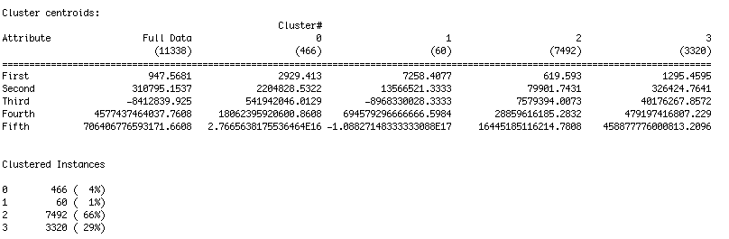
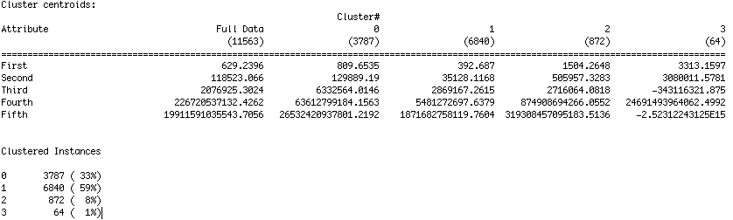
Cluster Information
HeLa
K562

Slide 7
HeLa Gene Associations
c0
c1
c2
c3

Slide 8
K562 Gene Associations
c0
c1
c2
c3

Slide 9
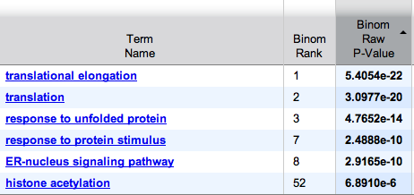
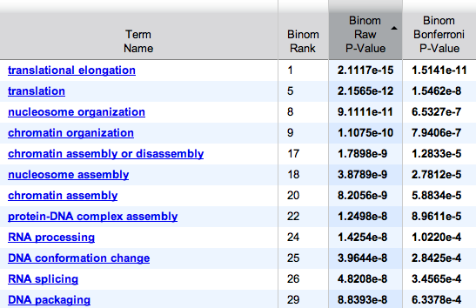
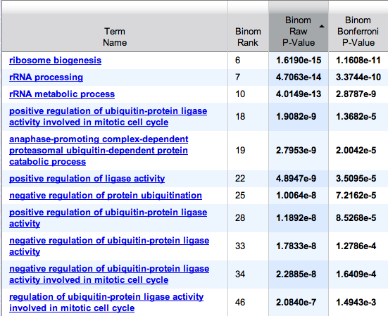
K562 Clusters by Biological Process
Cluster 0 (3,787 regions)
Cluster 3 (872 regions)
Cluster 1 (6,840 regions)

Slide 10
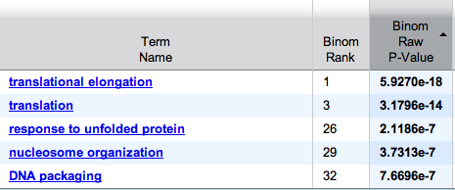
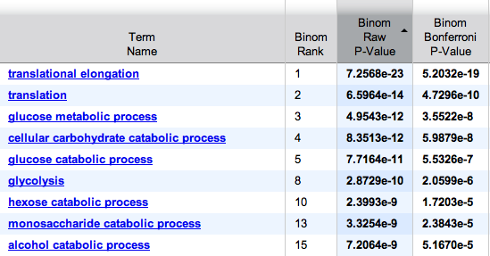
HeLa Clusters by Biological Process
Cluster 3 (3,320 regions)
Cluster 0 (466 regions)
Cluster 2 (7,492 regions)

Slide 11
So far…
The biological meaning behind the clustering is questionable
  Same for kurtosis/skewness clustering
  HeLa and K562 don’t agree where I think that they should
Open for suggestions on things to try next

