Slide 1
Twitter
11-1-11
Nets

Slide 2
Used a co-occurrence matrix for the clustalw alignment, figured it was not the best option
Could not find a good text matrix for mutation in words, need a matrix, not a table
Maybe that clustalw is not best option, does give a good indication of mutations, even without the proper matrix

Slide 3
Each node represents a tweet, while color change signifies a mutation
Try to build this network
There can be a mutation early on,
but then a different mutation later on
But when you actually look at the
retweets of retweets,
you see similarities to evolution

Slide 4
Sample Tweet
Tweet ID: 98929112365805568
Date: Thu Aug 04 01:31:53 +0000 2011
Source: Source: web
User: BarackObama
RT @OFA_IN: Today at our #BO50 house meeting in Indy we are live-streaming @BarackObama‚Äôs birthday party in Chicago. http://twitpic.com/60kw4w
No good way to find out where the retweet besides parsing the tweet
Basically would parse out the @users and connect them in a matrix

Slide 5
>one16Aug2011_17:18:47
UnlikelyWorlds: Humans living outside Africa owe up to 4% of their DNA to Neanderthals: http://t.co/MCs2Myh
>two16Aug2011_18:11:16
HelloBac: RT @UnlikelyWorlds: Humans living outside Africa owe up to 4% of their DNA to Neanderthals: http://t.co/MCs2Myh
>three16Aug2011_18:08:15
BobHole: RT @UnlikelyWorlds: Humans living outside Africa owe up to 4% of their DNA to Neanderthals: http://t.co/MCs2Myh
>four16Aug2011_18:04:17
shassinger: RT @UnlikelyWorlds: Humans living outside Africa owe up to 4% of their DNA to Neanderthals: http://t.co/MCs2Myh
>five16Aug2011_17:54:50
warriorgrrrl: RT @UnlikelyWorlds: Humans living outside Africa owe up to 4% of their DNA to Neanderthals: http://t.co/MCs2Myh
>six16Aug2011_17:52:0
SMLochhead: RT @UnlikelyWorlds: Humans living outside Africa owe up to 4% of their DNA to Neanderthals: http://t.co/MCs2Myh
>seven16Aug2011_17:39:11
_unabara_: RT @UnlikelyWorlds: Humans living outside Africa owe up to 4% of their DNA to Neanderthals: http://t.co/MCs2Myh
>eight16Aug2011_17:35:13
Kerred: RT @GreatDismal RT @UnlikelyWorlds: Humans living outside Africa owe up to 4% of their DNA to Neanderthals: http://t.co/Zolug7W
>nine16Aug2011_17:32:04
jennjoysmith: I'm the alien I've always been looking for! MT @UnlikelyWorlds Humans living outside Africa owe ≤ 4% of DNA to Neanderthals bit.ly/pAwkD7
>ten16Aug2011_17:31:53
KindlyStranger: RT @UnlikelyWorlds: Humans living outside Africa owe up to 4% of their DNA to Neanderthals: http://t.co/MCs2Myh
>eleven16Aug2011_17:31:14
adrahon: RT @UnlikelyWorlds: Humans living outside Africa owe up to 4% of their DNA to Neanderthals: http://t.co/MCs2Myh
>twelve16Aug2011_17:26:58
Legendgerry: RT @UnlikelyWorlds: Humans living outside Africa owe up to 4% of their DNA to Neanderthals: http://t.co/MCs2Myh
>thirteen16Aug2011_17:26:03
djdcool: RT @UnlikelyWorlds: Humans living outside Africa owe up to 4% of their DNA to Neanderthals: http://t.co/MCs2Myh
>fourteen16Aug2011_17:25:41
pickoo: @UnlikelyWorlds @GreatDismal Humans living outside Africa owe up to 4% of their DNA to Neanderthals <= Explains the UK riots then.
>fifteen16Aug2011_17:25:12
lindysmith: RT @UnlikelyWorlds: Humans living outside Africa owe up to 4% of their DNA to Neanderthals: http://t.co/MCs2Myh
>sixteen16Aug2011_17:23:28
GreatDismal: RT @UnlikelyWorlds: Humans living outside Africa owe up to 4% of their DNA to Neanderthals: http://t.co/MCs2Myh

Slide 6
Tweeter
Retweet
Each row would be the tweeter, column is a retweeted user and will mark one when there is a connection, when more than one tweet, we add one

Slide 7
Use the depth-first tranversal to create the tree
Graph of the tweets, with the different colors
representing mutations
I built this by hand, is there a program that you can
Input a matrix and get the network for the bigger
data sets?

Slide 8
Still wrestling with two different models
One is looking at the just the retweets, with each generation being the retweet
The other is to just look at the mutations, but how to track the generations?
By time?
By retweet?
Time wouldn’t work so well because, person A could read it a day later and still mutate it, many tweets look like this, with no generational retweets, just the one level, with different mutations, how to do calculations on this?

Slide 9
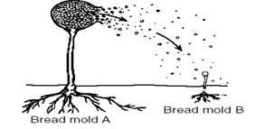
Focus more on organisms that reproduce asexually, budding, like yeast, fragmentation, like sea stars, or sporulation like mold
It occurs quickly producing many offspring that are identical, but also there are mutation that do occur, which then get passed on to their offspring
An asexual population tends to be genetically static, and mutations occur because of outside environments,which can then be passed on to there offspring very similar to twitter

Slide 10
Twitter
11-22-11
Nets

Slide 11
Build more matrices with larger datasets
Using an asexual model, I can hopefully do further calculations on mutation rates and selection.

Slide 12
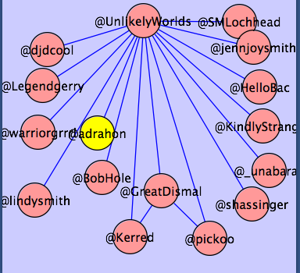
Cytoscape Network

Slide 13
Create new networks using bigger datasets and look at the patterns
Think about the context and similarities to other models

Slide 14
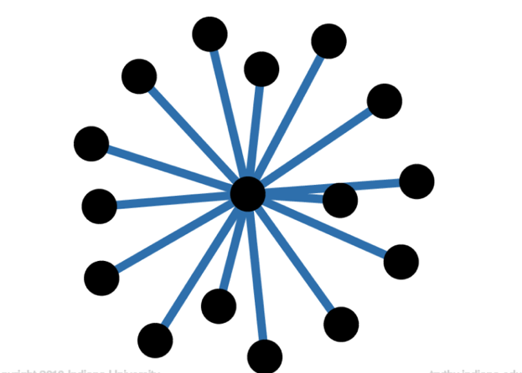
Tweet from Sarah Palin
All of them are retweets from the original source
Blue lines means retweet

Slide 15
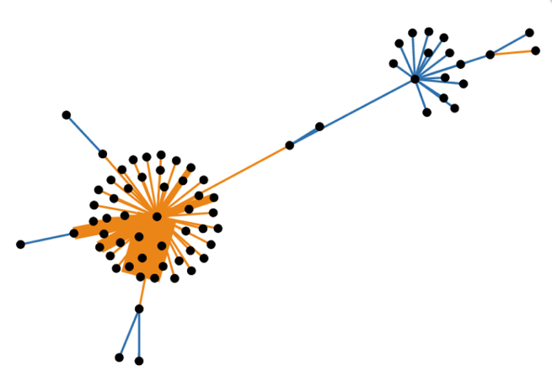
Lady Gaga tweet
We see a pattern of retweet and explosions

Slide 16
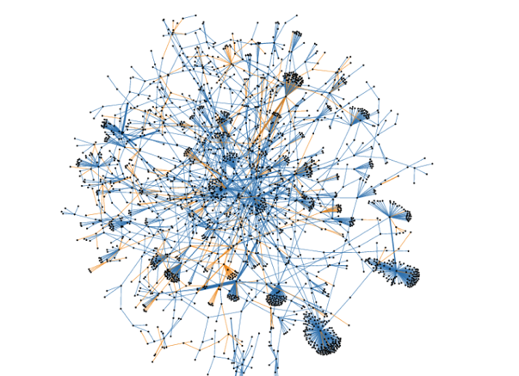
Network of an Obama tweet in for 45 min
Blue lines means retweet
Yellow lines mean mentions

Slide 17
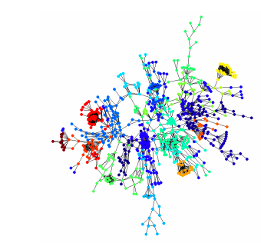
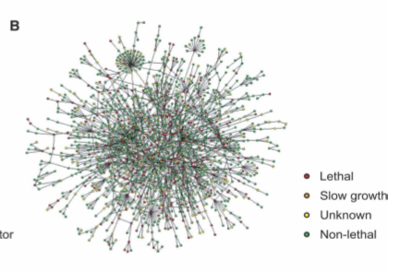
Protein interaction network of yeast
We can see similar patterns of the “fireworks”

Slide 18
Each node is a protein and interacts with other protein
Analogous to each user is like a protein and has similar interactions as the proteins
Have some semantic context
Proteins have a pathway
Each interaction may have some hash tag or other classification

Slide 19
Exciting because it shows similarities!!
We can make some inferences of how either data can travel, or how protein interacts!!
So many different analysis can be done
Bayesian models
Phylogenetic profiling
Interactomics

