Slide 1
Coevolution between Proteins

Slide 2
Protein–protein interactions effectively mediate molecular function and are maintained by the action of evolutionary pressure on the regions of the interacting proteins that contribute to binding.
For the most part, selection restricts amino acid replacements, accounting for the conservation of binding interfaces. However, in some cases, change in one protein will be mitigated by compensatory change in its binding partner, maintaining function in the face of evolutionary change.

Slide 3
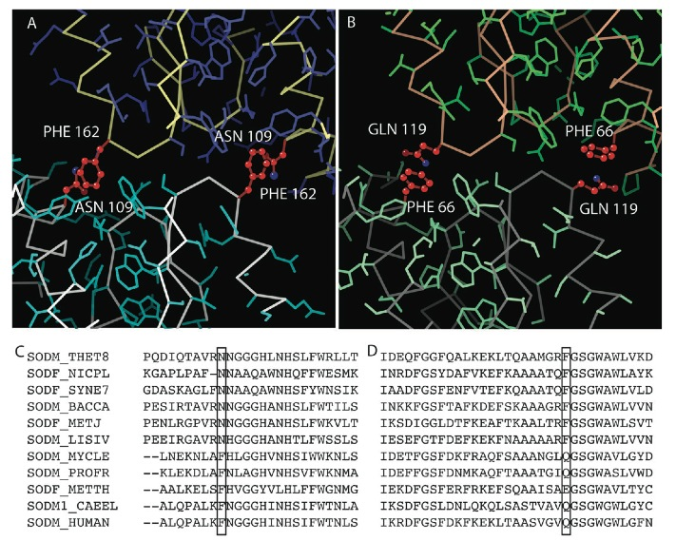

Slide 4
44 species ortholog alignments.
Example: Hsp70 & Hop

Slide 5
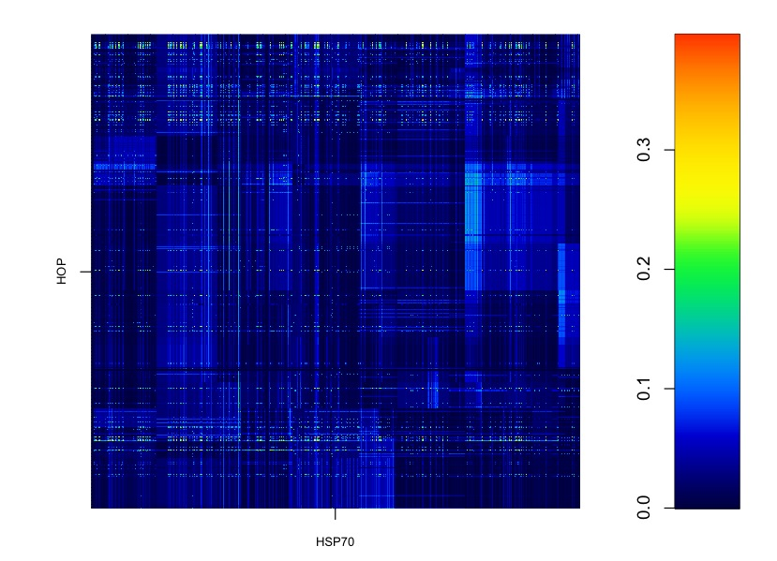

Slide 6
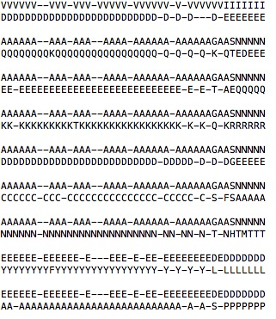

Slide 7
95
22
55
58
86
96
100
103
249
254
263
275
318
369
370
378
477
506
98
255
329
531
551
563
633
636
Notes:
95 22 0.355376178580786
98 55 0.359672192620679
98 96 0.360090345289351
98 100 0.388952108273402
98 249 0.389070130782775
98 370 0.373869373971683
98 477 0.362514247985983
255 58 0.352190308453388
255 103 0.396367856878961
329 86 0.36554496747706
531 96 0.383046209205391
531 369 0.379775924267351
531 378 0.365824393773413
531 506 0.364312367270479
551 86 0.350152530473324
551 263 0.363294184939554
563 318 0.353557282917785
633 254 0.357002600006909
633 275 0.357002600006909
636 254 0.357002600006909
636 275 0.357002600006909

Slide 8
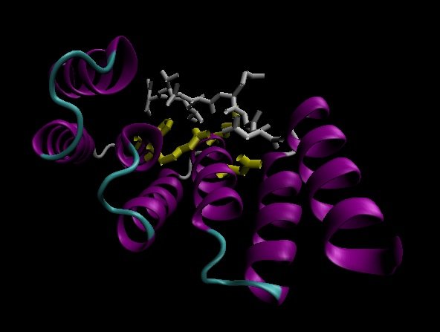

Slide 9
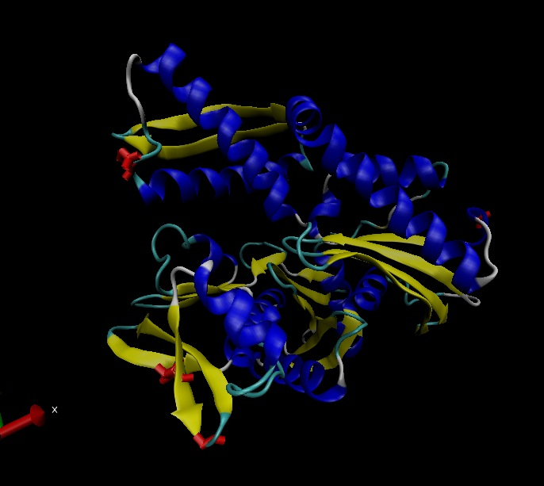
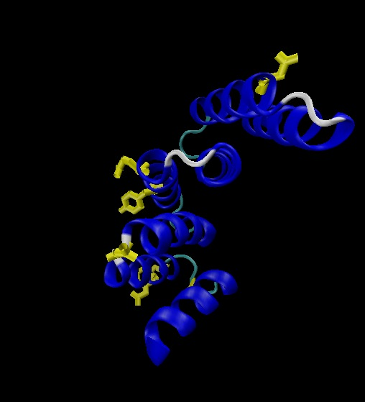
HOP
HSP70

Slide 10
The coevolutionary signal is subtle and somewhat weak in those proteins that only make transient interactions.
Map 1000 genome SNP data & disease SNP data onto these pairs.

