Slide 1
Relating gene expression with TF binding
Chao Cheng
Group meeting
Oct, 2011

Slide 2
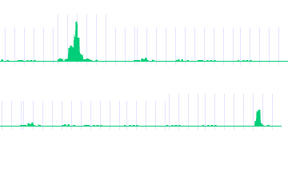
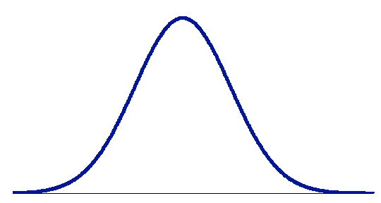
Conventional way to identify TF target genes
P53
TF binding and TF→gene regulation is NOT binary but quantitative
Gene A
P53 → A
Gene B
P53 X B
-2kb TSS 2kb
Limitations of peak-based method:
Low Medium High
- sensitive to # binding peaks
- sensitive to cut-off value (1, 2 or 5 kb of TSS?)
-- no significance estimation
Regulatory score
Notes:
Conventionally, you will check whether there is a binding peak around the transcription start site of a gene. In this example, we will say gene A is P53 target, but gene B is not.
this peak-based method is simple and easy to be implemented. But there several limitations: 1, it is sensitive to the number of binding peaks, which is determined by data quality, peak calling methods and so on. 2, it is sensitive to the definition of promoter. In previous publications, some used 1kb, other used 2kb or 5kb. This will result in quite different target gene set. 3, there is no significance estimation. You don’t know how confident a gene is regulated by the TF.
Moreover, the peak based method assume the TF binding and TF-gene regulation are binary event. That is you assume a gene is either regulated or not regulated by a TF. In reality, the TF gene regulation relationship should be quantitative. A TF can bind and regulate a gene strongly or weakly.

Slide 3
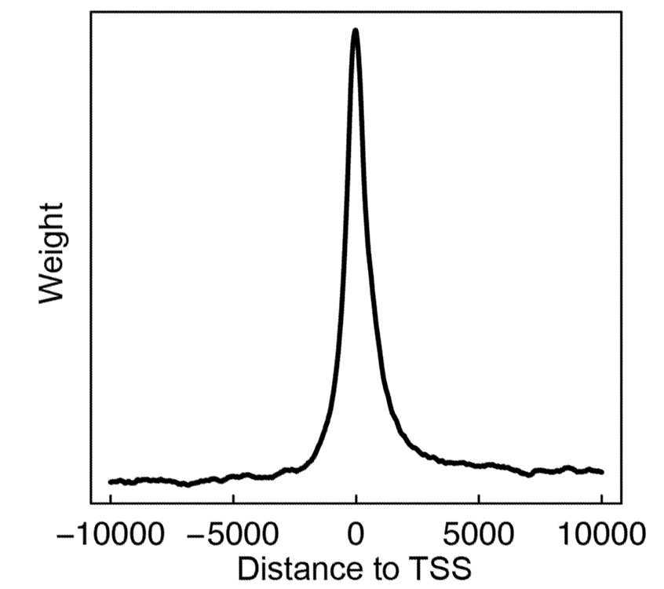
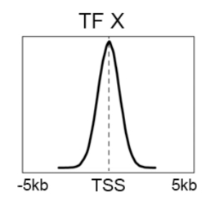
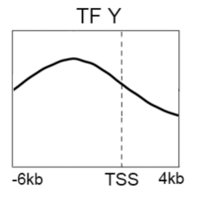
Target Identification with a Probabilistic model (TIP)
-10000 0 10000
S_{i}(g): the signal of a TF at nucleotide i of gene g
Binding signal: S_{i}(g)
Avg. profile: w_{i}
-- TF binding signal at different position contribute differently
Distance from TSS
binding preference of TFs
P-value & FDR
Calculate regulatory score and p-value for all genes
Avg binding signal across all genes
Cheng et al. 2011, Bioinformatics
Notes:
Based on this idea, we develop a new method named TIP. We don’t rely on binding peaks. Instead, I consider the binding signal Si(g), at each position i around the TSS of a gene g. I assume that TF binding signal at different position contribute differently to the TF targeting. The importance of a position depend on the its relative distance to the TSS as well as the binding preference of the TF. For example, some TFs prefer to binding a narrow regions around the TSS, while the others show strong binding signals even in distant regions.
I therefore use the binding profile of the TF as the weight, and calculate the weighted summation of binding signals as the regulatory score. The regulatory scores are then normalized into z-scores, and p-values are calculated. So, our result is a ranked gene list, ordered by the regulatory scores and p-values. Genes at the top of the list are more likely to be target genes of the TF.

Slide 4
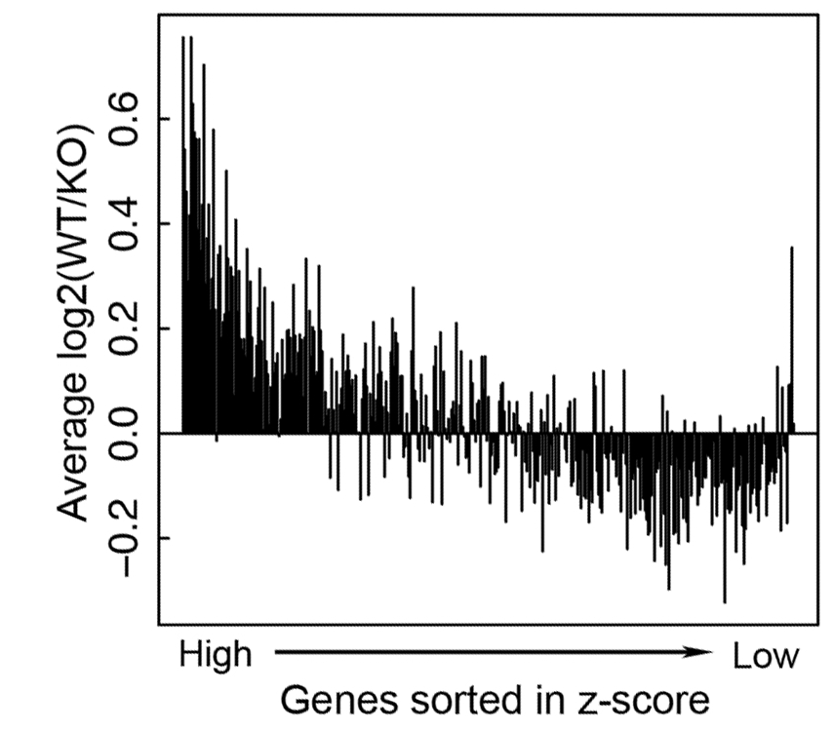
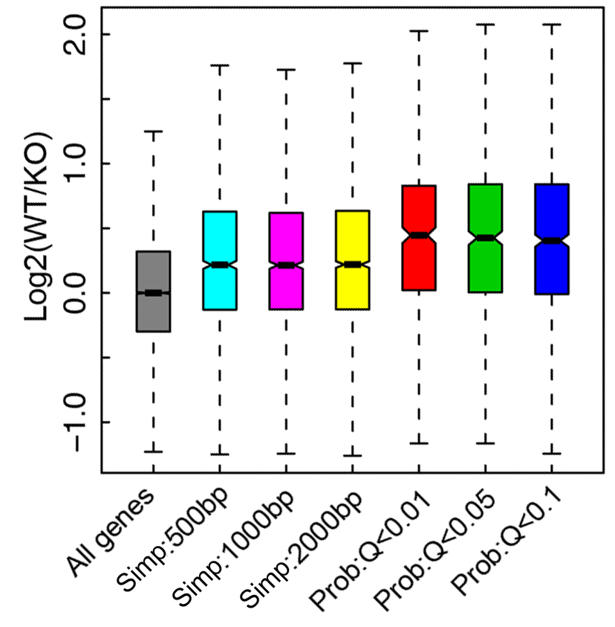
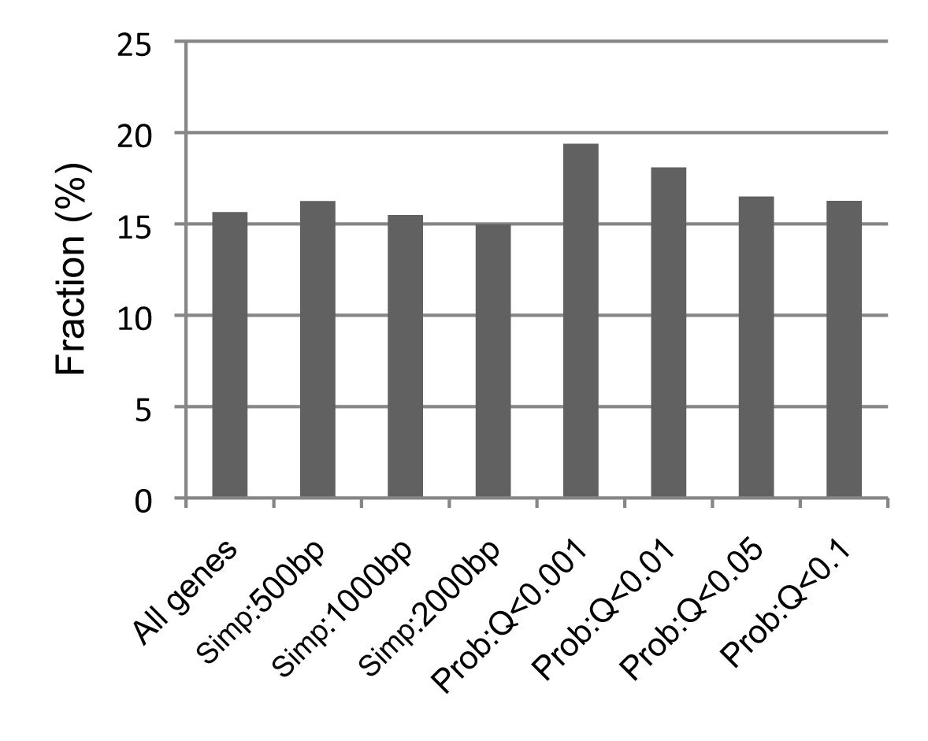
Example 1: STAT4 targets identified by TIP are more down-regulated in STAT4 KO
Peak
TIP
Data
ChIP-seq data:
Stat4 binding in Th1 cell
Gene expression:
STAT4KO + WT mice
Wei et al., 2010
Target
Non-target
TIP
STAT4 binding motif are more enriched in targets identified by TIP
Peak
STAT4 motif
Notes:
To show the advantage of our method, we applied it to the STAT4 knock-out data from a previous publication. In the data, the CHIP-seq was performed for STAT4. Expression levels of all genes were measured in the wild-type as well as in the STAT4 KO mice. So you can evaluate the quality of target genes by examining the expression changes in KO versus wt.
As shown here, the genes with high regulatory score tend to be more down-regulated in knock out relative to the wild-type. When compared to the peak-based method, target genes identified by TIP are more down-regulated.
In addition, if you check the existence of STAT4 motifs in the promoters of target genes, you will find the target genes identified by TIP contains more STAT4 motifs.

Slide 5
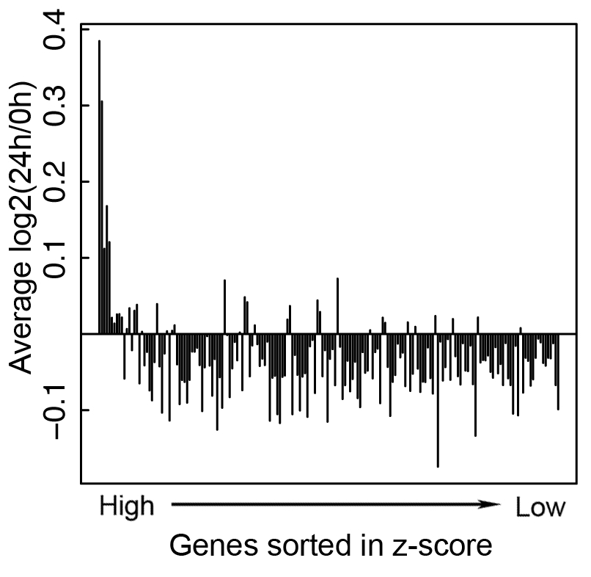
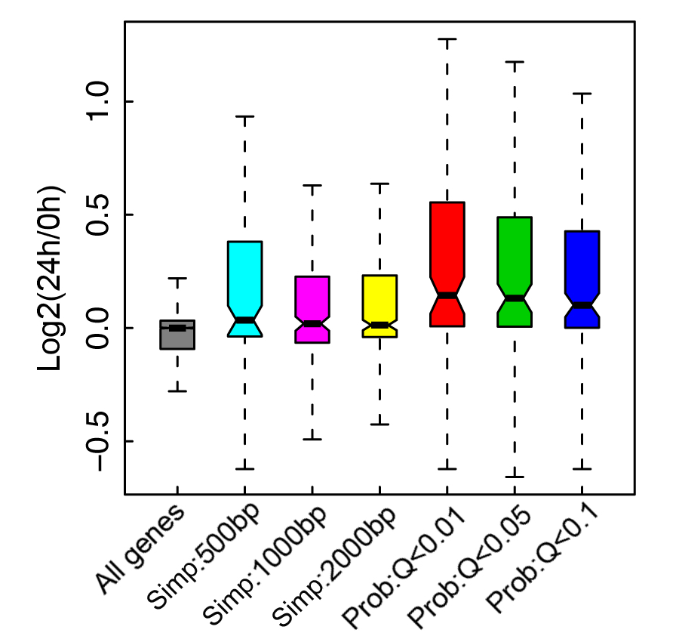
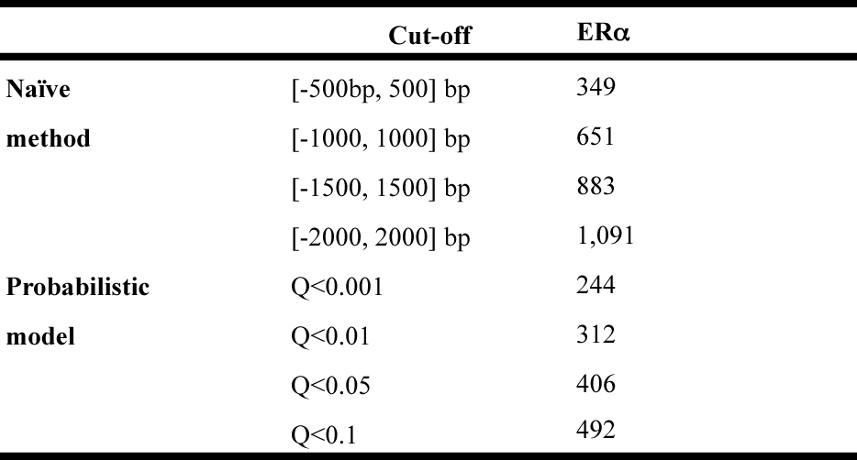
Example 2: ERα targets identified by TIP are more responsive to estrogen treatment
Data
E2 responsive genes
Peak
TIP
ChIP-seq data:
ERα binding in MDA-MB-231 cell line
Gene expression:
before and after E2 treatment
Stender et al., 2010
Target
Non-target
# target genes
Notes:
The better performance of TIP is also shown in another example. As shown, ER alpha target genes identified by TIP are more responsive to the treatment of E2, which activates ER alpha.
As shown here, the number of target genes identified by the peak-based method changes dramatically when different cut-off values are used for defining promoter region.

Slide 6
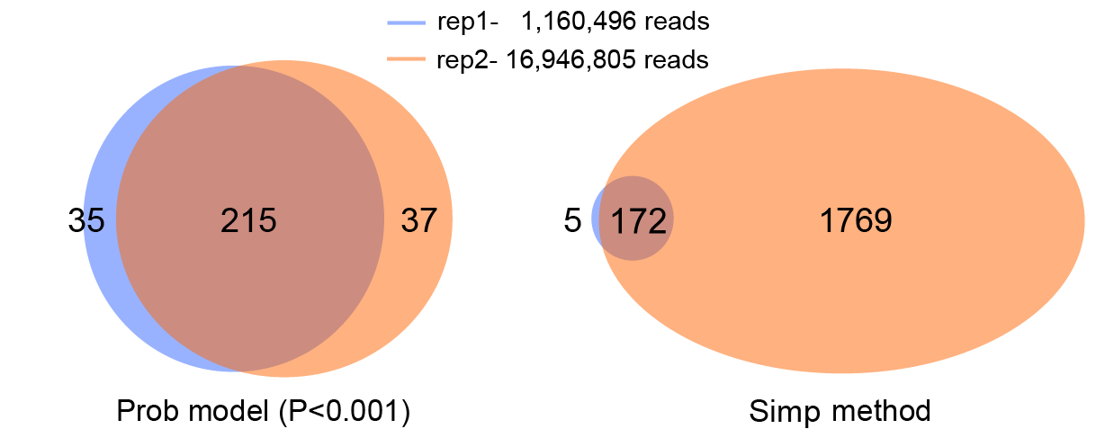
TIP is insensitive to sequencing depth
TCF4: Mokry et al., 2010
TIP is cost-effective-- do not require high read-depth for target gene identification!
Notes:
Another advantage of TIP is that it is not sensitive to the read depth. We applied the method to the TCF4 CHIP-seq data with two replicates. The two replicates have 10-fold of difference in number of sequencing reads. Usually, the number of binding peaks identify by peak calling method will increase if more reads are sequenced. As a consequence, the numbers of target genes identified by the peak-based method are substantially different between the two replicates. However, the numbers by TIP are very similar and consistent. This is very useful. Because, you don’t have to sequence into a very high read-depth.

Slide 7
Expression data of Gencode TSSs
267 profiles ×137,873 TSSs
12 cell lines
- A549, AGO4450, BJ, GM12878, H1-hESC, K562, HeLa-S3, HepG2, MCF7, HUVEC, NHEK, SK-N-SH
3 techniques
- CAGE, diTAG, RNA-Seq (short RNA, long RNA)
6 cellular components
- whole, Cy, Nuc, Nuol, Chr, Ps,
4 RNA extraction Protocols
- poly A+, polyA-, total, short

Slide 8
TF binding data
>120 TFs
- GTF, TFSS, TFNS, chrRem, etc
73 Cell lines
- A549, K562, GM12878, H1HESC, ECC1, HEPG2, HELAS3, PANC1, PFSK1, SKNSHRA, T47D, U87, FIBROBL, GM12891, GM12892, GM19238, GM19239, GM19240, HUVEC, MCF7, PROGFIB, NHEK, GM18505, HMEC, ……

Slide 9
Machine learning models
SVM/SVR
RF (Random forest)
MARS (Multivariate adaptive regression splines)
MLR (Multiple liner regression)
How to measure the goodness of a model?
- R [0,1], correlation between predicted and measured
- R² [0,1], explained variation of gene expression%
- RMSE [0, +∞], rooted mean squared error

Slide 10
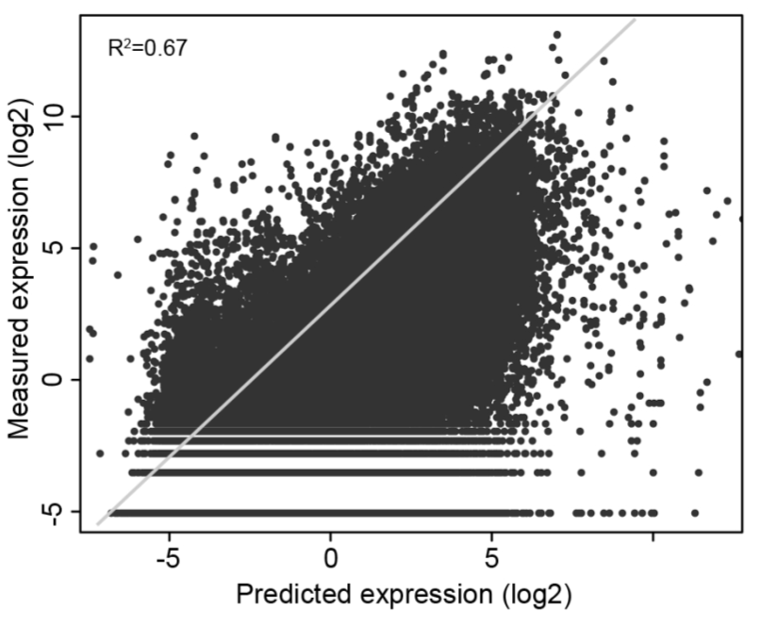
Example - cpkw

Slide 11
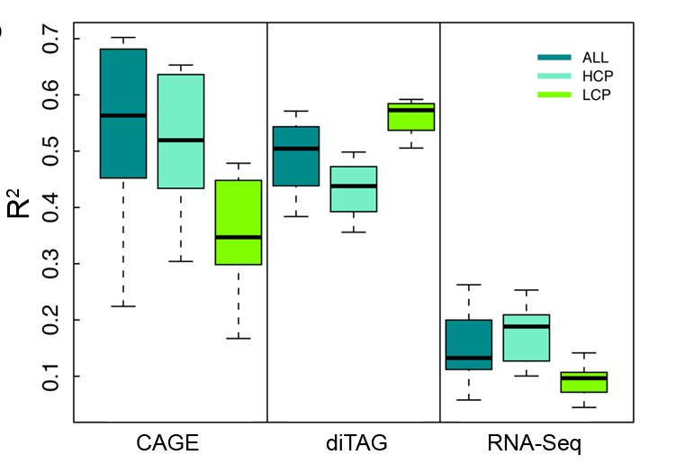

Slide 12
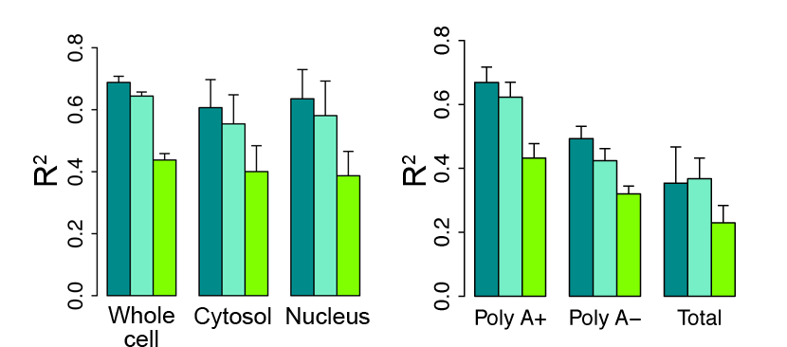
CAGE data

Slide 13
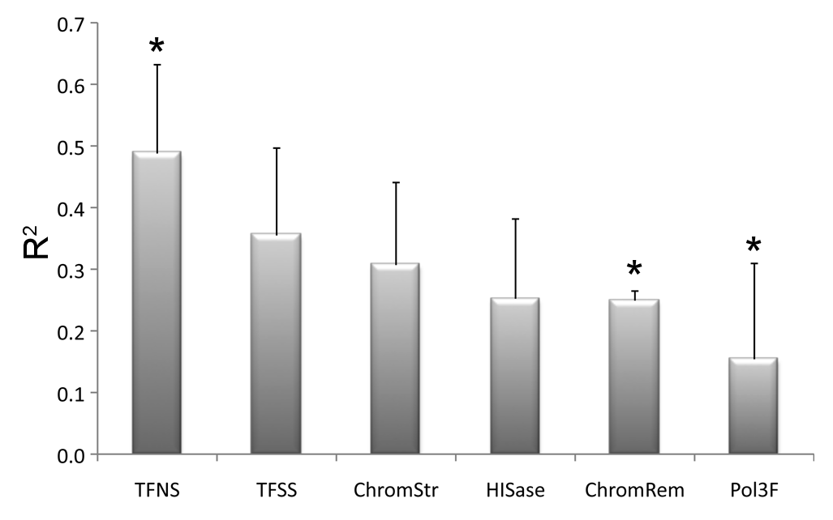
Predictive powers of different TF categories

Slide 14
Importance of genes

Slide 15
CpG content

Slide 16
HCP is easier than LCP

Slide 17
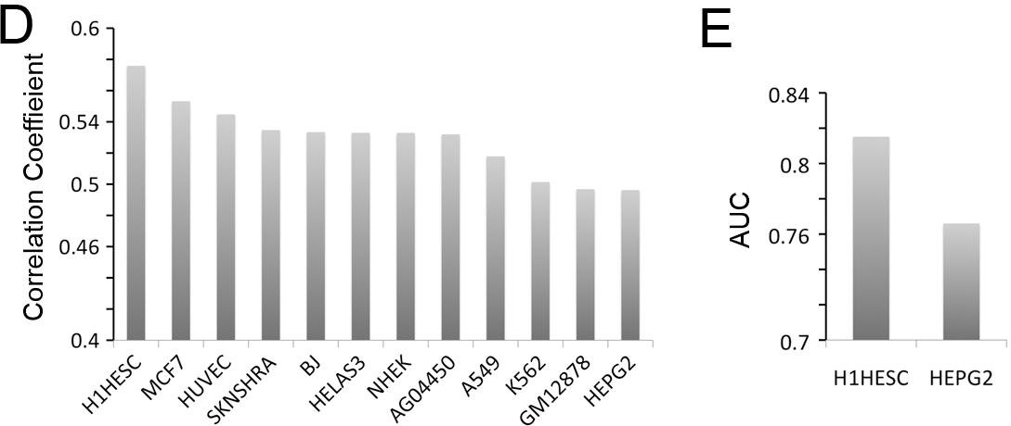
CpG is most correlated with expression in HESC
CpG content is shaped by selection in germ line cells

Slide 18
Relative importance

Slide 19
Aggregation plot of TF binding signals

Slide 20
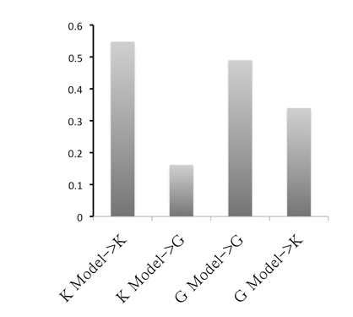
Cell line specificity of TF model
22 common TFs for K562 and GM12878 as predictors

Slide 21
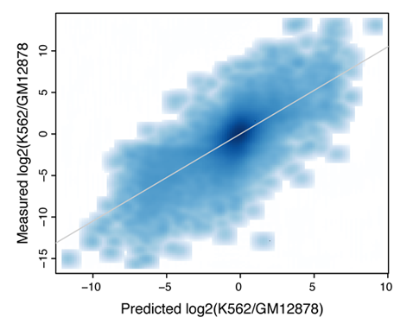
Predict differential expression based on differential binding of TFs
R2=0.53

Slide 22
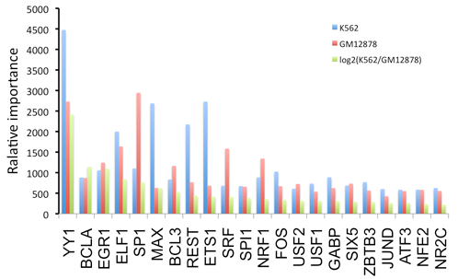
Relative importance of TFs

Slide 23
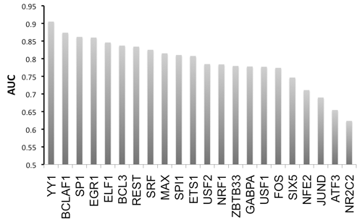
Classify K562/GM12878 specific TSSs
Log2(K562/GM12878) > +2
Log2(K562/GM12878) < -2

Slide 24
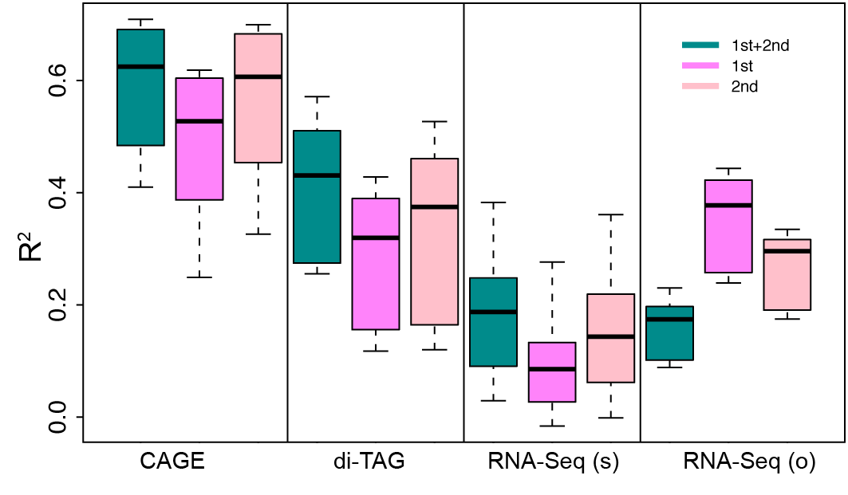
1st and 2nd TSSs for genes

Slide 25
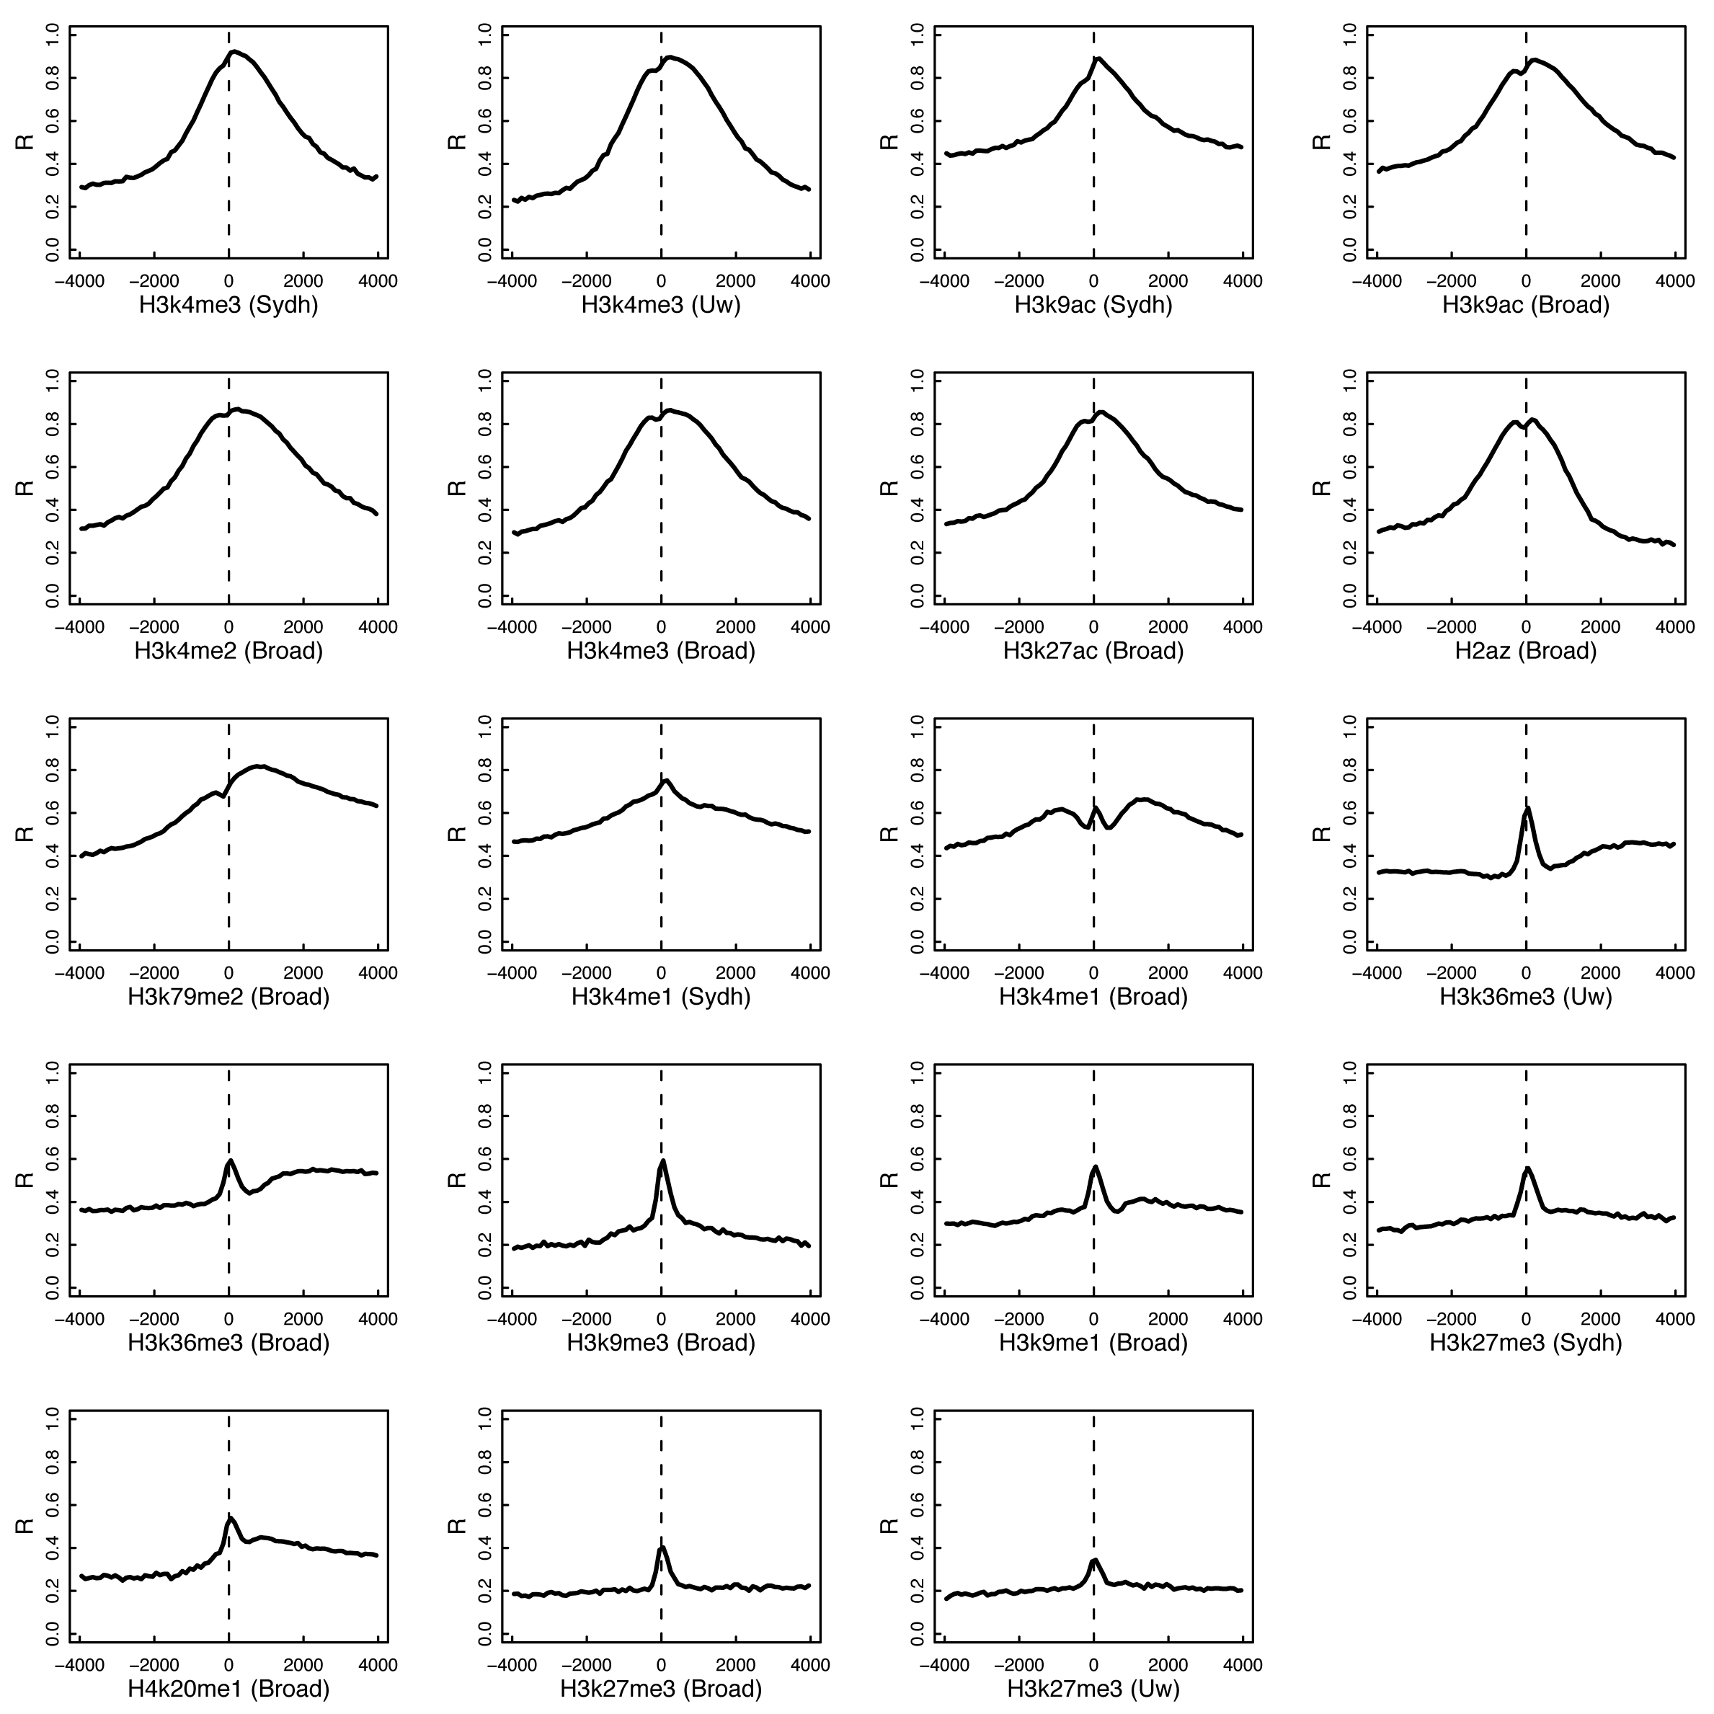
TF→HM

Slide 26
Conditional predictive power
TF model
R=0.8392592 (R²=0.7029763)
HM model
R=0.8044178 (R²=0.6464004)
TF + HM
R=0.8542955 (R²=0.7281623)
TF|HM
R=0.3682985 (R²=0.1343218)
HM|TF
R=0.2890375 (R²=0.08220921)

Slide 27
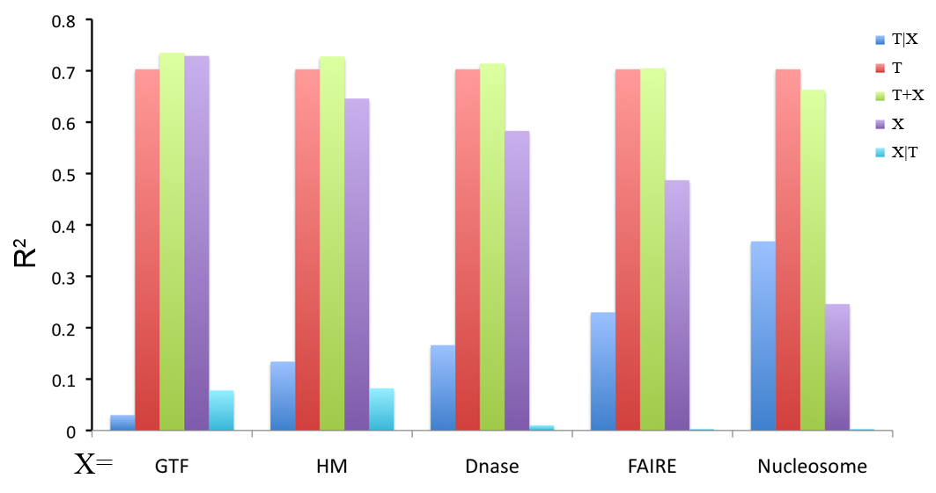
Conditional predictive power

Slide 28
CR model

Slide 29
CR model

Slide 30
CTCF insulates TF binding signals inside core promoters
Choose TSSs protected by CTCF binding peaks

Slide 31
X chromosome dosage

Slide 32
Conclusions
Different techniques/component/TSS
Cell line specificity
TF → HM

Slide 33
Bio-model
TF binding
5
6
3
Pol II binding
Expression
Chromatin structure
9
11
1
2
4
Histone modification
8
7
10
DNase, FAIRE, Input DNA…
recruiting histone modifiers
Recruiting TFs
Accessibility
Remodeling
Recruiting general TFs
Interacting with TFs
(7) Recruit general TFs
(8) Interacting with histone modifiers
(9) Accessibility
(10) Accessibility
(11) Transcription
1

Slide 34
Acknowledgements
Koon-Kiu Yan
Joel Rozowsky
Renqiang Min
Arif Harmanci
GeTech & Nets subgroup
Mark Gerstein
Xianjun Dong, Zhiping Weng
Sarah Djebali
Ewan Birney
ENCODE people

