Slide 1
Allele-specific SNPs in non-coding regions
GenomeAnnot
Jieming
2nd Nov 2011

Slide 2
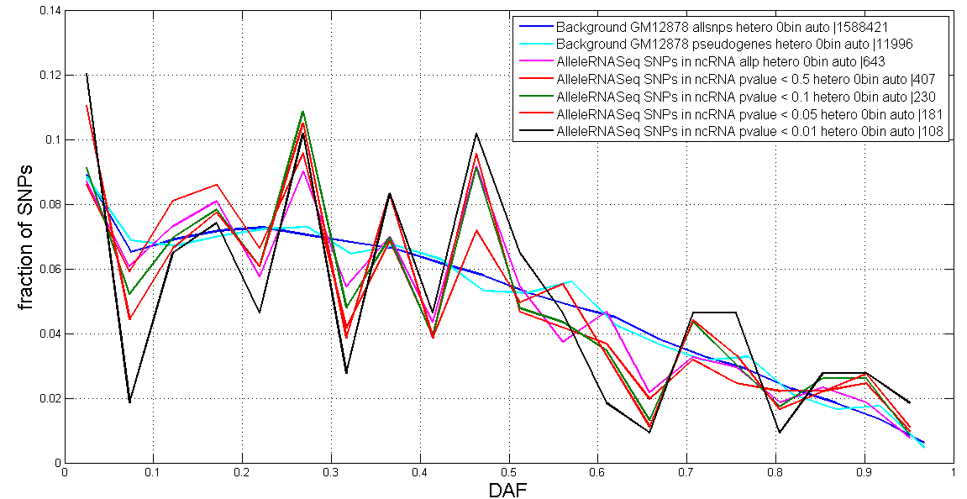
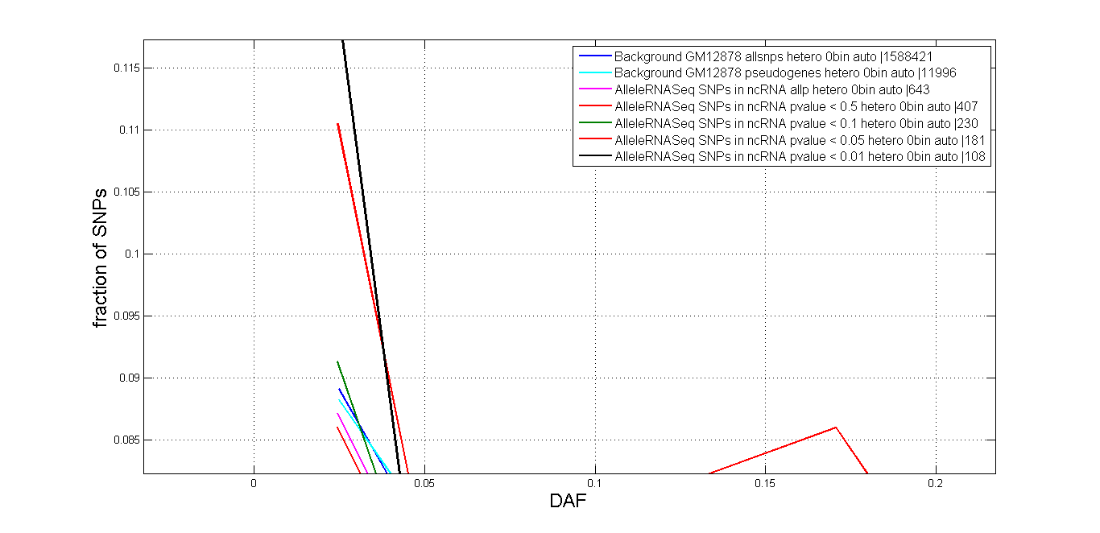
SNPs in ncRNA (RNAseq)
DAF
Notes:
edited

Slide 3
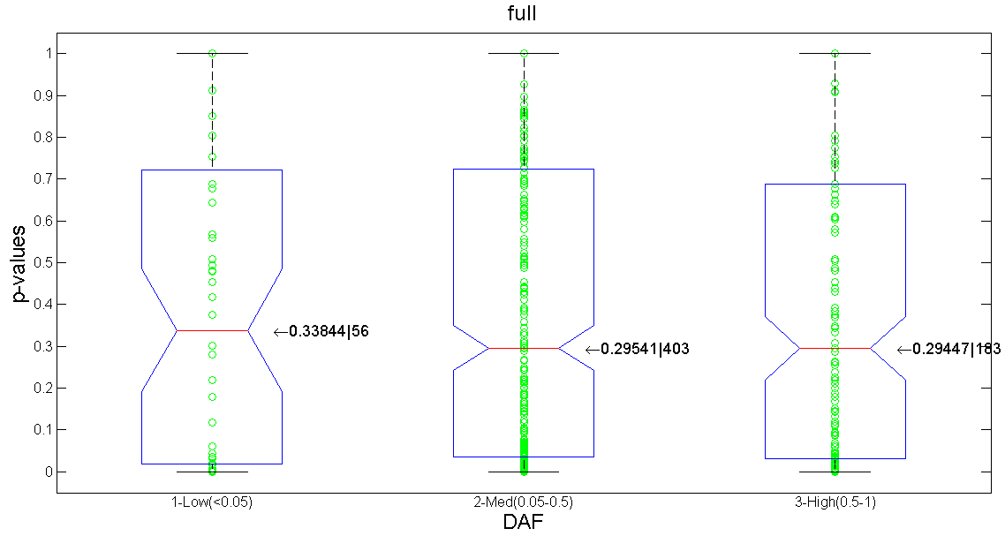
SNPs in ncRNA (RNAseq)
Correlation

Slide 4
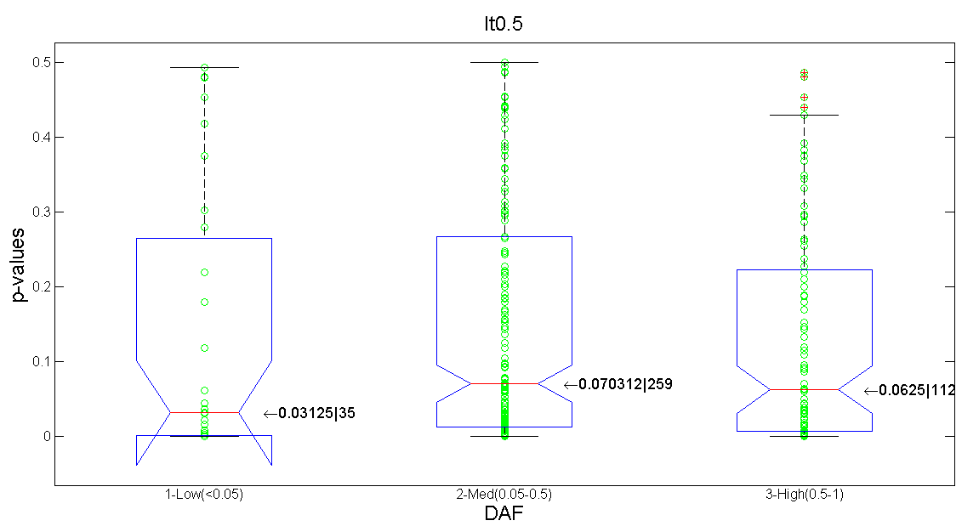
SNPs in ncRNA (RNAseq)
Correlation

Slide 5
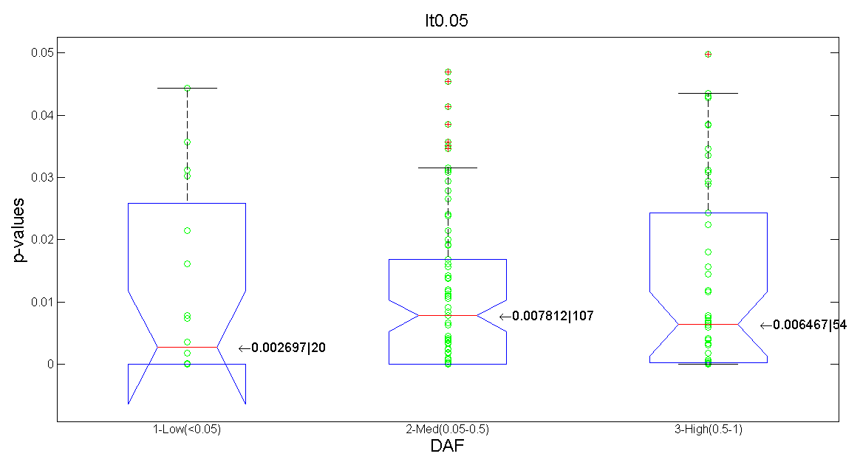
SNPs in ncRNA (RNAseq)
Correlation

Slide 6
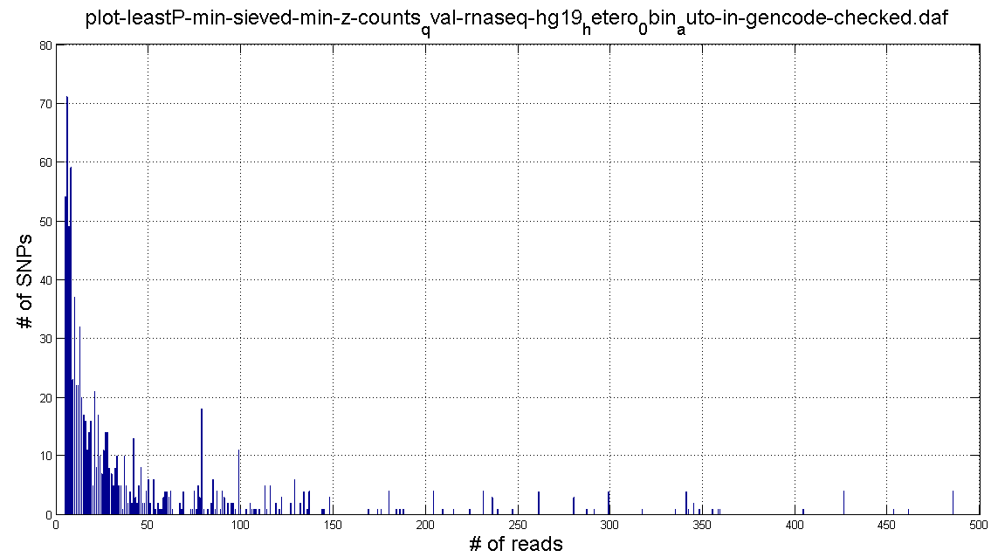
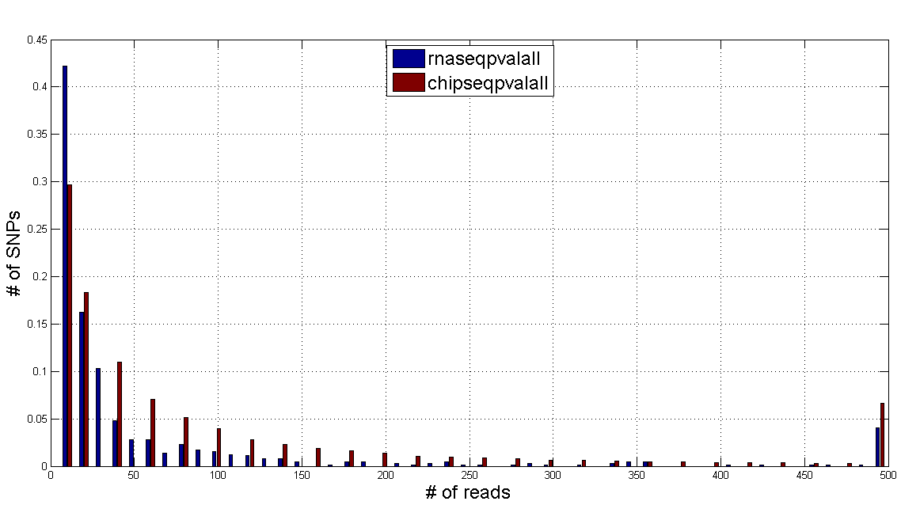
SNPs in ncRNA (RNAseq)
Reads Distribution

Slide 7
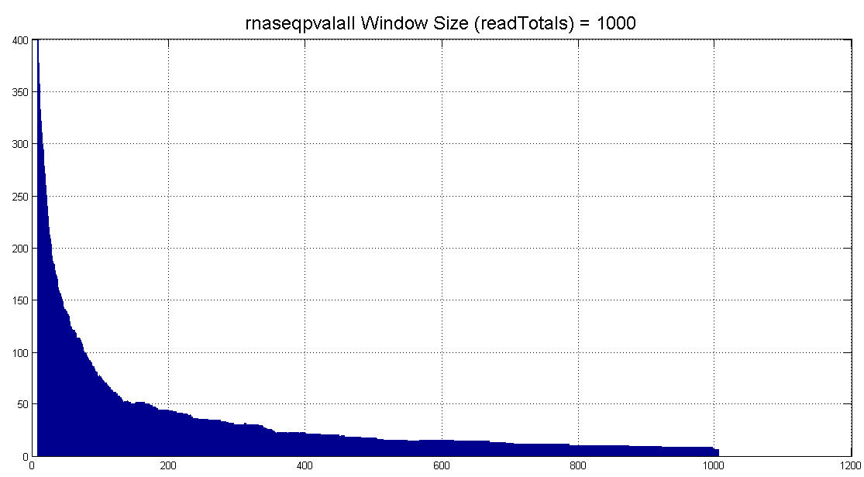
SNPs in ncRNA (RNAseq)
Sliding Window

Slide 8
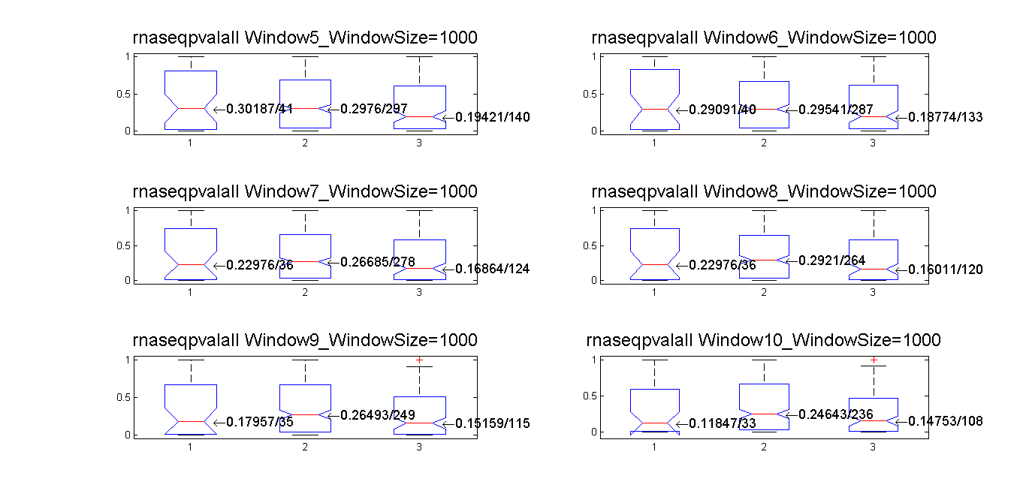
SNPs in ncRNA (RNAseq)
Correlation

Slide 9
Notes
Contradiction in interpretation of results when we compare DAF plot and boxplots.
→ might be due to small sample size after categorising?
→ peak in the middle
Validity of the 2 ways (sliding window VS whole set) applied to the small dataset in RNAseq?

