Slide 1
Allele-specific SNPs in non-coding regions
GenomeAnnot
Jieming
2nd Nov 2011

Slide 2
SNPs in ncRNA (RNAseq) DAF

Slide 3
SNPs in ncRNA (RNAseq) Correlation

Slide 4
SNPs in ncRNA (RNAseq) Correlation

Slide 5
SNPs in ncRNA (RNAseq) Correlation

Slide 6
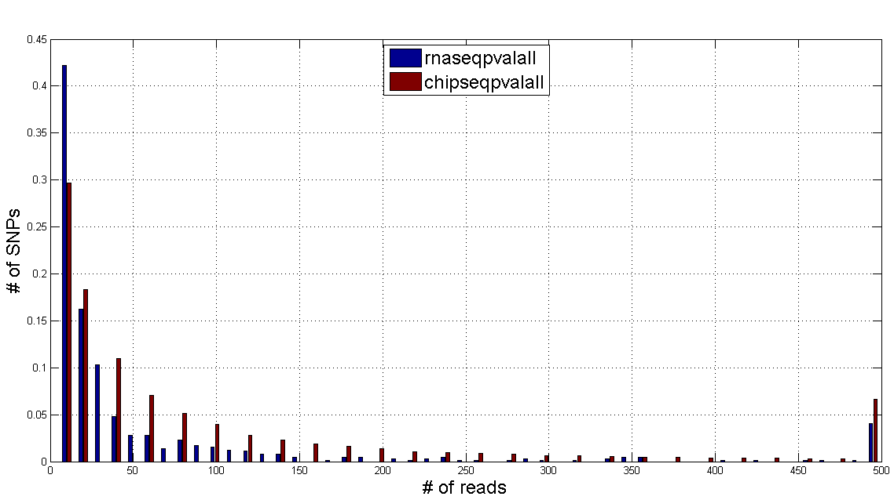
SNPs in ncRNA (RNAseq) Reads Distribution

Slide 7
SNPs in ncRNA (RNAseq) Sliding Window

Slide 8
SNPs in ncRNA (RNAseq) Correlation

Slide 9
Notes
Contradiction in interpretation of results when we compare DAF plot and boxplots. → might be due to small sample size after categorising? → peak in the middle
Validity of the 2 ways (sliding window VS whole set) applied to the small dataset in RNAseq?

