Slide 1
BN Analysis of TF Interactions on Coding Genes with Applications ncRNAs
Nov 1, 2011

Slide 2
Conditional Colocalizations
Identify promoter regions that are targeted by a Gene of interest, for example, GATA1
Get the binding profile data of all the other TFs on these gene promoters targeted by GATA1
Build Bayesian Networks to find significant binding dependencies between different TFs, that is, co-localizations between TFs conditional on GATA1’s binding

Slide 3
Results
[ SP1 CCNT2] -> MYC -> [MAX E2F1]
RAD21 -> CTCF -> CTCFL
SMC3 -> RAD21 -> [CTCF NFE2 SMARCB1]
[NR2C2 POU2F2 SMARCC1] -> TBP ->
[GTF2B JUN POLR3A]
[FOSL1 TAL1 TRIM28] -> GATA2 -> BATF
[BCLAF1 SMARCB1] -> TAL1->CCNT2
[NRF1 SIN3A] -> E2F4 -> E2F6

Slide 4
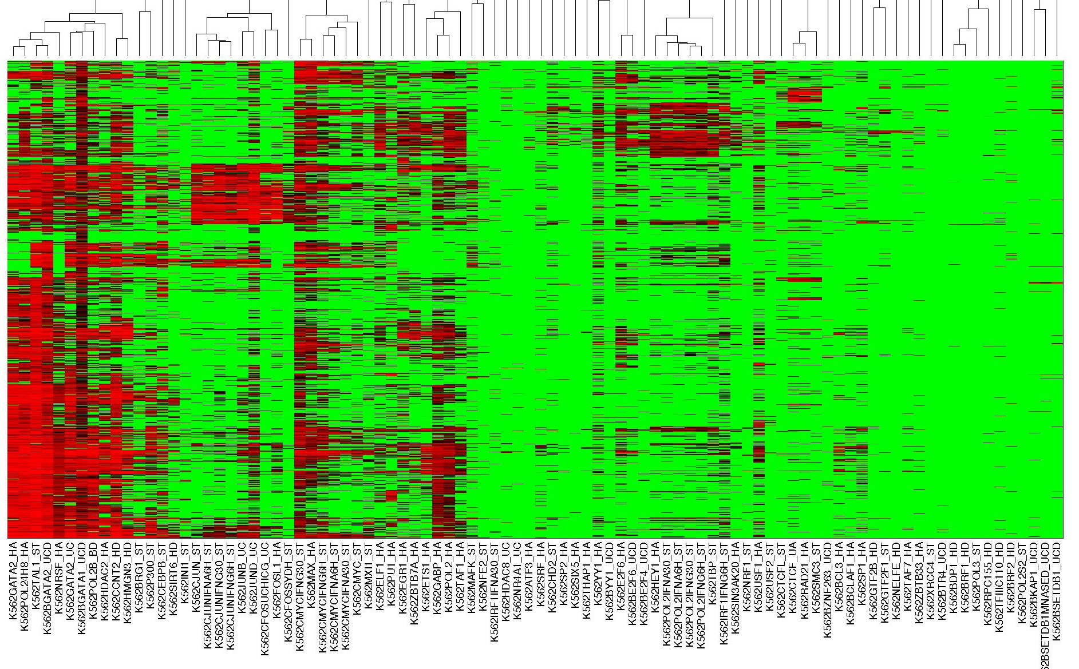
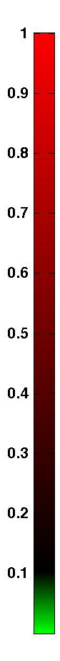
“Consistent” vs “Opportunistic” Partners
Gata2, Pol24H8, TAL1, NRSF, Pol2B, HDAC, CCNT2, HMGN3
Focus TF: Gata1 in K562
Biclustering partner association strengths
Myc, Max
Ctcf, Rad21, Smc3
E2Fs, Pol2, TBP
EGR1,Zbtb7,ETS1, Gabp, Pol2, Taf1,
Jun, Fos
E2F4,
E2F6

Slide 5
EGR1 Module
[SMC3 ZEB1] -> EGR1 -> ZBTB7A
[BRF1 SMC3] -> TAF1 -> ESRRA
[POU2F2 STAT1 ZBTB33] -> ETS1 -> CTBP2

Slide 6
Out-Degree Hubs in BN
POU2F2 -> [ELK4 ETS1 KAT2A NFKB1 TAF7 TBP USF2 ZNF263]
[HNF4G ZNF263] -> HDAC2 -> [BCL3 CTCFL FOSL1 HMGN3 NR3C1 SETDB1 SP1 STAT1 XRCC4 ]

Slide 7
Conclusions
Robust Bayesian Network learning can be used to identify conditional co-associations
BN can be trained discriminatively to find differential conditional associations
Identify interactions between TFs for a cluster of ncRNAs sharing the same expression profile as a set of coding genes
Find co-associations between TFs regulating a sub-class of ncRNAs to help functional annotation of ncRNAs

