Slide 1
Allele-specific SNPs in non-coding regions
GenomeAnnot
Jieming
26th Oct 2011

Slide 2
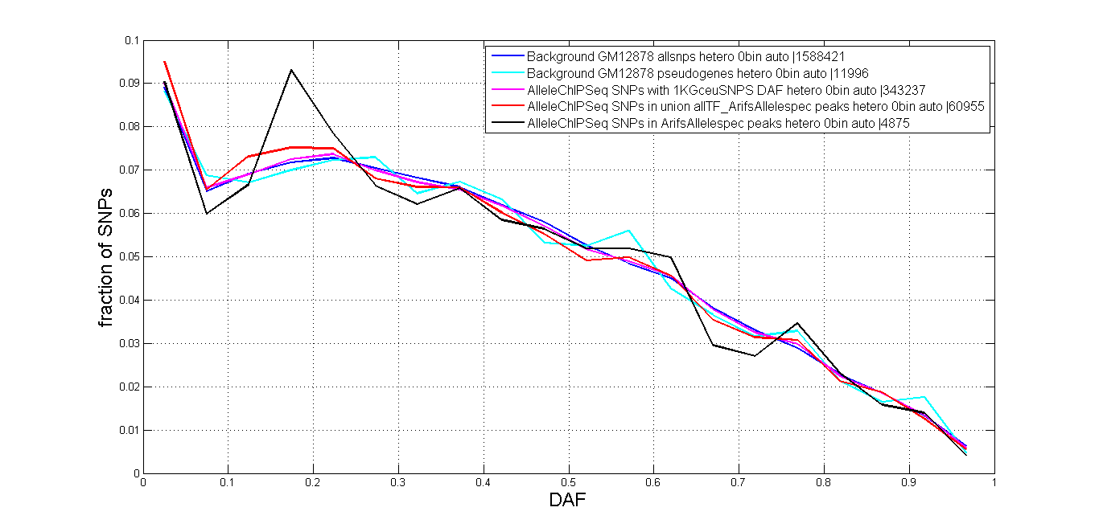
SNPs in DNA binding sites and motifs (ChIPseq) DAF

Slide 3
Correlation of allelicity and DAF: Issue
P-value correlates with larger sample size
Perform correlation on a slice of the reads distribution. → low numbers of reads give more false positives/noise.

Slide 4
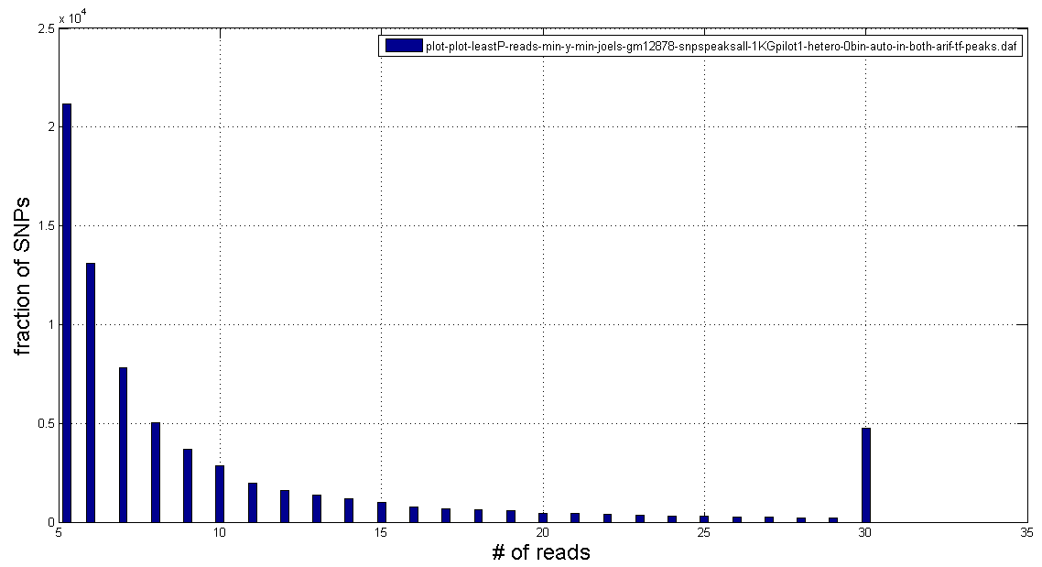
Reads distribution of allTF+AS

Slide 5
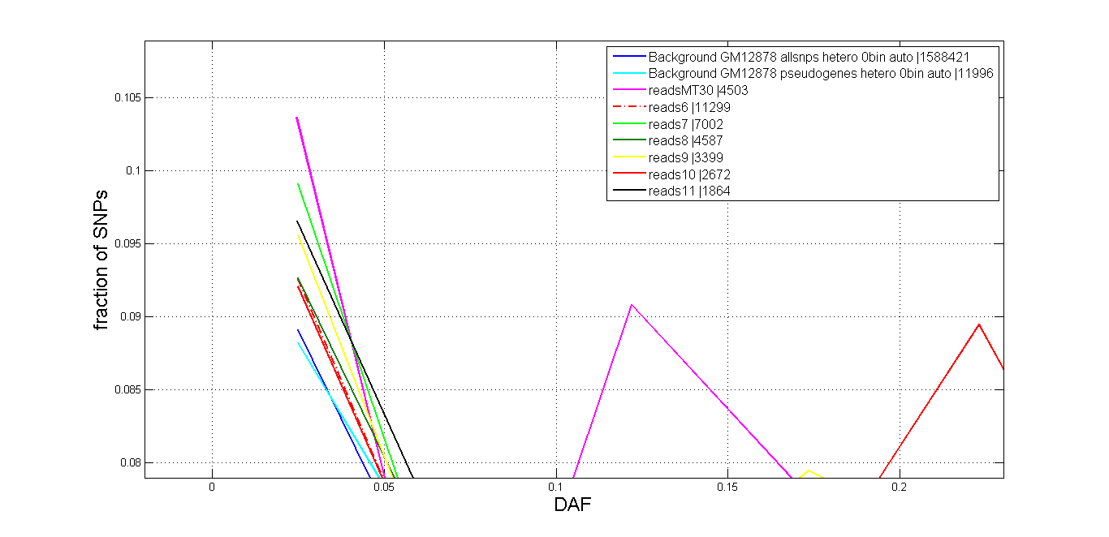
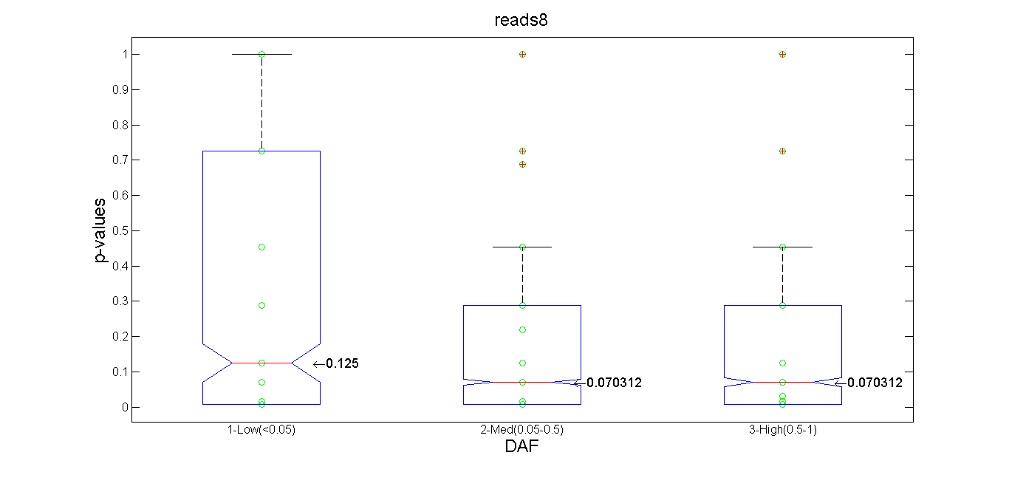
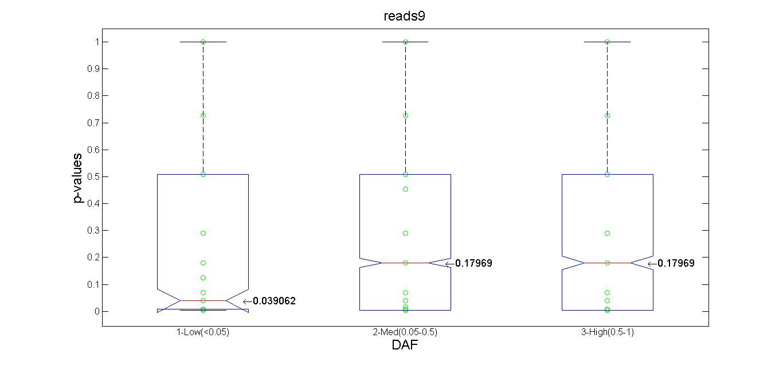
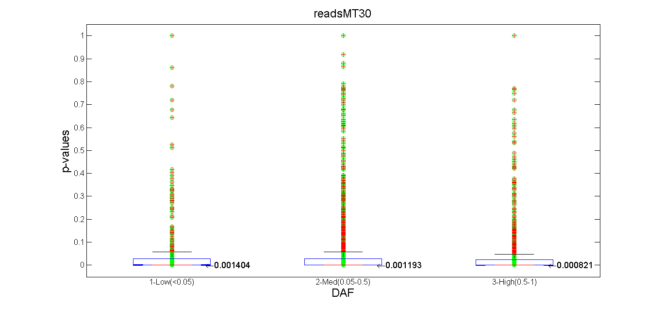
Reads distribution of allTF+AS

Slide 6
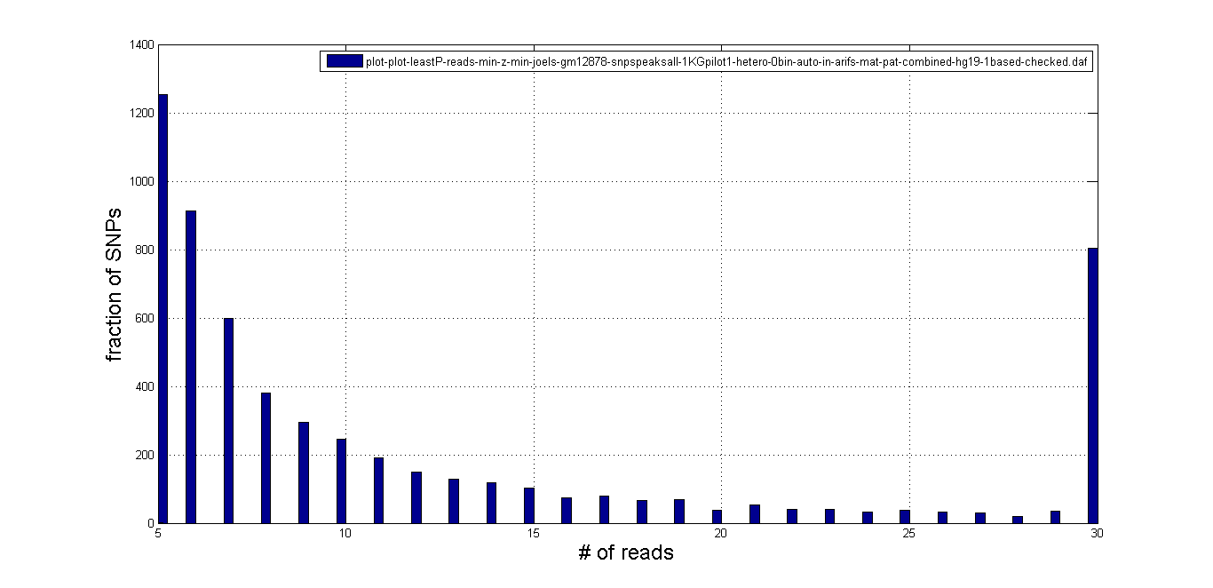
Reads distribution of only AS

Slide 7
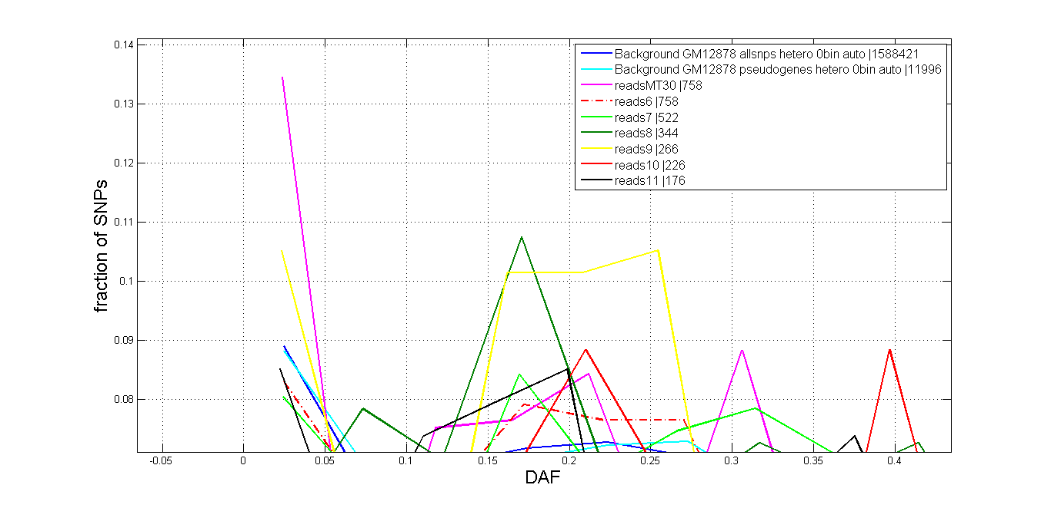
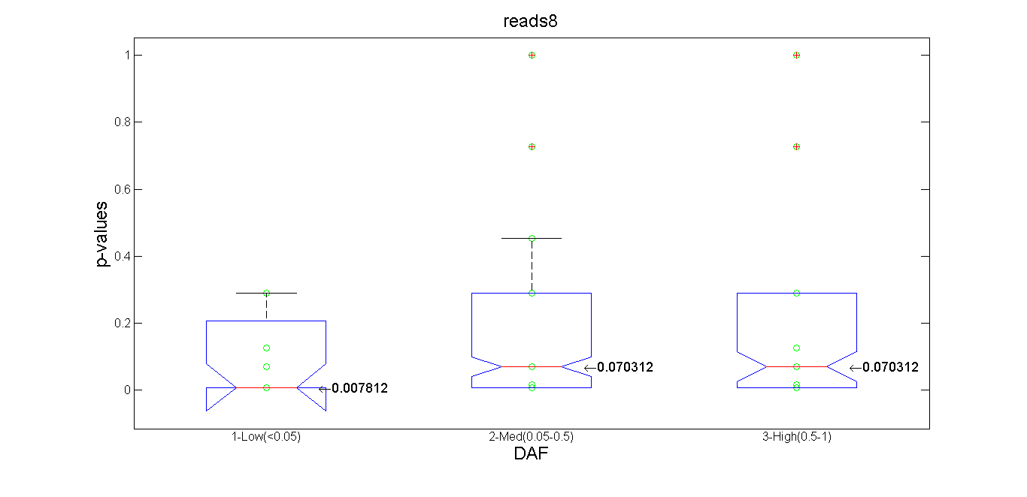
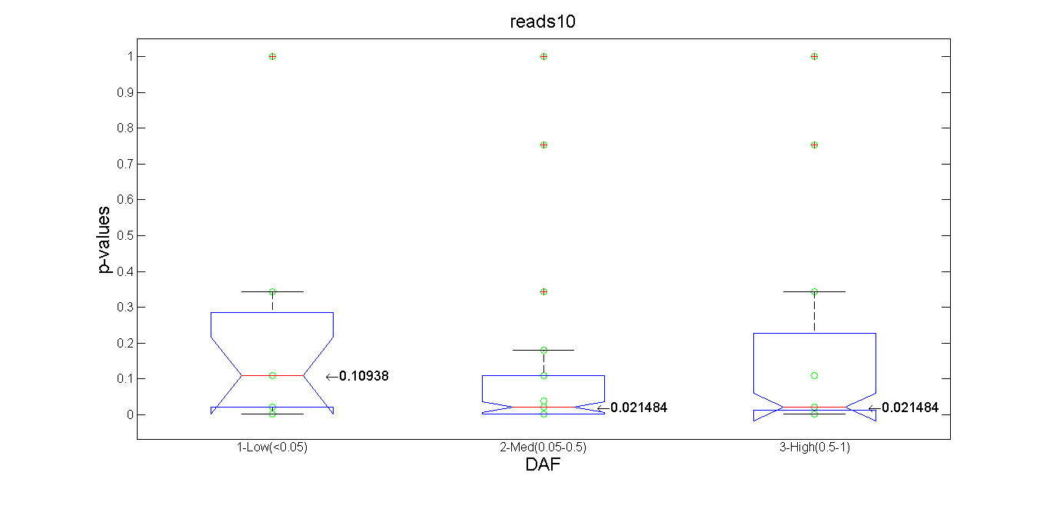
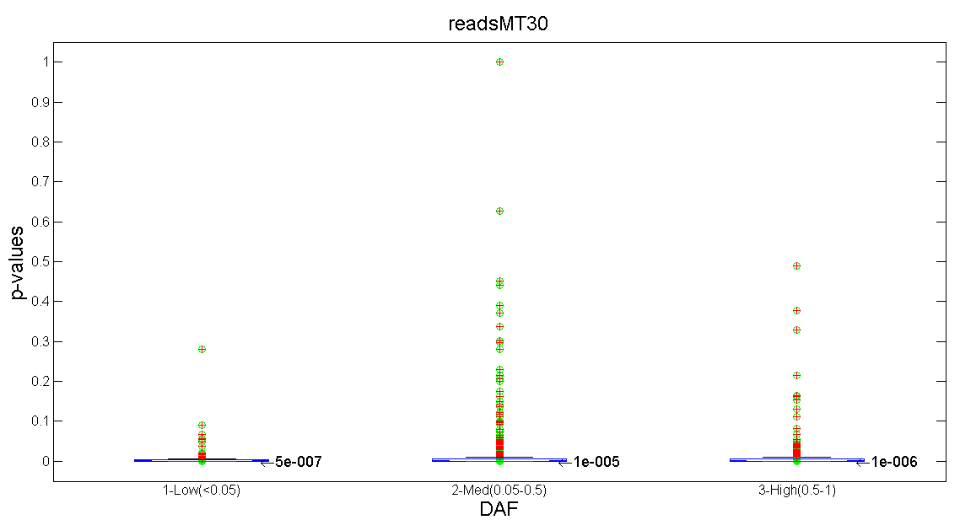
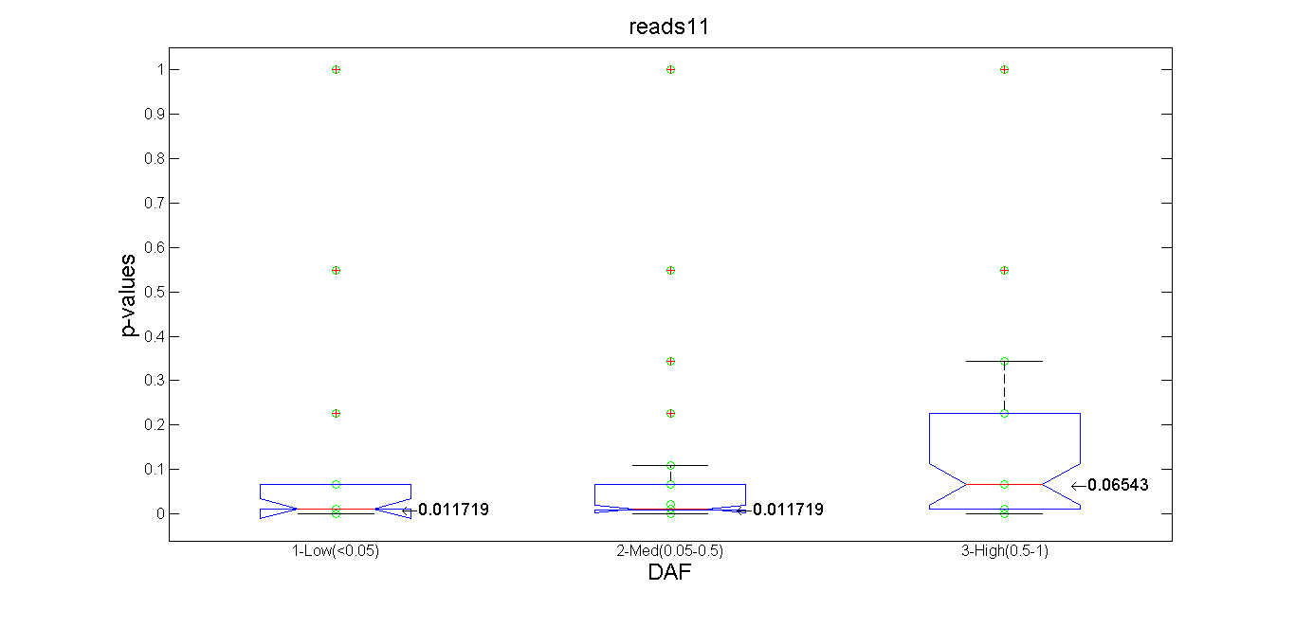
Reads distribution of only AS

Slide 8
Notes I
Less noise from MT30
AS only overly corrected or TF+AS more noise in rare SNPs in read counts?

Slide 9
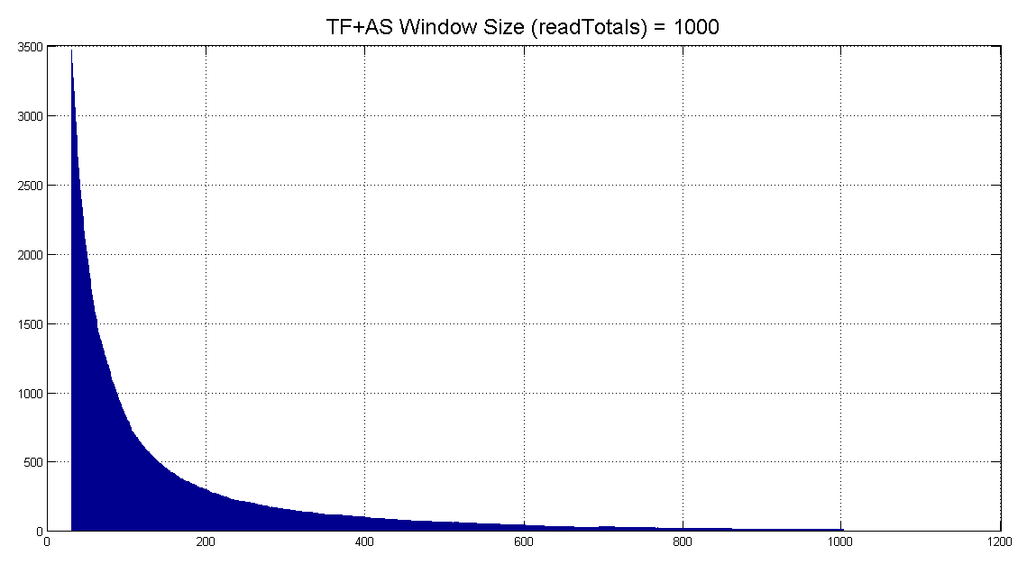
Sliding Window

Slide 10
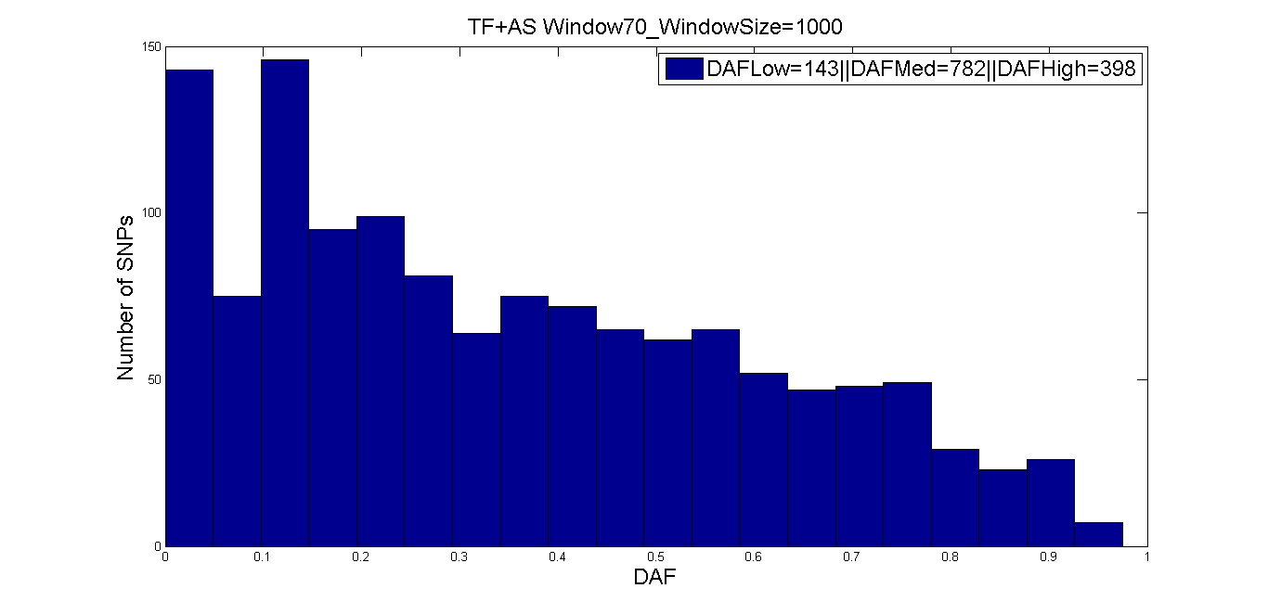
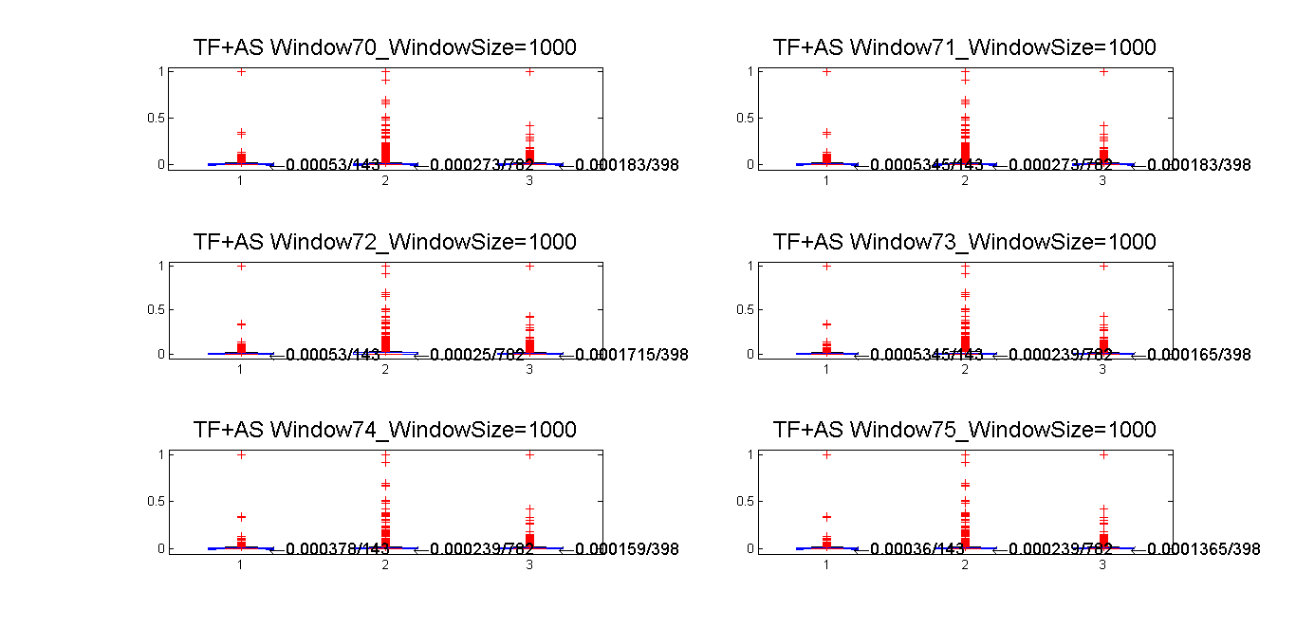
TF+AS 70th Window
P-values
(Mann-Whitney U Test)
window | LM | LH | MH
70 | 0.89927 | 0.626554 | 0.360956
71 | 0.941664 | 0.54836 | 0.314884
72 | 0.943081 | 0.557563 | 0.325831
73 | 0.907797 | 0.489426 | 0.380728
74 | 0.913341 | 0.582636 | 0.316802
75 | 0.858329 | 0.634584 | 0.315506

Slide 11
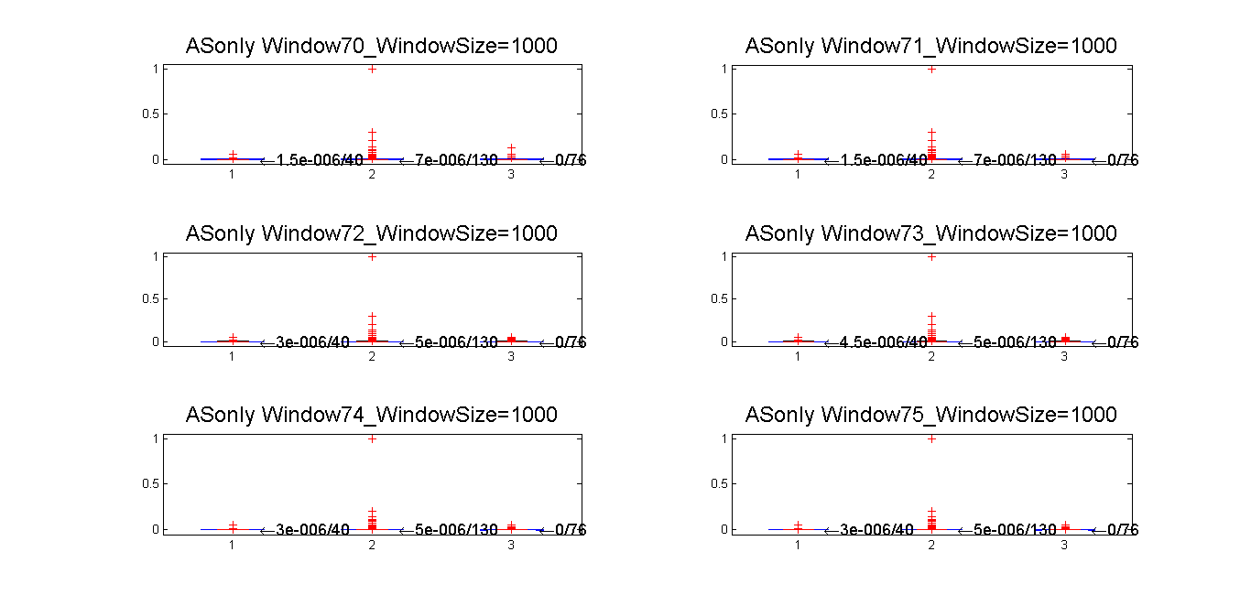
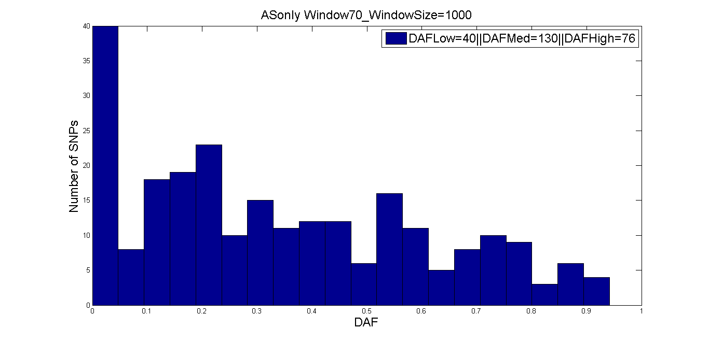
ASonly 70th Window
P-values
(Mann-Whitney U Test)
window | LM | LH | MH
70 | 0.345636 | 0.989931 | 0.230931
71 | 0.349138 | 0.963976 | 0.194782
72 | 0.472591 | 0.78037 | 0.187258
73 | 0.555616 | 0.695792 | 0.187258
74 | 0.469938 | 0.80706 | 0.200769
75 | 0.469938 | 0.80706 | 0.200769

