Slide 1
ncVarII
Selection on subgroups of non-coding elements

Slide 2
Hot regions for TF binding
0.01 0.02 0.03 0.04 0.05 Non-0.01 Non-0.05
Hot regions
None hot regions
Notes:
new SNP DAF corrected

Slide 3
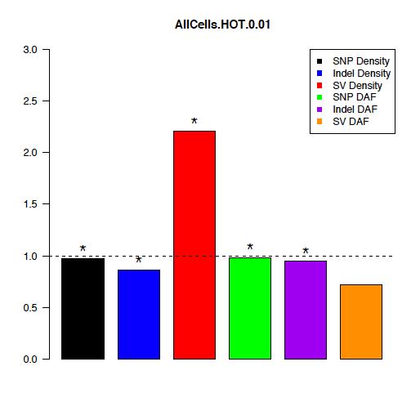

Slide 4
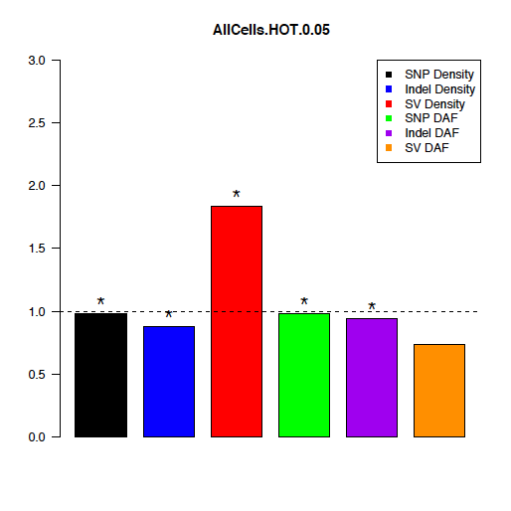

Slide 8
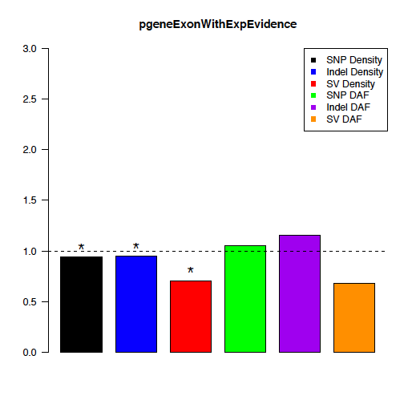

Slide 9
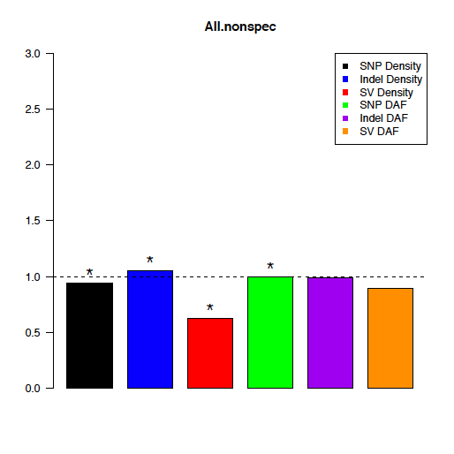

Slide 10
Selection on subregions of miRNA

Slide 11
miRNA
5’flank miR loop miR* 3’flank

Slide 12
Correlation between regulators, target sites, and target genes

Slide 13
TF
TF
TF
-0.09
-0.08
0.01
0.33**
target (T)
binding site:
peak (P)/motif (M)
M
T
M
T
0.03
0.07
SNP density
SNP DAF
TF
TF
Spearman’s correlation: rho
Average DAF
0.16
1.00
0.09
1.00
M
T
M
T
-0.18
-0.12
Indel density
Indel DAF
TF
TF
-0.05
-0.13
NA
NA
M
T
M
T
** p-value<0.01
* p-value<0.05
0.46**
0.73**
SV density
SV DAF
Notes:
Average DAF

Slide 14
TF
TF
TF
-0.09
-0.08
0.00
0.25*
target (T)
binding site:
peak (P)/motif (M)
M
T
M
T
0.03
0.06
SNP density
SNP DAF
TF
TF
Spearman’s correlation: rho
DAF<0.05
0.16
NA
0.09
-0.87
M
T
M
T
-0.18
0.00
Indel density
Indel DAF
TF
TF
-0.05
-0.13
NA
NA
M
T
M
T
** p-value<0.01
* p-value<0.05
0.46**
0.61**
SV density
SV DAF
Notes:
0.05 DAF

Slide 15
TF
M
TF
M
TF
0.10
0.07
0.36**
-0.08
-0.05
0.33**
target (T)
binding site:
peak (P)/motif (M)
P
T
P
T
-0.01
0.13
SNP density
SNP DAF
M
TF
M
TF
Spearman’s correlation: rho
Average DAF
0.10
-0.09
0.05
-1.00
0.09
1.00
P
T
P
T
0.01
-0.15
Indel density
Indel DAF
M
TF
M
TF
0.07
0.60**
0.32**
-0.13
NA
NA
P
T
P
T
** p-value<0.01
* p-value<0.05
0.34**
0.37**
SV density
SV DAF
Notes:
Average DAF

Slide 16
TF
M
TF
M
TF
0.10
0.07
0.30**
-0.08
-0.05
0.25*
target (T)
binding site:
peak (P)/motif (M)
P
T
P
T
-0.01
-0.06
SNP density
SNP DAF
M
TF
M
TF
Spearman’s correlation: rho
DAF<0.05
0.10
-0.09
0.04
-0.87
0.09
-0.87
P
T
P
T
0.01
-0.26
Indel density
Indel DAF
M
TF
M
TF
0.07
0.46*
0.32**
-0.13
NA
NA
P
T
P
T
** p-value<0.01
* p-value<0.05
0.34**
0.27*
SV density
SV DAF
Notes:
0.05 DAF

Slide 17
miRNA (R)
R
R
0.06*
0.00
binding site (S)
0.02
0.01
CDS (G)
S
G
S
G
5’UTR
3’UTR
0.33**
0.10**
target gene
SNP density
SNP DAF
R
R
Spearman’s correlation: rho
Average DAF
-0.04
-0.52
-0.02
0.13
S
G
S
G
-0.07*
0.12**
Indel density
Indel DAF
R
R
0.05
0.01
NA
NA
S
G
S
G
** p-value<0.01
* p-value<0.05
0.51**
0.59**
SV density
SV DAF

Slide 18
miRNA (R)
R
R
0.06*
-0.10
binding site (S)
0.02
0.04
CDS (G)
S
G
S
G
5’UTR
3’UTR
0.33**
0.04
target gene
SNP density
SNP DAF
R
R
Spearman’s correlation: rho
DAF < 0.05
-0.04
-0.19
-0.02
0.12
S
G
S
G
-0.07*
0.04
Indel density
Indel DAF
R
R
0.05
0.01
NA
NA
S
G
S
G
** p-value<0.01
* p-value<0.05
0.51**
0.58**
SV density
SV DAF

Slide 19
miRNA (R)/
miR (M)
0.39**
0.81**
R
M
R
M
0.07*
0.12
binding site (S)
0.03
-0.11
CDS (G)
S
G
S
G
5’UTR
3’UTR
0.33**
0.10**
target gene
SNP density
SNP DAF
0.52**
1.00
R
M
R
M
0.06
-0.01
-0.50
0.50
S
G
S
G
-0.07*
0.12**
Spearman’s correlation: rho
Average DAF
Indel density
Indel DAF
1.00**
1.00
R
M
R
M
0.05
0.01
NA
NA
S
G
S
G
** p-value<0.01
* p-value<0.05
0.51**
0.59**
SV density
SV DAF

Slide 20
miRNA (R)/
miR (M)
0.39**
0.89**
R
M
R
M
0.07*
-0.10
binding site (S)
0.03
0.19
CDS (G)
S
G
S
G
5’UTR
3’UTR
0.33**
0.04
target gene
SNP density
SNP DAF
0.52**
1.00
R
M
R
M
0.06
-0.01
NA
0.00
S
G
S
G
-0.07*
0.04
Spearman’s correlation: rho
DAF < 0.05
Indel density
Indel DAF
1.00**
NA
R
M
R
M
0.05
0.01
NA
NA
S
G
S
G
** p-value<0.01
* p-value<0.05
0.51**
0.58**
SV density
SV DAF

Slide 21
Cell line specific vs. ubiquitous RNA expressions
Cell line/tissue specific DNase I
Selection of between-motif regions vs. within-motif regions in TF-binding hot regions
Notes:
miRNAs

Slide 22
miRNA
miRNA flanking stem loop

