Slide 1
Upstream Elements of Pseudogenes, Genes and Paralogues
Cristina Sisu
4th Oct 2011
Annotation

Slide 2
Upstream Elements
Chromatin features
Transcription factor binding sites
Active promoters
Active enhancers

Slide 3
Test Set
80 pseudogenes in SD with parents in SD:
23 processed pseudogenes
52 unprocessed pseudogenes
1 pseudogene
2 TR-pseudogenes
2 IG-pseudogenes
8 transcribed pseudogenes
48 parent genes have 307 paralog genes within the human genome

Slide 4
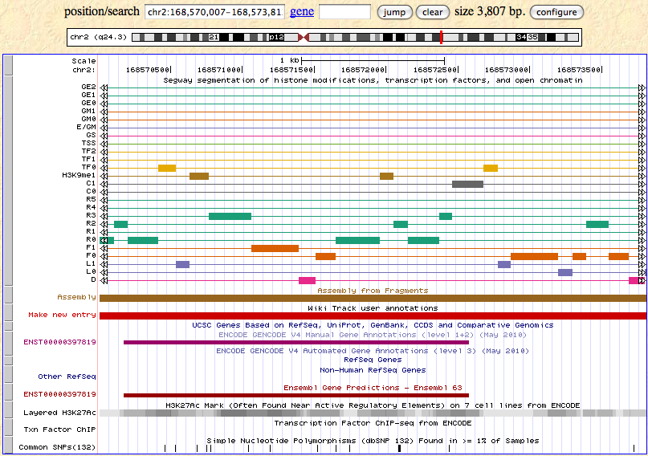
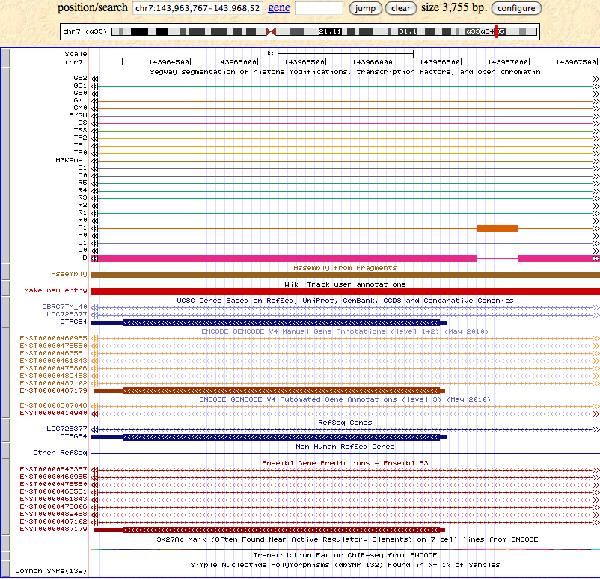
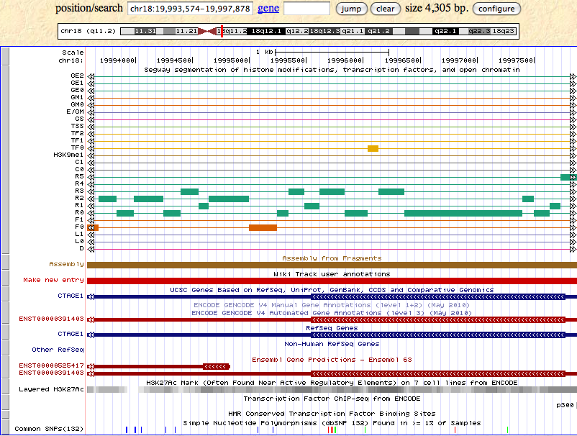
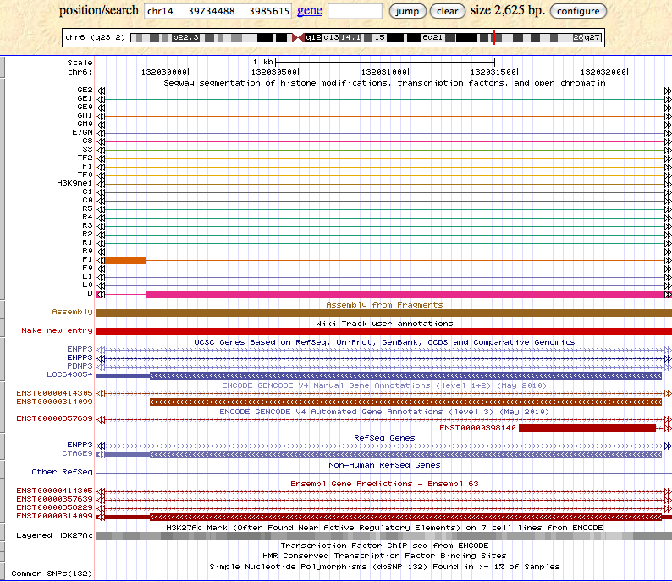
Pseudogene
Parent
Paralog1
Paralog2
Chromatin Marks

Slide 5
Chromatin Marks
When both parent and pgene are in SD on the same chromosome = > conservation of chromatin marks
When pgene and parent are in SD on different chromosomes => pgene shows degradation of the chromatin marks
Paralogs:
Seq Identity >90% => conservation of the chromatin marks
Seg Identity <90% => degradation of the chromatin marks

Slide 6
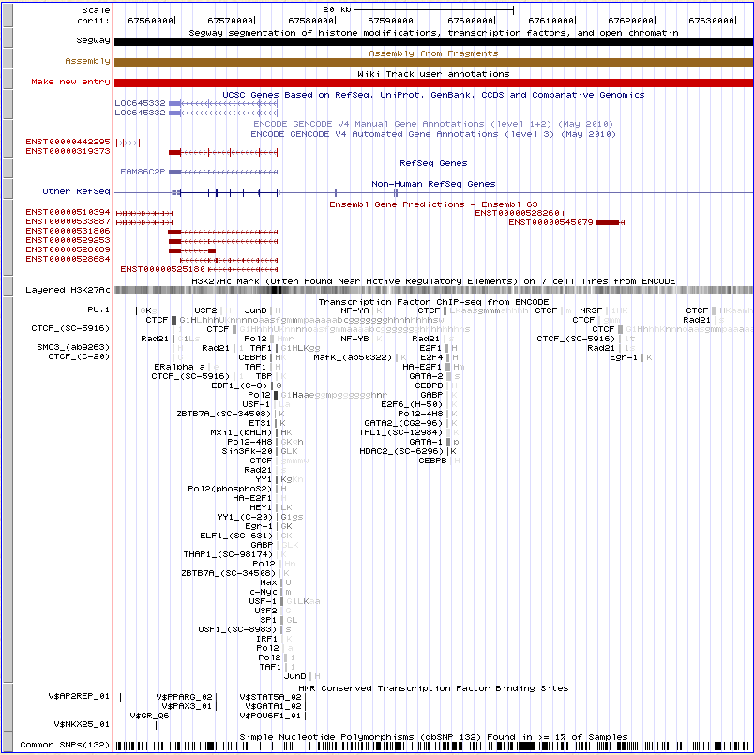
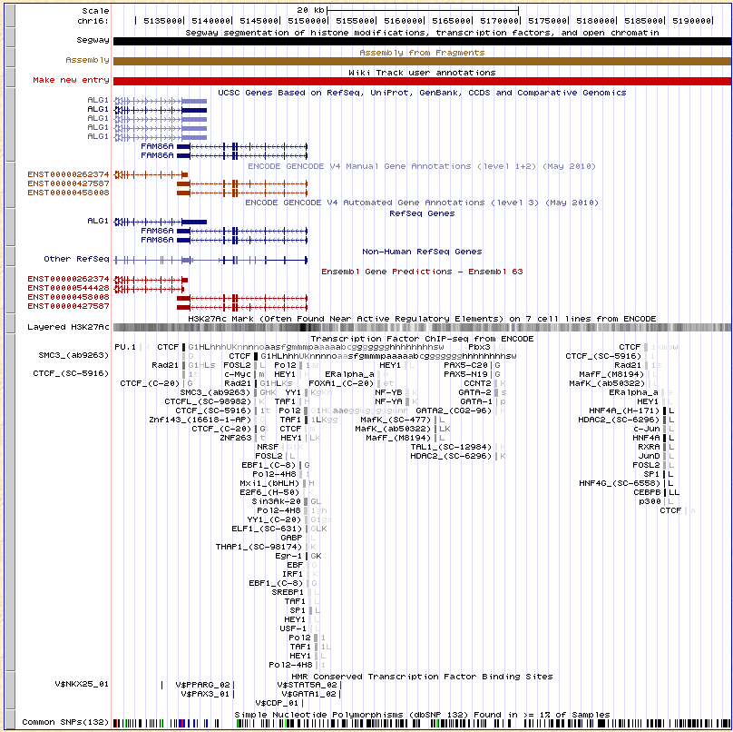
TFBS

Slide 7
Transcription Factor Binding Sites
Observed within the SD only for transcribed pgenes.
Up to 60% of TFBS are conserved between the parent gene and pseudogene in the SD
Paralogues:
Between 30-100% of the TFBS are conserved
No significant difference were observed when the % seq identity dropped beneath 90%

Slide 8
Active Promoters and Enhancers
No active promoters or enhancers were found in the upstream region within the SD for the pseudogenes in the test set for GM12878.
=> enlarge the pseudogene set
=> look for active promoters & enhancers in the parent genes & paralogues

Slide 9
To Do’s
Extend the list of pseudogenes in SD
Different cell lines
Extract pseudogenes paralogues
Diferentiate pseudogenes based on age

