Slide 1
Allele-specific SNPs in non-coding regions
GenomeAnnot
Jieming
13th Oct 2011

Slide 2
SNPs in DNA binding sites and motifs (ChIPseq)
Wants to see if variations in DNA binding sites, motifs and non-coding RNAs at allele-specific sites are disruptive.
Initial hypothesis: → SNPs causing more allele-specific effects tend to be under more negative selection.

Slide 3
SNPs in DNA binding sites and motifs (ChIPseq)
Hg19
Autosomal SNPs
SNPs are heterozygous on GM12878
DAF=0 for SNPs specific to GM12878
For non-background datasets, also
- Remove SNPs from pseudogenes

Slide 4
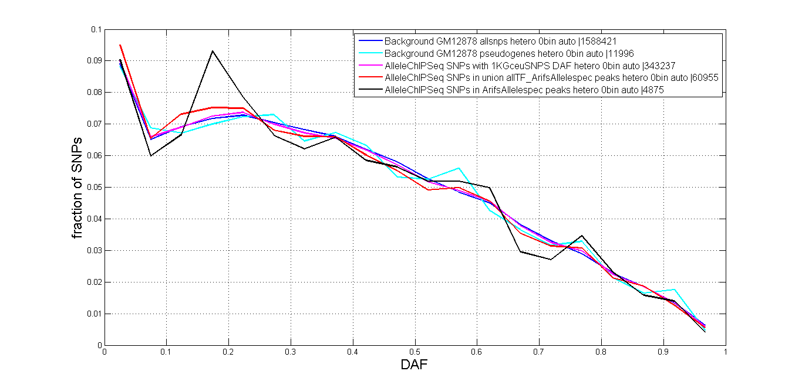
SNPs in DNA binding sites and motifs (ChIPseq) DAF

Slide 5
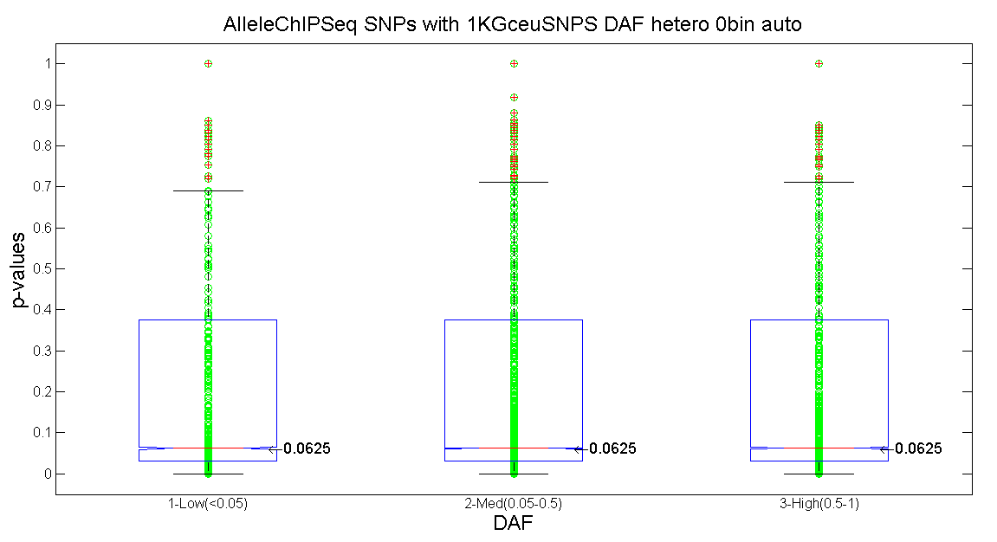
SNPs in DNA binding sites and motifs (ChIPseq) Correlation

Slide 6
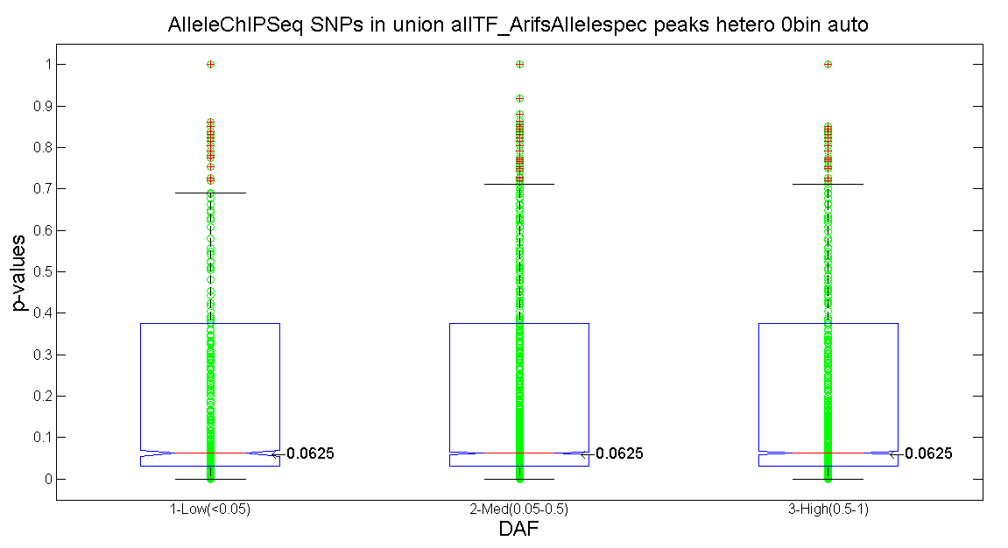
SNPs in DNA binding sites and motifs (ChIPseq) Correlation

Slide 7
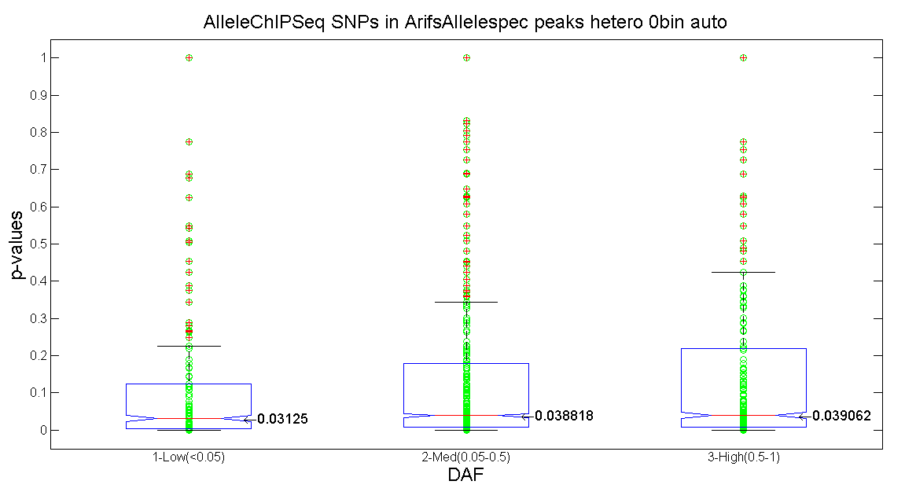
SNPs in DNA binding sites and motifs (ChIPseq) Correlation

Slide 8
SNPs in DNA binding sites and motifs (ChIPseq) Correlation
Joel all SNPs
DAF | Proportion of SNPs (343237) | Low | Med | High
Low (0-0.05) | 0.0901 | -- | 0.0975 | 0.759
Med (0.05-0.5) | 0.6028 | -- | -- | 0.0316
High (0.5-1) | 0.3071 | -- | -- | --
Joel SNPs in Arif’s and all TF peaks
DAF | Proportion of SNPs (60995) | Low | Med | High
Low (0-0.05) | 0.0951 | -- | 0.1332 | 0.4205
Med (0.05-0.5) | 0.6044 | -- | -- | 0.3071
High (0.5-1) | 0.3005 | -- | -- | --
Joel SNPs in Arif’s peaks only
DAF | Proportion of SNPs (4875) | Low | Med | High
Low (0-0.05) | 0.0905 | -- | 0.0199 | 0.0048
Med (0.05-0.5) | 0.6076 | -- | -- | 0.2519
High (0.5-1) | 0.3019 | -- | -- | --

Slide 9
SNPs in ncRNA (RNAseq)
Hg19
Autosomal SNPs
SNPs are heterozygous on GM12878
DAF=0 for SNPs specific to GM12878
ncRNAs annotations are from GENCODE
For non-background datasets, also
- Remove SNPs from pseudogenes (from RNA dataset too)

Slide 10
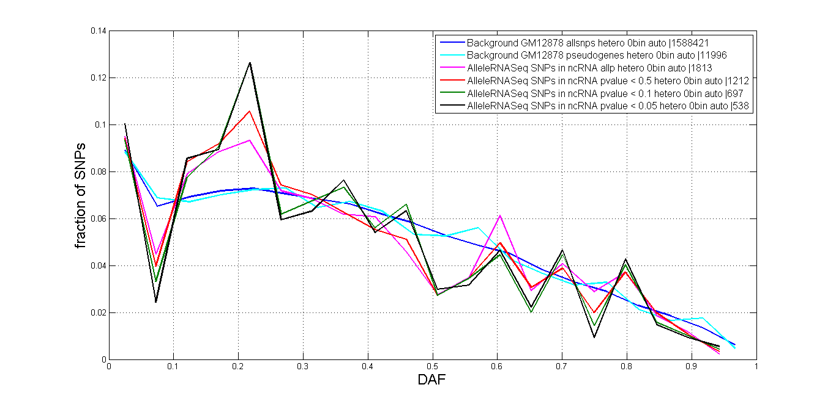
SNPs in ncRNA (RNAseq) DAF

Slide 11
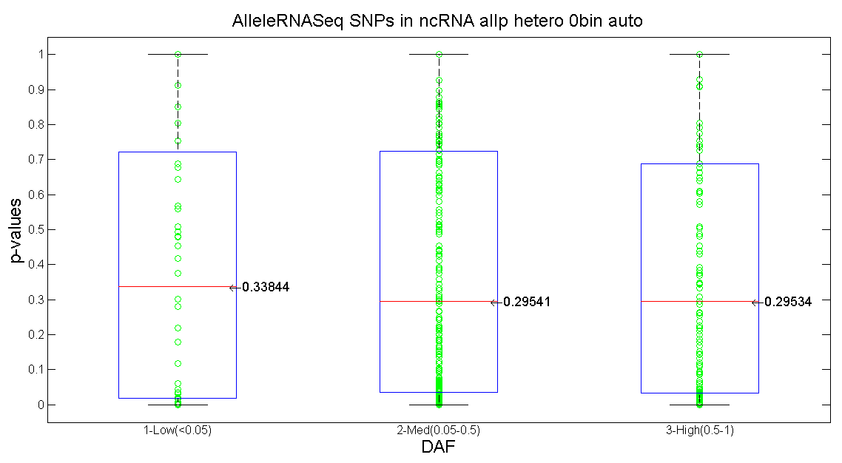
SNPs in ncRNA (RNAseq) Correlation

Slide 12
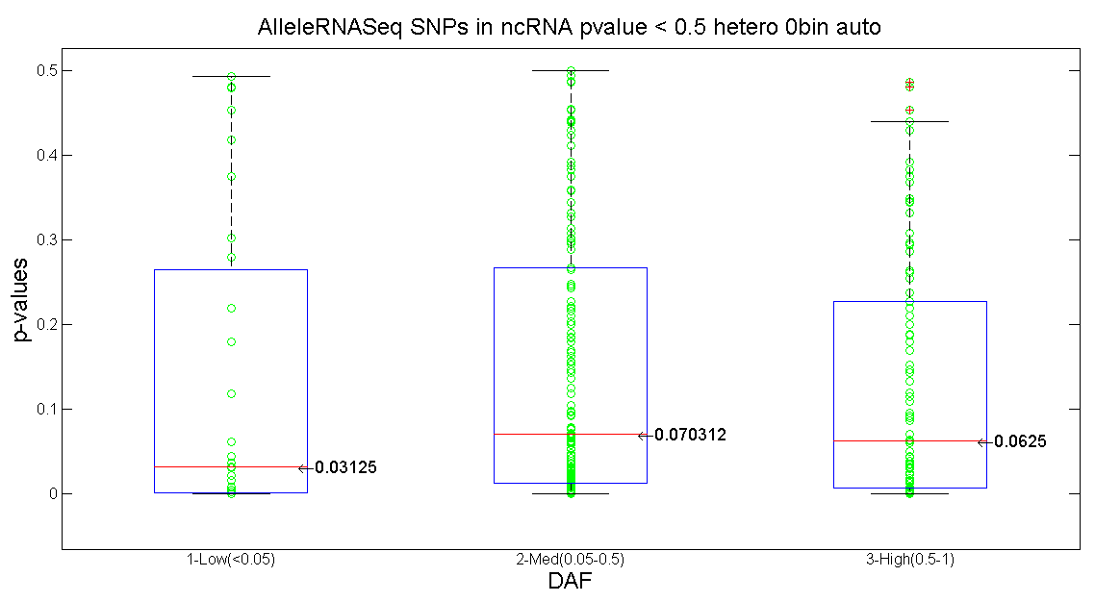
SNPs in ncRNA (RNAseq) Correlation

Slide 13
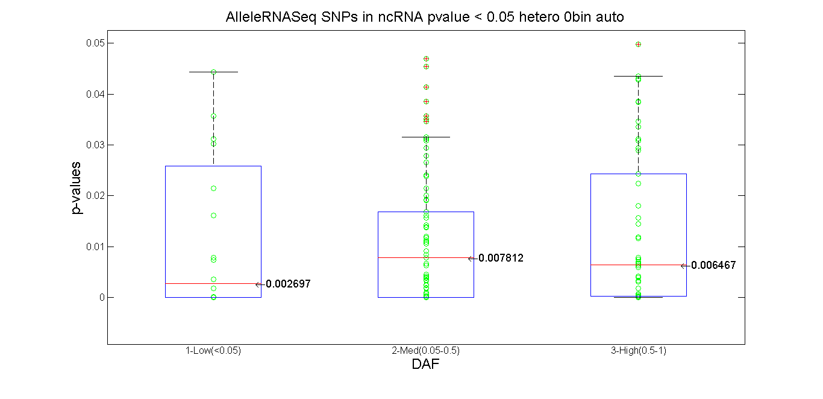
SNPs in ncRNA (RNAseq) Correlation

Slide 14
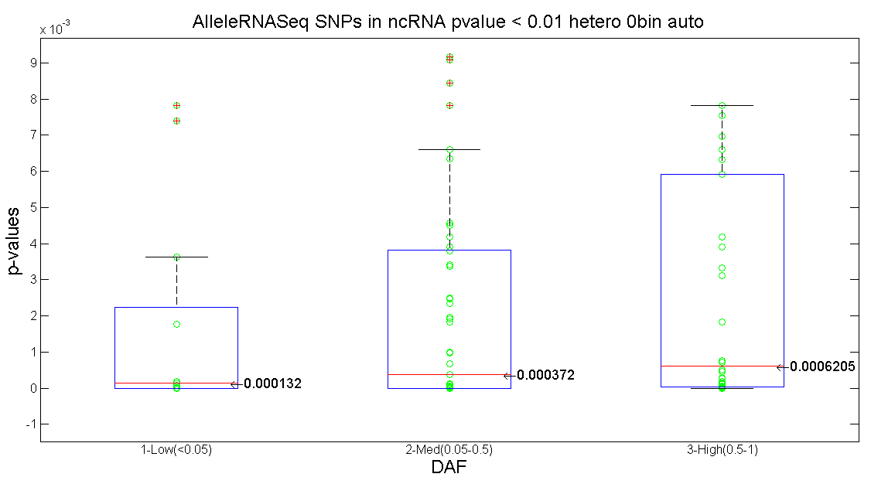
SNPs in ncRNA (RNAseq) Correlation

Slide 15
SNPs in ncRNA (RNAseq) Correlation
SNPs in ncRNA all p
DAF | Proportion of SNPs (643) | Low | Med | High
Low (0-0.05) | 0.0871 | -- | 0.7687 | 0.9325
Med (0.05-0.5) | 0.6267 | -- | -- | 0.6495
High (0.5-1) | 0.2862 | -- | -- | --
SNPs in ncRNA all p < 0.05
DAF | Proportion of SNPs (181) | Low | Med | High
Low (0-0.05) | 0.1105 | -- | 0.6808 | 0.4427
Med (0.05-0.5) | 0.5912 | -- | -- | 0.8102
High (0.5-1) | 0.2983 | -- | -- | --
SNPs in ncRNA all p < 0.01
DAF | Proportion of SNPs (108) | Low | Med | High
Low (0-0.05) | 0.1204 | -- | 0.6004 | 0.1891
Med (0.05-0.5) | 0.5648 | -- | -- | 0.3713
High (0.5-1) | 0.3148 | -- | -- | --

Slide 16
SNPs in DNA binding sites and motifs (ChIPseq) Thresholding

Slide 17
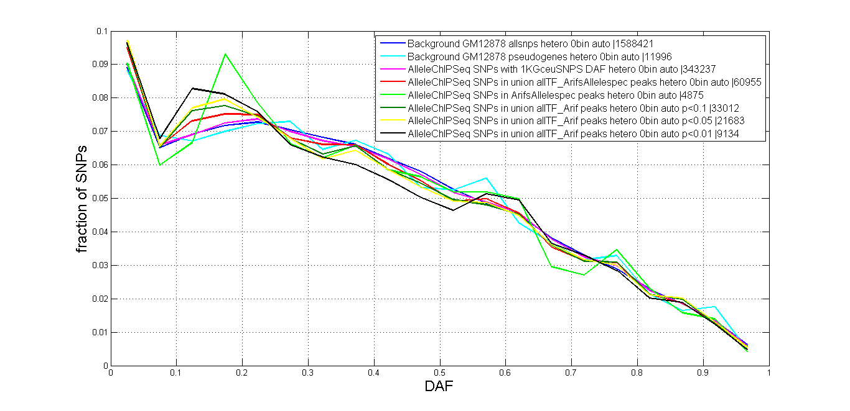
SNPs in DNA binding sites and motifs (ChIPseq) Thresholding

Slide 18
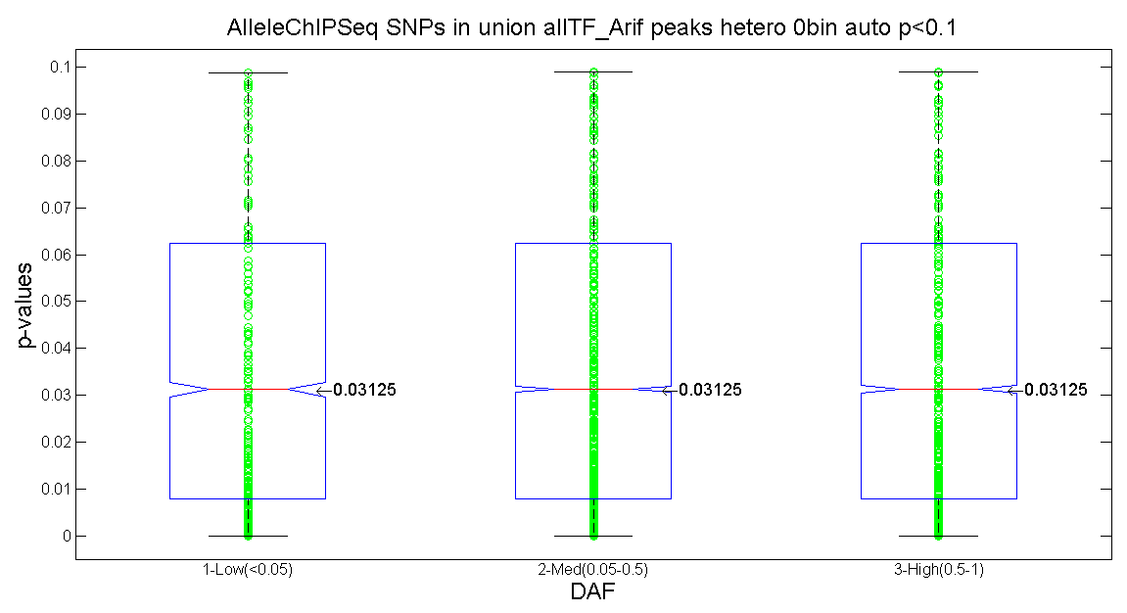
SNPs in DNA binding sites and motifs (ChIPseq) Thresholding

Slide 19
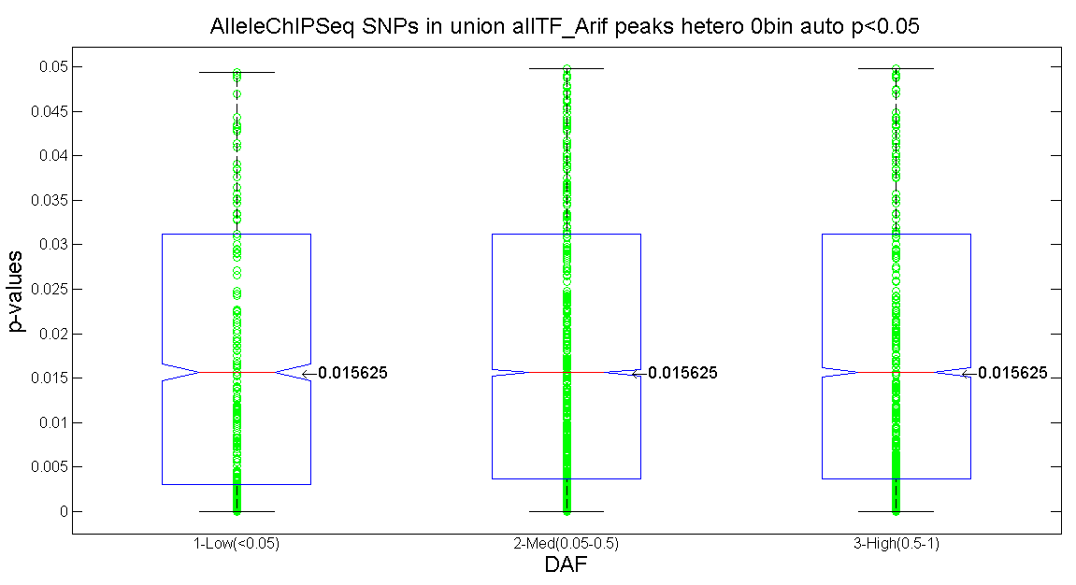
SNPs in DNA binding sites and motifs (ChIPseq) Thresholding

Slide 20
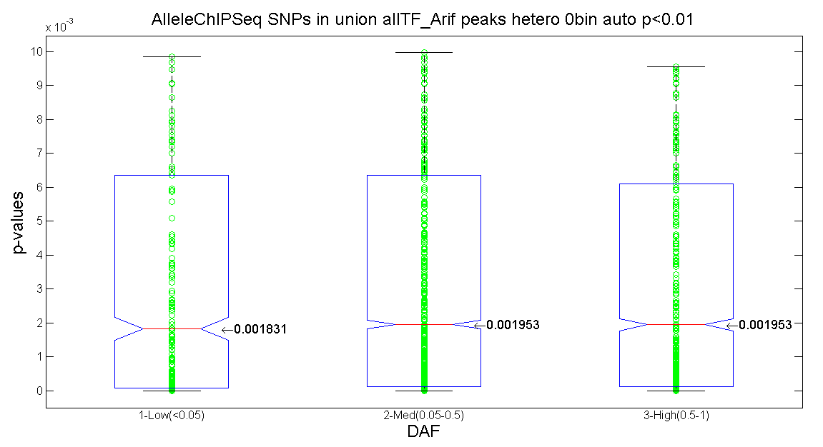
SNPs in DNA binding sites and motifs (ChIPseq) Thresholding

Slide 21
SNPs in DNA binding sites and motifs (ChIPseq) Correlation
Joel all SNPs
DAF | Proportion of SNPs (343237) | Low | Med | High
Low (0-0.05) | 0.0901 | -- | 0.0975 | 0.759
Med (0.05-0.5) | 0.6028 | -- | -- | 0.0316
High (0.5-1) | 0.3071 | -- | -- | --
Joel SNPs in Arif’s and all TF peaks
DAF | Proportion of SNPs (60995) | Low | Med | High
Low (0-0.05) | 0.0951 | -- | 0.1332 | 0.4205
Med (0.05-0.5) | 0.6044 | -- | -- | 0.3071
High (0.5-1) | 0.3005 | -- | -- | --
Joel SNPs in Arif’s peaks only
DAF | Proportion of SNPs (4875) | Low | Med | High
Low (0-0.05) | 0.0905 | -- | 0.0199 | 0.0048
Med (0.05-0.5) | 0.6076 | -- | -- | 0.2519
High (0.5-1) | 0.3019 | -- | -- | --

Slide 22
SNPs in DNA binding sites and motifs (ChIPseq) Correlation
Joel SNPs in Arif’s and all TF peaks < 0.5
DAF | Proportion of SNPs (33012) | Low | Med | High
Low (0-0.05) | 0.0901 | -- | 0.2087 | 0.3975
Med (0.05-0.5) | 0.6028 | -- | -- | 0.5793
High (0.5-1) | 0.3071 | -- | -- | --
Joel SNPs in Arif’s and all TF peaks < 0.05
DAF | Proportion of SNPs (21683) | Low | Med | High
Low (0-0.05) | 0.0951 | -- | 0.8615 | 0.9361
Med (0.05-0.5) | 0.6044 | -- | -- | 0.6817
High (0.5-1) | 0.3005 | -- | -- | --
Joel SNPs in Arif’s and all TF peaks < 0.01
DAF | Proportion of SNPs (9134) | Low | Med | High
Low (0-0.05) | 0.0905 | -- | 0.1726 | 0.2301
Med (0.05-0.5) | 0.6076 | -- | -- | 0.8822
High (0.5-1) | 0.3019 | -- | -- | --

