Slide 1
De novo CNV (iPS vs fibroblast); gene expression in de novo
Alexej Abyzov, Mike Wilson & Mark Gerstein
October 12, 2011

Slide 2
Samples and data
S1123
03
Fiii
Fiii
Fi
Fii
Fii
Fii
Fii
A – autism
F – fibroblast sequencing
i – iPSC sequencing
Analysis with CNVnator only

Slide 3
Sibling 03
Region | Person | iPSC | F CN | i CN | Comments
chr12:37993001-38422000 | 03-04 | #1 | 1.92 | 1.37 | Overlap DGV, unsure, del
chr1:243008001-243533000 | 03-04 | #1 | 2.04 | 1.09 | Confident, del
chr20:29510001-29533000 | 03-04 | #1 | 1.98 | 1.31 | SD, close to centromere and a gap
chr8:3558001-3685000 | 03-04 | #1 | 2.16 | 0.98 | Confident, del
chr8:43564001-43793000 | 03-04 | #1 | 1.78 | 1.22 | In centromere, close to a gap
chr16:29468001-29561000 | 03-04 | #1 | 2.38 | 2.92 | SD, overlap DGV
chr7:1617001-2920000 | 03-04 | #1 | 2.22 | 2.78 | Overestimated next
chr7:2400000-2800000 | 03-04 | #1 | 2.07 | 3.49 | Confident, dup

Slide 4
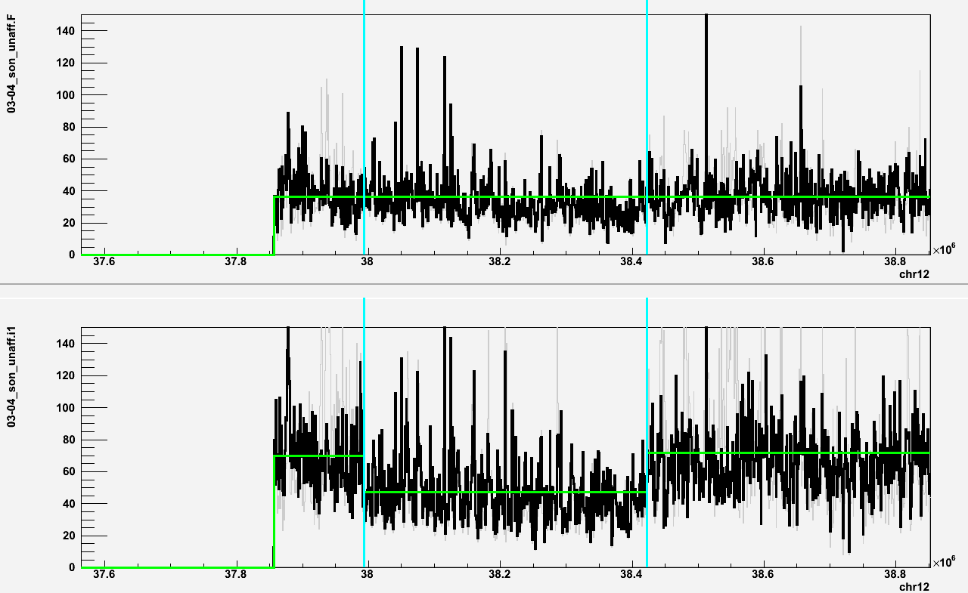
chr12:37993001-38422000 (deletion in i1; 03 unaffected son)
i1 Fibroblast

Slide 5
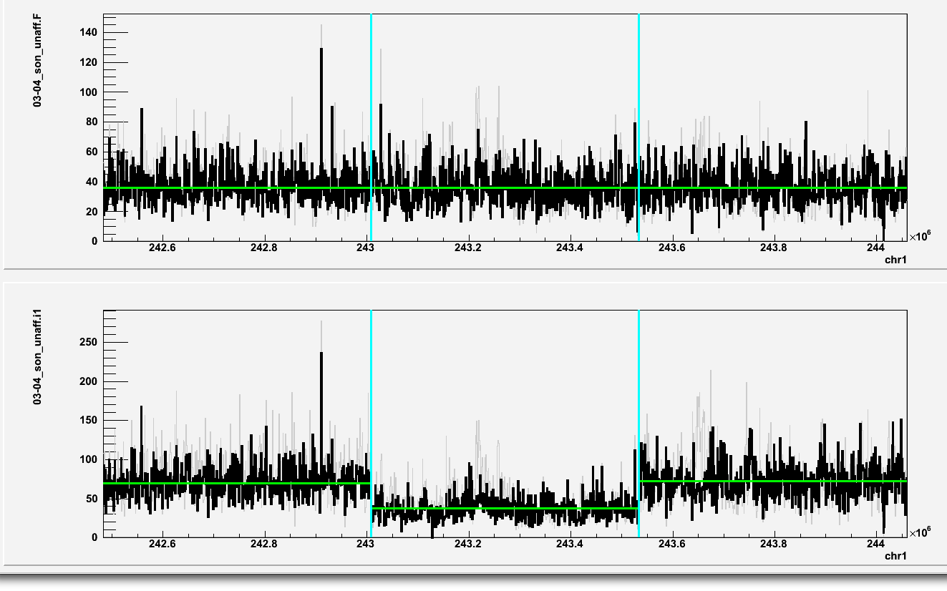
chr1:243008001-243533000 (deletion in i1; 03 unaffected son)
i1 Fibroblast

Slide 6
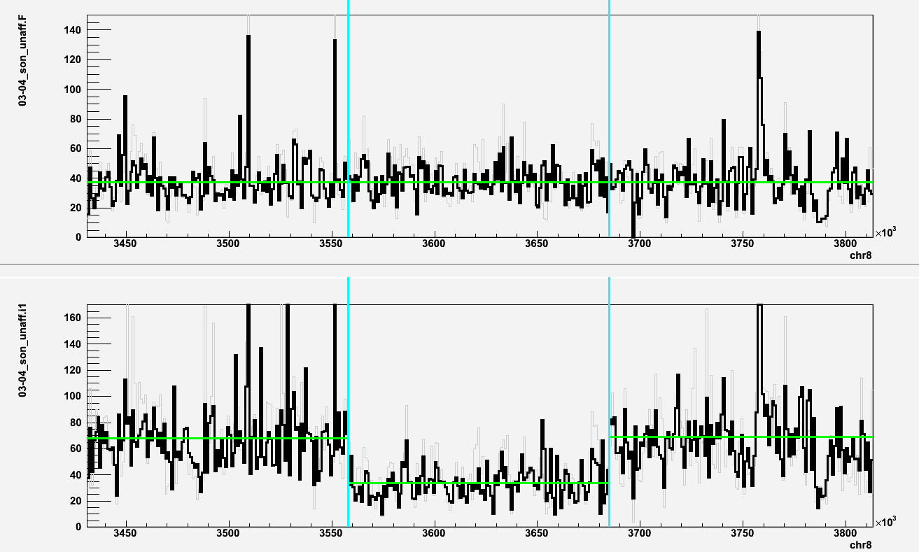
chr8:3558001-3685000 (deletion in i1; 03 unaffected son)
i1 Fibroblast

Slide 7
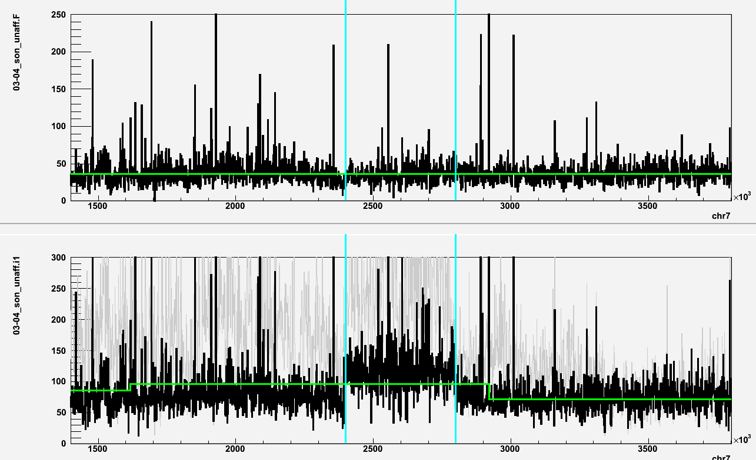
chr7:2400000-2800000 (deletion in i1; 03 unaffected son)
i1 Fibroblast

Slide 8
Correlating gene expression with de novo CNVs

Slide 9
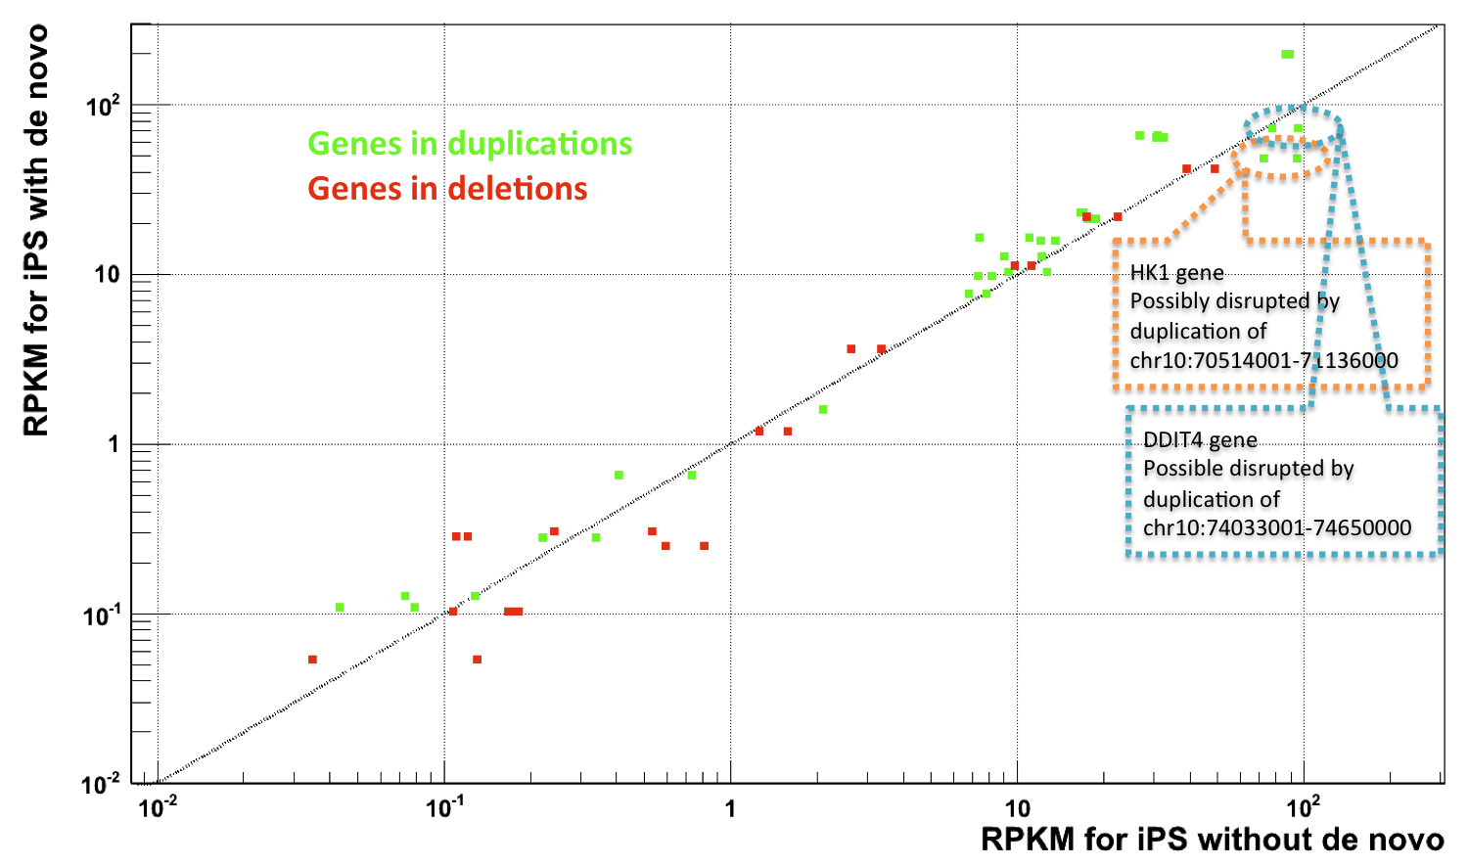
CNVs do affect gene expression

Slide 10
chr10:70514001-71136000, HK1
chr10:74033001-74650000, DDIT4

Slide 11
Fischer’s exact test
p-value = 0.03

