Slide 1
Analysis of population genome sequencing reveals variability of humans in Ψgenes
Alexej Abyzov, Michael Snyder, and Mark Gerstein
Yale/Stanford, ‘
CEGS, October 21, 2011

Slide 2
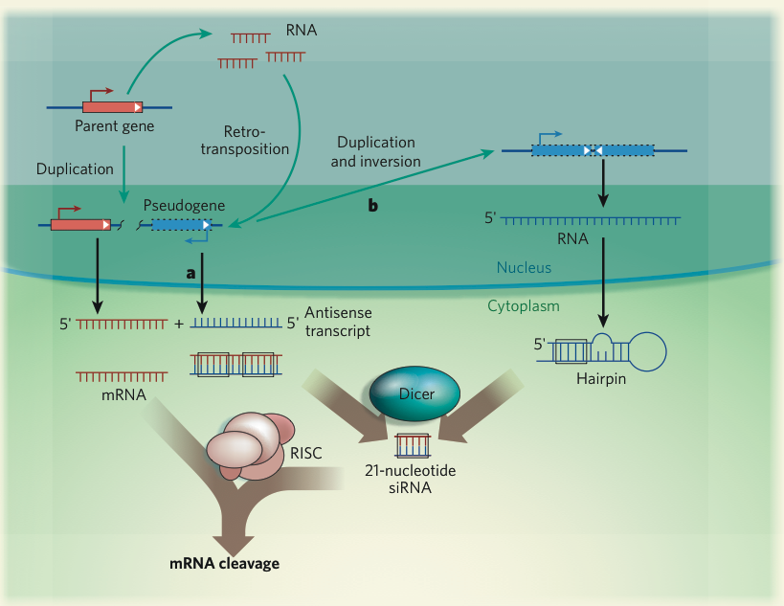

Slide 3
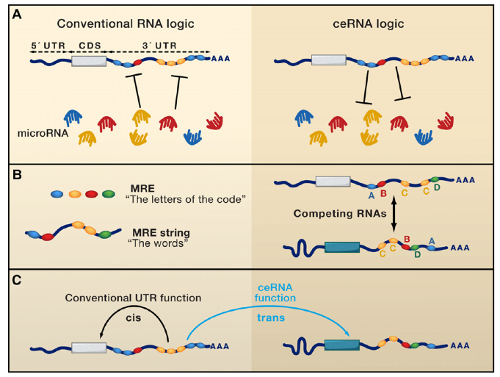

Slide 4
Variability in Ψgenes
Gene
Ψgene
Reference
Person 1
Known Ψgene
Person 2
Person 3
. . .
Reference
Person 1
Person 2
Unknown Ψgene
Person 3
. . .

Slide 5
Approaches
Gene
Unknown Ψgene
Person
( )
( )
( )
Splice junction
library
Unique sequences
Bowtie mapping
Genomic not mapped reads
Gene
Unknown Ψgene
Read sequencing
…
Person
Reference
…
Read mapping
Cluster

Slide 6
Empirical null model
Gene model
Shift
Null model
Normal
splice-junction
library
Null
splice-junction
library
Bowtie mapping
Bowtie mapping
Not mapped reads
Not mapped reads
Gene structure is preserved by coordinates are shifted
Aim at < 5% of false discovery rate

Slide 7
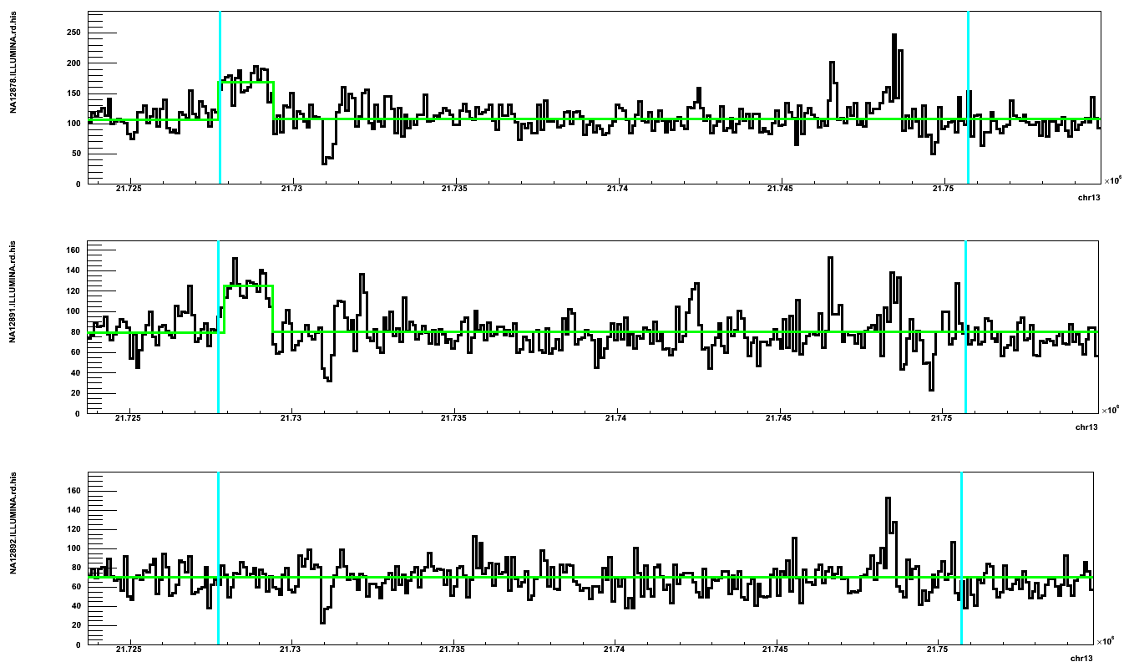
Predicting a Ψgene for SKA3 gene
Mother Father Daughter

Slide 8
Data from 1000 Genomes Project
Caucasian trio, > 20x Solexa
Yoruba trio, > 20x Solexa
NA12891
NA12892
NA19239
NA19238
NA12878
NA19240
+ >1000 individuals with 1-6x coverage

Slide 9
Discovery in NA12878 (CEU)
Parent gene with Ψgene | Read depth support | Insertion point support | Found in Venter genome | PCR validation
CDC27 | Yes | Yes
BCLAF1 | Yes |  | Yes
LAPTM4B | Yes
MTCH2 |  |  |  | Yes
CBX3 | Yes | Yes | Yes
TMEM66 | Yes |  |  | Yes
TDG | Yes | Yes | Yes
BOD1
CACNA1B
SKA3 | Yes | Yes
AP3S1 | Yes |  | Yes
AC131157.1
AL590623.1 | Centromere

Slide 10
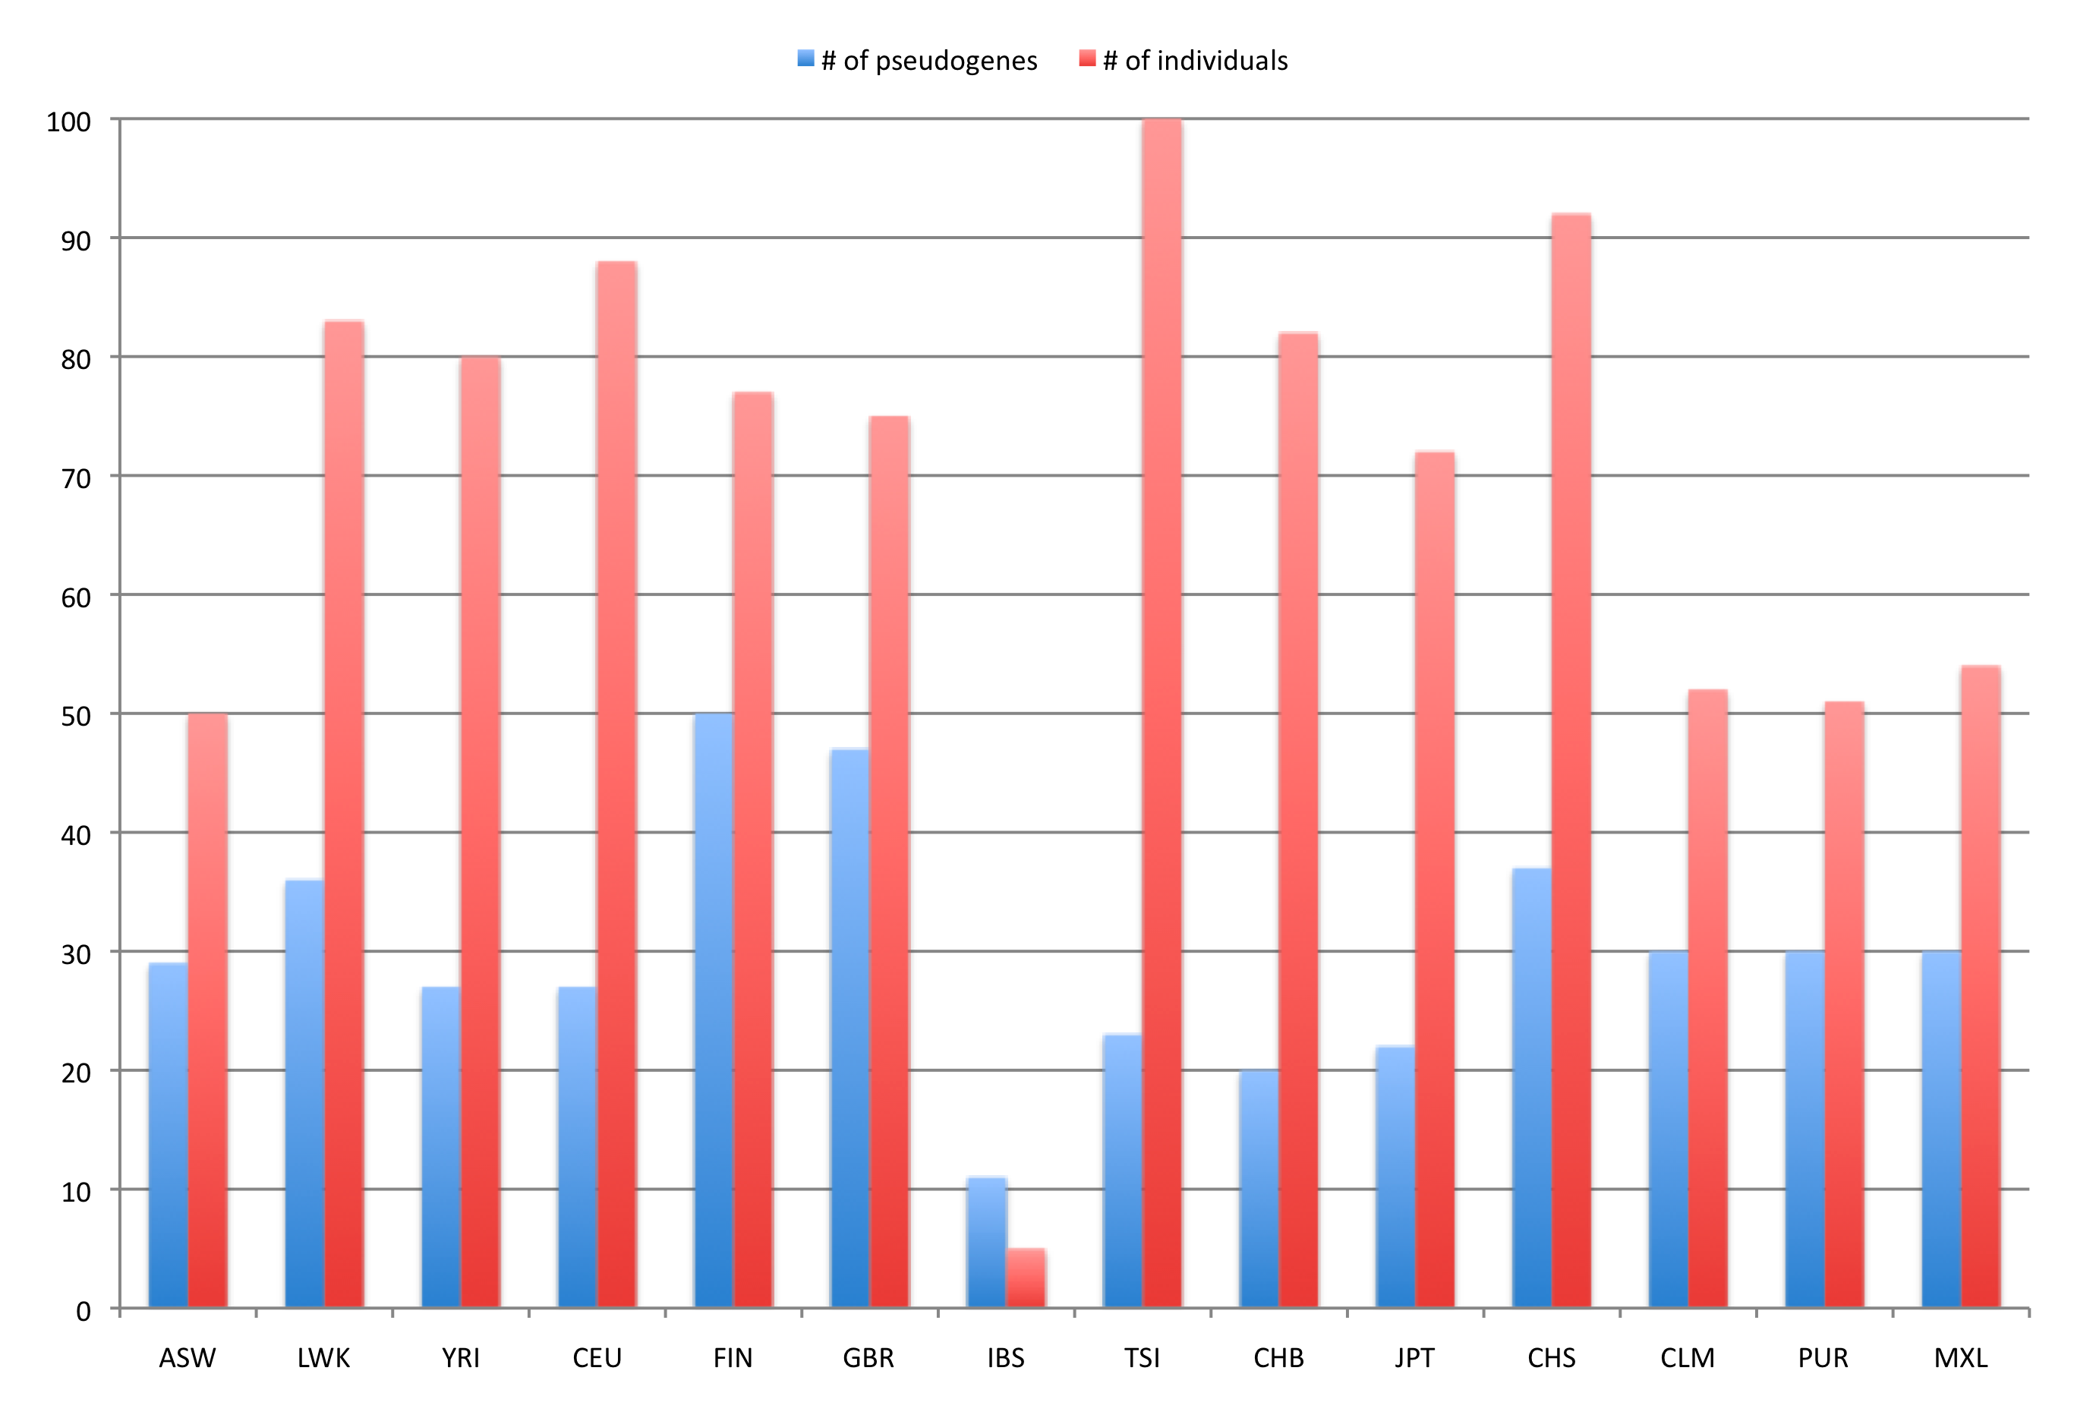
Ψgenes by population

Slide 11
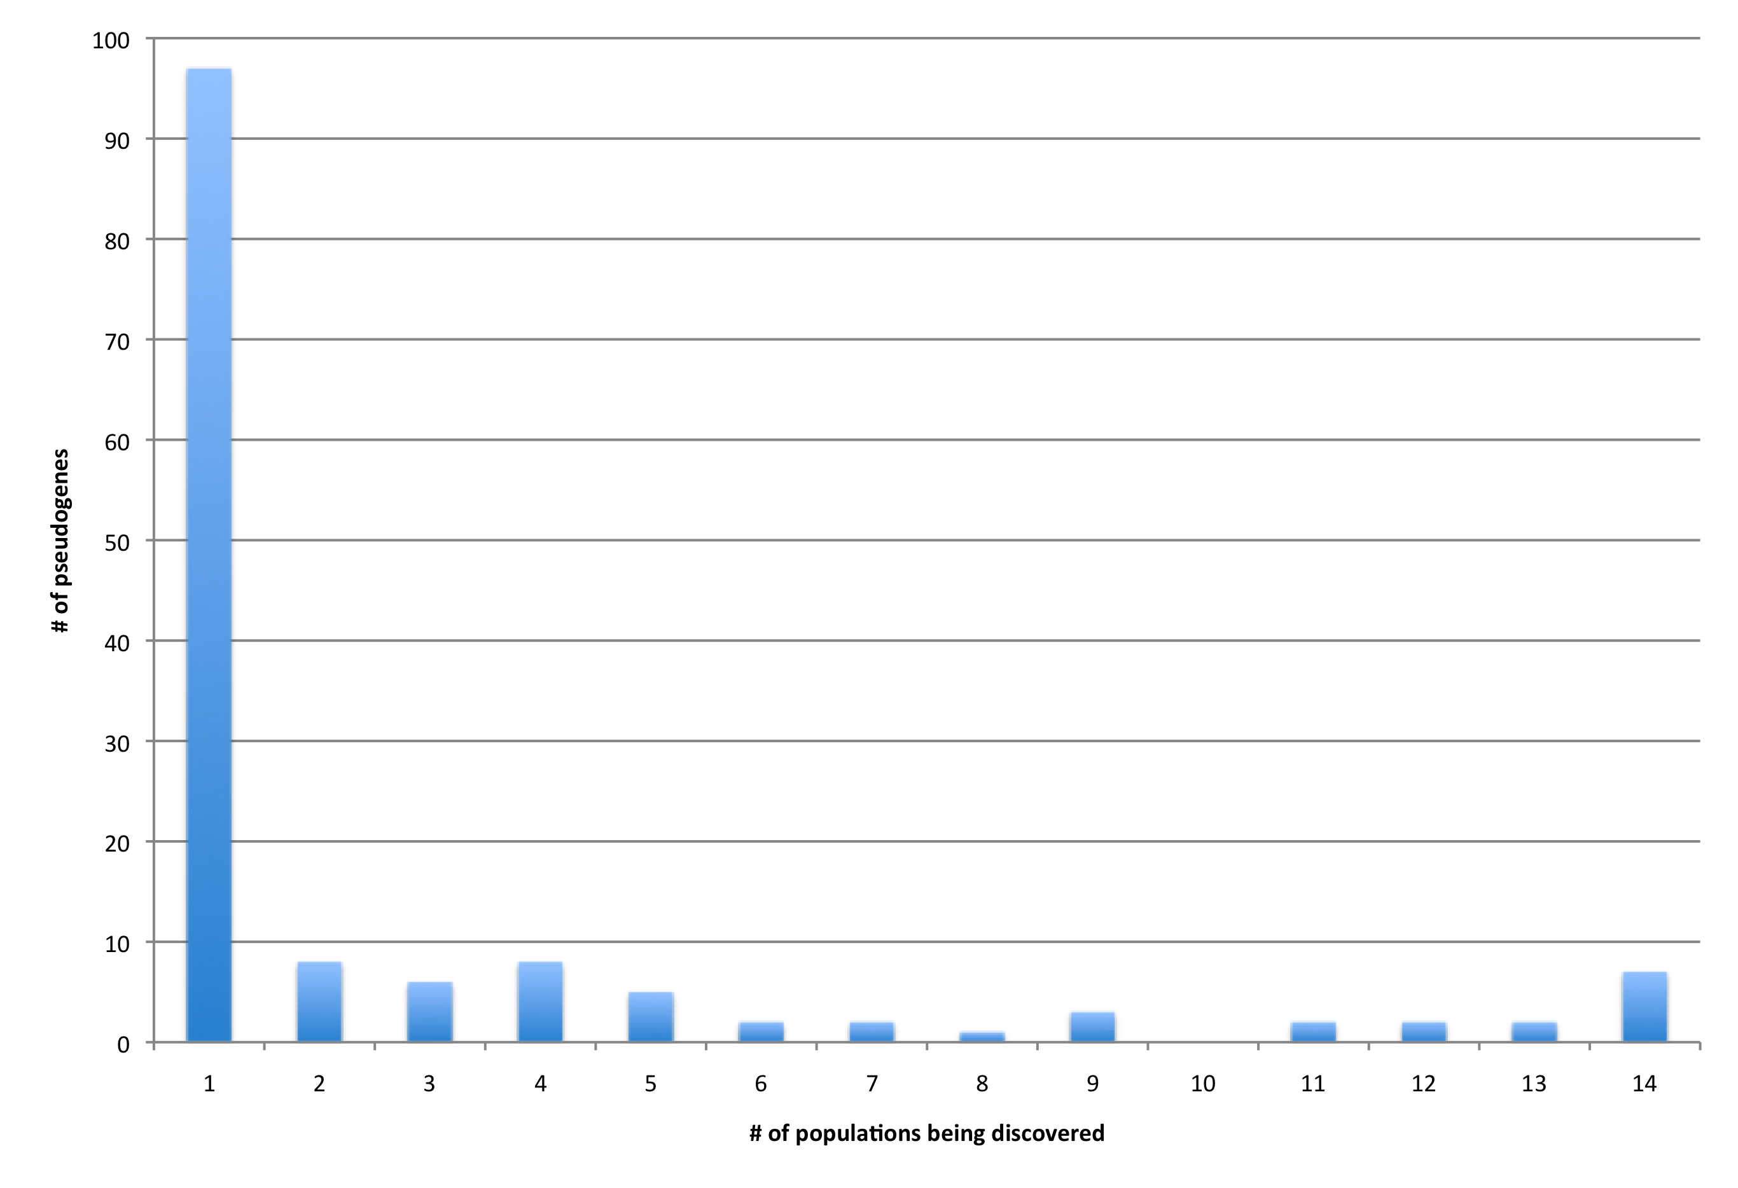
Frequency by populations
Total of 145 of parent genes
are predicted to have
unknown Ψgenes
# of parent genes with a Ψgene

Slide 12
Conclusion
Discovering and validating unknown Ψgenes is extremely hard
High similarity to parent genes
Relaying on annotation (incomplete, wrong)
Yet variation in Ψgenes does exist and was not noticed before
Most unknown Ψgenes seems to be rare and population specific
Common Ψgenes may be result of incomplete reference

Slide 13
GO enrichment
All populations

Slide 14
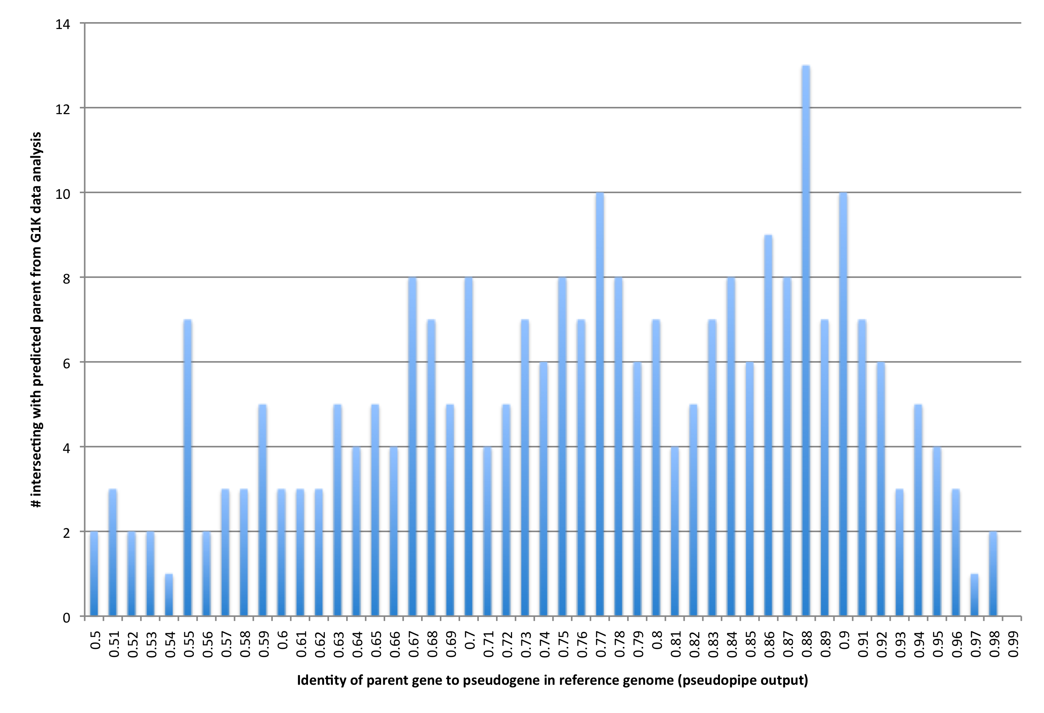
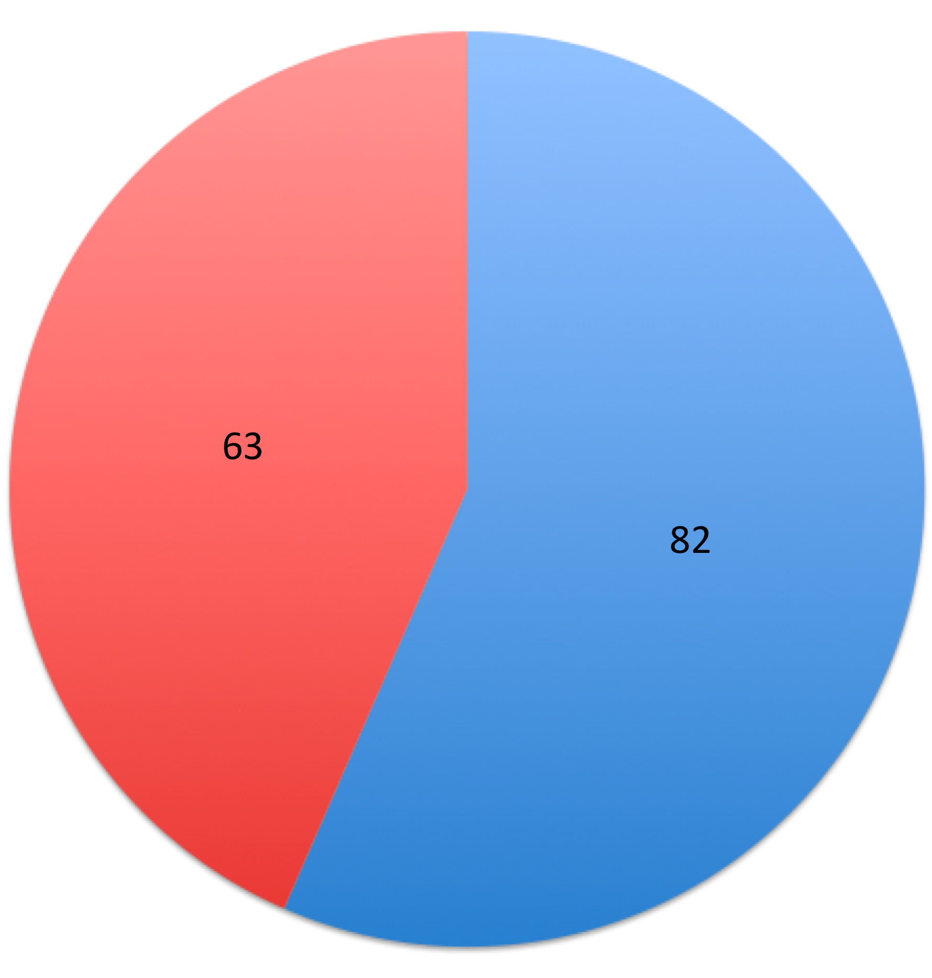
Intersection with known parents (Ψpipe 61 output)

