Slide 1
What can we learn from RNAPII ChIP-Seq Signal Profiles?
Raymond Auerbach
Genome Tech

Slide 2
Considerations about Current Methods
ENCODE is highly integrative
Good for understanding a general model, not as practical for de novo prediction
Like one theory of the stock market, is all the information we really need to know already baked into “the chart”?

Slide 3
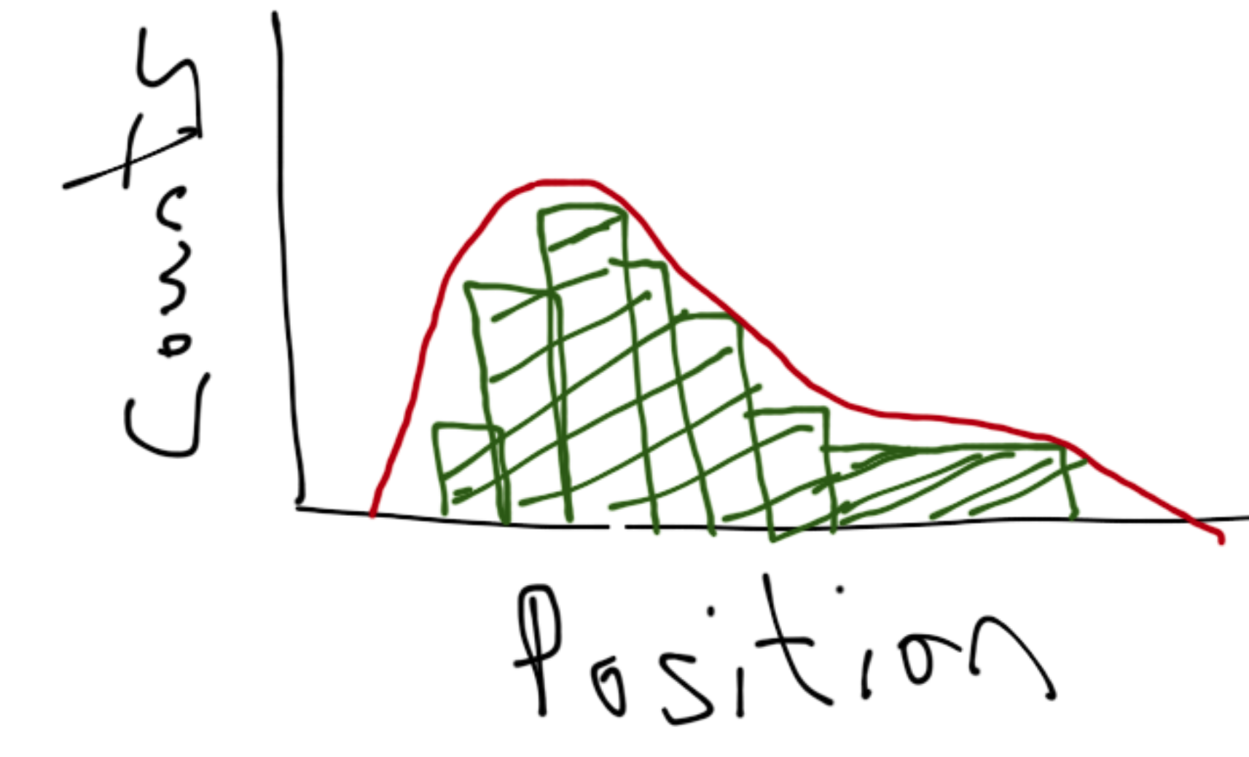
What is a ChIP-Seq peak?
Simply stated, a called ChIP-Seq peak is the probability that a read starts at a given nucleotide position within the called peak.
The summit of the peak is the position with the highest probability of TF binding.

Slide 4
Broad Binding
How to define broad binding?
For this example, peakedness (kurtosis). Peak length is irrelevant. We care about TF binding characteristics.
What does a broad peak mean?
ChIP-Seq reads do not favor a small range of nucleotides, but rather have binding probabilities that are more evenly distributed
Protein may have large binding region
Protein may be able to bind to multiple sites in same region (i.e. the binding site has a lot of play).

Slide 5
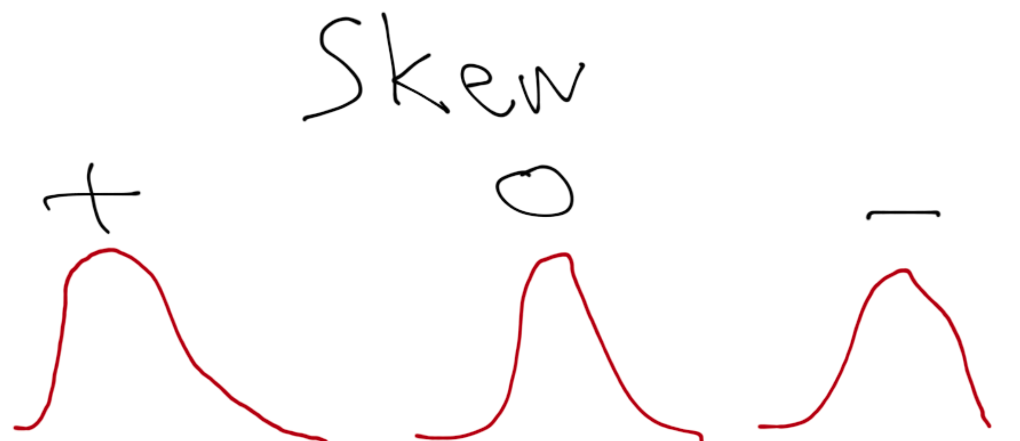
Summit Position
Where does the summit occur relative to the entire peak (skewness)?
Example: Does it tend to lean towards the promoter? The TATA box?
Does it vary between different classes of Pol II peaks? (next slide)
Let’s pretend that I can draw a perfect bell

Slide 6
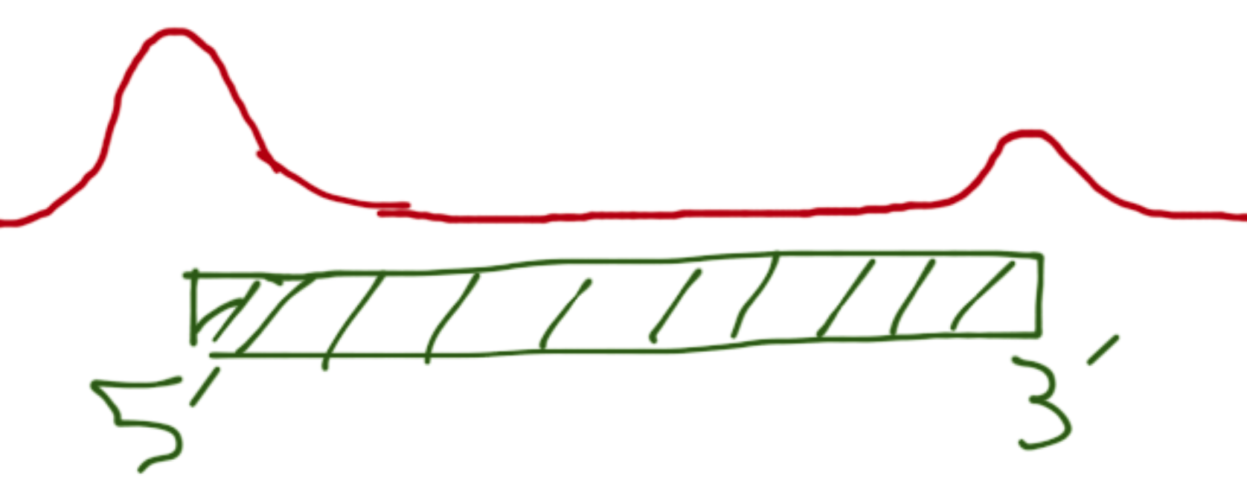
Some classes to consider
highly expressed genes
Lowly expressed genes
Internal exons (i.e. alternative start site)
Intergenic regions
Bidirectional promoters
3’ ends
TATA vs TATA-less promoters

Slide 7
In general…
Summarize, classify/cluster, build model, apply model.
Do any observed patterns hold up between cell lines?
K562, GM12878, HeLa
How do various cellular treatments affect peak characteristics?
How accurately can we predict classes in a de novo signal track?
Do we see differences between different antibodies (Myers lab ab5406 vs. Snyder, Farnham, and Iyer labs 8WG16)?

