Slide 1
TargetScan 5.2 on human genome: 17884 3’ UTRs. (If a gene have multiple transcripts, the one with longest UTR is used)

Slide 2
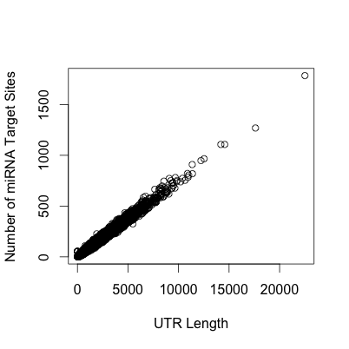
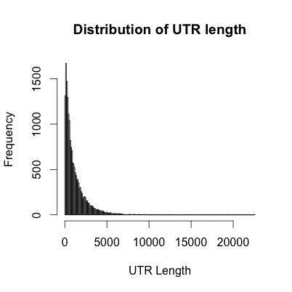

Slide 3
Paired Distance between any of two human miRNAs. Within 100 bp range.
3’
5’
3’
5’
5’
3’ UTR
3’

Slide 4
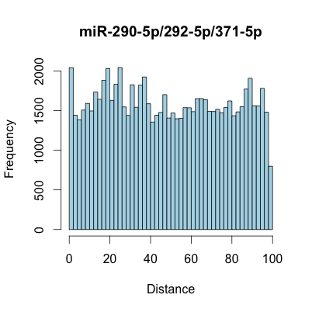
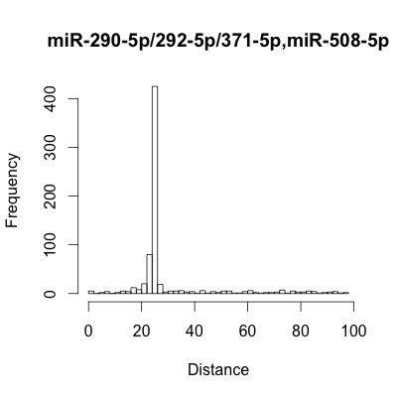
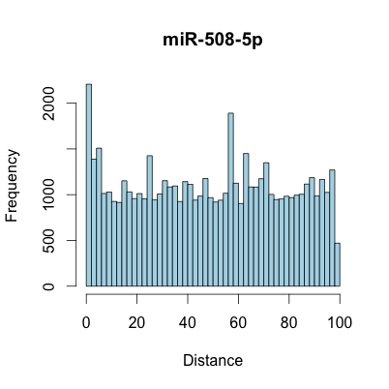
Example

Slide 5
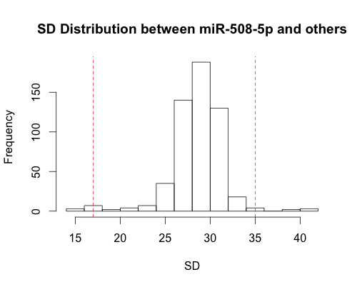
Separate microRNA Pairs into 3 groups.
Group1: with SD p< 0.05, in SD distribution of both microRNAs.
Group1: with SD p> 0.95, in SD distribution of both microRNAs.
Group 1
Group 3
Group 2
0.05
0.95

Slide 6
Compare with 1000 genome SNP data within 3’ UTR regions.

Slide 7
Group 1

Slide 8
Population | Whole UTR | Group 1 | Group 2 | Group 3
CEU | 0.0046416913959841 | 0.00227523962040645 | 0.00238421728370267 | 0.00239863129604441
CHBJPT | 0.00328500307447137 | 0.00180694760669803 | 0.00189253561298917 | 0.00192810821947849
YRI | 0.00577854415416049 | 0.0031693475834813 | 0.00334650709565637 | 0.00337615853352674

