Slide 1
Annotation of variants in non-coding regions
Ekta Khurana, Cristina Sisu, Xinmeng Mu, Joel Rozowsky, Arif Harmanci, Alexej Abyzov, Suganthi Balasubramanian, Baikang Pei, Renqiang Min, Jing Leng, Jing Wang, Mark Gerstein

Slide 2
Overview
Loss-of-function group focused on protein-coding genes for Pilot project
Annotation of variants in non-coding regions also crucial, e.g., recent studies show GWAS SNPs enriched in enhancers
Proposal to expand LOF to include non-coding annotation
Levels of non-coding annotation
  1) ncRNA and pseudogenes in GENCODE annotation
  2) Transcription factor binding sites, chromatin marks from ENCODE
  3) Chromatin states, enhancers, promoters derived from combining various features from (2).

Slide 3
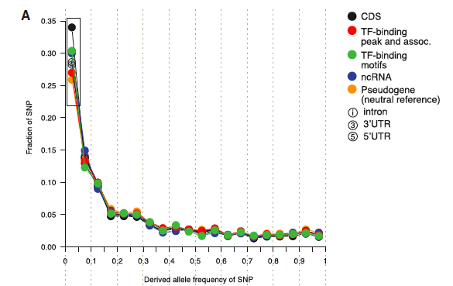
Pilot 1 SNPs in different annotation classes (levels 1 and 2)
Population | Coding exons | ncRNA | TF binding sites (9 TFs) | TF binding motifs | pseudogenes
CEU | 48,623 | 2,201 | 107,083 | 2,358 | 37,282
YRI | 69,022 | 3,058 | 152,343 | 3,328 | 48,647
CHB+JPT | 39,681 | 1,681 | 86,082 | 1,792 | 28,158
Mu et al, Nucleic Acids Res, 2011

Slide 4
Variant ε: excess of rare alleles (MAF<0.05) compared to neutral ref.
Mu et al, Nucleic Acids Res, 2011

Slide 5
Mu et al, Nucleic Acids Res, 2011

Slide 6
 |  |  | GENCODE (v7) |  |  |  | Functional Elements
 |  |  | Genes |  | PGenes | NC RNAs | Binding Sites (Representative Sites)
 |  |  | all transcripts | at least one transcript |  |  | Pol II | CTCF | P300 | cMyc | Max | Averages (Over all TFs)
 |  |  | 20646 | 20646 | 10118 | 16579 | 20722 | 39107 | 2710 | 2881 | 432 | 10006
 |  |  |  |  |  |  | N/A | 61671 | 2914 | 4427 | 905 | 11980
All variants in NA12878 | Annotations overlapping a variant | Homozygous (Total) | 1634 | 1843 | 2364 | 2264 | 8104 | 6517 | 756 | 669 | 104 | 2452
 |  | SNP | 1609 | 1798 | 2220 | 1858 | 6594 | 5748 | 653 | 571 | 90 | 2098
 |  | indel | 58 | 112 | 452 | 400 | 1329 | 768 | 103 | 98 | 14 | 353
 |  | SV | 1 | 1 | 13 | 6 | 1 | 1 | 0 | 0 | 0 | 1
 |  | Heterozygous (Total) | 3511 | 4022 | 1798 | 4876 | 5145 | 7674 | 746 | 684 | 112 | 2410
 |  | SNP | 3457 | 3958 | 1756 | 4252 | 3677 | 6563 | 616 | 569 | 96 | 1975
 |  | indel | 84 | 126 | 405 | 608 | 1459 | 1099 | 130 | 115 | 16 | 432
 |  | SV | 6 | 5 | 20 | 16 | 9 | 12 | 0 | 0 | 0 | 3
 | Annotations significantly disrupted) | Homozygous (Total) | 42 | 130 | N/A | N/A | N/A | 268 | 12 | 11 | 1 | 42
 |  | SNP | 10 | 48 | N/A | N/A | N/A | 251 | 10 | 7 | 1 | 35
 |  | indel | 33 | 85 | N/A | N/A | N/A | 17 | 2 | 4 | 0 | 6
 |  | Heterozygous (Total) | 69 | 187 | N/A | N/A | N/A | 438 | 12 | 18 | 6 | 66
 |  | SNP | 27 | 111 | N/A | N/A | N/A | 396 | 8 | 12 | 6 | 57
 |  | indel | 46 | 81 | N/A | N/A | N/A | 35 | 4 | 6 | 0 | 8
Rare variants in NA12878 | Annotations overlapping a variant | Homozygous (Total) | 19 | 21 | 119 | 58 | 208 | 98 | 24 | 22 | 4 | 54
 |  | SNP | 18 | 18 | 35 | 22 | 61 | 17 | 7 | 4 | 0 | 13
 |  | indel | 1 | 5 | 79 | 36 | 146 | 81 | 17 | 18 | 4 | 41
 |  | SV | 0 | 1 | 1 | 0 | 1 | 0 | 0 | 0 | 0 | 0
 |  | Heterozygous (Total) | 248 | 333 | 313 | 314 | 934 | 498 | 65 | 83 | 11 | 247
 |  | SNP | 241 | 314 | 242 | 232 | 695 | 357 | 54 | 64 | 9 | 175
 |  | indel | 9 | 20 | 131 | 79 | 236 | 139 | 11 | 19 | 2 | 70
 |  | SV | 0 | 1 | 1 | 3 | 3 | 2 | 0 | 0 | 0 | 2
 | Annotations significantly disrupted | Homozygous (Total) | 1 | 4 | N/A | N/A | N/A | 5 | 0 | 1 | 0 | 1
 |  | SNP | 0 | 0 | N/A | N/A | N/A | 3 | 0 | 0 | 0 | 0
 |  | indel | 1 | 4 | N/A | N/A | N/A | 2 | 0 | 1 | 0 | 1
 |  | Heterozygous (Total) | 10 | 22 | N/A | N/A | N/A | 19 | 1 | 1 | 1 | 4
 |  | SNP | 6 | 8 | N/A | N/A | N/A | 17 | 0 | 0 | 1 | 3
 |  | indel | 4 | 14 | N/A | N/A | N/A | 2 | 1 | 1 | 0 | 1
by Rozowsky et al

Slide 7
 |  |  | GENCODE (v7) |  |  |  | Functional Elements
 |  |  | Genes |  | PGenes | NC RNAs | Binding Sites (Representative Sites)
 |  |  | all transcripts | at least one transcript |  |  | Pol II | CTCF | P300 | cMyc | Max | Averages (Over all TFs)
 |  |  | 20646 | 20646 | 10118 | 16579 | 20722 | 39107 | 2710 | 2881 | 432 | 10006
 |  |  |  |  |  |  | N/A | 61671 | 2914 | 4427 | 905 | 11980
All variants in NA12878 | Annotations overlapping a variant | Homozygous (Total) | 1634 | 1843 | 2364 | 2264 | 8104 | 6517 | 756 | 669 | 104 | 2452
 |  | SNP | 1609 | 1798 | 2220 | 1858 | 6594 | 5748 | 653 | 571 | 90 | 2098
 |  | indel | 58 | 112 | 452 | 400 | 1329 | 768 | 103 | 98 | 14 | 353
 |  | SV | 1 | 1 | 13 | 6 | 1 | 1 | 0 | 0 | 0 | 1
 |  | Heterozygous (Total) | 3511 | 4022 | 1798 | 4876 | 5145 | 7674 | 746 | 684 | 112 | 2410
 |  | SNP | 3457 | 3958 | 1756 | 4252 | 3677 | 6563 | 616 | 569 | 96 | 1975
 |  | indel | 84 | 126 | 405 | 608 | 1459 | 1099 | 130 | 115 | 16 | 432
 |  | SV | 6 | 5 | 20 | 16 | 9 | 12 | 0 | 0 | 0 | 3
 | Annotations significantly disrupted) | Homozygous (Total) | 42 | 130 | N/A | N/A | N/A | 268 | 12 | 11 | 1 | 42
 |  | SNP | 10 | 48 | N/A | N/A | N/A | 251 | 10 | 7 | 1 | 35
 |  | indel | 33 | 85 | N/A | N/A | N/A | 17 | 2 | 4 | 0 | 6
 |  | Heterozygous (Total) | 69 | 187 | N/A | N/A | N/A | 438 | 12 | 18 | 6 | 66
 |  | SNP | 27 | 111 | N/A | N/A | N/A | 396 | 8 | 12 | 6 | 57
 |  | indel | 46 | 81 | N/A | N/A | N/A | 35 | 4 | 6 | 0 | 8
Rare variants in NA12878 | Annotations overlapping a variant | Homozygous (Total) | 19 | 21 | 119 | 58 | 208 | 98 | 24 | 22 | 4 | 54
 |  | SNP | 18 | 18 | 35 | 22 | 61 | 17 | 7 | 4 | 0 | 13
 |  | indel | 1 | 5 | 79 | 36 | 146 | 81 | 17 | 18 | 4 | 41
 |  | SV | 0 | 1 | 1 | 0 | 1 | 0 | 0 | 0 | 0 | 0
 |  | Heterozygous (Total) | 248 | 333 | 313 | 314 | 934 | 498 | 65 | 83 | 11 | 247
 |  | SNP | 241 | 314 | 242 | 232 | 695 | 357 | 54 | 64 | 9 | 175
 |  | indel | 9 | 20 | 131 | 79 | 236 | 139 | 11 | 19 | 2 | 70
 |  | SV | 0 | 1 | 1 | 3 | 3 | 2 | 0 | 0 | 0 | 2
 | Annotations significantly disrupted | Homozygous (Total) | 1 | 4 | N/A | N/A | N/A | 5 | 0 | 1 | 0 | 1
 |  | SNP | 0 | 0 | N/A | N/A | N/A | 3 | 0 | 0 | 0 | 0
 |  | indel | 1 | 4 | N/A | N/A | N/A | 2 | 0 | 1 | 0 | 1
 |  | Heterozygous (Total) | 10 | 22 | N/A | N/A | N/A | 19 | 1 | 1 | 1 | 4
 |  | SNP | 6 | 8 | N/A | N/A | N/A | 17 | 0 | 0 | 1 | 3
 |  | indel | 4 | 14 | N/A | N/A | N/A | 2 | 1 | 1 | 0 | 1
by Rozowsky et al

Slide 8
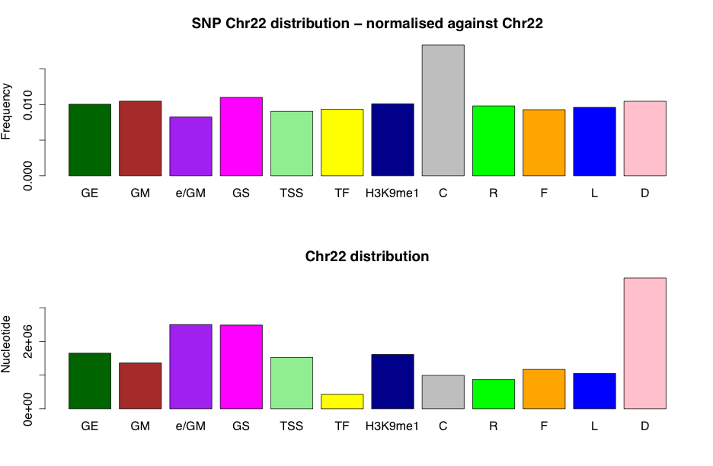
Phase I Chr22 SNPs in different segmentations (level 3)
Fraction of polymorphic nucleotides
GE Gene body (end)
GM Gene body (middle)
E/GM Enhancer/Gene middle
GS Gene body (start)
TSS Transcription start site
TF Transcription factor activity
H3K9me1 H3K9me1 only
C CTCF (weak and strong)
R Repression
F Low signal in all tracks besides FAIRE
L Low signal zone
D Dead zone
Using ENCODE segmentation

Slide 9
Aims of FIG
Decide which levels of non-coding annotation (1,2,3) to put in VCF files
Build automated pipelines for decorating VCF files
Long term goals could include more detailed analysis like eQTLs, allele specific expression etc

