Slide 1
Applying RD and RP for Ψgene variation analysis
Alexej Abyzov
October 4, 2011

Slide 2
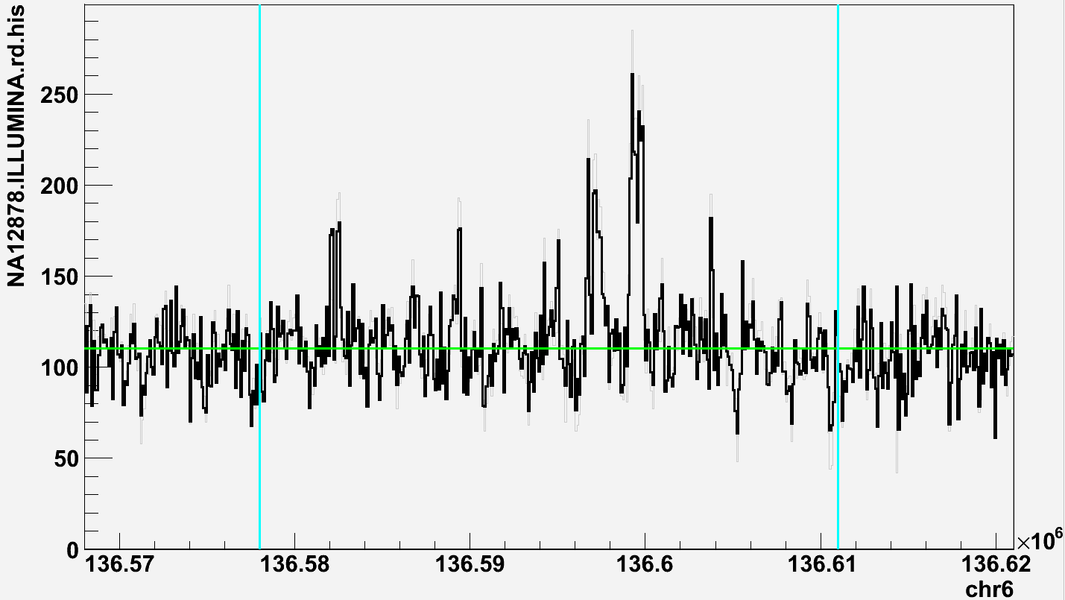
BCLAF1
RD_{exon}/RF_{non-exon}=1.33,
while expected ~2

Slide 3
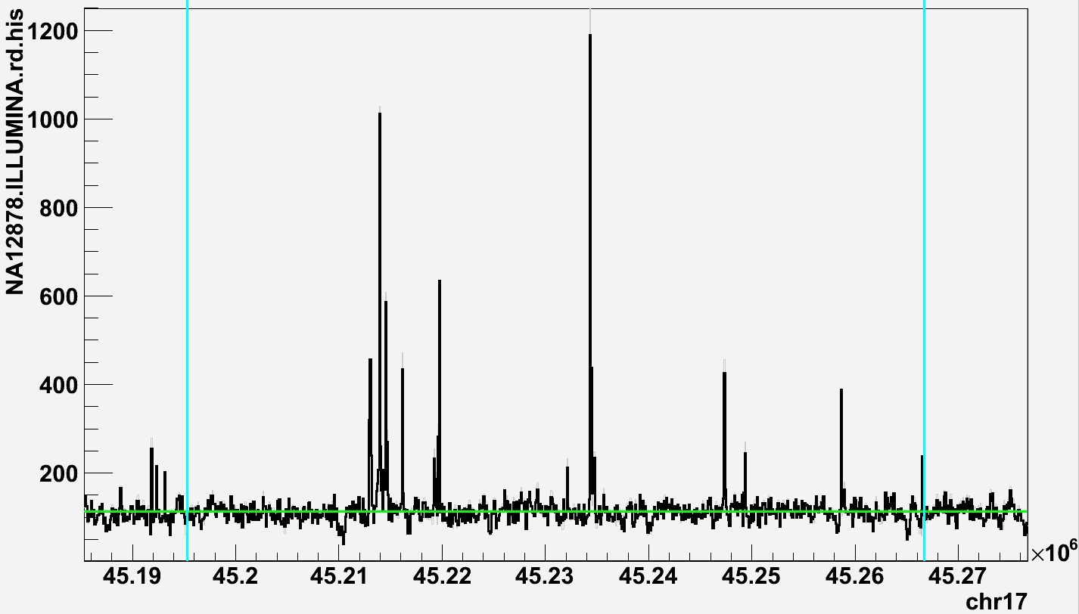
CDC27
RD_{exon}/RF_{non-exon}=1.68,
while expected >10

Slide 4
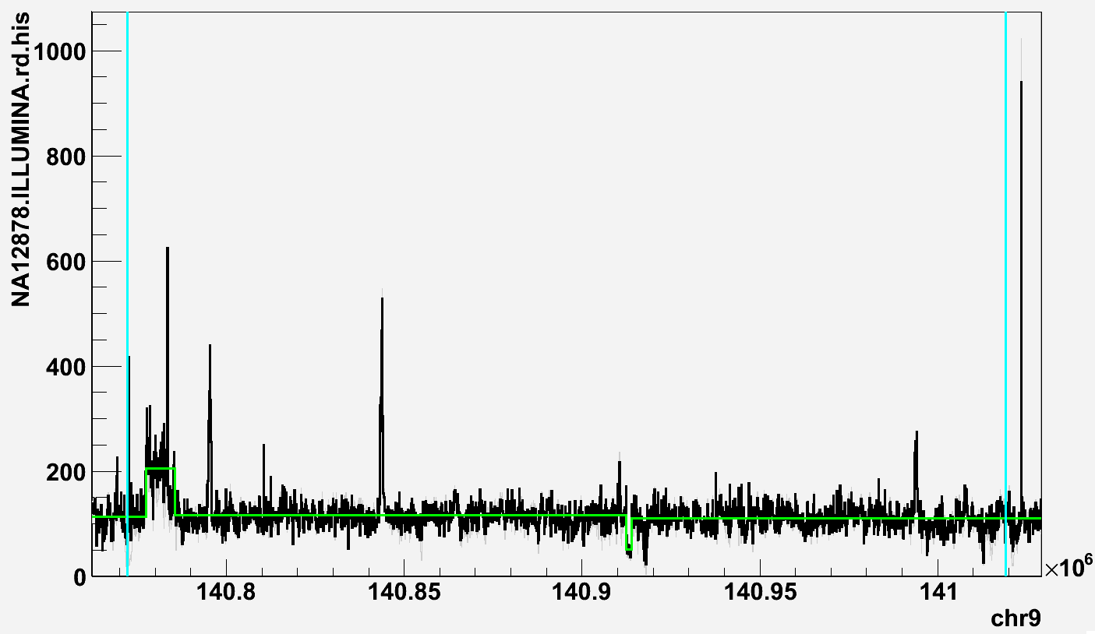
CACNA1B
RD_{exon}/RF_{non-exon}=0.84,
while expected ~2
Unknown exons?

Slide 5
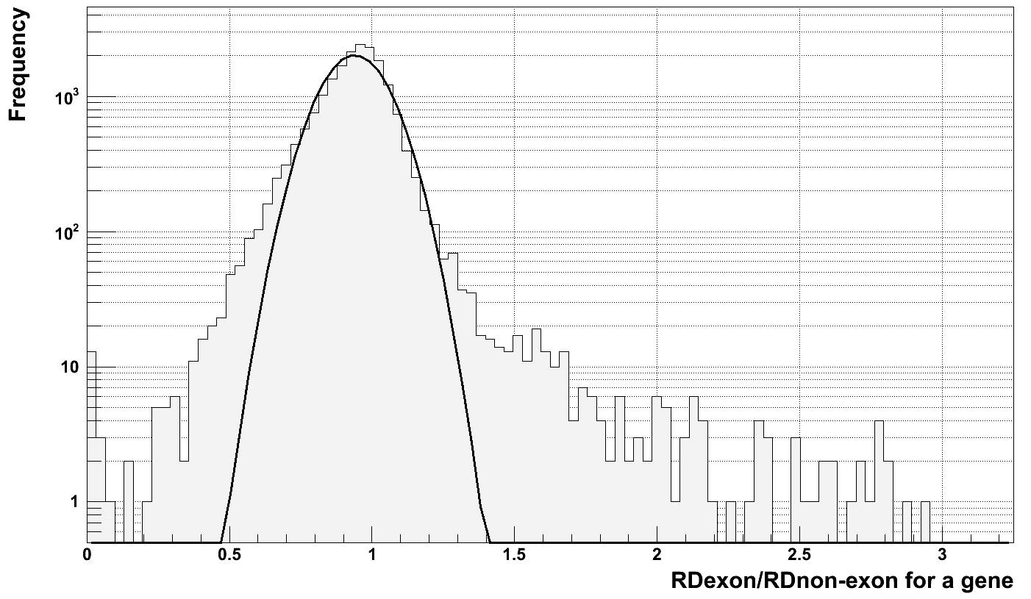
Genotyping/discovering Ψgenes with RD
On NA12878

Slide 6
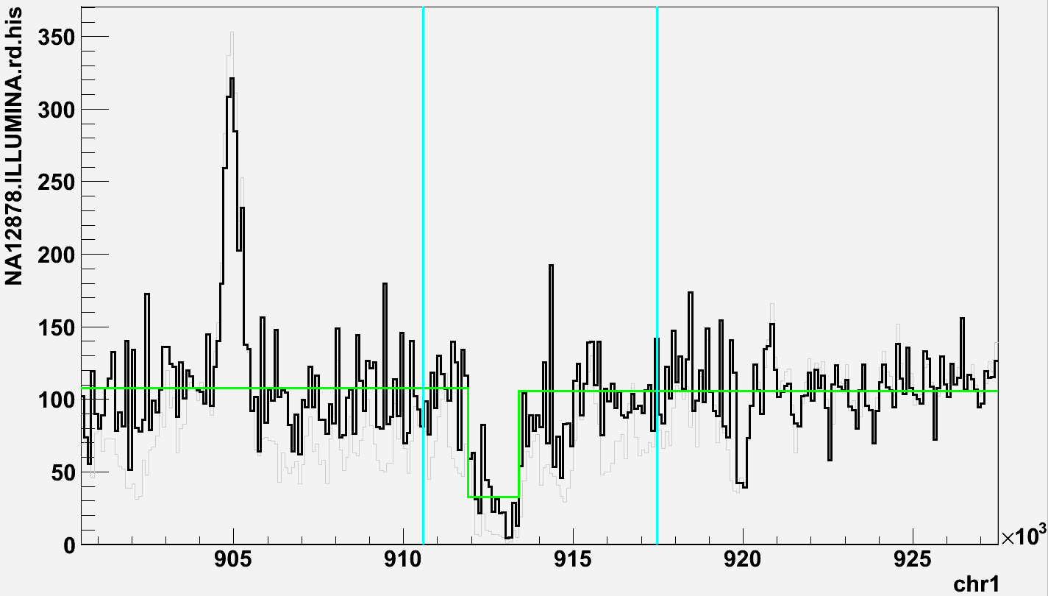
C1orf170
Intron is deleted or
misannotated

Slide 7
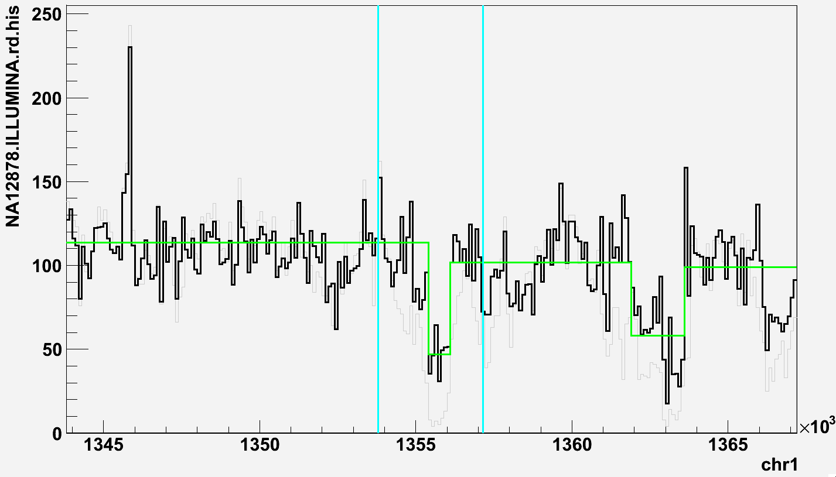
RP4-758J18.6
Intron is deleted or
misannotated

Slide 8
Problems in RD for Ψgene analysis
Fundamental
Relying on annotation (pseudogenized exons can be different/absent/unknown)
SV/deletion(s) in introns
Technical
Mapping reads close to exon-intron boundaries
Difficulty in correcting for GC/AT sequencing bias
Repeats and existing Ψgenes

Slide 9
Applying RP
Gene
Ψgene
Read sequencing
Studied genome
…
Reference genome
…
Read mapping
Cluster
Gene
Ψgene
Read sequencing
Studied genome
…
Reference genome
…
Read mapping
Cluster

Slide 10
Clustering
Mapping quality >= 20
Select RPs with
one read mapped to “–” strand in first third of a gene
one read mapped to “+” strand in second third of a gene
Cluster (average linkage clustering) RPs to have proper orientation and using average distance between reads as a score (max score < 500)
Report cluster with 2 RPs support on each side of insertion point

Slide 11
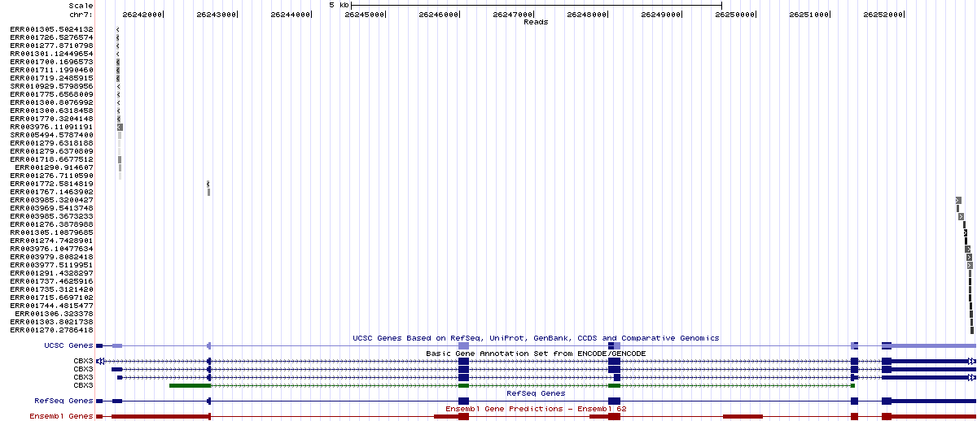
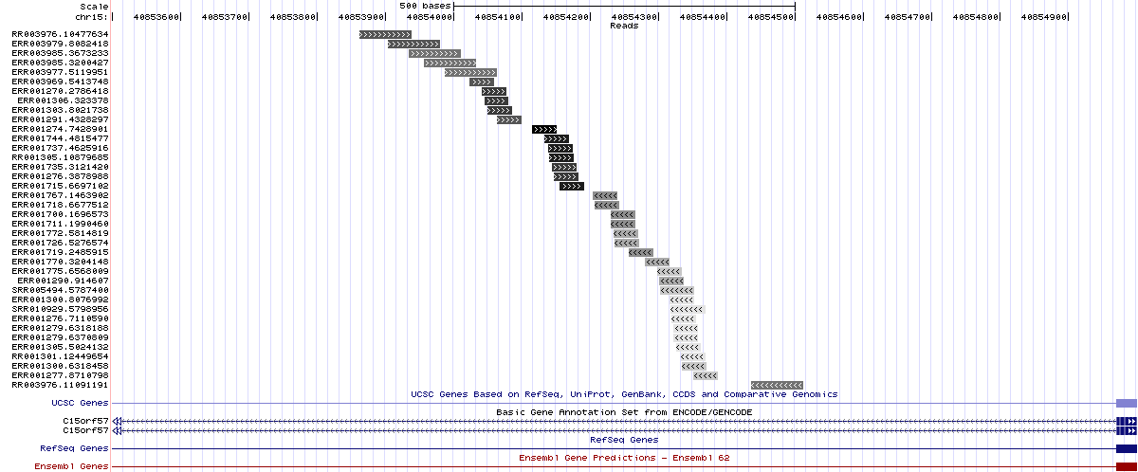
CBX3 chr7:26,241,099-26,252,974
5’->3’ direction of mapped reads
chr15:40,853,500-40,855,000

Slide 12
CBX3 chr7:26,241,099-26,252,974
chr15:40,853,500-40,855,000

Slide 13
NA12878
Analysis | Gene | Insertion from alt. assembly | Insertion from PE | RD_{exon}/RD_{non-exon}
Splice-junction mapping | CDC27 | - | GL000229.1:12153-12290 GL000220.1:139559-139655 | 1.68
 | BCLAF1 | Undetectable | - | 1.33
 | LAPTM4B | - | - | 0.90
 | MTCH2 | - | - | 0.98
 | CBX3 | chr15:40854179-40854180 | chr15:40854154-40854203 | 1.13
 | TMEM66 | - | - | 0.89
 | TDG | chr12:125801147-125801148 | chr12:125801093-125801147 | 1.57
 | BOD1 | - | - | 0.87
 | CACNA1B | - | - | 0.84
 | SKA3 | - | chr11:108585725-108585781 | 1.46
 | AP3S1 | chr16:71325250-71325256 with additional sequence | - | 1.26
 | AC131157.1 | - | - | 1.00
 | AL590623.1 | - | Too many; gene is in centromere | 2.77
RD | AL133216.2 |  | chr10:38793517-38793584; gene is in centromere | 2.96
 | TAS2R46 |  | chr12:11208861-11209010 | 1.34
 | HNRNPC |  | chr6:114017450-114017539 | 1.21
 | BCL2A1 |  | chr15:80196197-80196337 | 1.22
 | AC087650.2 |  | chr17:41381697-41381797 | 2.78

Slide 14
Problems in RP for Ψgene analysis
Fundamental
Relying on annotation (pseudogenized exons can be different/absent/unknown)
Incomplete pseudogenization
Technical
Mapping reads close to exon-intron boundaries
Repeats and existing Ψgenes

