Slide 1
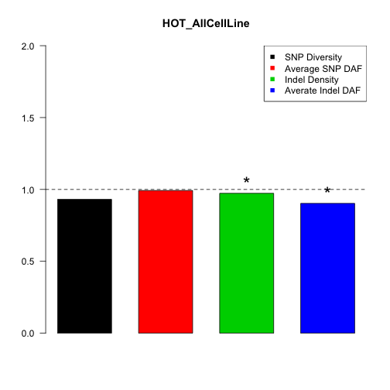
TF hotspots vs. all peakSeq peaks not in hotspots
Enrichment
Height: ratio of TF hotspots vs. all peakSeq peaks not in hotspots
*: Wilcoxon test p-value < 0.05

Slide 3
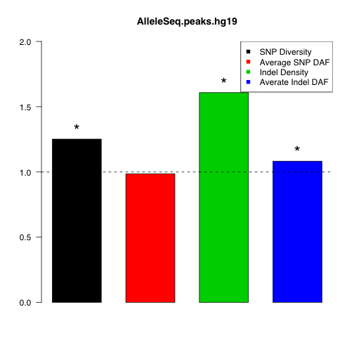
AlleleSeq peaks vs. all peakSeq peaks for Gm12878
Enrichment

Slide 5
Five cell lines: GM12878, K562 , HEPG2, HELAS3, H1HESC
Cell line specific peaks: No overlapping with peaks in other cell lines for the same TF.
Cell line nonspecific peaks: Any overlapping with peaks in other cell lines for the same TF.

Slide 6
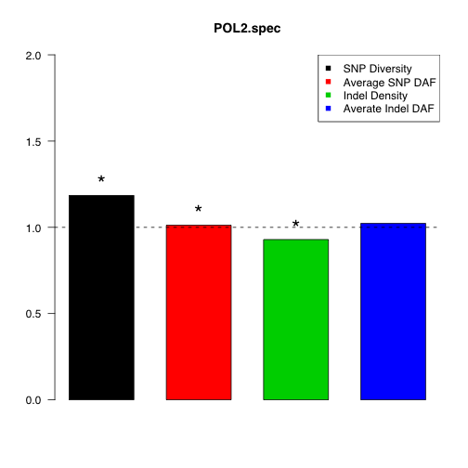
Enrichment

Slide 7
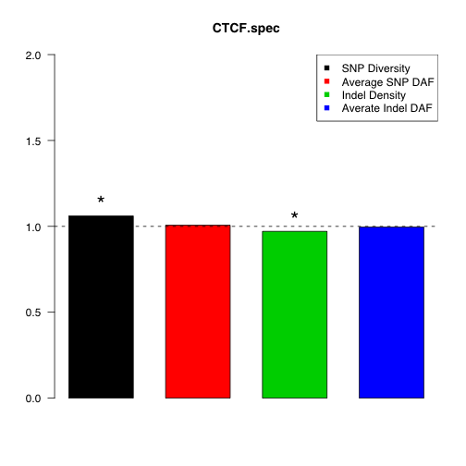
Enrichment

Slide 8
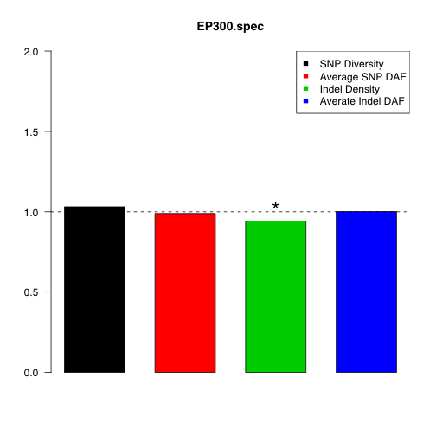
Enrichment

Slide 9
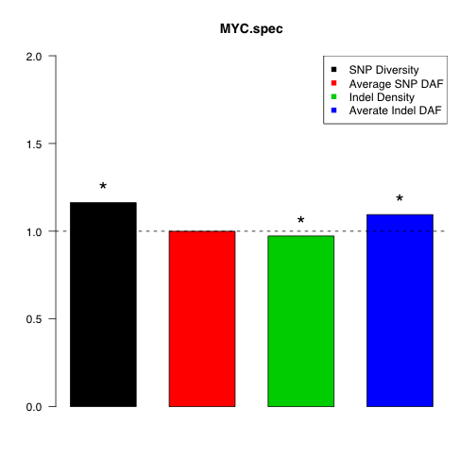
Enrichment

Slide 10
Enrichment

Slide 11
Cell line specific RNA regions
Protein-coding genes vs. TF-binding motifs
miRNA genes vs. miRNA-binding targets

Slide 12
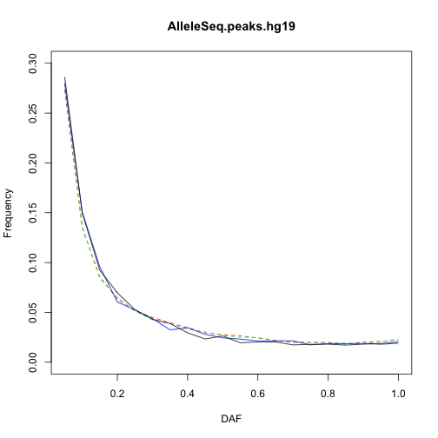
PolII

Slide 13
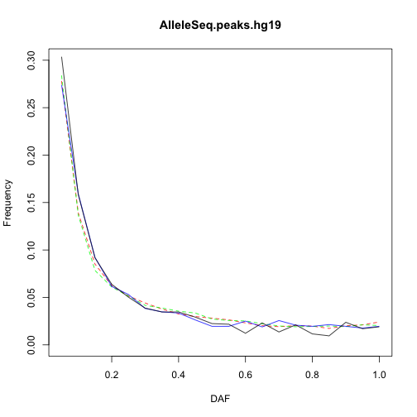
MYC

Slide 14
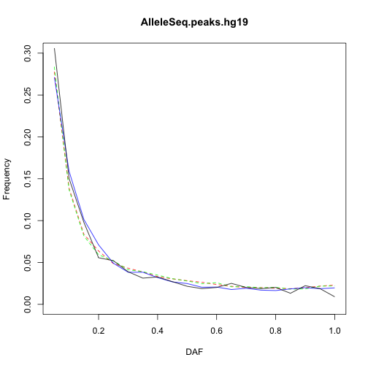
MAX

