Slide 1
For each ChIP-seq experiment for a TF, reads are mapped onto the diploid personal genome of Gm12878.
At each heterozygous SNP location, a p-value is calculated from binomial test on the number of reads mapped to maternal and paternal alleles.
The theoretical distribution of the p-values is a uniform distribution.
Goodness of fit test using one sample Kolmogorov-Smirnov test.
Allelic measure: D statistic from the KS test – the largest vertical distance between the observed distribution and the theoretical distribution.
57 unique TFs for Gm12878
54 TFs with >50 SNPs in the peaks

Slide 2
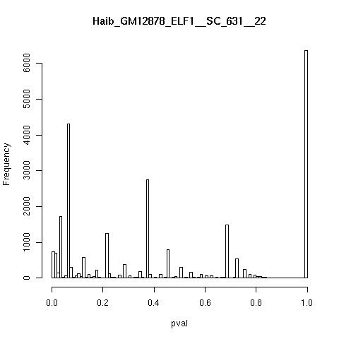

Slide 3
ELF1
D = 0.25

Slide 4
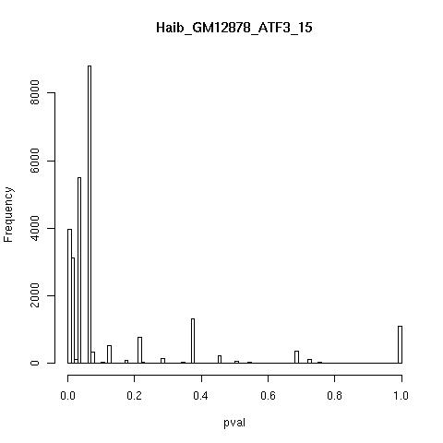

Slide 5
ATF3
D = 0.74

Slide 6
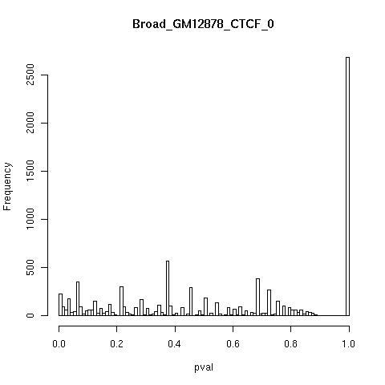

Slide 7
CTCF

Slide 8
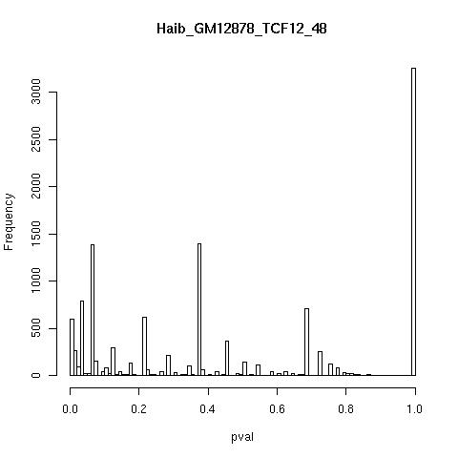

Slide 9
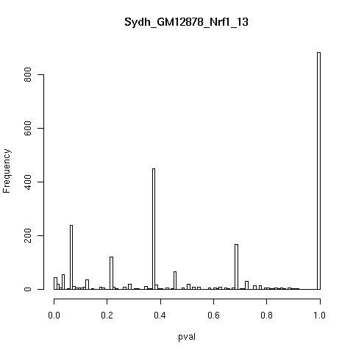

Slide 10
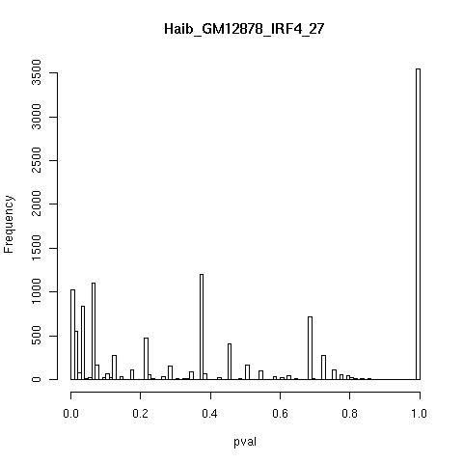

Slide 11
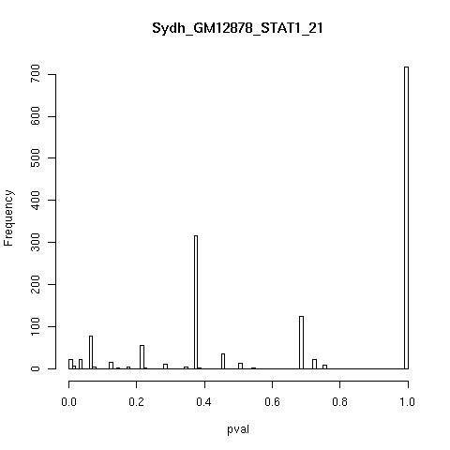

Slide 12
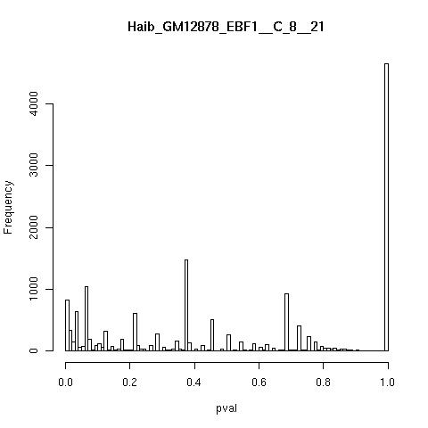

Slide 13
