Slide 1
ncVar II – allele-specific SNPs
GenomeAnnot
Jieming
30th Sept 2011

Slide 2
Wants to see if variations in DNA binding sites, motifs and non-coding RNAs at allele-specific sites are disruptive.
Initial hypothesis: → SNPs causing more allele-specific effects tend to be under more negative selection.

Slide 3
SNPs in DNA binding sites and motifs (ChIPseq)
Polymorphic 1KG CEU SNPs in Pouya’s motifs and are found in Arif’s data for NA12878.
Polymorphic 1KG CEU SNPs found in Joel’s data (genome-wide SNPs that are found in peaks) for NA12878.
Polymorphic 1KG CEU SNPs found in Joel’s data (allele-specific SNPs, p-value ≤ 0.05) for NA12878.
Polymorphic 1KG CEU SNPs found in Joel’s data (allele-specific SNPs, p-value ≤ 0.1) for NA12878.

Slide 4
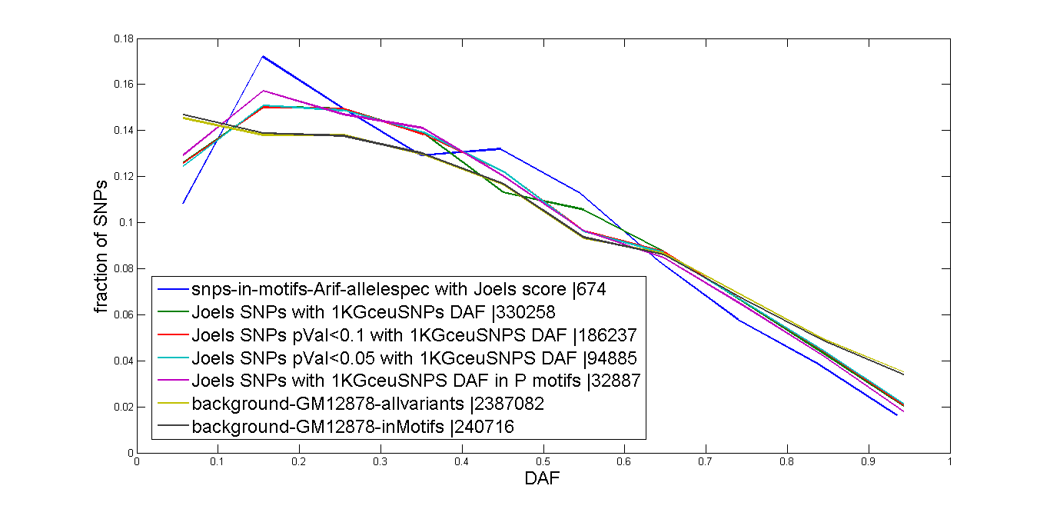

Slide 5
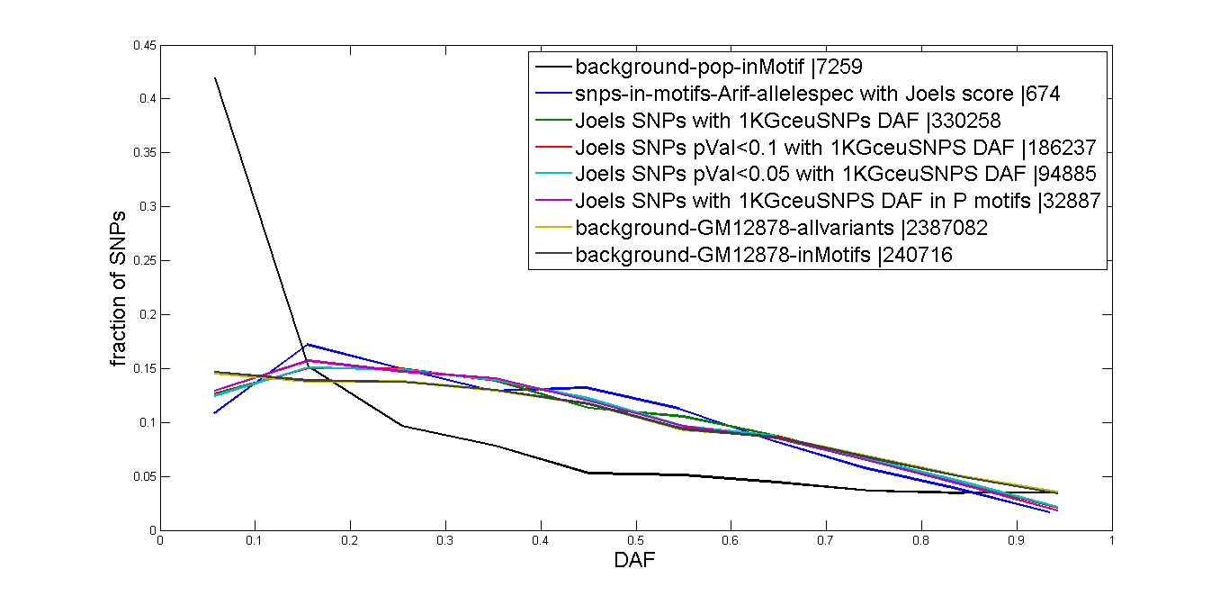

Slide 6
Correlations
Source | Data1 | Data2 | Spearman’s rho | P-value
SNPs-in-motifs-in-Arif’s | DAF | SymPval (Joel’s) | 0.0736 | 0.05615
 | Heterozygosity 2*DAF*(1-DAF) | SymPval | 0.125 | 0.001165
Joel’s GW SNPs with 1KG | DAF | SymPval | -0.0036 | 0.03842
 | Heterozygosity 2*DAF*(1-DAF) | SymPval | 0.000954 | 0.5835
Notes:
Joel’s SNPs in motifs rho 0.00194 pval = 0.7256

