Slide 1
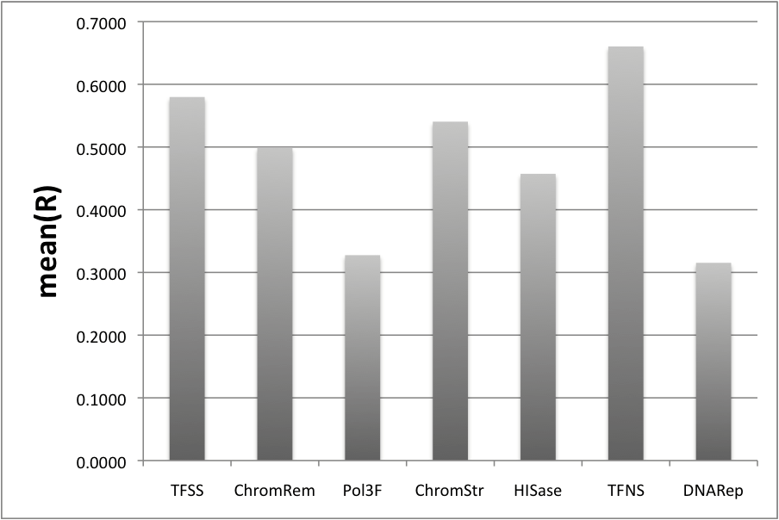
Predictive accuracy of TFs in different families

Slide 2
Predictive accuracy of TFs in different families
Category Number PCC SD P-value What
TFSS 46 0.5796 0.1389 0.013 >
ChromRem 2 0.4990 0.0156 0.02 <
Pol3F 5 0.3275 0.2073 0.03 <
ChromStr 5 0.5404 0.1356 Not Sig
HISase 5 0.4572 0.1387 Not Sig
TFNS 4 0.6603 0.0855 0.029 >
DNARep 1 0.3153 NA

