Slide 1
SV phase 1 validation by PCR (follow up analysis)
Alexej Abyzov
(Adrian Stuetz, Jan Korbel, etc.)
September 14, 2011

Slide 2
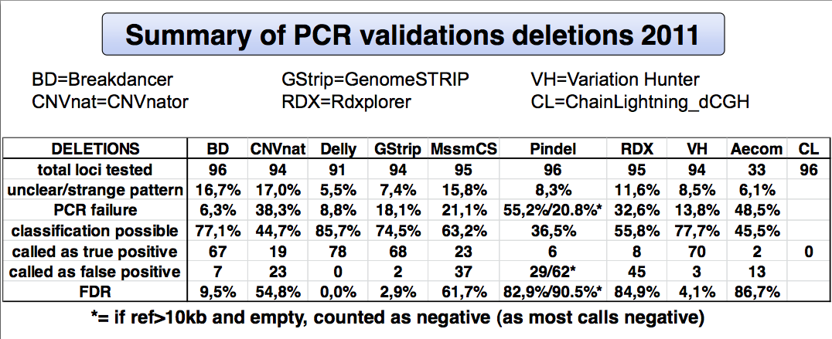
Summary by Adrian
Appear that unfiltered calls were used

Slide 3
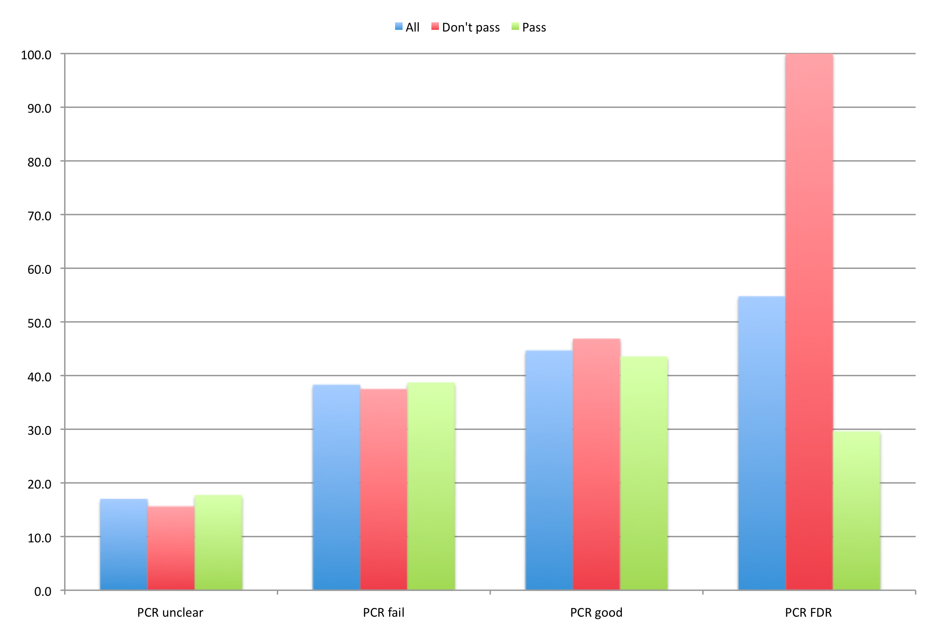
Filtered (PASS) vs. unfiltered

Slide 4
Inspection
Pop. | Predicted boundaries | # PE | Boundaries from PE | DGV/1KG | Conclusion
LWK | chr19:18741201-18744000 | 0 | NA
LWK | chr4:86976501-86978850 | 39 | chr4:86976239-86979964 | yes | Right underestimation, badly placed primer
LWK | chr16:936251-937300 | 4 | chr16:936488-936839
LWK | chr19:46940201-46944900 | 0 | NA
CHS | chr6:8433901-8435650 | 25 | chr6:8432403-8435259 | yes | Left underestimation, badly placed primer
CHS | chr12:53423651-53424150 | 7 | chr12:53423703-53424311
CHS | chr4:178374201-178375100 | 4 | chr4:178373969-178374661
CHS | chr3:82869751-82873950 | 68 | chr3:82868748-82872887 | yes | Left underestimation, badly placed primer
FDR = (8 – 3)/27 =~ 19%

Slide 5
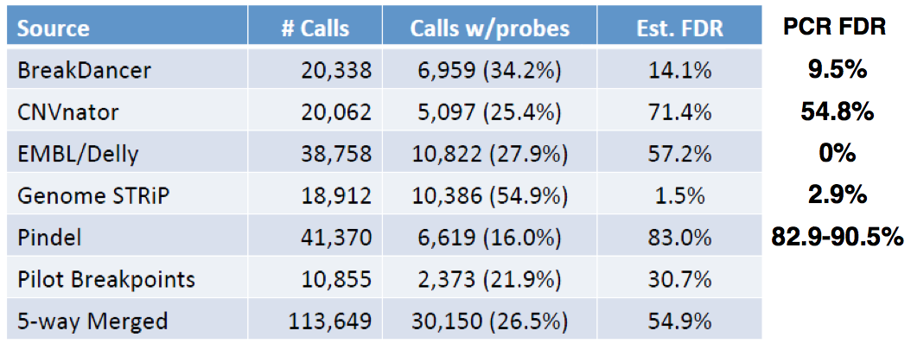
FDR comparison
SAV FDR

