Slide 1
De novo CNV; iPS vs fibroblast
Alexej Abyzov, Mike Wilson & Mark Gerstein
September 14, 2011

Slide 2
Samples and data
Fiii
S1123
Fiii
Fi
03
Fi
Fii
Fii
Fi
A
A
A – autism
F – fibroblast sequencing
i – iPSC sequencing
Analysis with CNVnator only

Slide 3
Father S1123
Region | Person | iPSC | F CN | i CN | Comments
chr8:47224001-47408000 | S1123-01 | i1 | 2.0 | 1.5 | In centromere
chr12:79858001-79888000 | S1123-01 | i1 | 2.4 | 3.4 | Repeat rich, overlap DGV
chr16:18437001-18513000 | S1123-01 | i1 | 2.2 | 2.8 | 4 PE, unsure, dup
chr16:30236001-30304000 | S1123-01 | i1 | 2.3 | 2.8 | unsure, dup
chr22:38755001-38789000 | S1123-01 | i1 | 2.1 | 2.7 | unsure, dup
chr3:175005001-175064000 | S1123-01 | i3 | 2.0 | 3.0 | 3 PE, confident, dup
chr5:168431001-168719000 | S1123-01 | i3 | 2.3 | 3.1 | 6 PE, confident, dup
chr7:61560001-61660000 | S1123-01 | i3 | 2.1 | 1.5 | SD, repeat rich, close to gap
chr20:14809001-14884000 | S1123-01 | i3 | 2.1 | 1.3 | 1 PE, confident, del
chrX:64962001-65029000 | S1123-01 | i3 | 1.2 | 1.9 | 3 PE, confident, dup
chr8:46857001-47395000 | S1123-01 | i4 | 2.0 | 1.5 | Repeat rich, in centromere, overlap DGV
chr11:55017001-55042000 | S1123-01 | i4 | 2.1 | 1.4 | SD, repeat rich, overlap DGV
chrX:64963001-65028000 | S1123-01 | i4 | 1.2 | 4.0 | 5 PE, confident , dup
chrY:6115001-6134000 | S1123-01 | i4 | 2.4 | 4.9 | SD, overlap DGV
Diploid for X and Y

Slide 4
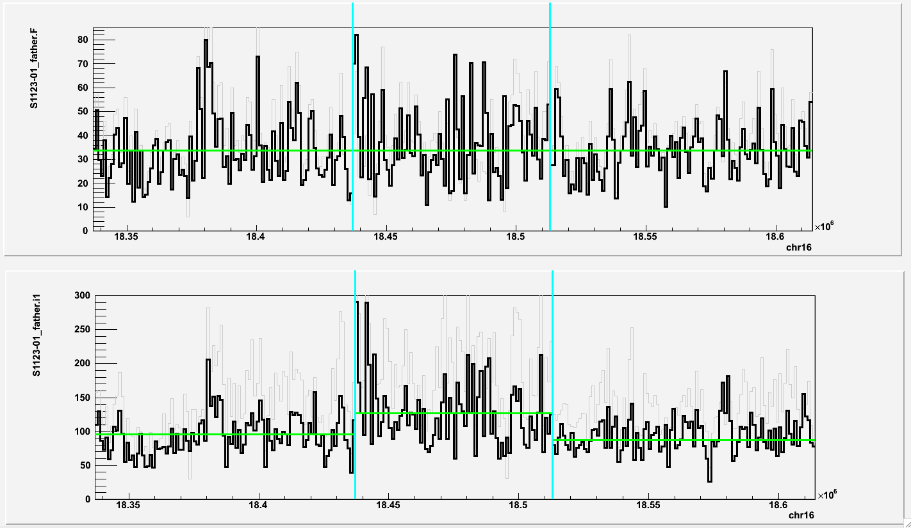
chr16:18437001-18513000 (duplication in i1; S1123 father)
i1 Fibroblast

Slide 5
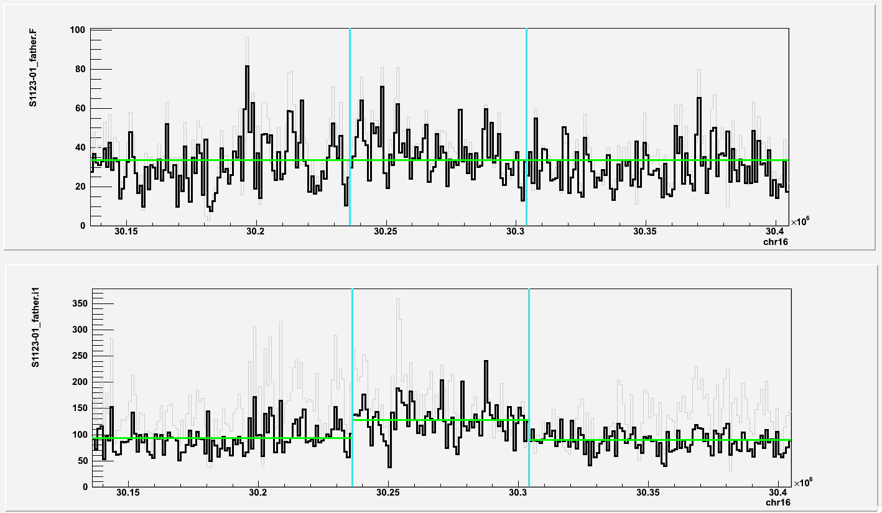
chr16:30236001-30304000 (duplication in i1; S1123 father)
i1 Fibroblast

Slide 6
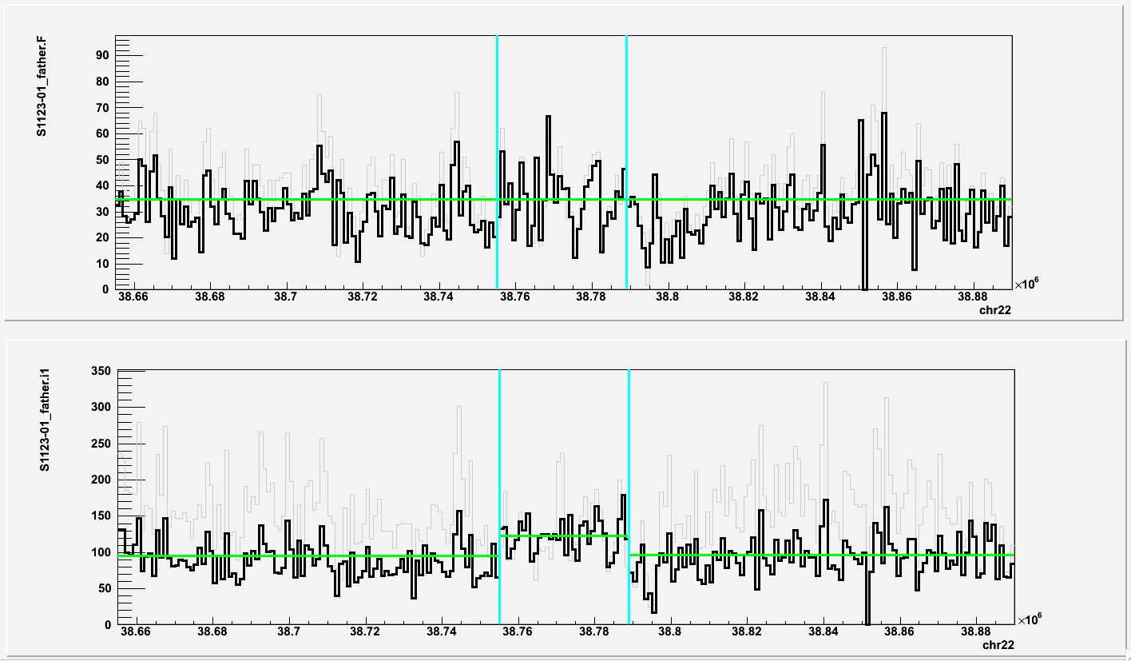
chr22:38755001-38789000 (duplication in i1; S1123 father)
i1 Fibroblast

Slide 7
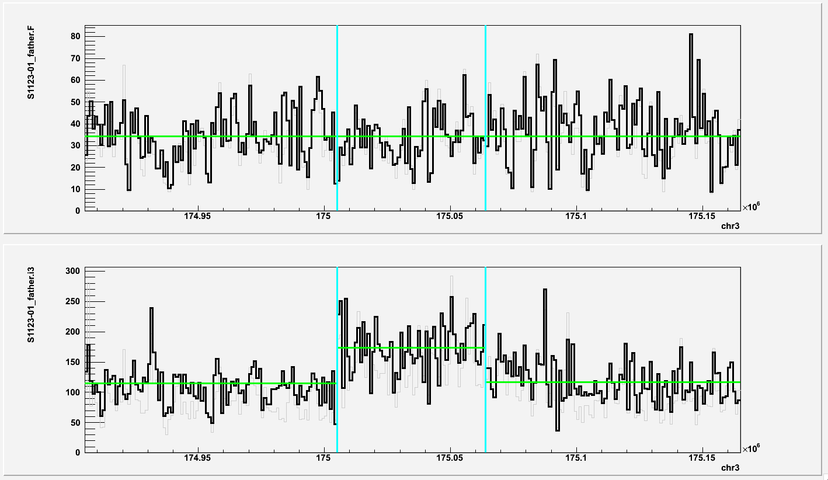
chr3:175005001-175064000 (duplication in i3; S1123 father)
i3 Fibroblast

Slide 8
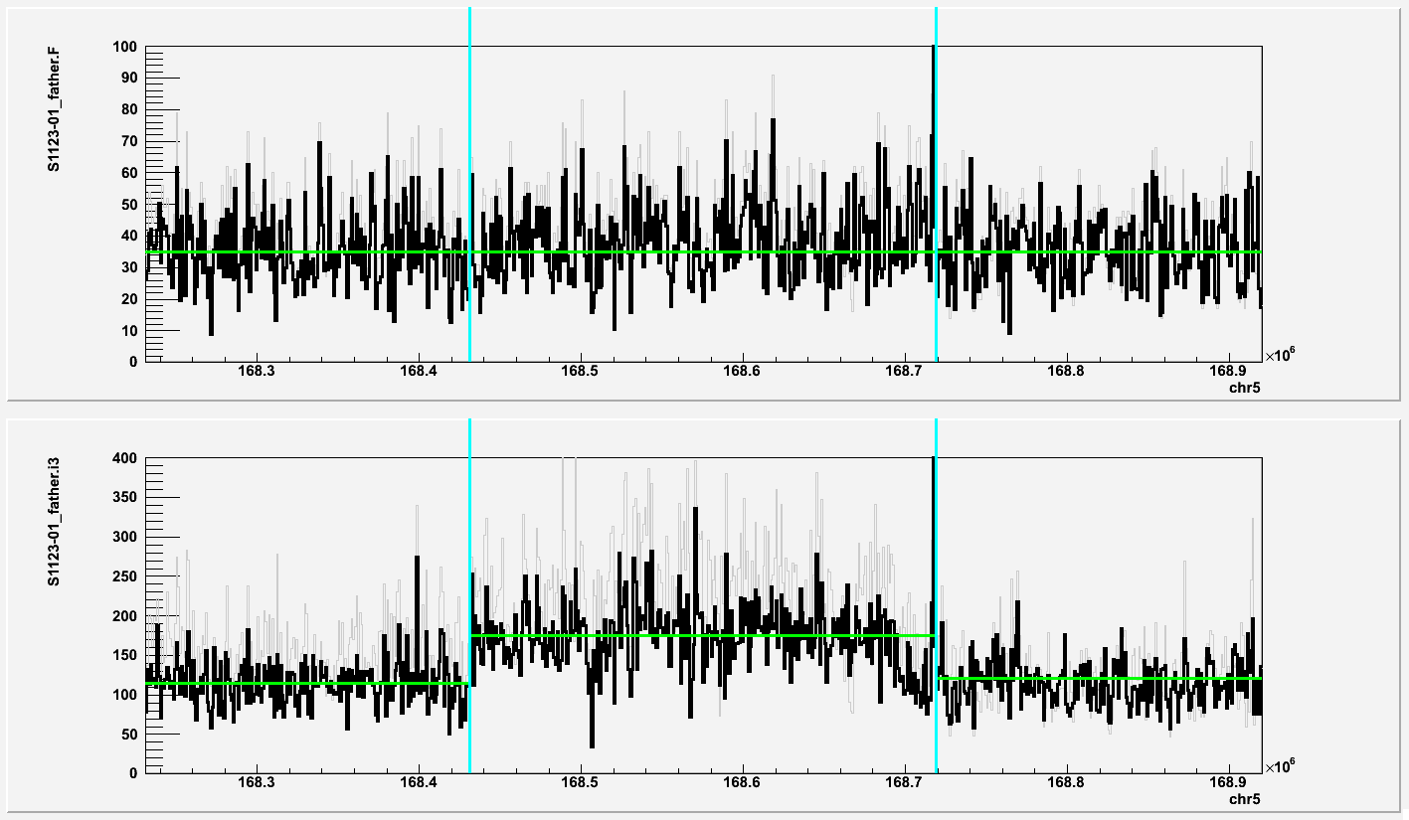
chr3:175005001-175064000 (duplication in i3; S1123 father)
i3 Fibroblast

Slide 9
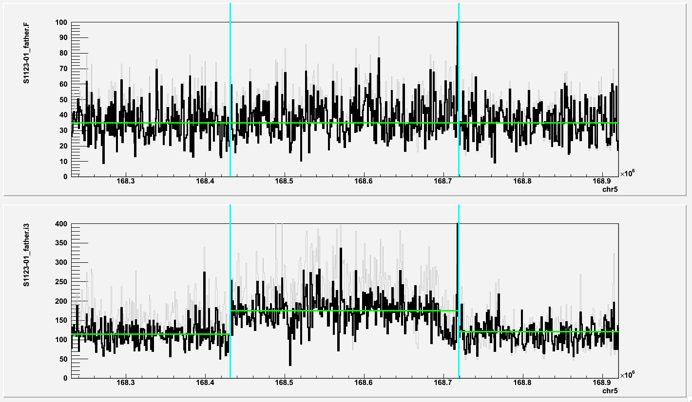
chr5:168431001-168719000 (duplication in i3; S1123 father)
i3 Fibroblast

Slide 10
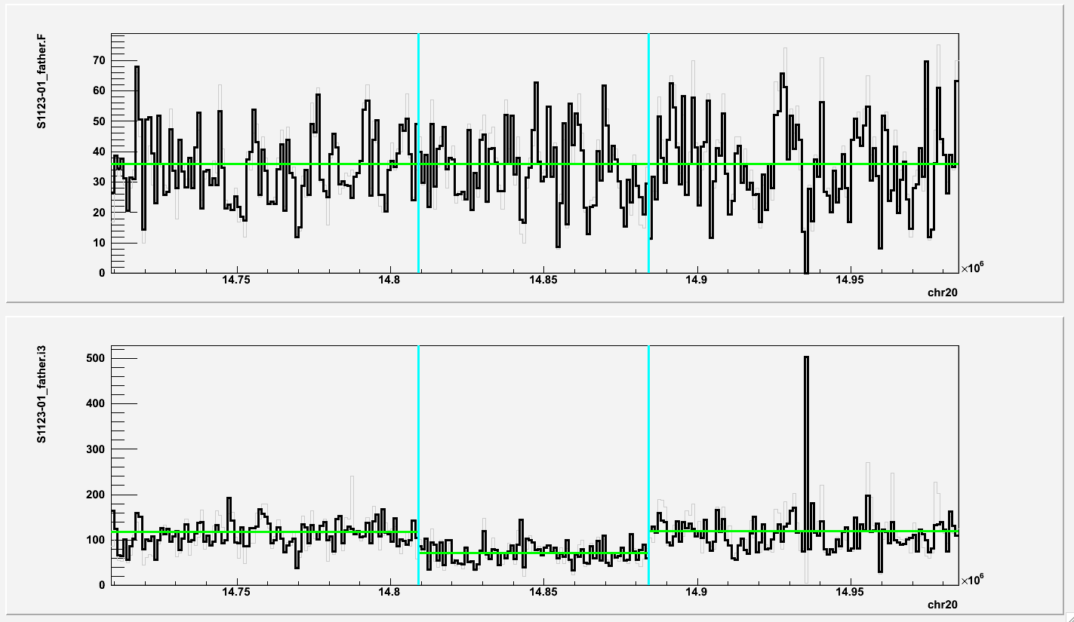
chr20:14809001-14884000 (deletion in i3; S1123 father)
i3 Fibroblast

Slide 11
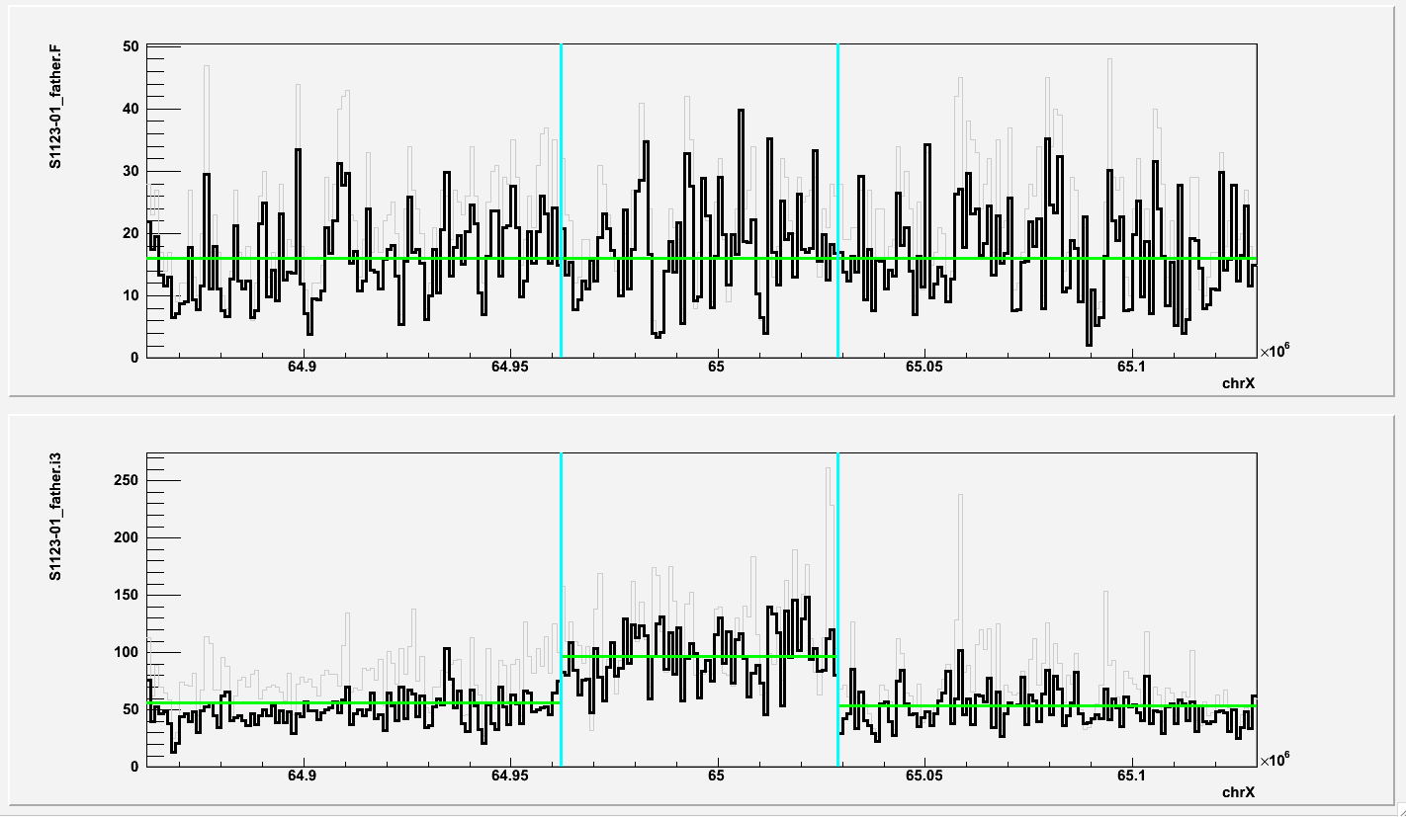
chrX:64962001-65029000 (duplication in i3; S1123 father)
i3 Fibroblast

Slide 12
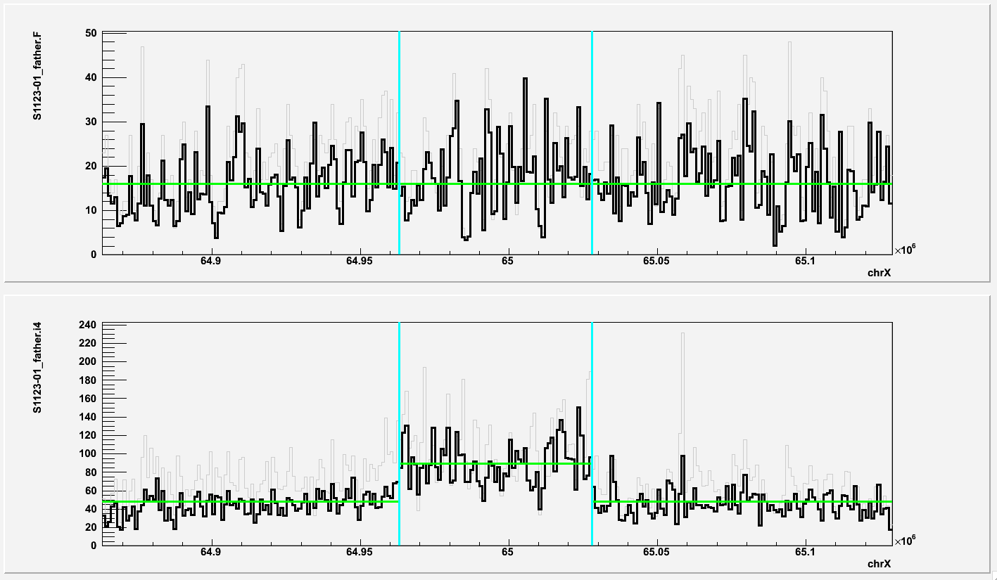
chrX:64963001-65028000 (duplication in i4; S1123 father)
i4 Fibroblast

Slide 13
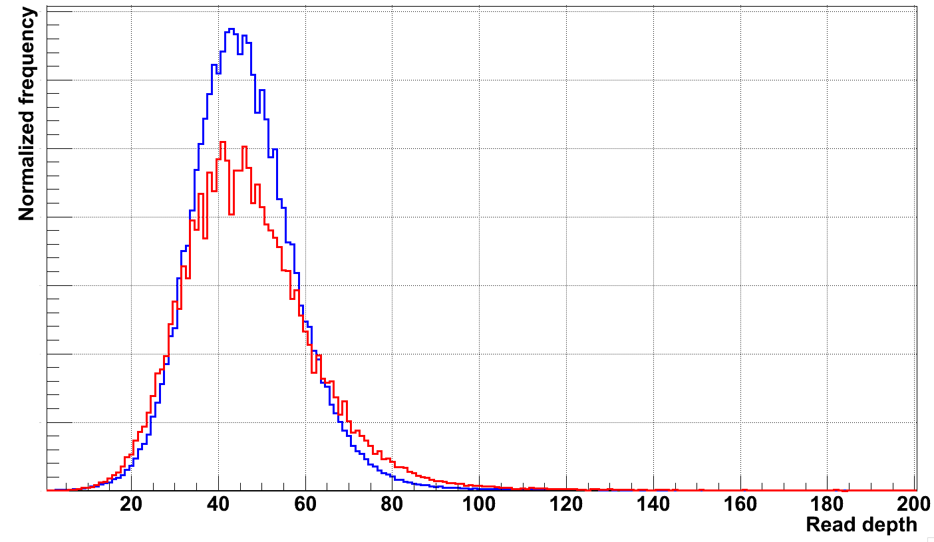
i4 replica for S1123 father has two copies of X and Y
RD for 1-22
RD for X and Y

Slide 14
Mother S1123
Region | Person | iPSC | F CN | i CN | Comments
chr12:66253001-66325000 | S1123-02 | i2 | 2.2 | 1.1 | 5 PE, confident, del
chr13:111112001-111126000 | S1123-02 | i2 | 2.0 | 0.9 | Confident, del
chr7:133748001-133785000 | S1123-02 | i7 | 2.3 | 3.4 | 4 PE, confident, dup
chr11:84329001-84540000 | S1123-02 | i7 | 2.2 | 1.1 | Confident, del
chr20:15010001-15192000 | S1123-02 | i7 | 2.2 | 1.3 | 5 PE, confident, del
chr4:10211001-10236000 | S1123-02 | i11 | 1.8 | 1.3 | Overlap DGV
chr4:130288001-130618000 | S1123-02 | i11 | 2.0 | 1.0 | 1 PE, confident, del

Slide 15
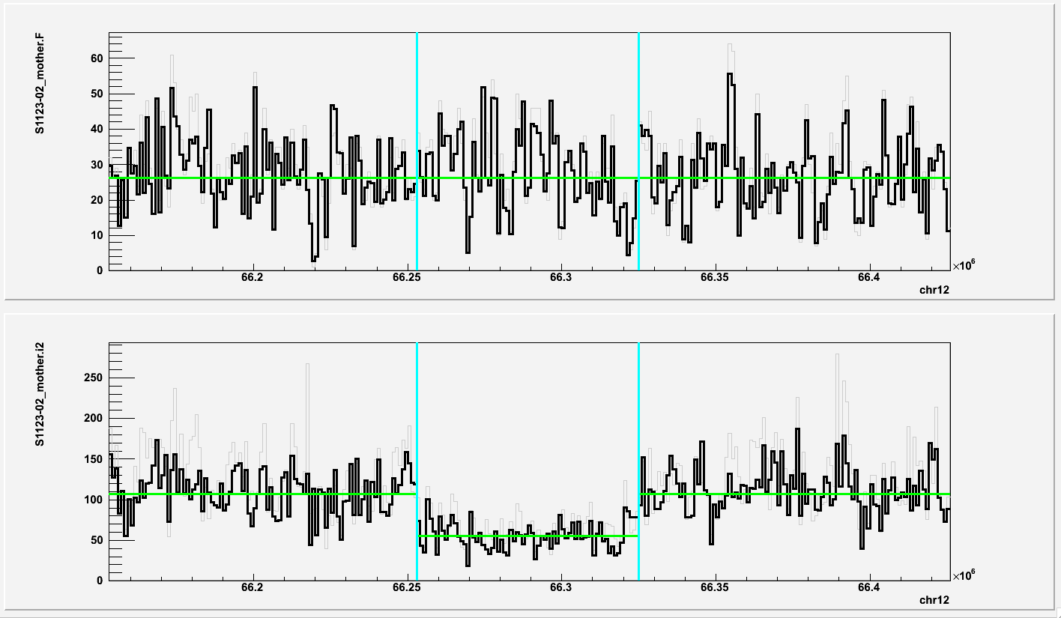
chr12:66253001-66325000 (deletion in i2; S1123 mother)
i2 Fibroblast

Slide 16
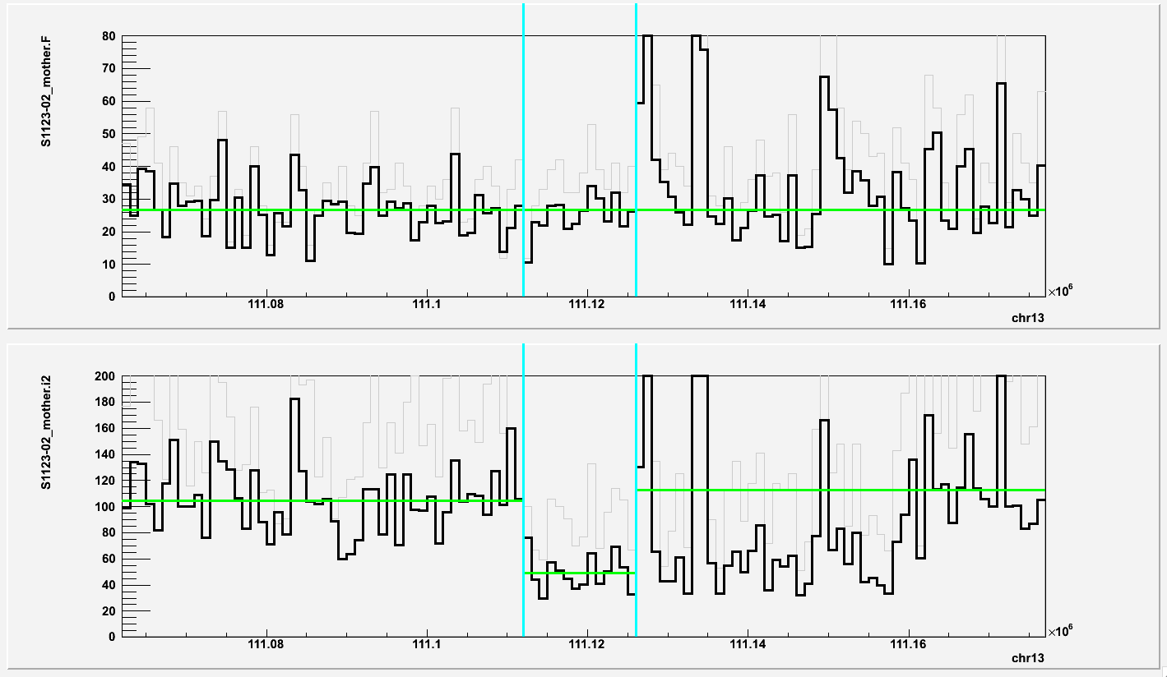
chr13:111112001-111126000 (deletion in i2; S1123 mother)
i2 Fibroblast

Slide 17
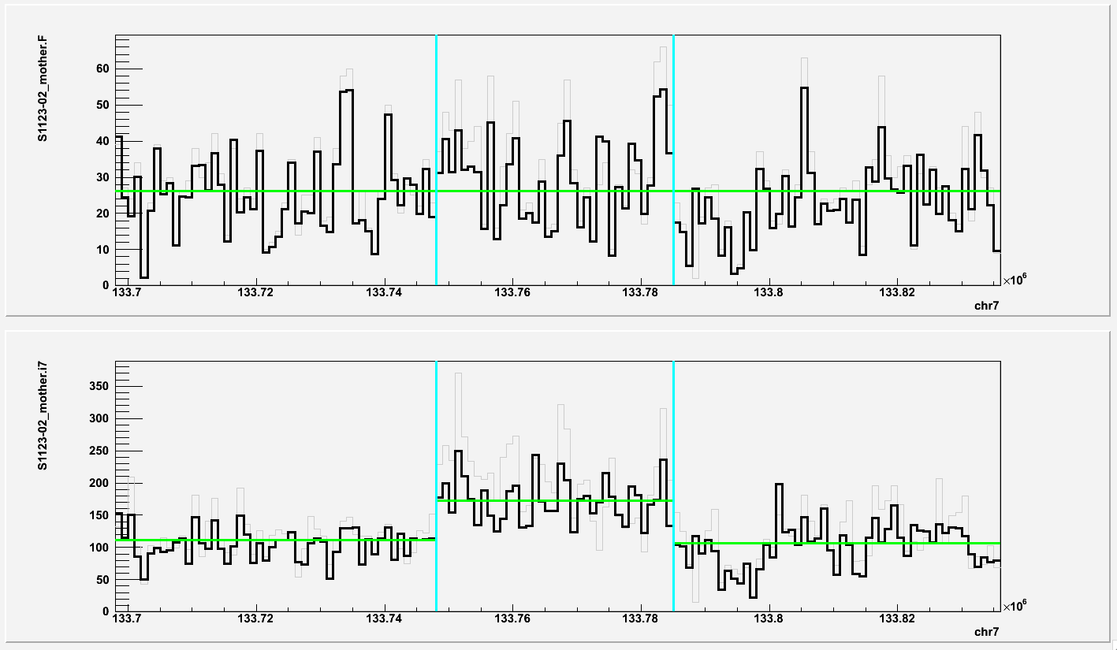
chr7:133748001-133785000 (duplication in i7; S1123 mother)
i7 Fibroblast

Slide 18
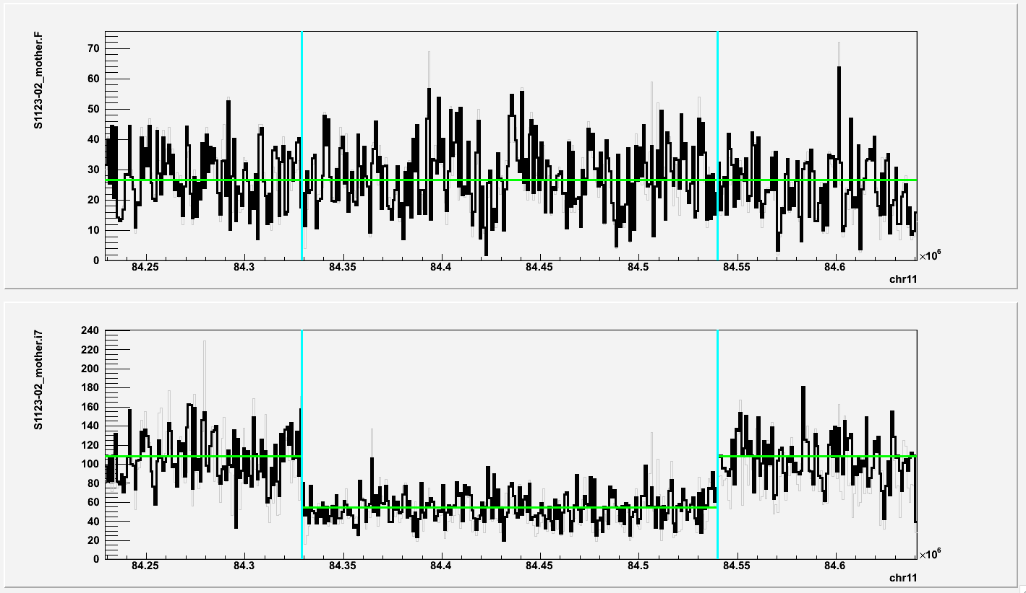
chr11:84329001-84540000 (deletion in i7; S1123 mother)
i7 Fibroblast

Slide 19
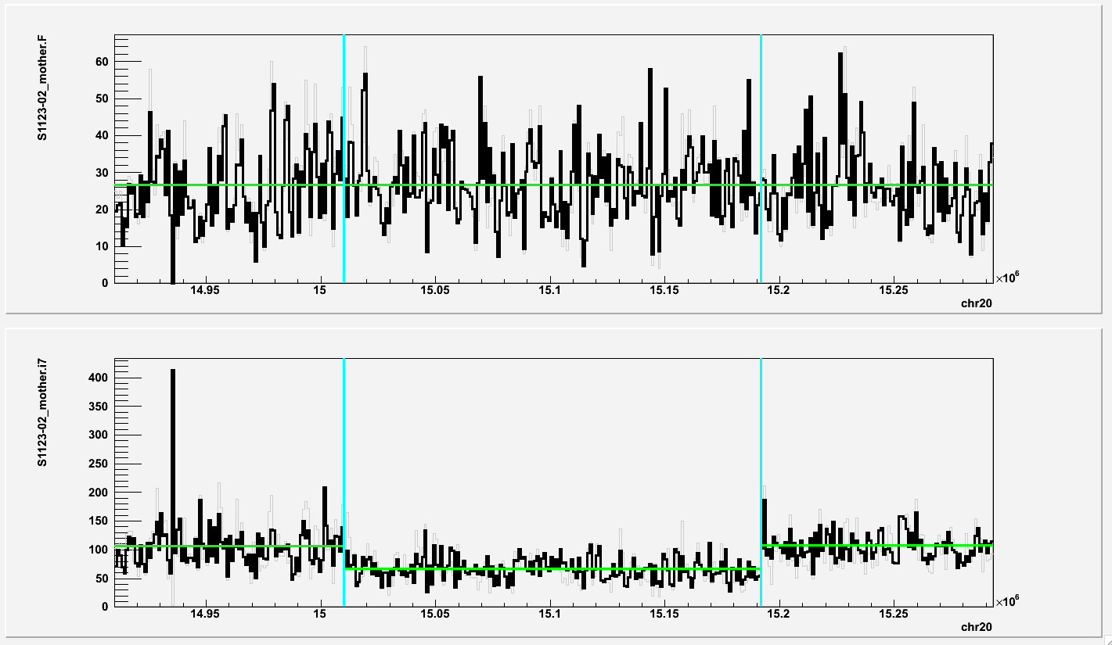
chr20:15010001-15192000 (deletion in i7; S1123 mother)
i7 Fibroblast

Slide 20
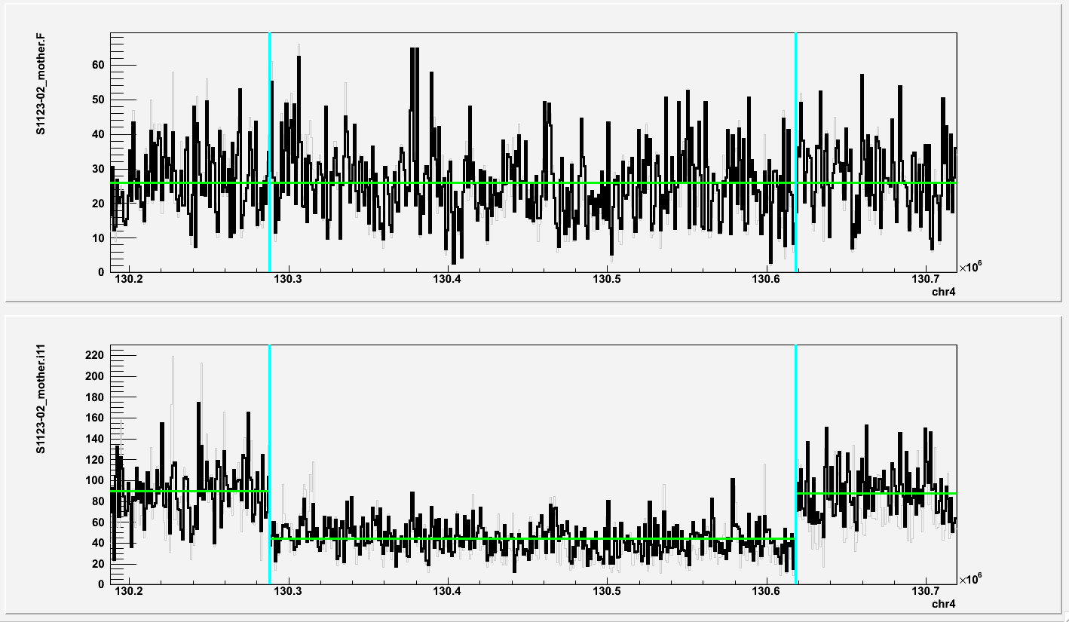
chr4:130288001-130618000 (deletion in i11; S1123 mother)
i11 Fibroblast

Slide 21
Son S1123 (affected)
Region | Person | iPSC | F CN | i CN | Comments
chr5:12811001-12821000 | S1123-03 | i1 | 1.5 | 0.9 | 2 PE, unsure
chr11:51327001-51367000 | S1123-03 | i8 | 1.7 | 1.1 | Overlap DGV
i9 seems to be derived from son in 03 family (03-03)

Slide 22
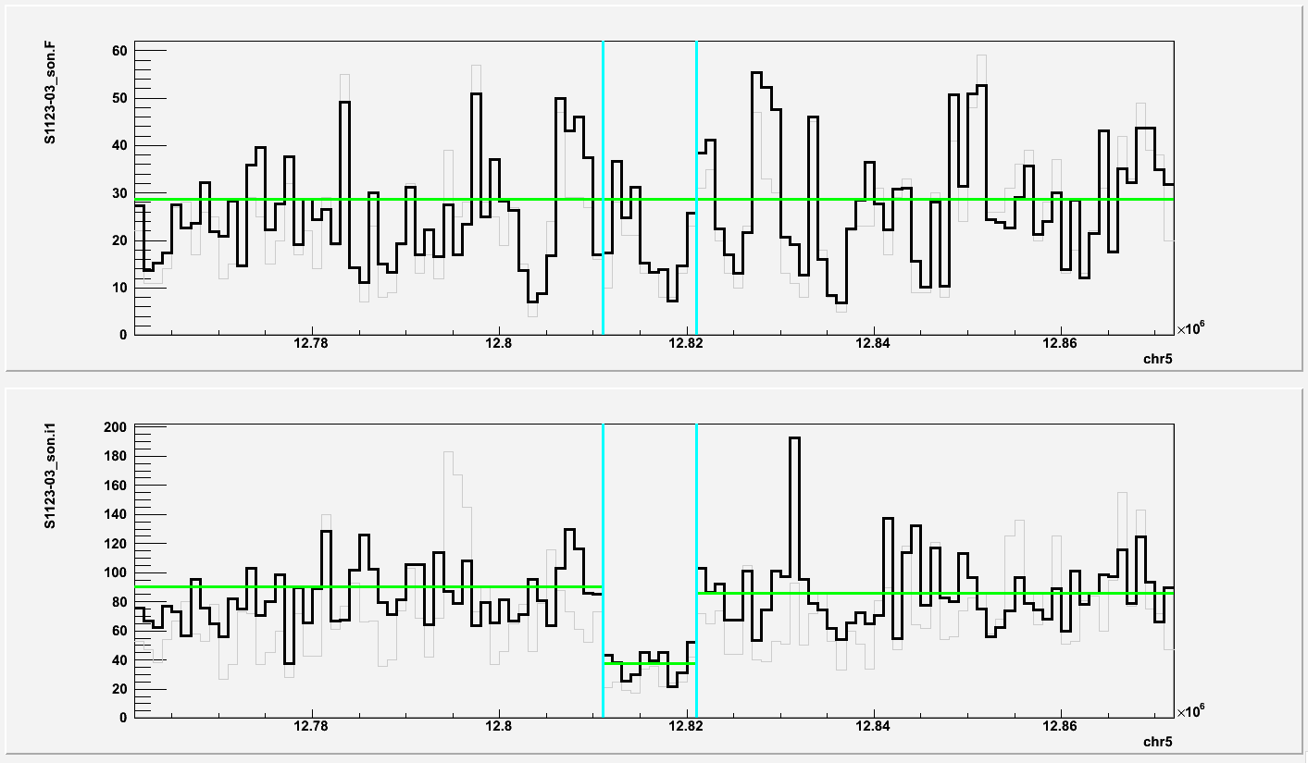
chr5:12811001-12821000 (deletion in i1; S1123 son)
i1 Fibroblast

Slide 23
Father 03
Region | Person | iPSC | F CN | i CN | Comments
chr4:93228001-93258000 | 03-01 | i3 | 2.10 | 2.89 | By chance
chr8:124671001-124704000 | 03-01 | i3 | 2.21 | 3.07 | Confident, dup
chr22:38753001-38789000 | 03-01 | i3 | 2.26 | 2.83 | SD, overlap DGV

Slide 24
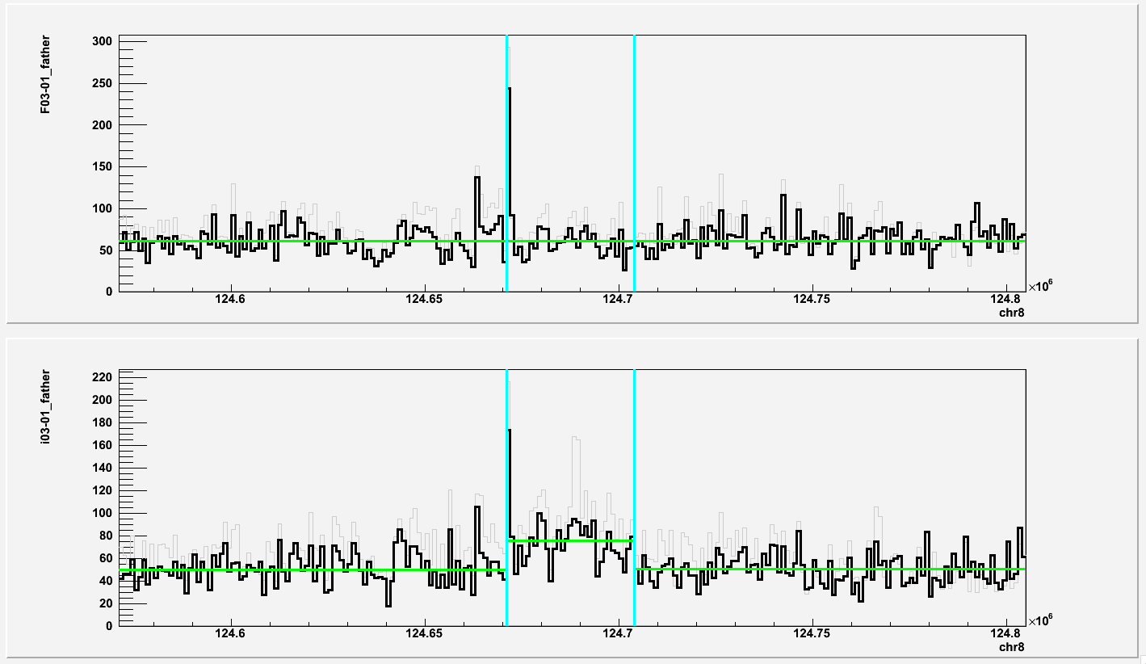
chr8:124671001-124704000 (duplication in i3; 03 father)
i3 Fibroblast

Slide 25
Mother 03
Region | Person | iPSC | F CN | i CN | Comments
chr1:162043001-162108000 | 03-02 | i9 | 2.24 | 2.88 | By chance
chr10:42410001-42485000 | 03-02 | i9 | 2.04 | 1.26 | Close to a centromere
chr12:37961001-38423000 | 03-02 | i9 | 1.90 | 1.36 | AT rich and repeat rich, overlap DGV
chr18:70516001-70543000 | 03-02 | i9 | 1.98 | 1.37 | Confident, del
chrX:141153001-141191000 | 03-02 | i9 | 1.95 | 1.43 | Confident, del

Slide 26
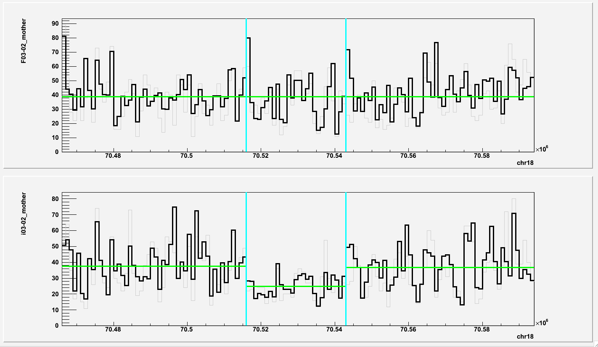
chr18:70516001-70543000 (deletion in i9; 03 mother)
i9 Fibroblast

Slide 27
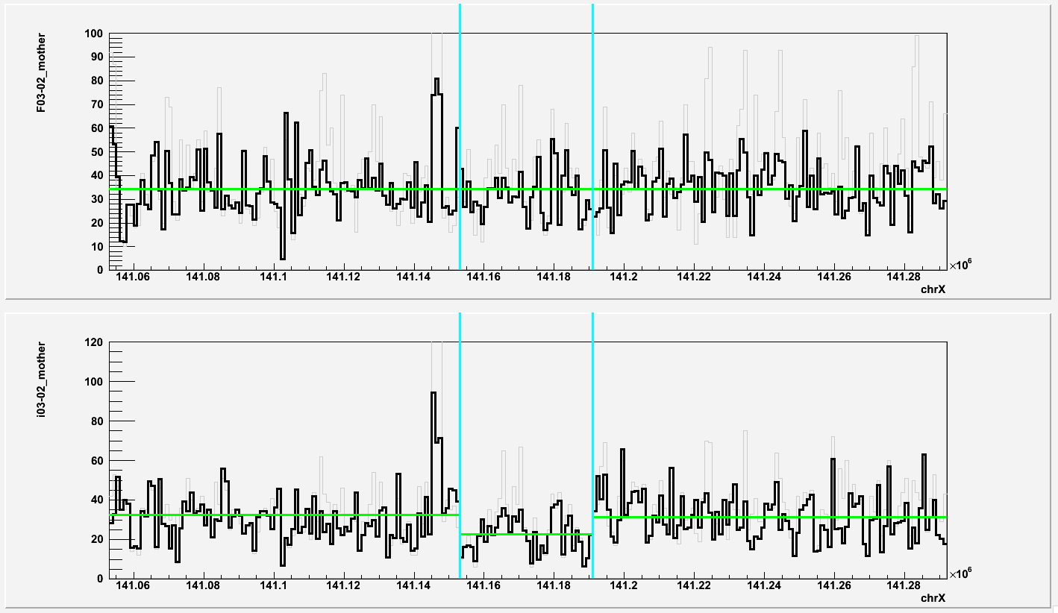
chrX:141153001-141191000 (deletion in i9; 03 mother)
I9 Fibroblast

Slide 28
Sun 03 (affected)
Region | Person | iPSC | F CN | i CN | Comments
chr1:228720001-228744000 | 03-03 | i2 | 1.9 | 1.3 | Repeat rich, overlap DGV
chr14:76667001-76778000 | 03-03 | i2 | 2.2 | 1.1 | 2 PE support, confident, del
chr22:28832001-28879000 | 03-03 | i2 | 2.1 | 1.1 | 2 PE support, confident, del
chr7:63042001-63218000 | 03-03 | i4 | 1.9 | 1.4 | SD
chr11:84581001-84688000 | 03-03 | i4 | 2.0 | 3.2 | 6 PE support, confident, dup
chr14:19276001-19303000 | 03-03 | I4 | 1.7 | 1.1 | SD, repeat rich, overlap DGV
chr15:21286001-21324000 | 03-03 | i4 | 1.9 | 1.4 | SD, overlap DGV

Slide 29
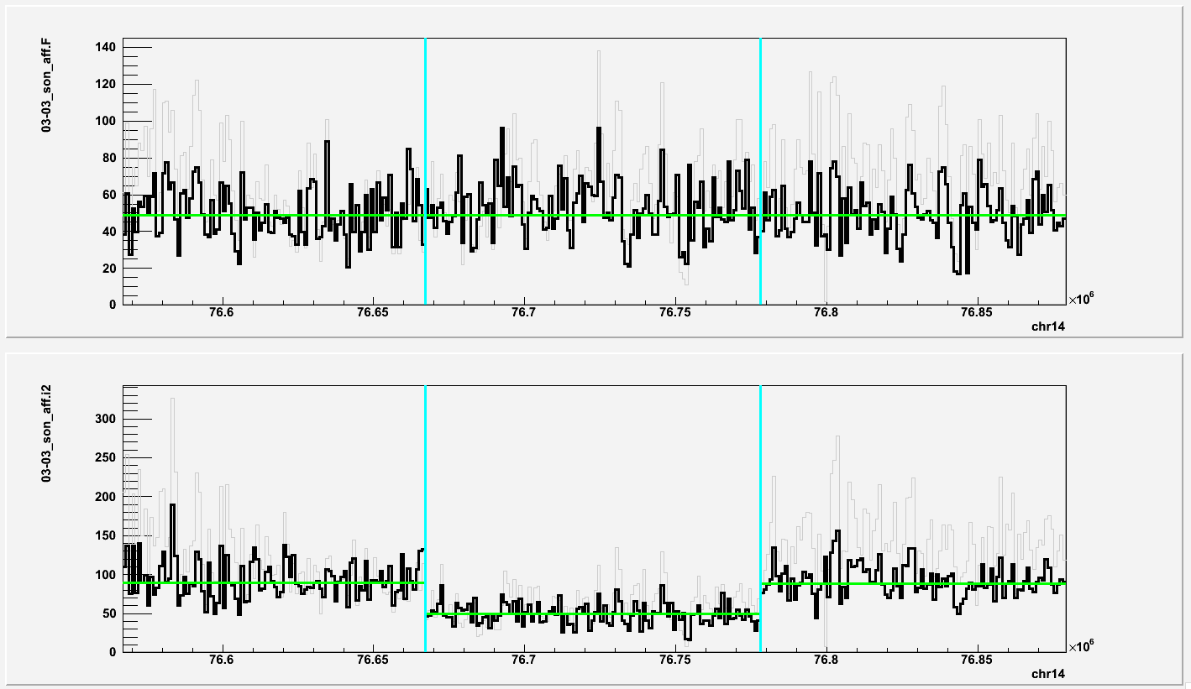
chr14:76667001-76778000 (deletion in i2; 03 affected son)
i2 Fibroblast

Slide 30
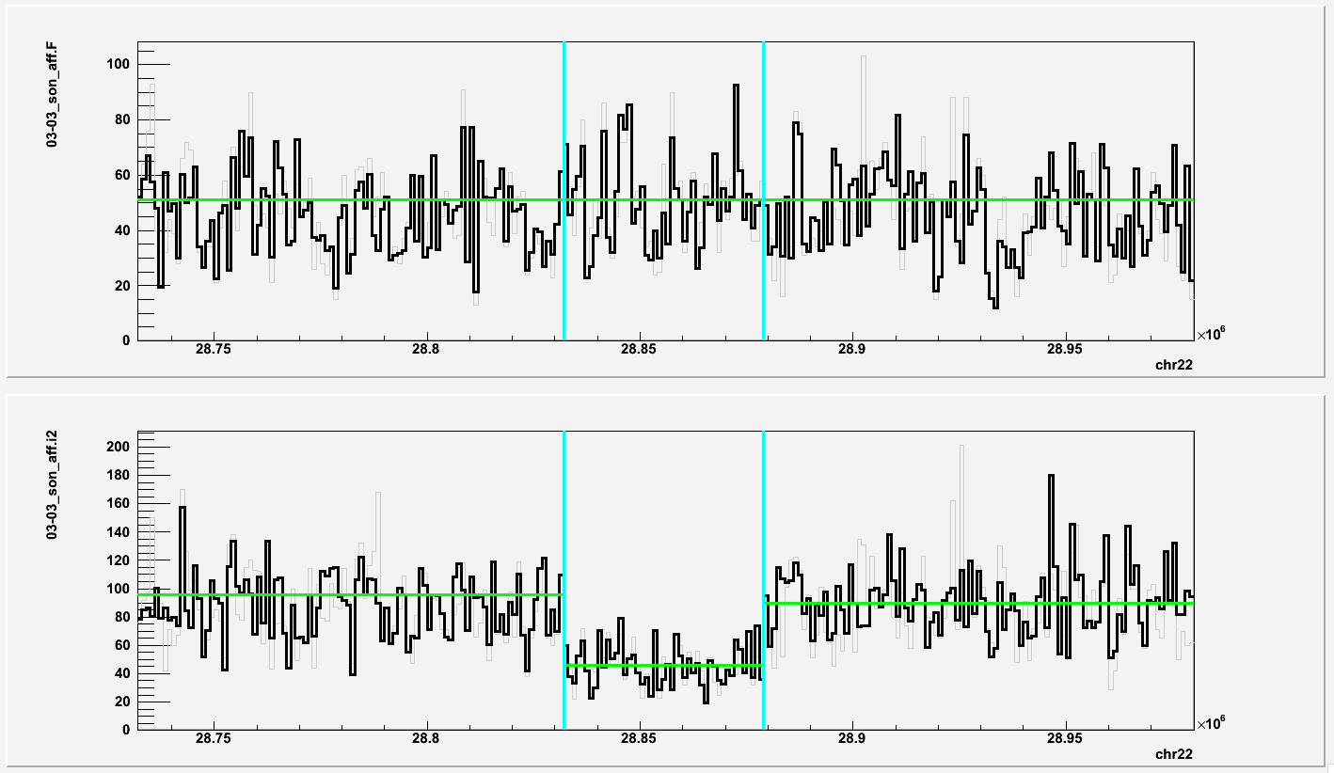
chr22:28832001-28879000 (deletion in i2; 03 affected son)
i2 Fibroblast

Slide 31
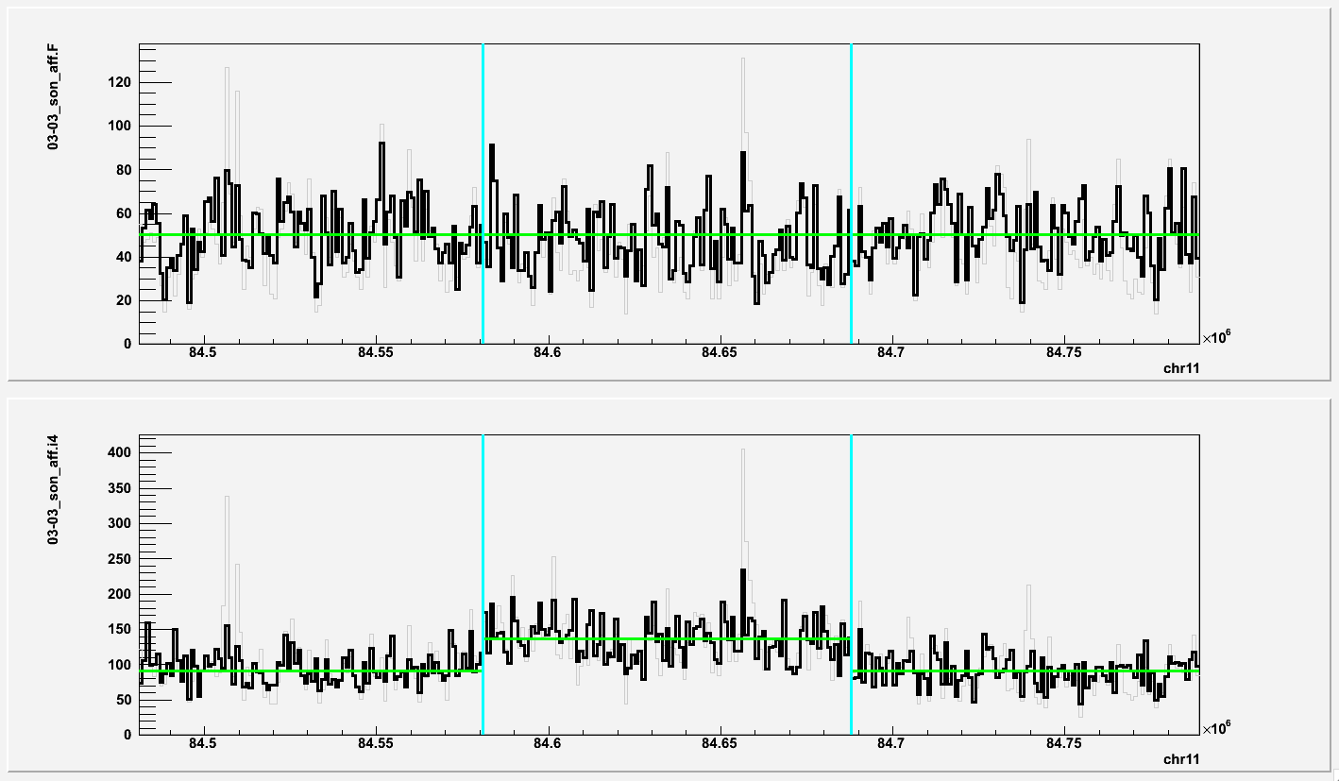
chr11:84581001-84688000 (duplication in i4; 03 affected son)
i2 Fibroblast

Slide 32
Sun 03 (unaffected)
Region | Person | iPSC | F CN | i CN | Comments
chr3:143236001-143867000 | 03-04 | i6 | 2.06 | 2.83 | 1 PE support, confident, dup
chr4:79028001-79080000 | 03-04 | i6 | 2.10 | 2.68 | By chance
chr8:15540001-15615000 | 03-04 | i6 | 2.02 | 1.02 | 1 PE support, confident, del
chr10:70514001-71136000 | 03-04 | i6 | 1.85 | 3.05 | 3 PE support, confident, dup
chr10:74033001-74650000 | 03-04 | i6 | 1.89 | 3.17 | confident, dup
chrY:6115001-6134000 | 03-04 | i6 | 2.94 | 2.15 | Misgenotyping?

Slide 33
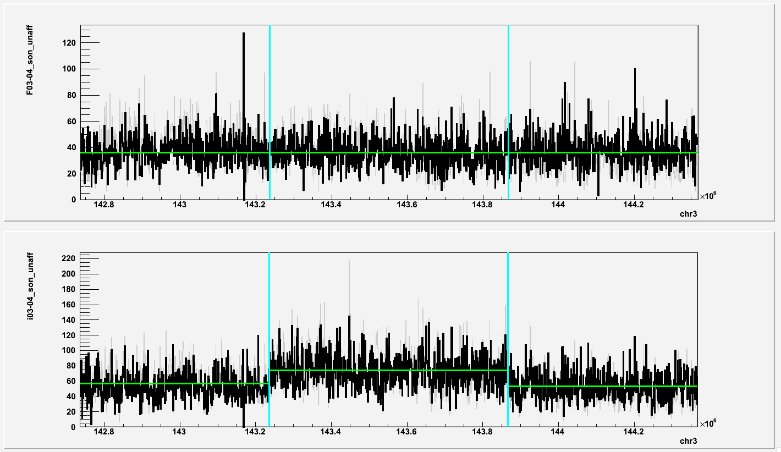
chr3:143236001-143867000 (duplication in i4; 03 unaffected son)
i6 Fibroblast

Slide 34
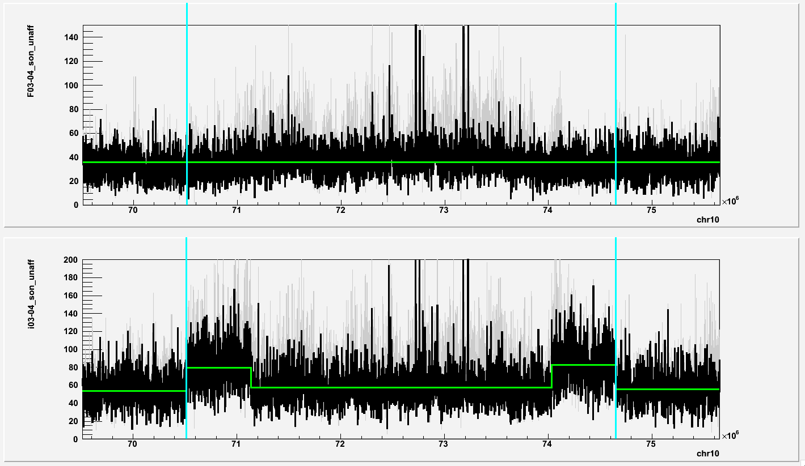
chr10:70514001-71136000 chr10:74033001-74650000 (duplications in i4; 03 unaffected son)
i6 Fibroblast

Slide 35
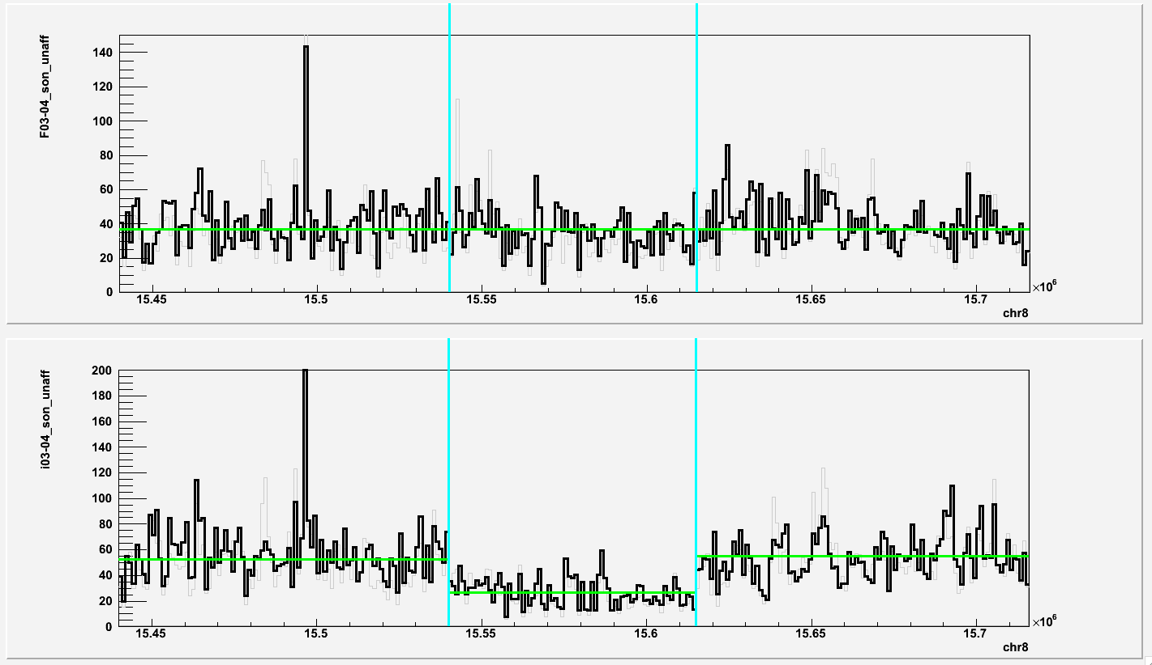
chr8:15540001-15615000 (deletion in i4; 03 unaffected son)
i6 Fibroblast

Slide 36
Summary
Region | Person | iPSC | F CN | i CN | Comments
chr16:18437001-18513000*,º | S1123-01 | i1 | 2.2 | 2.8 | 4 PE, unsure, dup
chr16:30236001-30304000º | S1123-01 | i1 | 2.3 | 2.8 | Unsure, dup
chr22:38755001-38789000º | S1123-01 | i1 | 2.1 | 2.7 | Unsure, dup
chr3:175005001-175064000 | S1123-01 | i3 | 2.0 | 3.0 | 3 PE, confident, dup
chr5:168431001-168719000 | S1123-01 | i3 | 2.3 | 3.1 | 6 PE, confident, dup
chr20:14809001-14884000 | S1123-01 | i3 | 2.1 | 1.3 | 1 PE, confident, del
chrX:64962001-65029000 | S1123-01 | i3 | 1.2 | 1.9 | 3 PE, confident, dup
chrX:64963001-65028000 | S1123-01 | i4 | 1.2 | 4.0 | 5 PE, confident , dup
chr12:66253001-66325000 | S1123-02 | i2 | 2.2 | 1.1 | 5 PE, confident, del
chr13:111112001-111126000 | S1123-02 | i2 | 2.0 | 0.9 | Confident, del
chr7:133748001-133785000 | S1123-02 | i7 | 2.3 | 3.4 | 4 PE, confident, dup
chr11:84329001-84540000 | S1123-02 | i7 | 2.2 | 1.1 | Confident, del
chr20:15010001-15192000 | S1123-02 | i7 | 2.2 | 1.3 | 5 PE, confident, del
chr4:130288001-130618000 | S1123-02 | i11 | 2.0 | 1.0 | 1 PE, confident, del
chr5:12811001-12821000º | S1123-03 | i1 | 1.5 | 0.9 | 2 PE, unsure
chr8:124671001-124704000 | 03-01 | i3 | 2.21 | 3.07 | Confident, dup
chr18:70516001-70543000 | 03-02 | i9 | 1.98 | 1.37 | Confident, del
chrX:141153001-141191000 | 03-02 | i9 | 1.95 | 1.43 | Confident, del
chr14:76667001-76778000 | 03-03 | i2 | 2.2 | 1.1 | 2 PE, confident, del
chr22:28832001-28879000 | 03-03 | i2 | 2.1 | 1.1 | 2 PE, confident, del
chr11:84581001-84688000 | 03-03 | i4 | 2.0 | 3.2 | 6 PE, confident, dup
chr3:143236001-143867000 | 03-04 | i6 | 2.06 | 2.83 | 1 PE, confident, dup
chr8:15540001-15615000 | 03-04 | i6 | 2.02 | 1.02 | 1 PE, confident, del
chr10:70514001-71136000 | 03-04 | i6 | 1.85 | 3.05 | 3 PE, confident, dup
chr10:74033001-74650000 | 03-04 | i6 | 1.89 | 3.17 | Confident, dup
Recurrent
Predicted 25 de novo CNVs in 12 iPS cell lines
17 (71%) of predictions have PE support in iPS sequencing
1* (4%) of predictions have PE support in fibroblast sequencing
4º (16%) of predictions has 50% reciprocal overlap with G1K or DGV
Diploid X,Y
Predicted before

Slide 37
Statistics
Out of 13 pairs of F-to-I comparison, 12 (92%) have strong evidence of de novo SV in iPSC cells
Total SVs: 25 = 13 (52%) duplications + 12 (48%) deletions
2 (8%) recurrent duplications (de novo in fibroblast?)
1 (8%) “weird” (diploid X and Y chromosomes) iPS cell line

Slide 38
Conclusion
Most of iPS cell lines and replicates have de novo SVs
Multiple copies of chromosomes can be another side effect of induction to pluripotency
Duplication on chromosome X suggests unknown mechanism of disperse duplication
SVs may be recurrent

Slide 39
De novo in affected child (S1123 family)
Program source | Coordinate | Type | Support | Comments
CNVnator | chr15:32702001-32894000 | deletion | RD | Weak
 | chr19:112001-174000 | deletion |  | Weak
 | chr5:69212001-70060000 | deletion |  | Weak
 | chr9:70428001-70482000 | deletion |  | Weak
 | chr10:106879001-106941000 | duplication
BreakDancer | chr15:60447092-60447980 | deletion | RD
 | chr15:91402020-91402596 | deletion
 | chr16:89301319-89301504 | deletion |  | Weak
 | chr17:983965-984393 | deletion |  | Weak
 | chr21:41216723-41217328 | deletion
 | chr4:186198651-186199321 | deletion
 | chr4:187718478-187719065 | deletion |  | Weak
 | chr5:159022113-159023089 | deletion
 | chr5:175464-175991 | deletion
 | chr6:11443860-11444678 | deletion |  | Weak
 | chr7:156395077-156395751 | deletion |  | Weak
 | chr7:158998499-158999653 | deletion
 | chr7:8463311-8465637 | deletion
 | chr8:1323307-1324279 | deletion
 | chr5:172972709-172974589 | deletion | PE | Overlap DGV, false
 | chr7:13585767-13591510 | deletion
Suggest to
validate
bolded!

Slide 40
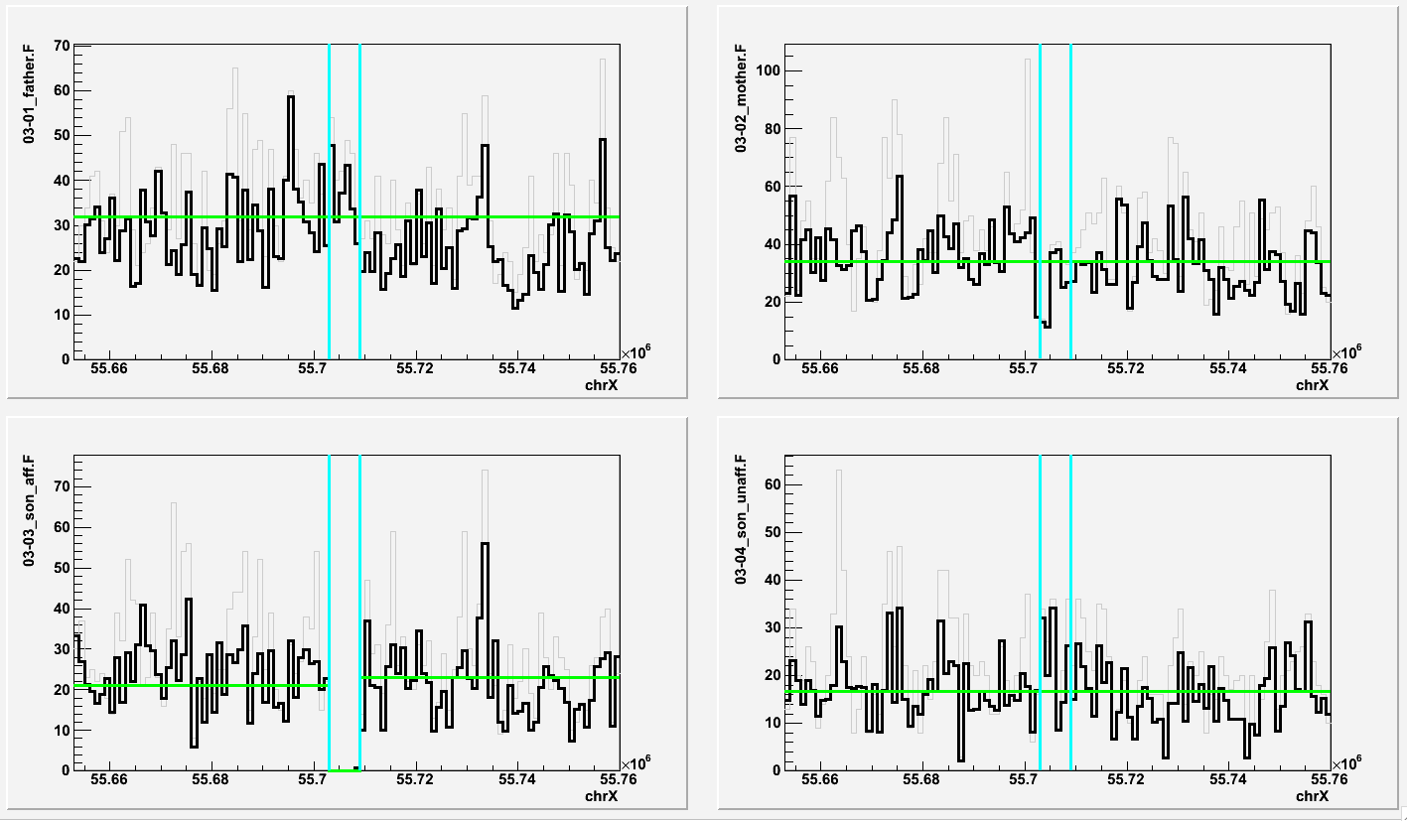
chrX:55703001-55709000
Father
Mother
Son affected
Son unaffected

Slide 41
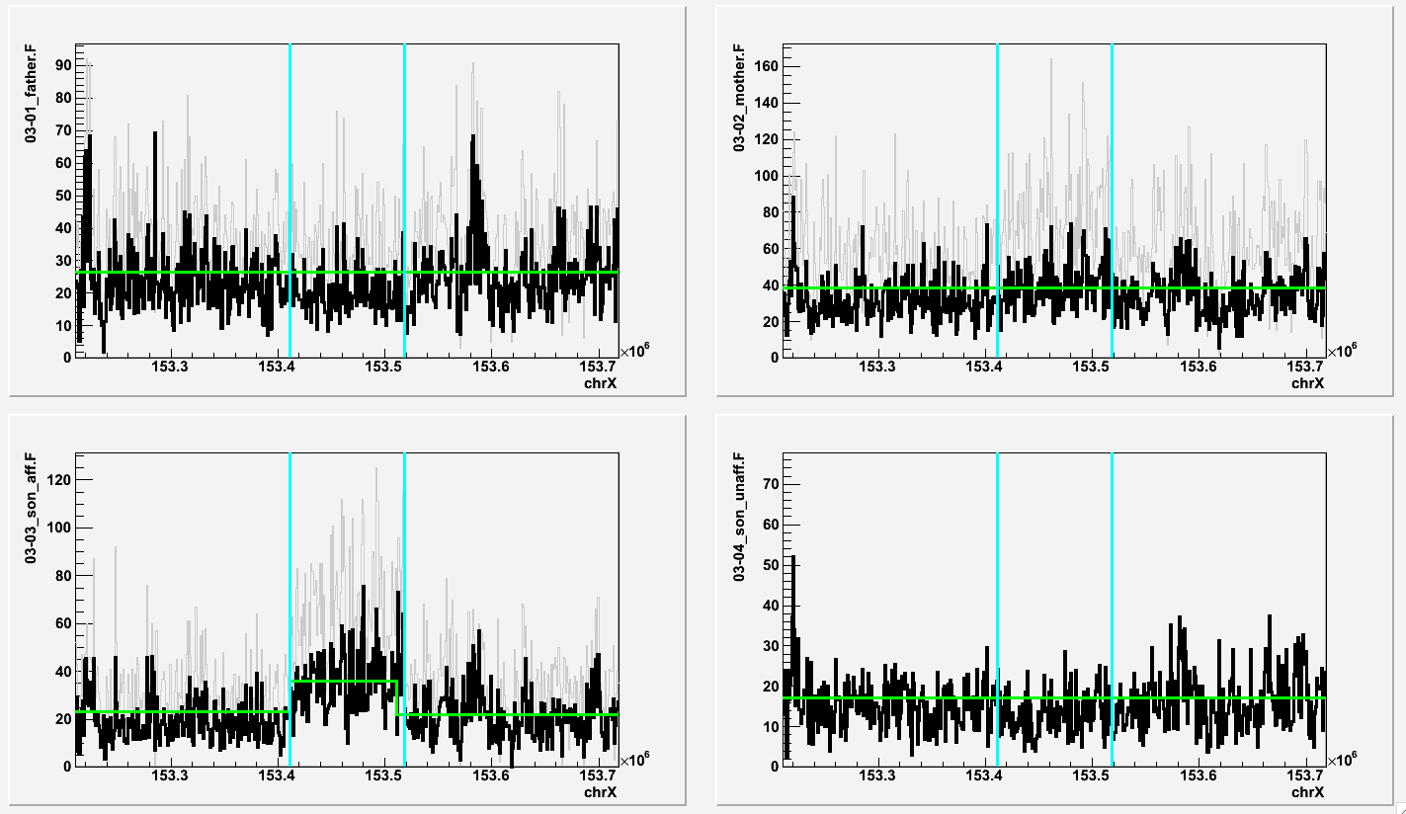
chrX:153411001-153518000
Father
Mother
Son affected
Son unaffected

Slide 42
De novo in affected child (S1123 family)
Program source | Coordinate | Type | Support | Comments
CNVnator | chr19:115001-198000 | deletion | RD | SD, close to gap, weak
 | chr1:207700001-207749000 | deletion |  | SD, overlap DGV, weak
 | chrX:55703001-55709000 | deletion
 | chrX:153411001-153518000 | duplication |  | Overlap DGV
BreakDancer | chr1:2627310-2629075 | deletion | PE | weak
 | chr10:79790026-79791178 | deletion |  | weak
 | chr10:82363554-82387173 | deletion
 | chr11:122809804-122813778 | deletion |  | weak
 | chr13:29786933-29922194 | deletion
 | chr15:66877638-66878524 | deletion | RD | Overlap DGV
 | chr2:127718861-127722348 | deletion
 | chr2:174327604-174330753 | deletion
 | chr5:140563373-140573680 | deletion
 | chr6:8337659-8341514 | deletion |  | Overlap DGV
 | chr19:21750644-21751842 | duplication
Suggest to
validate
bolded!

Slide 43
Next
BreakDancer analysis of F-to-i comparison
Determining mechanism for de novo CNVs
Targeted re-sequencing of regions around breakpoints with long reads
Analysis of de novo SVs with Pindel
Indel and SNP comparison

