Slide 1
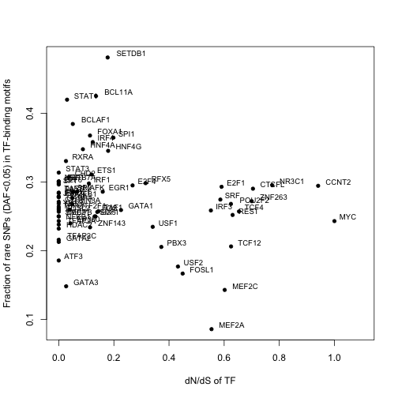
Correlation p-value
Pearson -0.20 0.096
Spearman -0.047 0.70

Slide 2
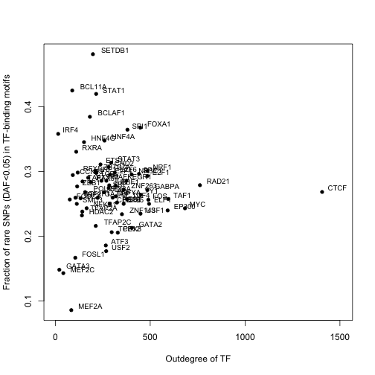
Correlation p-value
Pearson 0.0006 1
Spearman -0.03 0.8

Slide 3
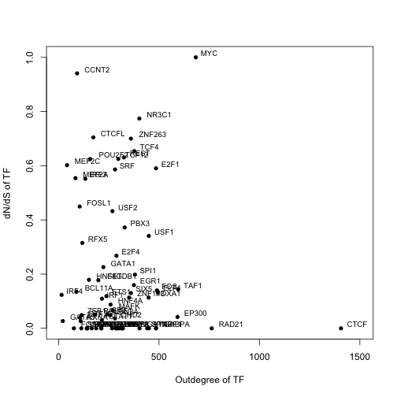
Correlation p-value
Pearson -0.03 0.8
Spearman -0.02 0.9

Slide 4
miRNA ~22bp mature sequences
miRNA binding target prediction using seed region (2-8bp) on 3’UTRs of longest trx of GENCODE genes – Target scan, exact matches
SNPs in CEU population pilot 1 1000G in corresponding positions in miRNA and binding targets
The mutation also corresponds to each other

Slide 5
SNP compensation in mature miRNA and its binding targets
miRNA | SNP position in miRNA | SNP DAF in miRNA | SNP DAF in target | DAF difference | Ancestral allele | Derived allele
hsa-mir-4470 | 7 | 0.0083 | 0.2833 | -0.2750 | A | G
hsa-mir-195 | 10 | 0.0083 | 0.4917 | -0.4833 | G | A
hsa-mir-4254 | 5 | 0.0083 | 0.0083 | -0.0000 | G | A
hsa-mir-4254 | 5 | 0.0083 | 0.3417 | -0.3333 | G | A
hsa-mir-548aa | 16 | 0.0250 | 0.0083 | 0.0167 | C | A
hsa-mir-4672 | 10 | 0.0833 | 0.2583 | -0.1750 | G | C
hsa-mir-1262 | 12 | 0.1083 | 0.0250 | 0.0833 | G | A
hsa-mir-3182 | 3 | 0.1750 | 0.7833 | -0.6083 | G | A
hsa-mir-4437 | 13 | 0.1833 | 0.1750 | 0.0083 | T | C
hsa-mir-4635 | 2 | 0.2000 | 0.0083 | 0.1917 | G | A
hsa-mir-4276 | 11 | 0.5750 | 0.6583 | 0.0833 | A | G
hsa-mir-642a | 15 | 0.7333 | 0.0083 | 0.7250 | G | A

