Slide 1
Cooperation between miRNAs for targeting 3’UTR?

Slide 2
Distance of binding sites for the same miRNA
Does the distance follow a uniform distribution? Or shows some kind of tendency?

Slide 3
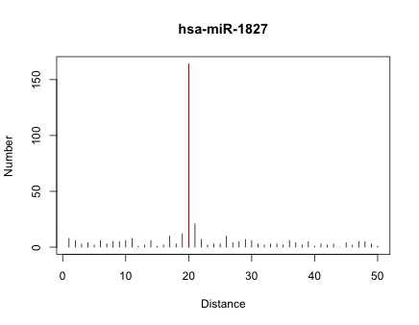
Example

Slide 4
Human
- 677 miRNAs
- 53 [P<0.001 & max pairs>10]
Mouse
- 491 miRNAs
- 50 [P<0.001 & max pairs>10]

Slide 5
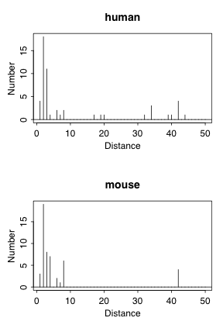
Prefer to short distance

Slide 6
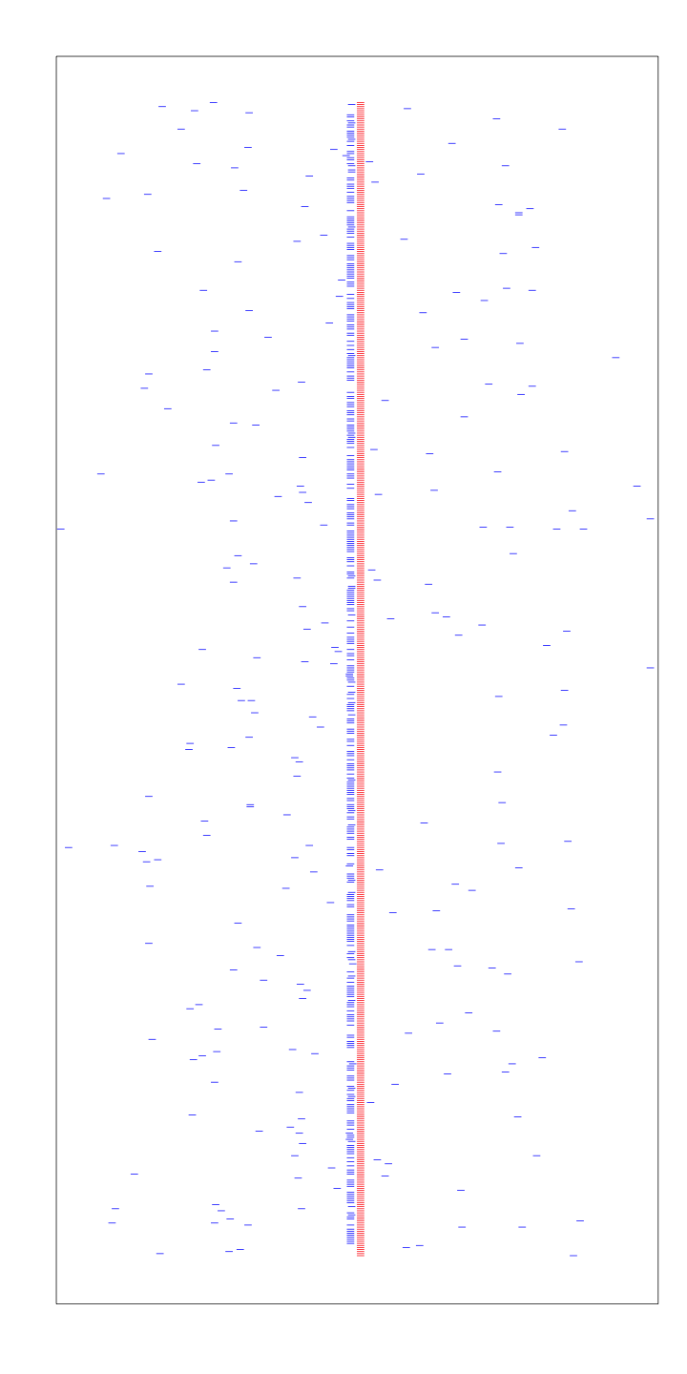

Slide 7
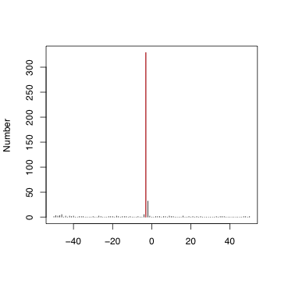

Slide 8
Why?
It is NOT due to multiple isoforms
It is NOT due to sequence similarity

Slide 9
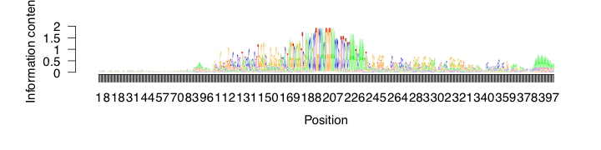
Align 3’UTR sequences with miR-197 and miR-588 binding sites

Slide 10
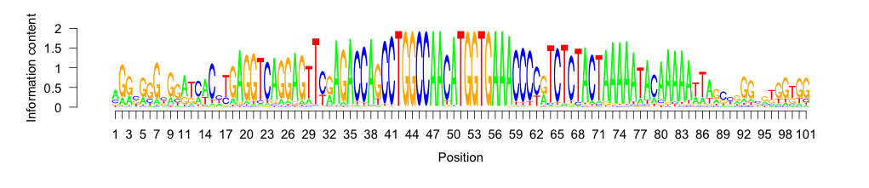
miR-588
miR-197

