Slide 1
GATA1 knockdown

Slide 2
RNA-seq experiment
GATA1 knockdown
- 20,848,451
Control knockdown
- 19,683,264
Data processing
- map reads using “bowtie”, allowing one MM
- calculate the FPKM of all know genes using “cufflink”
- calculate log2(siRNA/cntr) of genes expressed in both

Slide 3
ChIP-Seq for GATA1 (ENCODE)
wgEncodeSydhTfbsPbdeGata1UcdAln
- 13,368 binding peaks
wgEncodeSydhTfbsK562bGata1UcdAln
- 1,704 binding peaks
- a few target genes:
~250 by peak-based method
~60 by Prob. Model
even less when combined with expression data

Slide 4
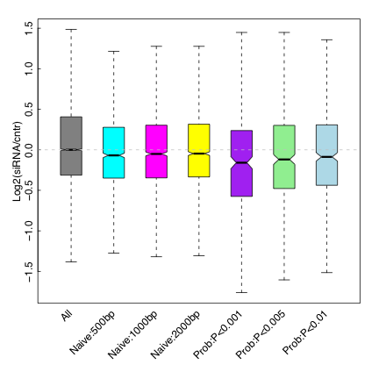
Down-regulation of GATA1 target genes in its know-down

Slide 5
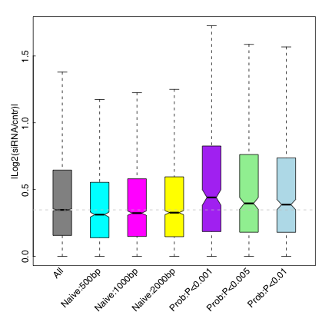
Targets are more likely to differentially expressed

