Slide 1
Figure pack (TF co-association)
Kevin and Nitin
… but mostly Kevin

Slide 2
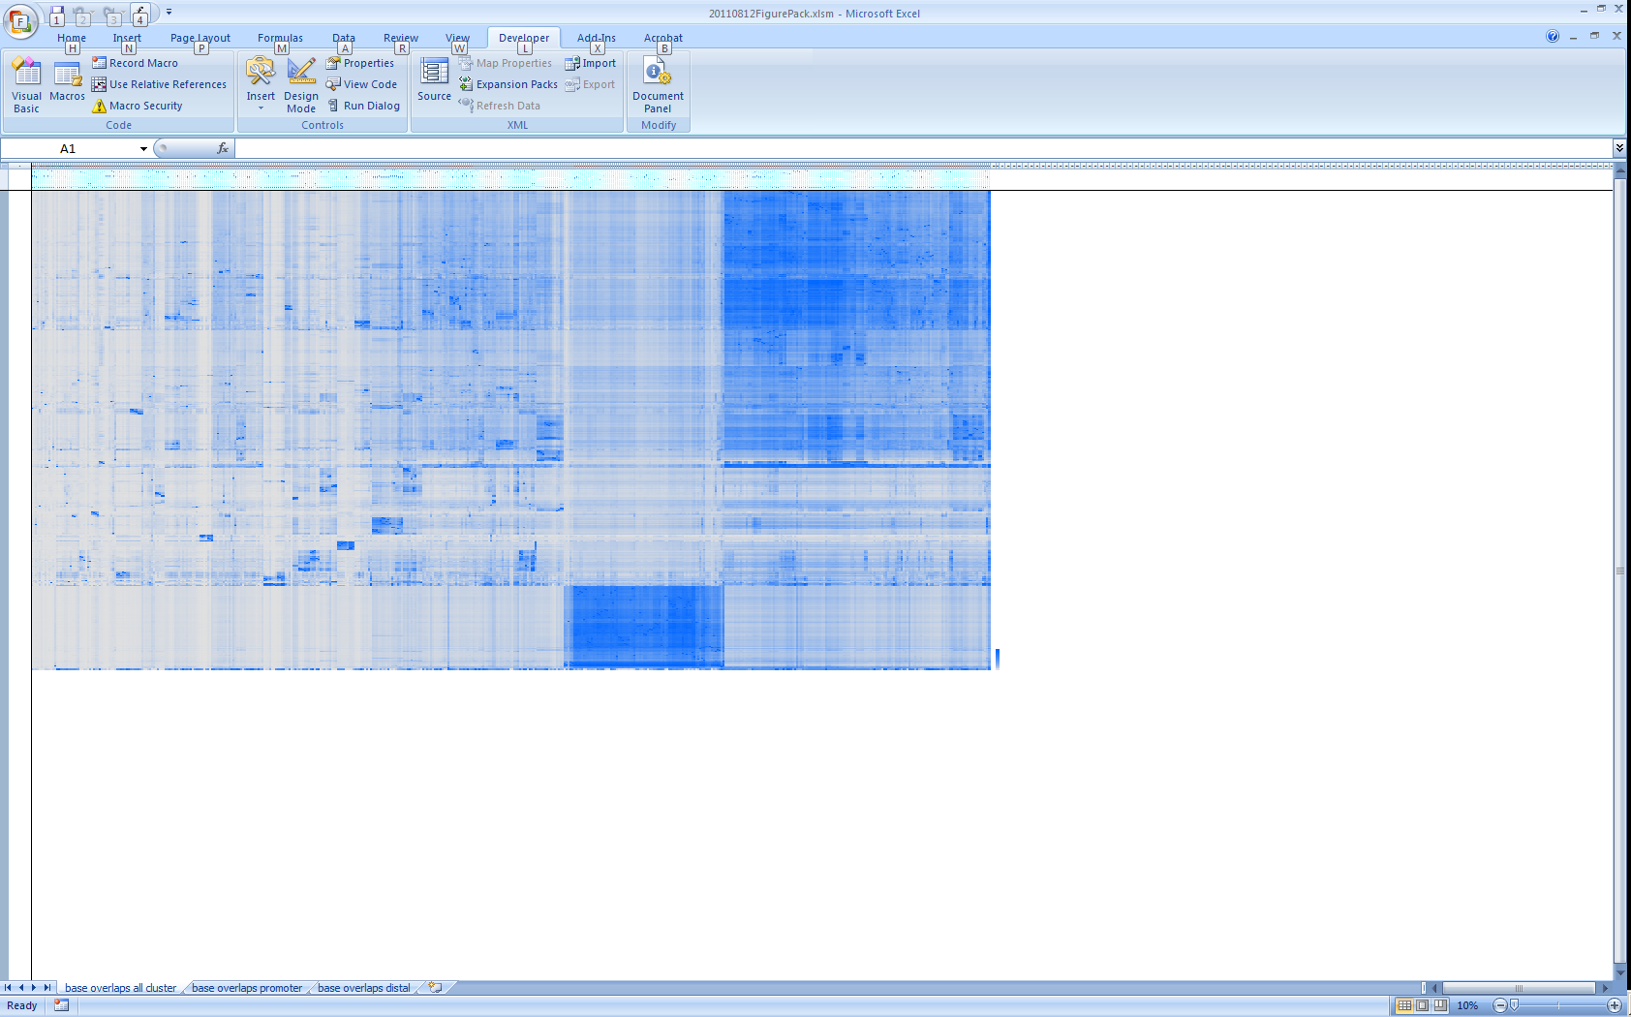
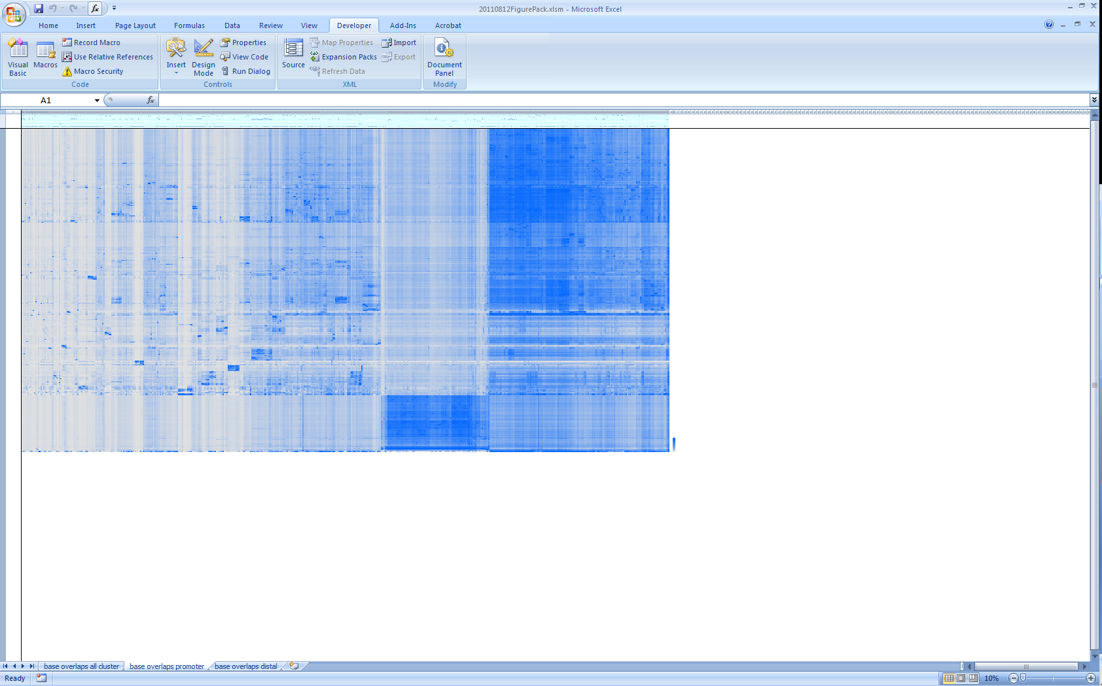

Scale
B
A
Whole genome
Promoter regions
Intergenic regions
Base overlap ratios of TF binding peaks between all pairs of TF datasets in the whole genome (left), promoter regions (within 2kb upstream of an annotated transcription start site, middle) and intergenic regions (at least 10kb away from annotated transcripts, right). Each row and each column represents a TF dataset. The color represents the base overlap ratio, defined as |R∩C|/|C|, where R and C denote the sets of bases covered by the TF binding peaks from the datasets represented by the row and the column, respectively, and |X| denotes the size of any set X. The datasets are ordered according to a clustering based on the whole-genome data. A: cluster of CTCF, RAD21 and SMC3. B: a cluster with higher base overlap ratios at promoter regions than intergenic regions.
Suggested use: Main figure of integrative paper

Slide 3
Promoters
Scale
Intergenic regions
Clusters of significantly co-associating TFs. Three example clusters are shown, in which the TFs co-associate with similar significant in both promoters and intergenic regions (left), more significantly in promoters (middle) and more significantly in intergenic regions (right). Significant values are represented by the z-scores of the observed base overlap ratios in a sample distribution from random regions with genome structure corrections.
Suggested use: Main figure of integrative paper

Slide 4
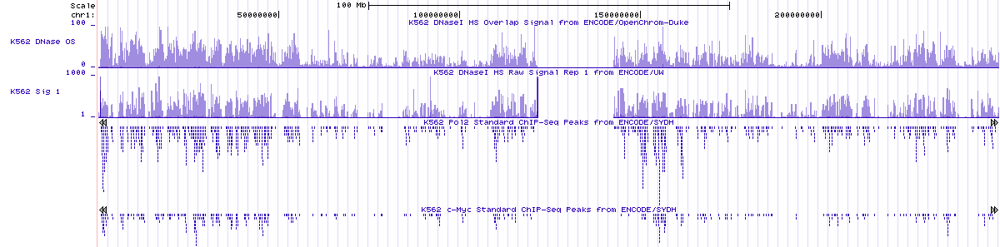
Tracks showing the correlation of transcription factor binding peaks and DNase I hypersensitivity across chromosome 1 in the cell line K562. The first two tracks show the DNaseI hypersensitivity signals from two different experiments. The third track shows the binding peaks of RNA polymerase II. The fourth track shows the binding peaks of the transcription factor MYC.
Suggested use: Main figure of GSC paper

Slide 5
Distributions of sampled base overlap ratios without segmentation (left) and with DNase I segmentation (right).
Suggested use: Main figure of GSC paper

Slide 6
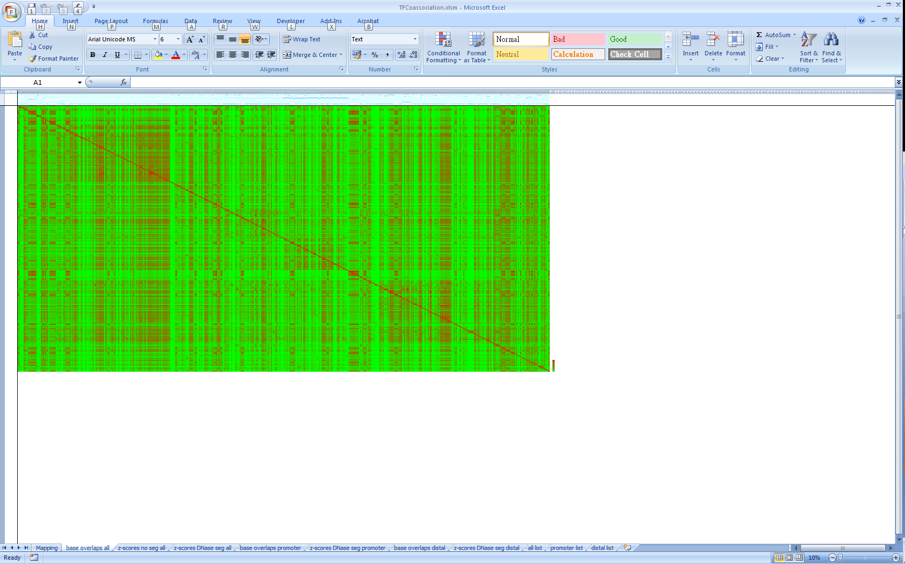

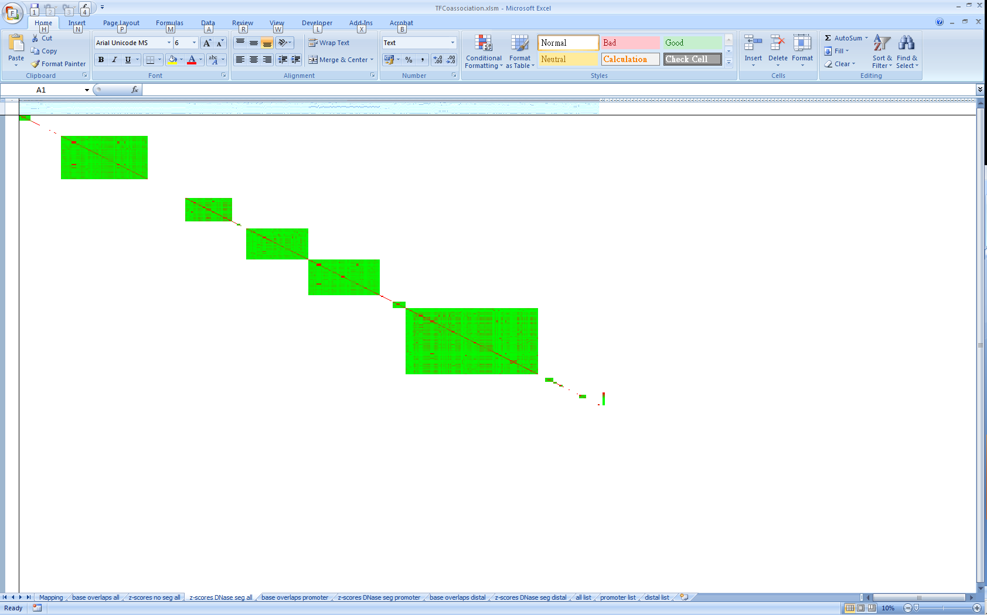
Base
overlap
ratio
Z-score
Base overlap ratios
Non-segmented z-scores
Segmented z-scores
Base overlap ratios (left), z-scores from block sampling without segmentation (middle) and z-scores from block sampling with Dnase I segmentation (right) of transcription factor dataset pairs. Each row and each column represents a dataset. The datasets are ordered first by cell line, then by transcription factor, experimental condition and laboratory.
Suggested use: Supplementary figure of GSC paper

Slide 7
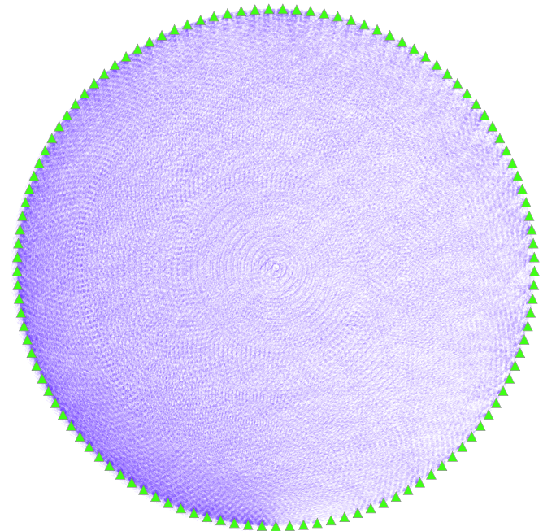
Overall
Suggested use: network paper

Slide 8
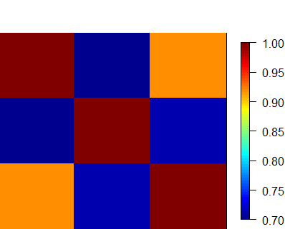
All
Distal
Promoter
Suggested use: Suppl figure of main paper

