Slide 1
Chromatin Segmentation Pseudogenes TF Binding Sites
Cristina Sisu
Annotation – 17th August 2011

Slide 2
Chr14:103749270-103749805 ‘+’ ENSG00000240624.1 ENST00000494237.1 Processed Pseudogene
Notes:
Processed oC

Slide 3
Chr12:4218875-4219381 ‘-’ ENSG00000242444.2 ENST00000489396.1 Transcribed Processed Pseudogene
Notes:
Trans + OC

Slide 4
Chr11: 71314307-71318638 ‘+’ ENSG00000255562.1 ENST00000528242.1 Transcribed Processed Pseudogene
Notes:
Transc + CC

Slide 5
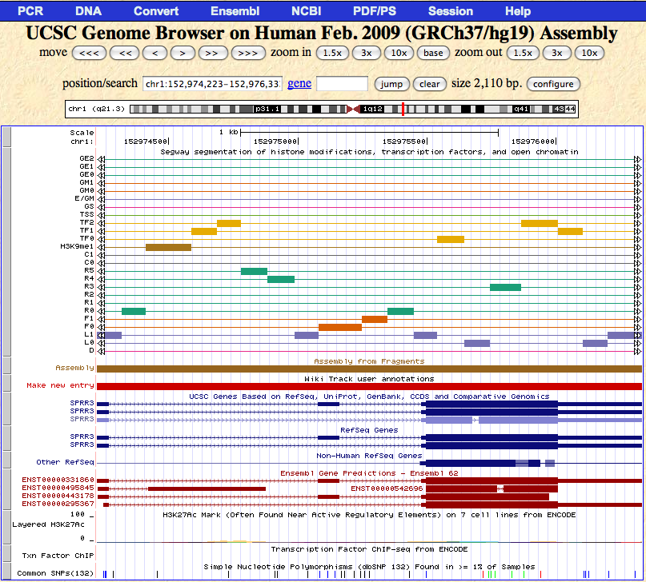
Chr1:152996438-152996736 ‘+’ ENSG00000234262.1 ENST00000429623.1 Unprocessed Pseudogene
Pseudogene Parent

Slide 6
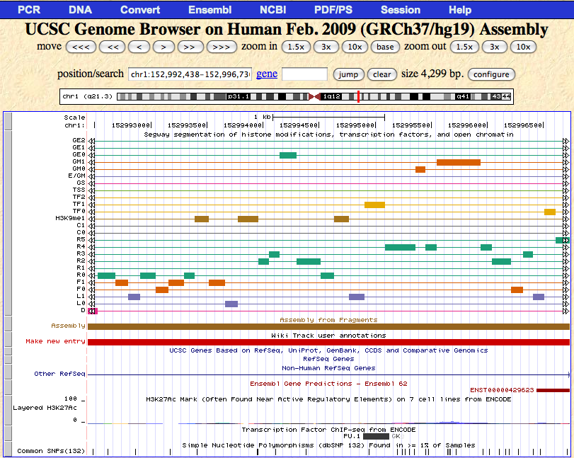
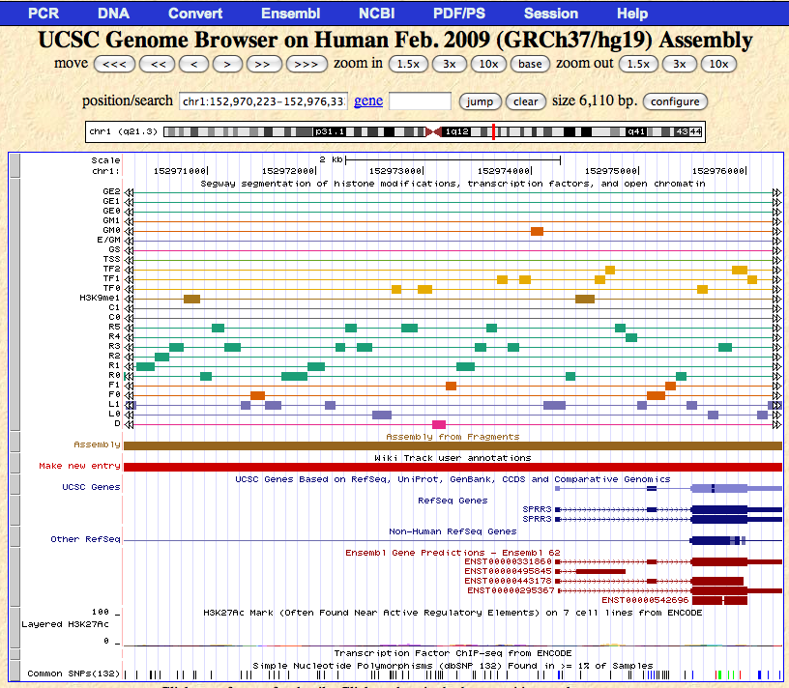
Chr1:152996438-152996736 ‘+’ ENSG00000234262.1 ENST00000429623.1 Unprocessed Pseudogene
Pseudogene Parent
Notes:
Unproc oC

Slide 7
Coming Soon!
Distribution of segements over TF binding sites upstream of pseudogenes:
Processed
Unprocessed
Transcribed
Untranscribed

