Slide 1
TF spacing
Alexej Abyzov,
August 10, 2011

Slide 2
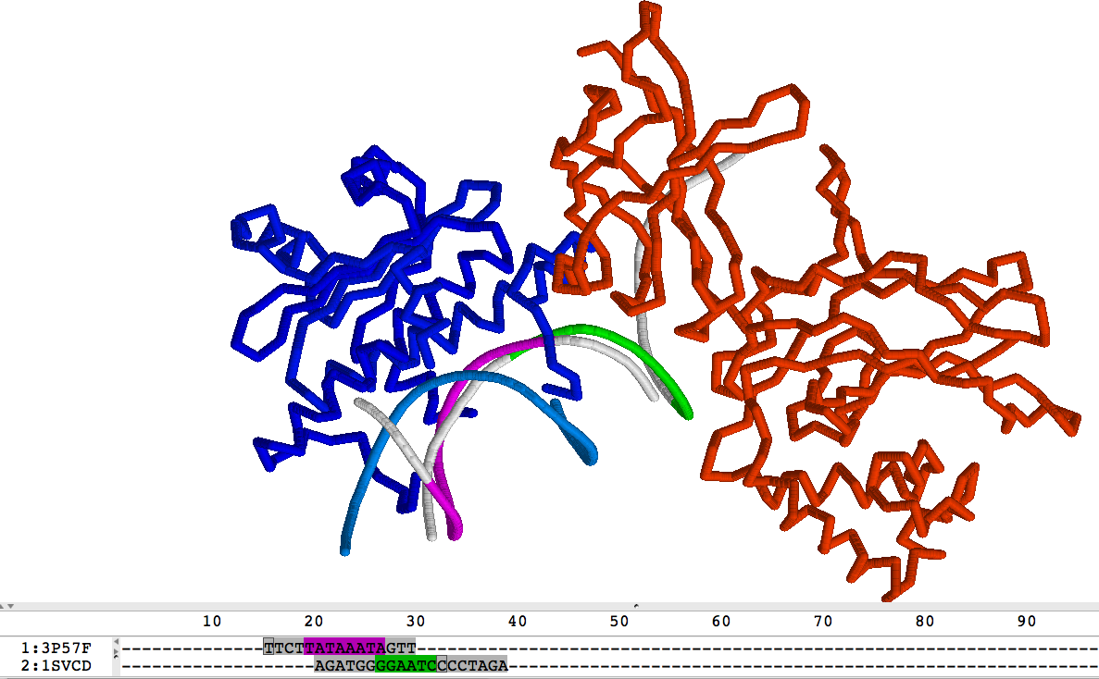
MEF2A and NFKB
MEF2A = 3p57
NFKB = 1svc

