Slide 1
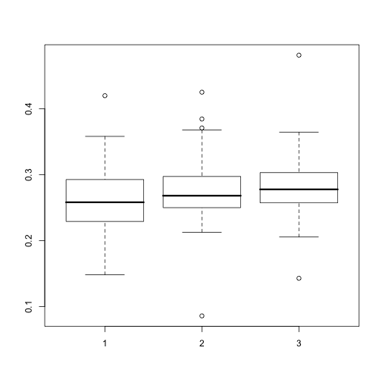
TF net prob, All SNPs, hierarchy KKY, DAF<0.05
Notes:
None of the 3 wilcoxon test significant
TF net prob, All SNPs, hierarchy KKY, SNP DAF<0.05, union of all cell lines

Slide 2
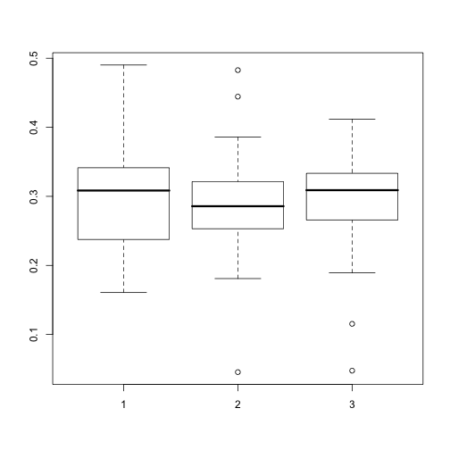
TF net prob, unfavorable SNPs, hierarchy KKY, DAF<0.05
Notes:
TF net prob, All SNPs, hierarchy KKY, unfavorable SNP DAF<0.05, union of all cell lines

Slide 3
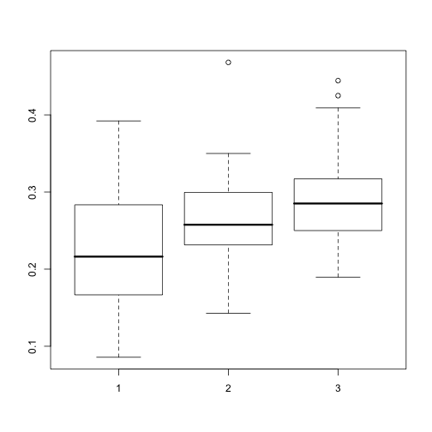
TF net prob, favorable SNPs, hierarchy KKY, DAF<0.05, top is 3, bottom is 1
wilcoxon p-val
1 vs. 3 - 0.0088
1 vs. 2 – 0.15
2 vs. 3 – 0.13
Notes:
TF net prob, All SNPs, hierarchy KKY, unfavorable SNP DAF<0.05, union of all cell lines

Slide 4
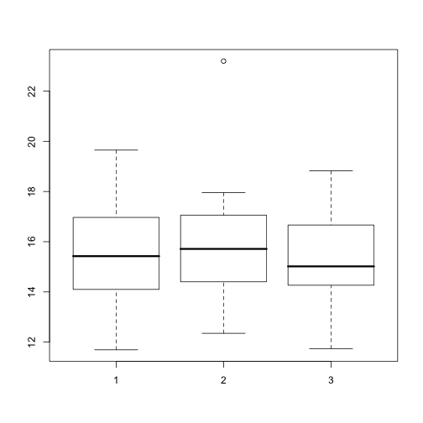
TF net prob, Information content, hierarchy KKY, top is 3, bottom is 1
Notes:
TF net prob, All SNPs, hierarchy KKY, Information content with correction, union of all cell lines

Slide 5
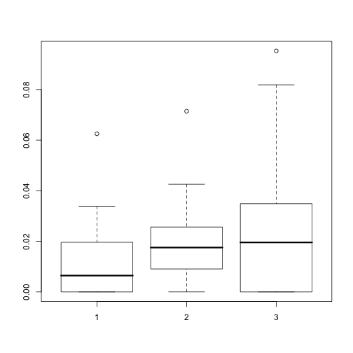
TF net prob, favorable SNPs, hierarchy KKY, DAF>0.95, top is 3, bottom is 1
wilcoxon p-val
1 vs. 3 – 0.24
1 vs. 2 – 0.068
2 vs. 3 – 0.96
Notes:
TF net prob, All SNPs, hierarchy KKY, unfavorable SNP DAF<0.05, union of all cell lines

Slide 6
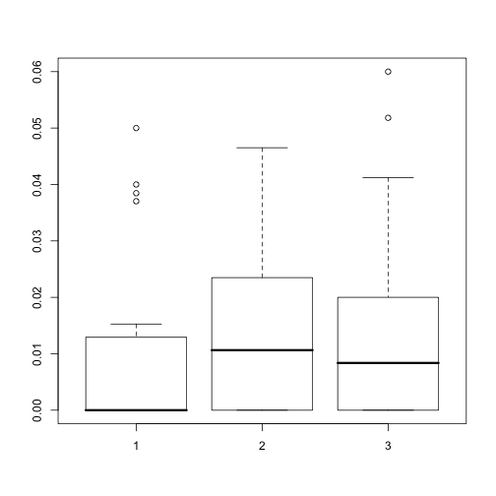
TF net prob, unfavorable SNPs, hierarchy KKY, DAF>0.95
Notes:
TF net prob, All SNPs, hierarchy KKY, unfavorable SNP DAF<0.05, union of all cell lines

