Slide 1
Null model for Ψgene discovery
Alexej Abyzov,
July 7, 2011

Slide 2
Pipeline
Not mapped reads
Splice-junction library
Ψgene predictions
Mapping with Bowtie
Parameter optimization using null model
Uniquely mapped reads to splice-junctions
Mapping with Bowtie
Reads with better mapping to splice-junctions
Reference genome

Slide 3
Population | # | Cut offs | # of Ψgenes (normal/null) | Cut offs, unmapped | # of Ψgenes (normal/null) | Cut offs, better map | # of Ψgenes (normal/null)
ASW | 50 | >= 9, SC1 | 68/2 | >=7, SC1 | 29/1 | >=9, SC1 | 29/1
LWK | 83 | >= 9, SC1 | 463/17 | >=11, SC1 | 35/1 | >=11, SC1 | 36/1
YRI | 83 | >= 10, SC2 | 42/2 | >=15, SC1 | 29/1 | >=12, SC3 | 27/1
CEU | 91 | >= 11, SC2 | 75/3 | >=14, SC1 | 31/1 | >=11, SC2 | 27/1
FIN (new) | 79 | >= 10, SC1 | 367/13 | >=4, SC1 | 50/2 | >=9, SC1 | 50/1
GBR (new) | 77 | >= 11, SC1 | 490/20 | >=10%, SC1 | 38/1 | >=9, SC1 | 47/2
IBS | 6 | >= 3, SC1 | 11/0 | >=3, SC1 | 10/0 | >=3, SC1 | 11/0
TSI | 100 | >= 15, SC2 | 27/1 | >=12, SC3 | 21/0 | >=12, SC3 | 23/1
CHB | 83 | >=13, SC2 | 28/1 | >=11, SC2 | 20/1 | >=12, SC2 | 20/1
JPT | 81 | >= 12, SC1 | 294/12 | >=4, SC1 | 258/10 | >=10, SC1 | 245/11
CHS (blood) | 92 | >= 10, SC1 | 482/17 | >=4, SC1 | 31/1 | >=10, SC1 | 37/1
CLM (new) | 53 | >= 10, SC1 | 152/5 | >=10, SC1 | 29/1 | >=10, SC1 | 30/1
PUR (blood) | 59 | >= 11, SC1 | 29/0 | >=6, SC1 | 28/1 | >=6, SC1 | 30/1
MXL | 57 | >= 9, SC1 | 29/1 | >=8, SC1 | 29/1 | >=8, SC1 | 30/1
NA12878 | 1 | N/A | N/A | >=5, SC3 | 8/0 | >=7, SC3 | 10/0
NA12891 | 1 | N/A | N/A | >=3, SC3 | 8/0 | >=9, SC3 | 11/0
NA12892 | 1 | N/A | N/A | >=6, SC2 | 2/0 | >=10, SC2 | 3/0
NA19238 | 1 | N/A | N/A | >=3, SC3 | 6/0 | >=3, SC3 | 8/0
NA12839 | 1 | N/A | N/A | >=3, SC1 | 4/0 | >=3, SC3 | 3/0
NA12840 | 1 | N/A | N/A | >=3, SC3 | 3/0 | >=10, SC1 | 7/0

Slide 4
Population | # | Combined coverage | <length> trim q15 | Cut offs, trim q15 | # of Ψgenes (normal/null) | <length> trim q30 | Cut offs, trim q30 | # of Ψgenes (normal/null)
ASW | 50 | 300 | 76 | >=9, SC1 | 29/1 | 41 | >=10, SC1 | 25/1
LWK | 83 | 460 | 75 | >=11, SC1 | 36/1 | 42 | >=9, SC1 | 31/1
YRI | 83 | 403 | 43 | >=12, SC3 | 27/1 | 39 | >=14, SC1 | 21/1
CEU | 91 | 427 | 41 | >=11, SC2 | 27/1 | 37 | >=10, SC3 | 21/1
FIN (new) | 79 | 332 | 63 | >=9, SC1 | 50/1 | 46 | >=9, SC1 | 35/1
GBR (new) | 77 | 364 | 68 | >=9, SC1 | 47/2 | 45 | >=8, SC1 | 45/2
IBS | 6 | 28 | 100 | >=3, SC1 | 11/0 | 60 | >=9, SC1 | 10/0
TSI | 100 | 450 | 41 | >=12, SC3 | 23/1 | 39 | >=11, SC3 | 22/1
CHB | 83 | 355 | 45 | >=12, SC2 | 20/1 | 41 | >=9, SC1 | 21/1
JPT | 81 | 509 | 73 | >=10, SC1 | 245/11 | 41 | >=9, SC1 | 97/3
CHS (blood) | 92 | 400 | 69 | >=10, SC1 | 37/1 | 44 | >=14, SC1 | 27/1
CLM (new) | 53 | 312 | 67 | >=10, SC1 | 30/1 | 43 | >=9, SC1 | 31/1
PUR (blood) | 59 | 336 | 91 | >=6, SC1 | 30/1 | 45 | >=9, SC1 | 28/1
MXL | 57 | 333 | 76 | >=8, SC1 | 30/1 | 42 | >=8, SC1 | 27/1
NA12878 | 1 | 43 | 40 | >=7, SC3 | 10/0 | 38 | >=15, SC1 | 7/0
NA12891 | 1 | 30 | 37 | >=9, SC3 | 11/0 | 36 | >=3,SC1 | 4/0
NA12892 | 1 | 25 | 39 | >=10, SC2 | 3/0 | 37 | >=6, SC1 | 2/0
NA19238 | 1 | 19 | 36 | >=3, SC3 | 8/0 | 35 | >=3, SC1 | 2/0
NA12839 | 1 | 25 | 36 | >=3, SC3 | 3/0 | 36 | >=3, SC1 | 1/0
NA12840 | 1 | 33 | 36 | >=10, SC1 | 7/0 | 35 | >=3, SC1 | 2/0

Slide 5
CEU trio

Slide 6
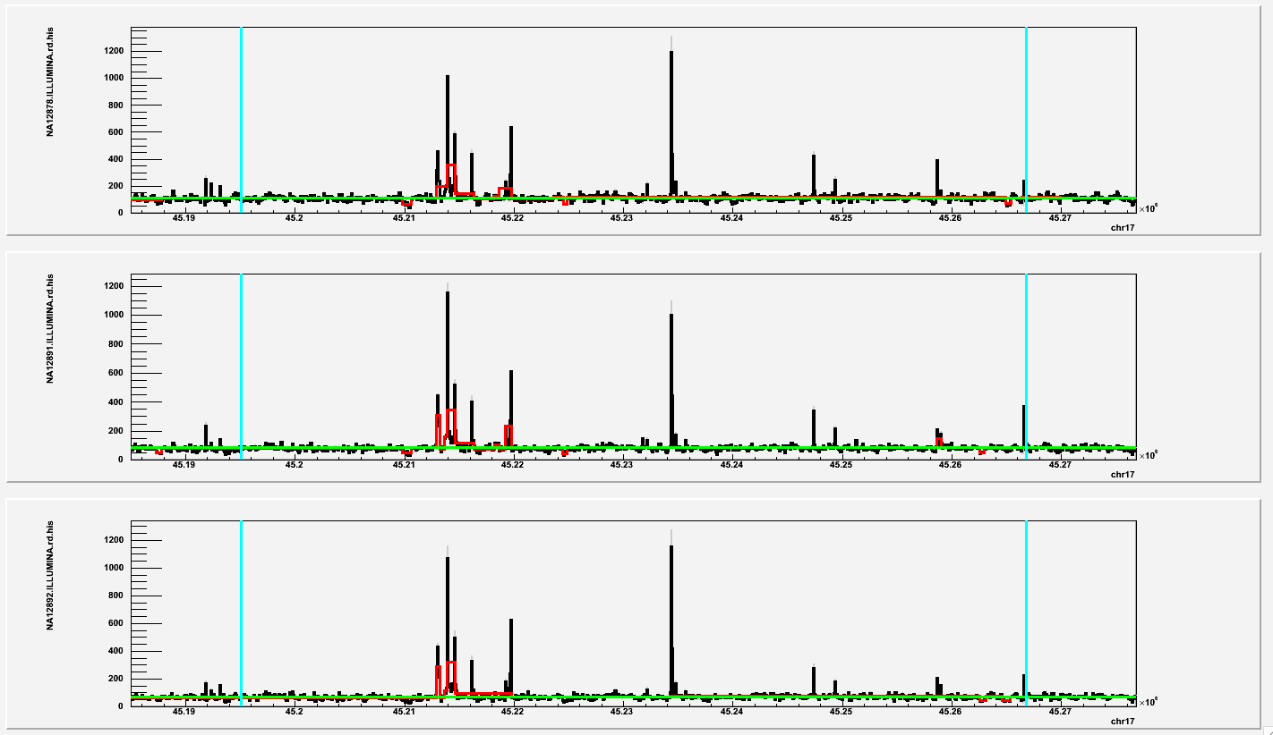
CDC27
3’-end?
Exons

Slide 7
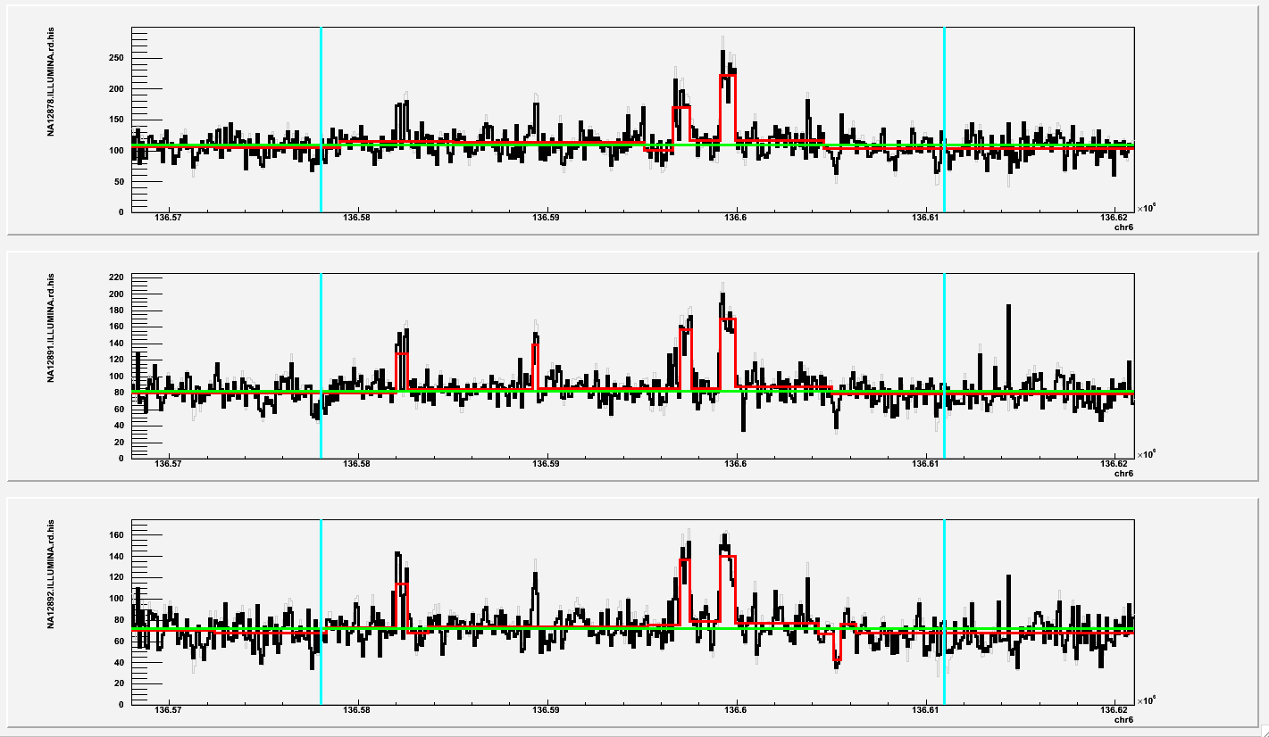
BCLAF1
Not validated
3’-end?
Exons

Slide 8
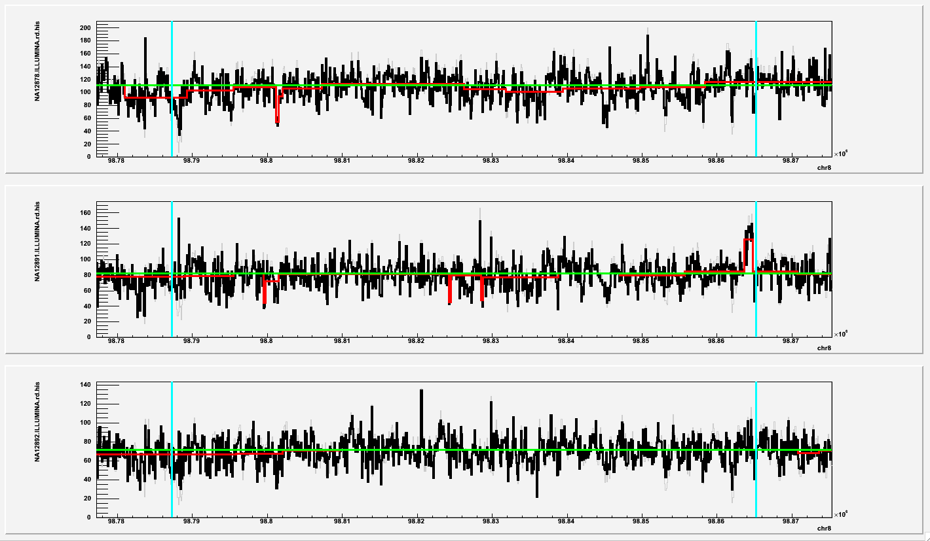
LAPTM4B
3’-end

Slide 9
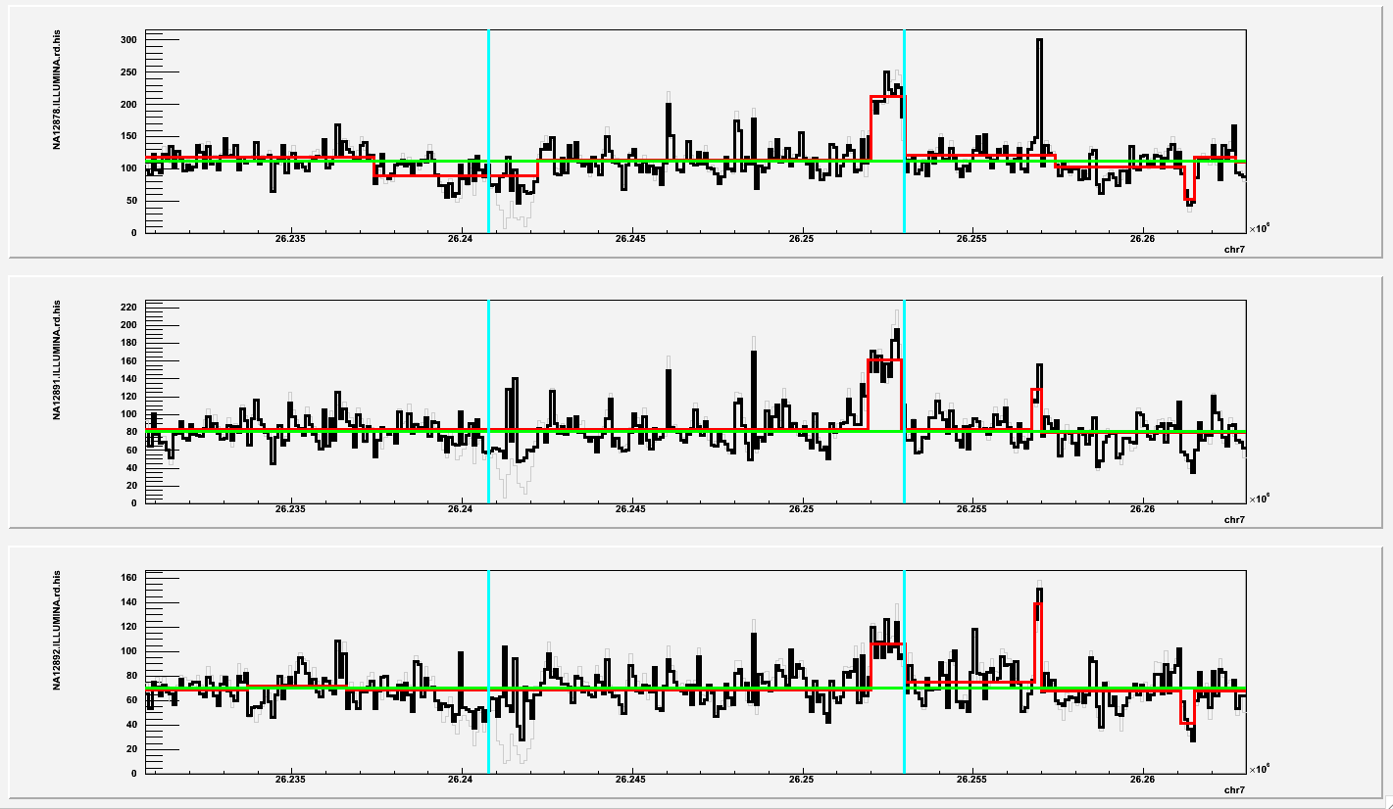
CBX3
3’-end
May be validated

Slide 10
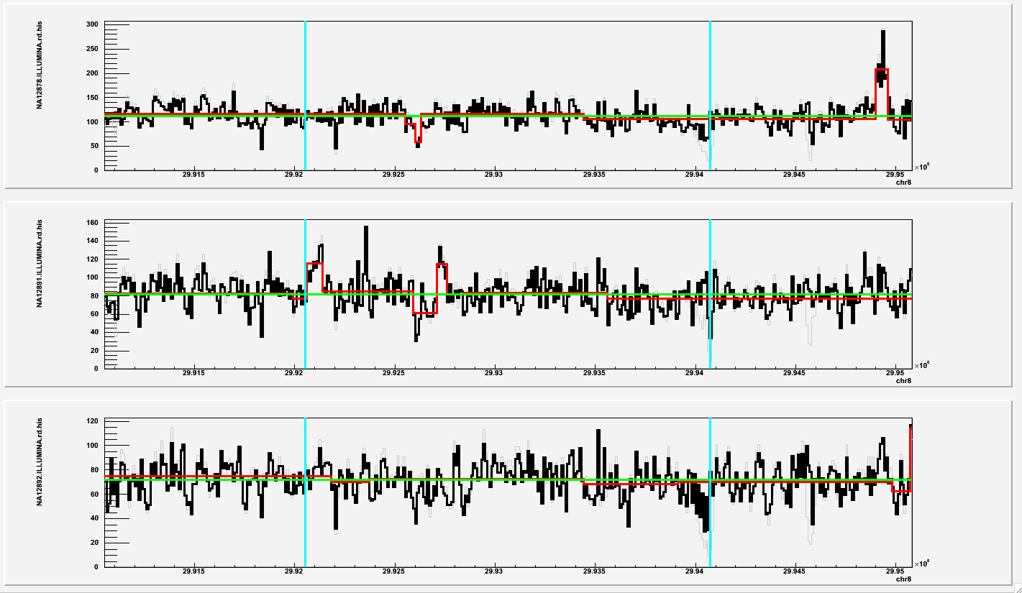
TMEM66
Validated
3’-end
Exons

Slide 11
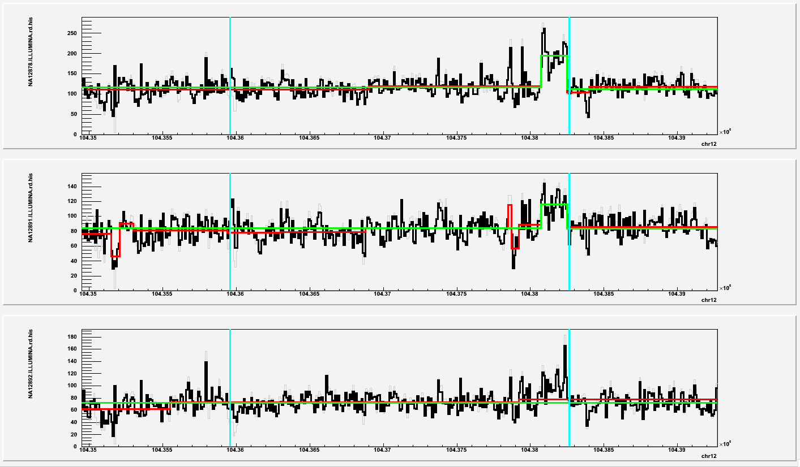
TDG
3’-end

Slide 12
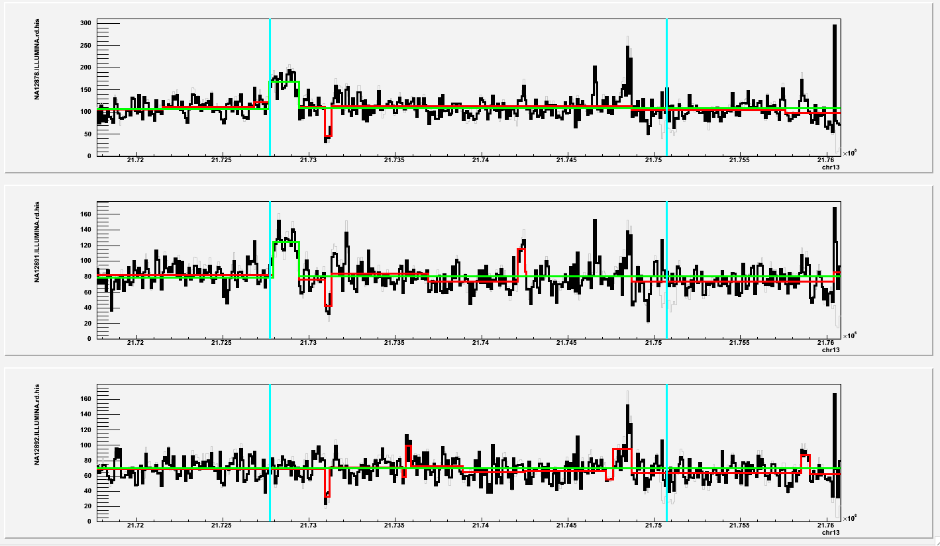
SKA3
3’-end
Exons

Slide 13
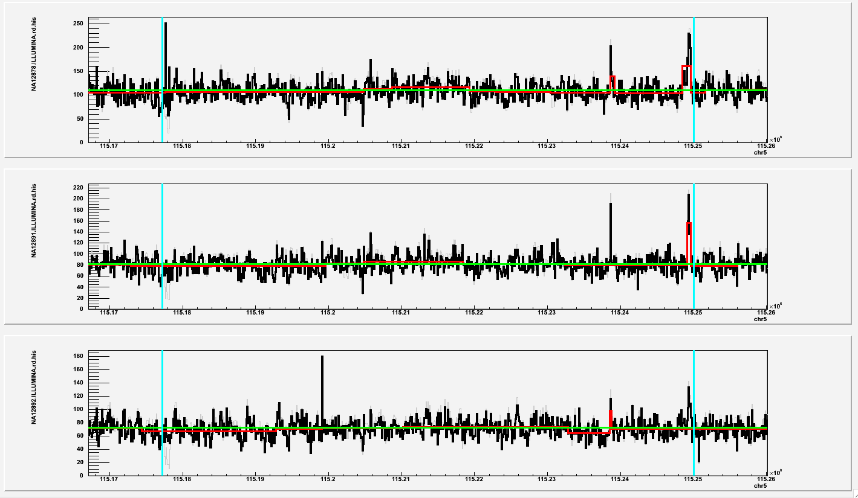
AP3S1
3’-end
Not validated
Exons

Slide 14
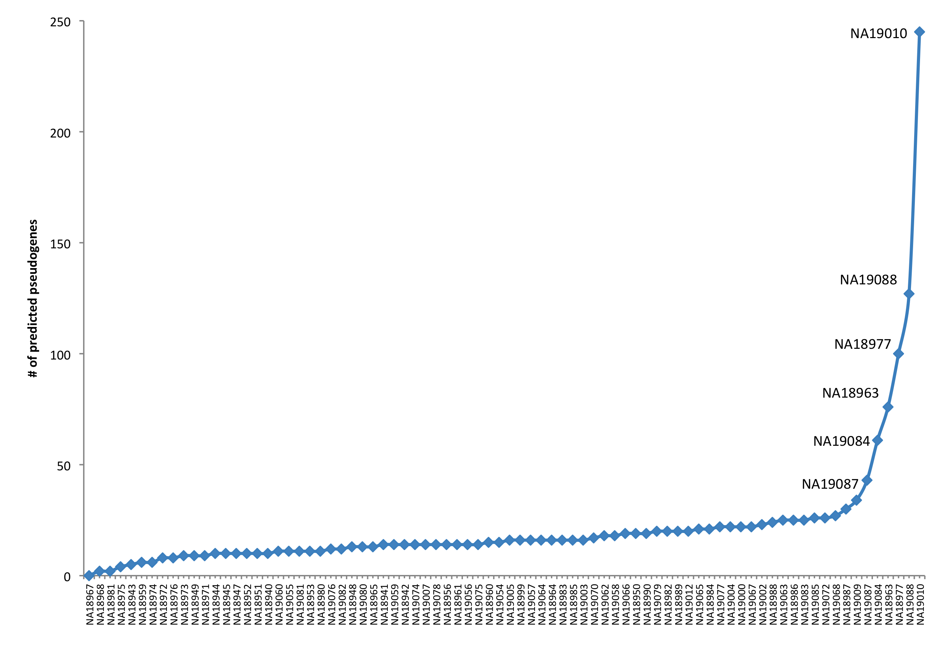
Ψgenes in Japanese
For the noted 6:
no know relationship
4 female, 2 male
if excluded predict 22 Ψgenes (>=11, SC2)

Slide 15
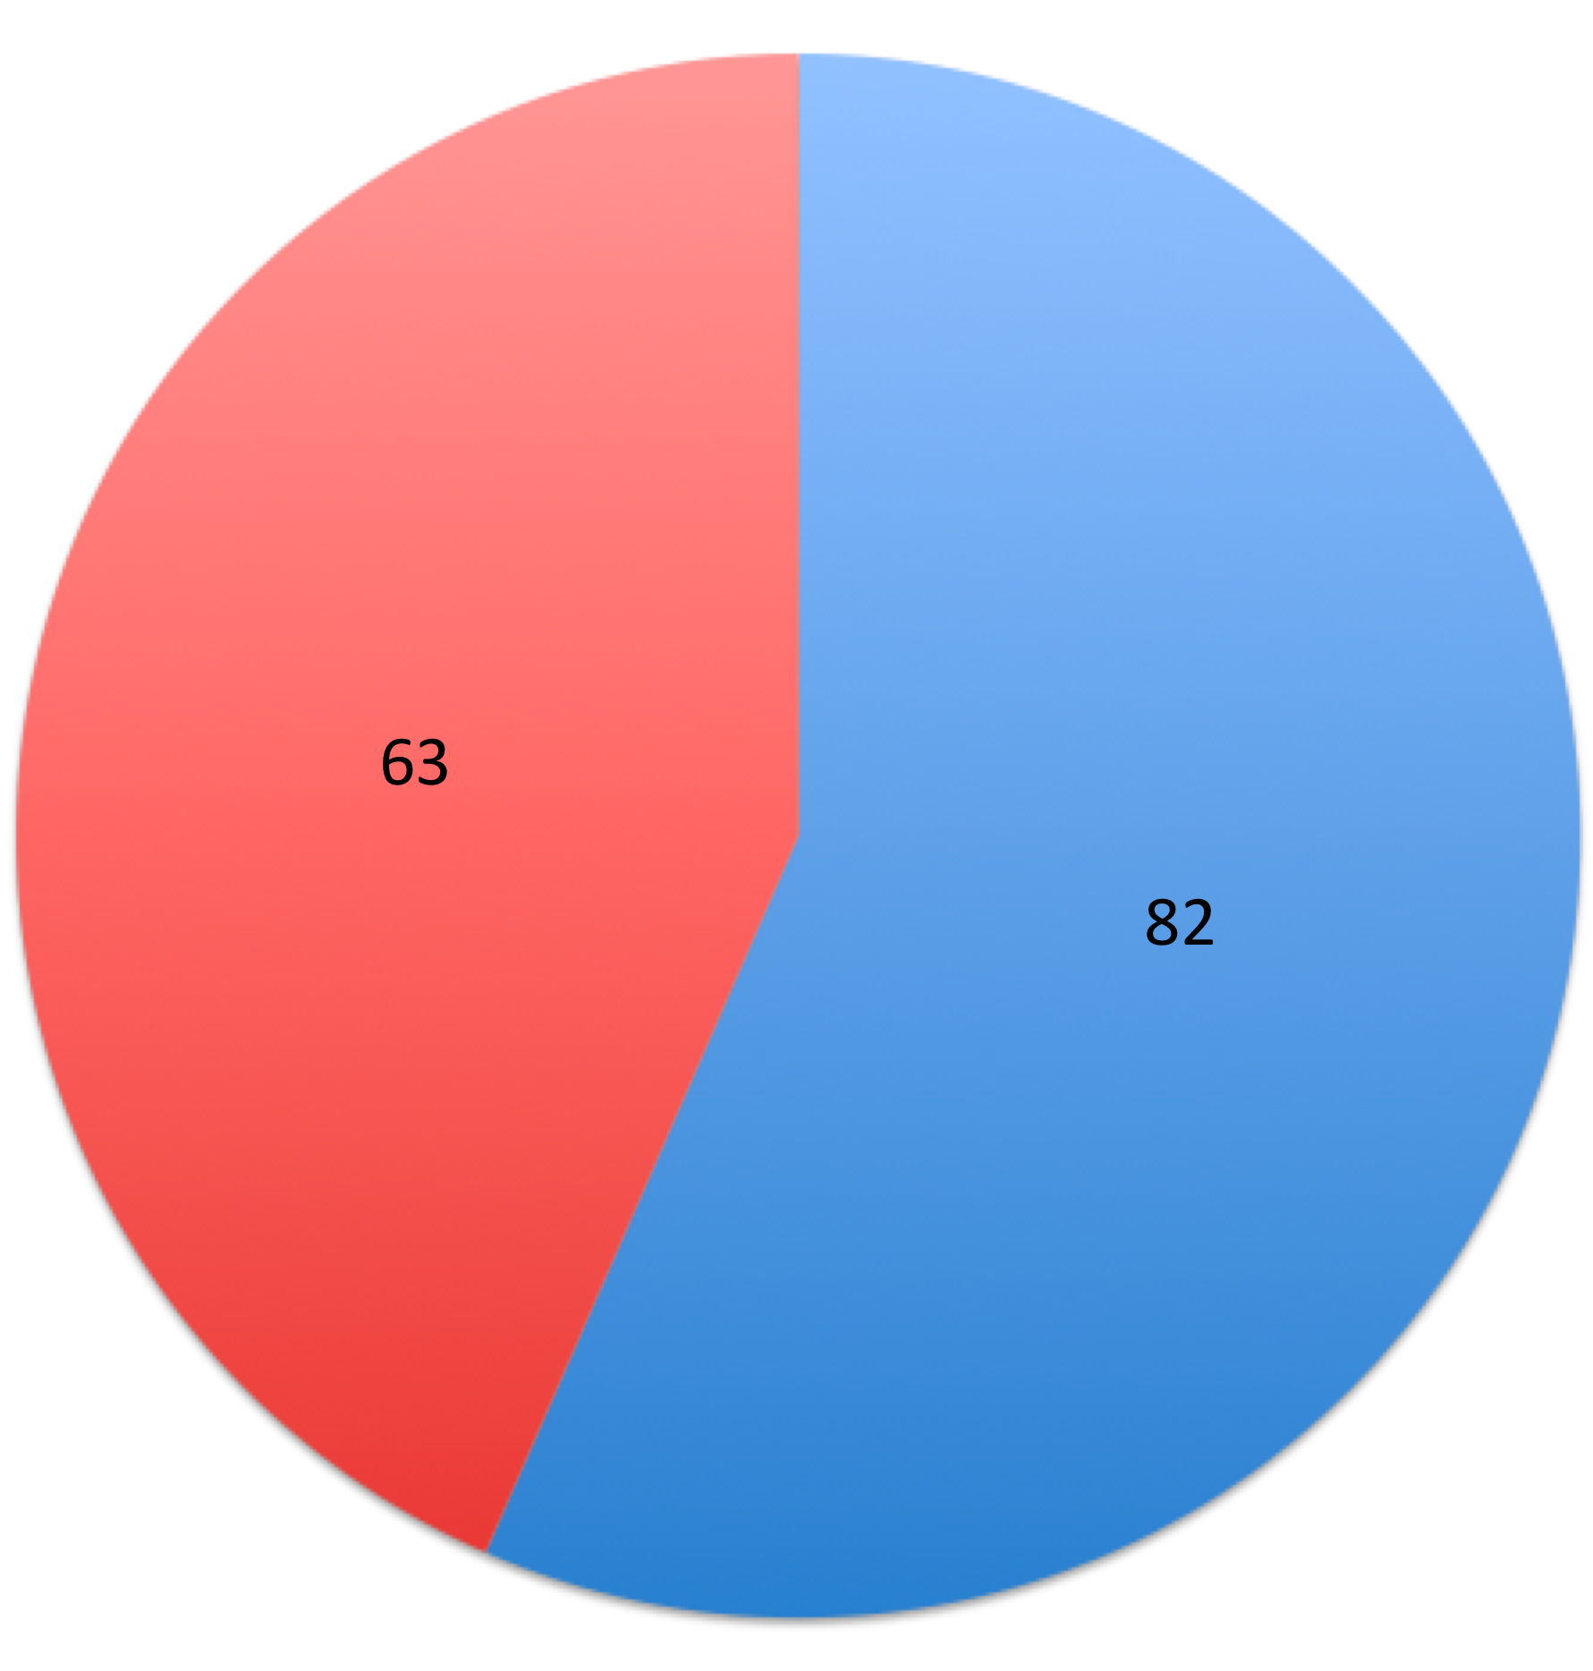
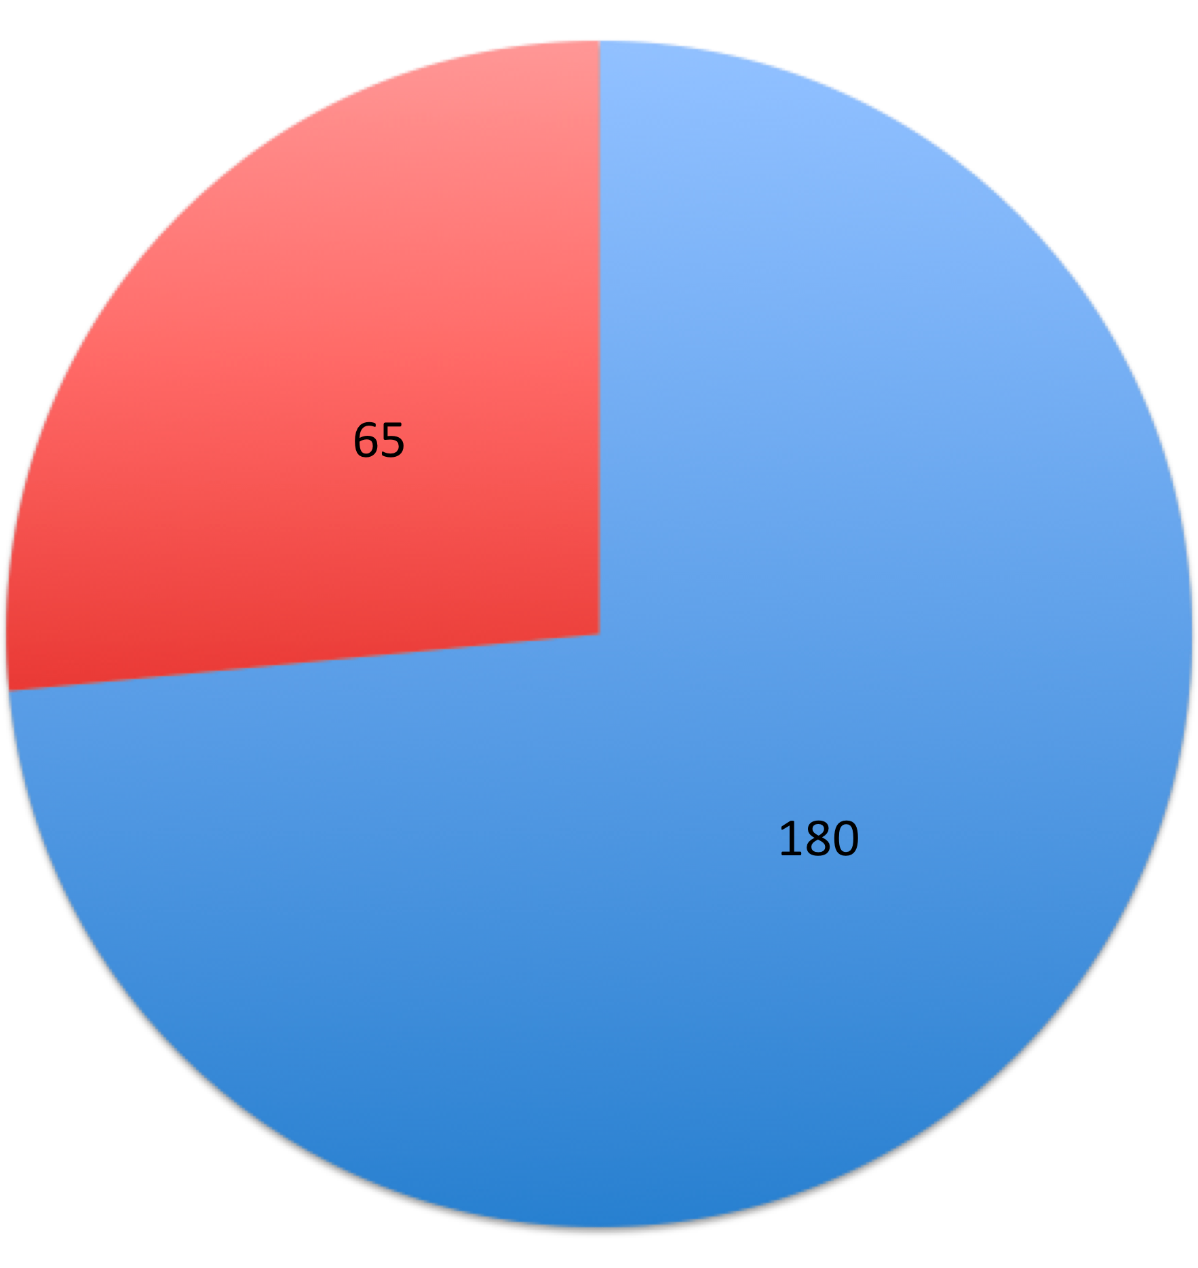
Intersection with parents in reference
All populations, JPT – 6
JPT only
All pop, JPT - 6
99
46
All populations: 145
All pops + trios: 146
199
JPT all

Slide 16
All populations, JPT-6
JPT only

Slide 17
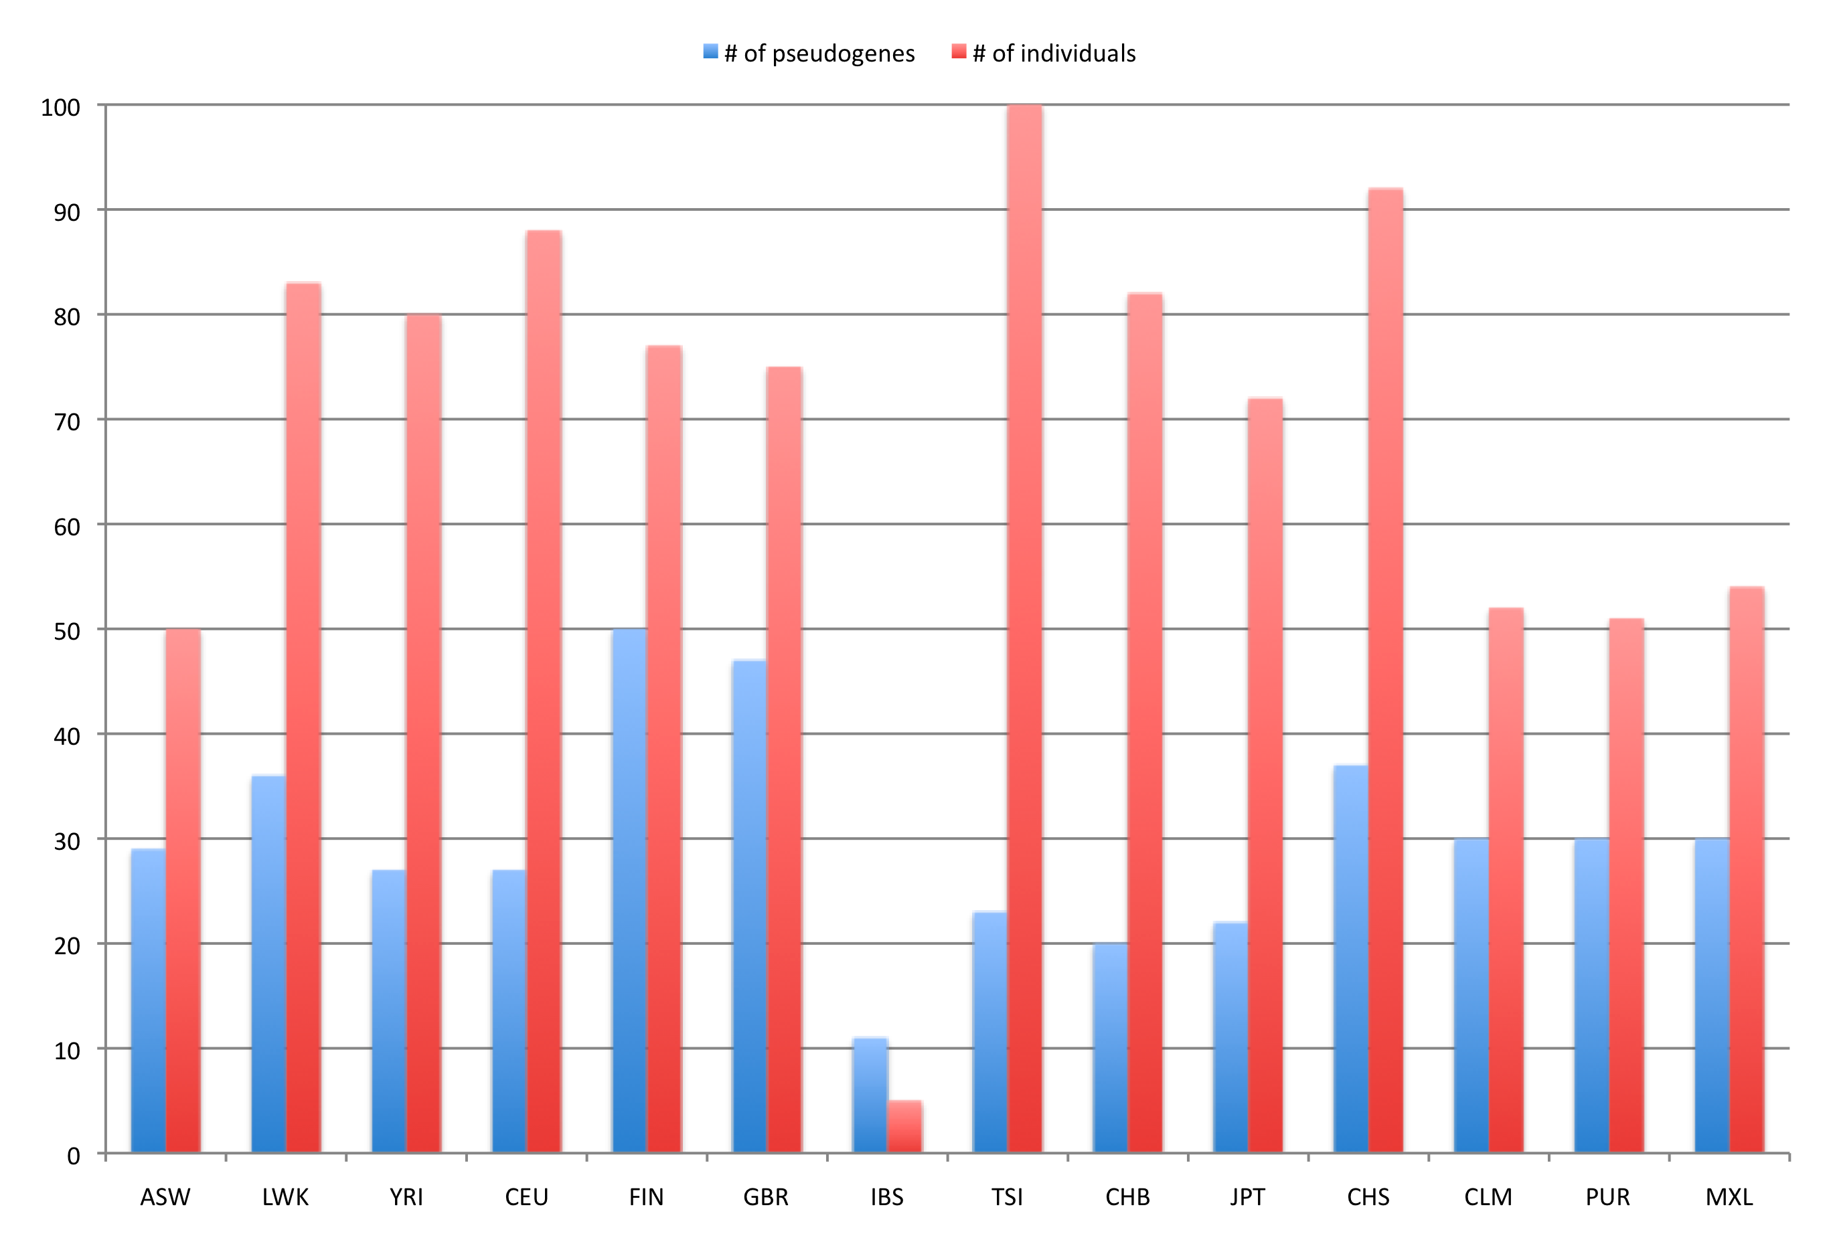
Ψgenes by population

Slide 18
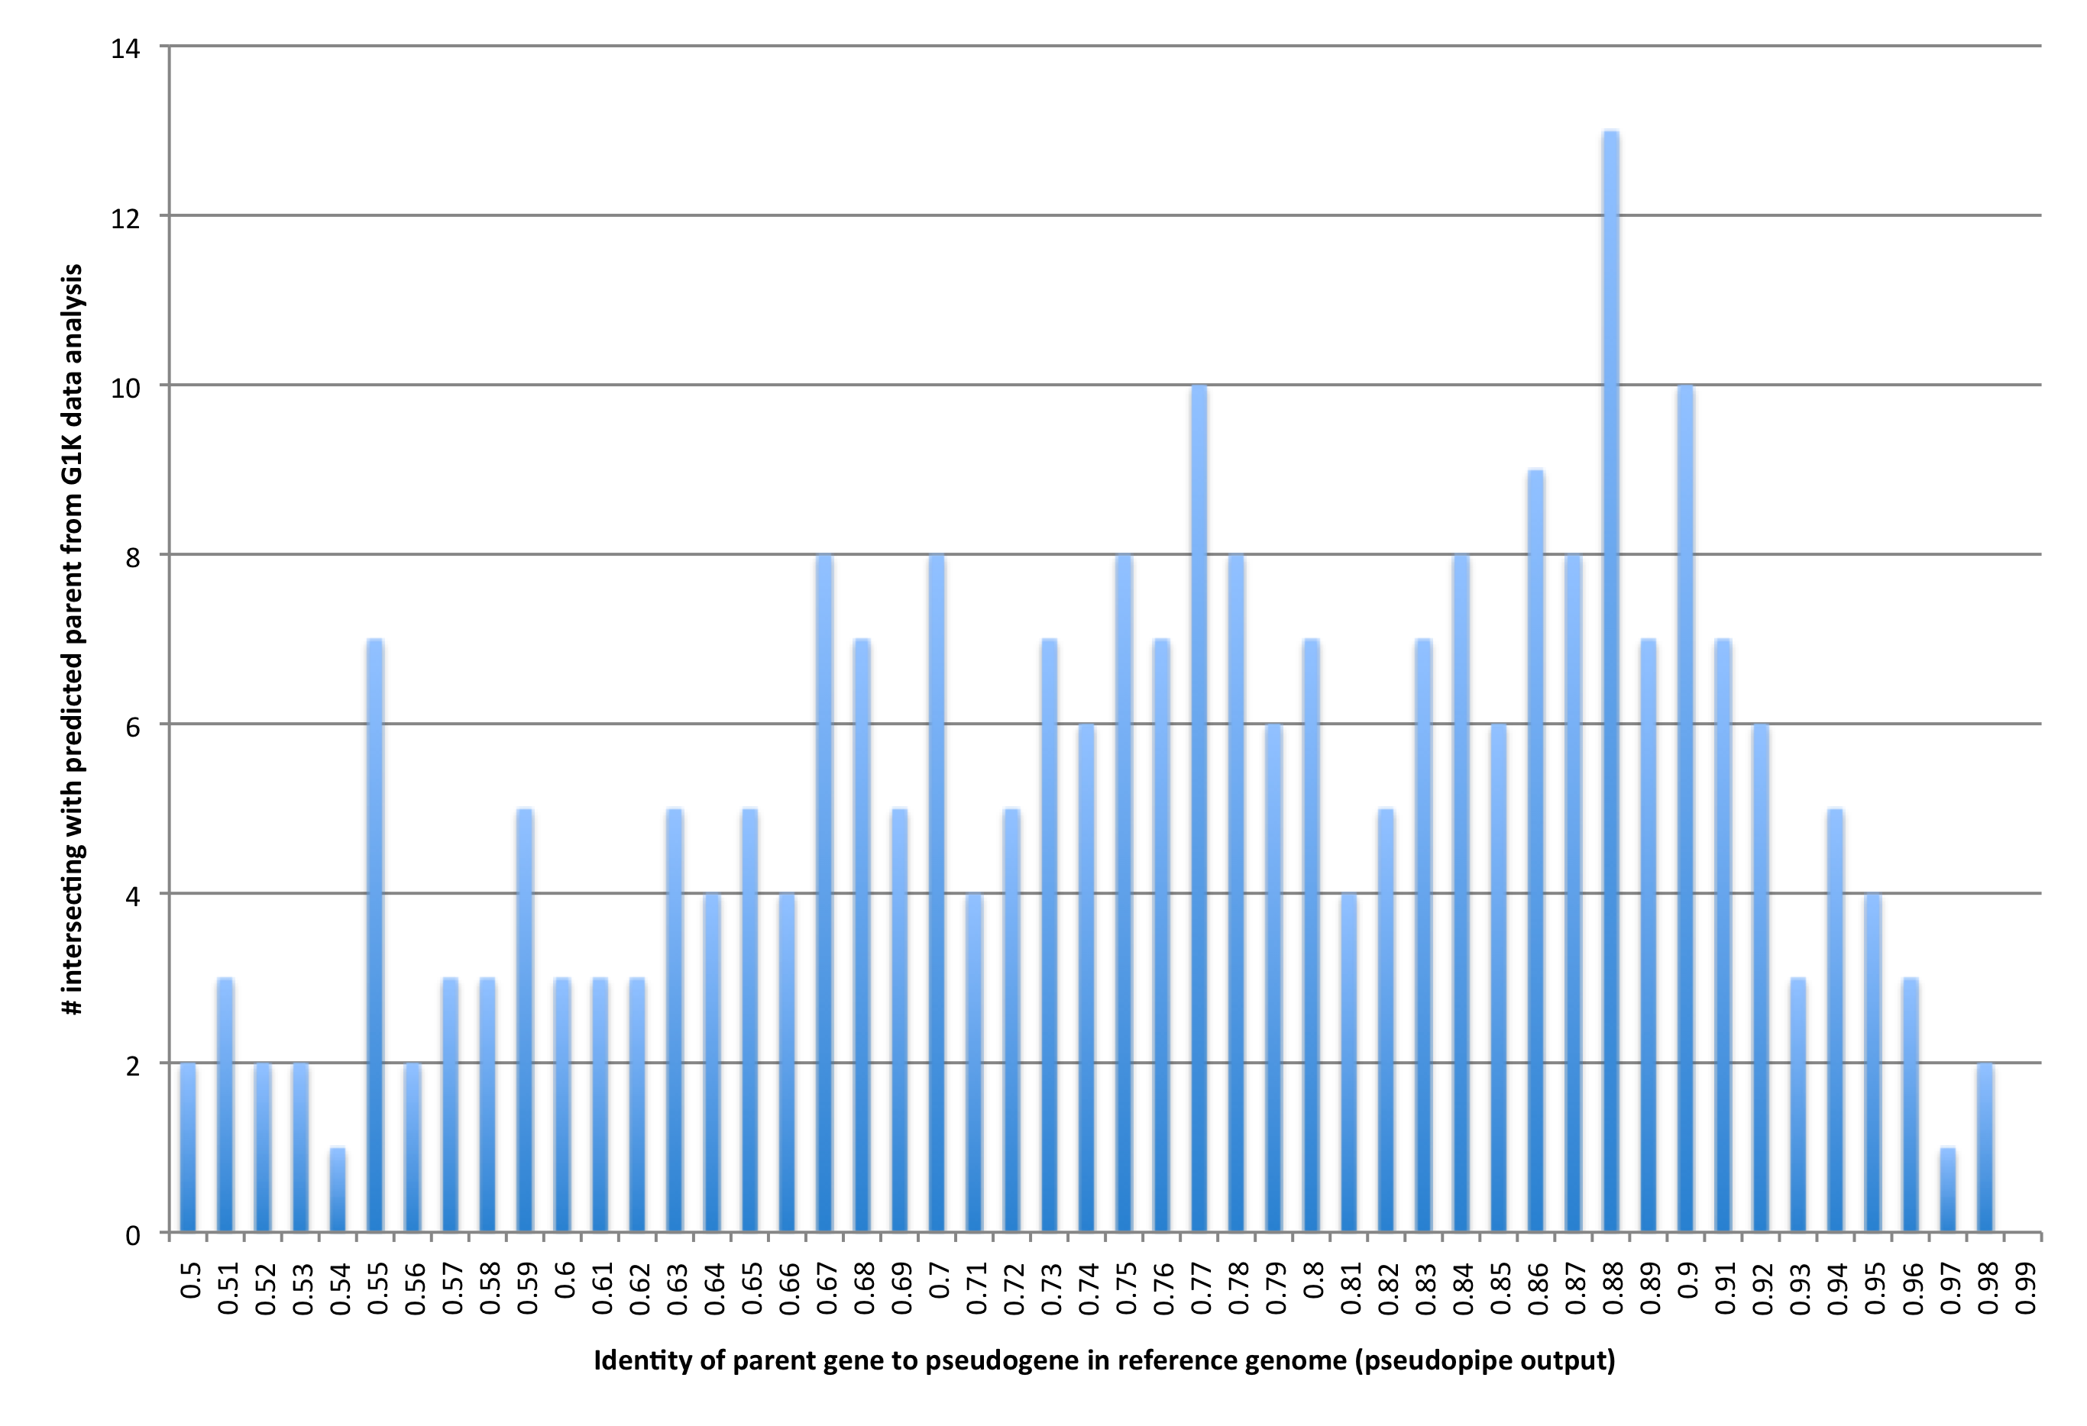
Intersection with known parents (Ψpipe 61 output)

Slide 19
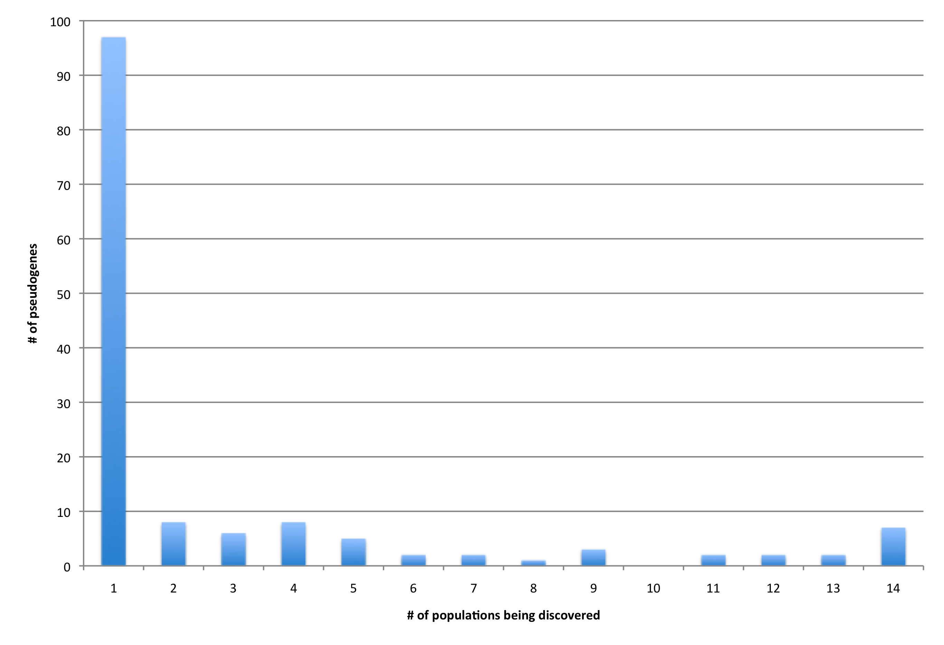
Frequency by populations

Slide 20
Blasting composite transcript against various assemblies of human genome
Gene | # pop | Confirmed in reference | Celera assembly | HuRef assembly
PRKRA | 14 | Alt. haplotype on chr6, 99% NT_167249.1 | Celera on chr6, 99% NW_923051.1 | HuRef, 99% NW_001841135.1
AP3S1 | 14 | - | Celera on chr16, 98% NW_926517.1 | HuRef on chr16, 98% NW_001838324.1
CBX3 | 14 | - | Celera on chr15, 100% NW_925840.1 | HuRef on chr15, 100% NW_001838214.2
TYRO3 | 14 | - | - | -
PABPC1 | 14 | - | - | -
BCLAF1 | 14 |  | Celera, 99% NW_927779.1 | HuRef no chr16, 99% NW_001838285.2
CDC27 | 14 | - | - | -
SKA3 | 13 | - | - | -
TDG | 13 | - | Celera on chr12, 99% NW_925395.1 | HuRef on chr12, 99% NW_001838064.2
MFF | 12 | - | - | -
MTCH2 | 12 | - | - | -
AC131157.1 | 11 | - | - | -
CACNA1B | 11 | - | - | -
RBMX | 9 | - | Celera on chr9, 97% NW_924062.1 | HuRef on chr9, 97% NW_001839149.2
BOD1 | 9 | - | - | -
AK2 | 9 | - | - | -
FRG1B | 8 | - | - | -
ZNF664 | 7 | - | - | -
MATR3 | 7 | - | - | -

Slide 21
Conclusions
Results are reliable
BLAT read realignment for ~10 predictions
Manual inspection of prediction for CEU trio, lots of evidence from RD analysis
Support from alternative assemblies
More of less consistent # of predictions across populations
Genes with Ψgenes in the reference are NOT dominating predictions
Only few sample in JPT drive prediction counts (possible cell line artifacts)
Partial PCR validation (hope to see more soon)

Slide 22
Next
Validation
Ensure that designed primers target regions that are predicted to be pseudogenized
Genotyping and estimating CN
Using RD and compare signal for exons vs introns
Estimate of allele frequencies
Assembling Ψgene sequences
PE clustering to predict Ψgene locations
Complete/incomplete pseudogenization
Breakpoint and sequence assembly

