Slide 1
XJM

Slide 2
Using the TF network by probability model
Using TF network from the union of all the cell lines for 119 TFs.
Take union regions of the TFs, i.e. for the same TF take the union of the TF regions from all the cell lines and all the experiments and conditions.

Slide 3
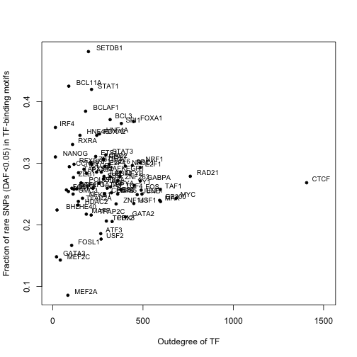
All the SNPs, union of all the cell lines
Correlation p-value
Pearson 0.0005 0.996
Spearman -0.021 0.85
Notes:
All the TFs, union of all the cell lines

Slide 4
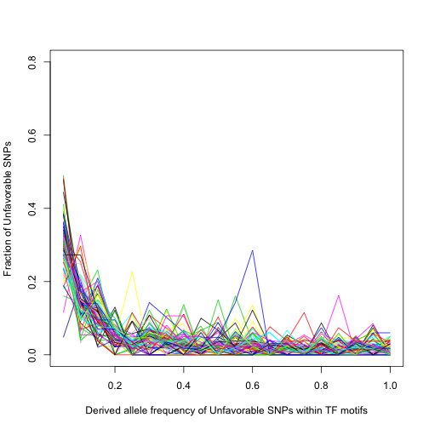
Notes:
union of all cell lines

Slide 5
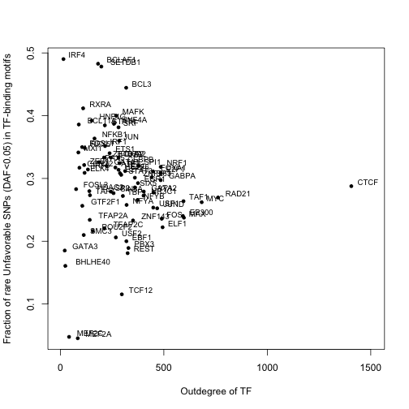
All the unfavorable SNPs, union of all the cell lines
Correlation p-value
Pearson 0.090 0.43
Spearman -0.23 0.039
Notes:
union of all cell lines

Slide 6
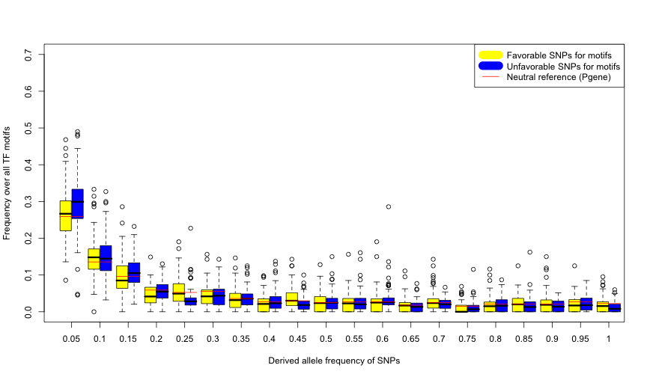
Notes:
All the union of the cell lines

Slide 7
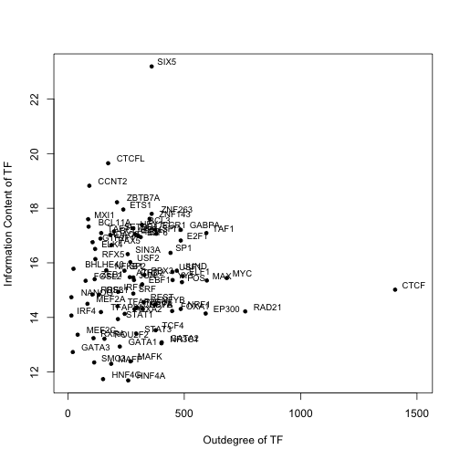
Correlation p-value
Pearson 0.032 0.78
Spearman 0.059 0.60
Notes:
Information content, all TF, union of all cell lines, prob TF network

Slide 10
Pearson | Correlation |  | P-value
 | Low-DAF SNP vs. Outdegree | High-DAF SNP vs. Outdegree | Low-DAF SNP vs. Outdegree | High-DAF SNP vs. Outdegree
Favorable SNPs | -0.019 | 0.026 | 0.87 | 0.82
Unfavorable SNPs | -0.090 | 0.11 | 0.43 | 0.33
Spearman | Correlation |  | P-value
 | Low-DAF SNP vs. Outdegree | High-DAF SNP vs. Outdegree | Low-DAF SNP vs. Outdegree | High-DAF SNP vs. Outdegree
Favorable SNPs | 0.021 | 0.066 | 0.86 | 0.56
Unfavorable SNPs | -0.23 | 0.27 | 0.039 | 0.018
Notes:
All the union of the cell lines

Slide 11
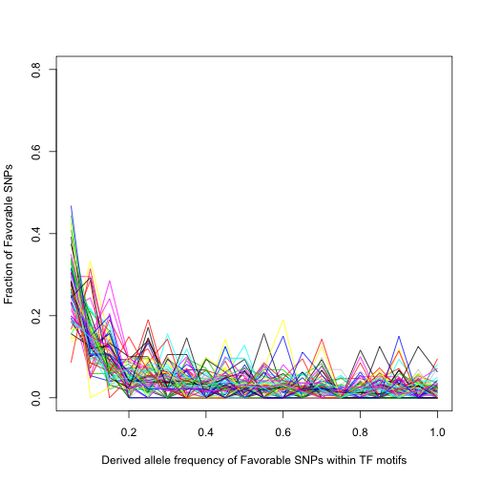
Notes:
union of all cell lines

Slide 12
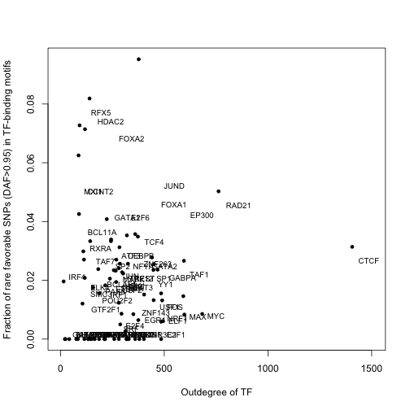
All TF, union of all cell lines, probability method TF network
Notes:
union of all cell lines

Slide 13
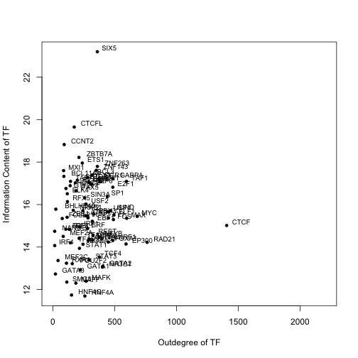
All TF, union of all cell lines, probability method TF network
Correlation p-value
Pearson 0.032 0.78
Spearman 0.059 0.60
Notes:
Information content, all TF, union of all cell lines, prob TF network

Slide 14
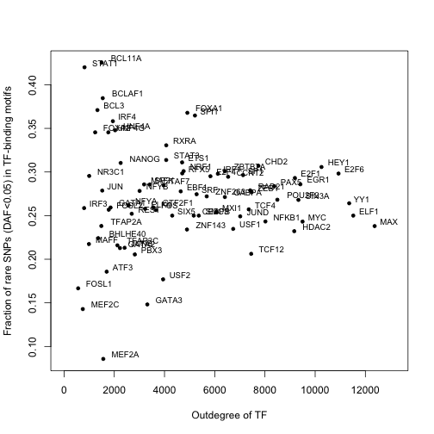
All TF, union of all cell lines, peak method TF network
Correlation p-value
Pearson -0.0010 0.99
Spearman 0.024 0.83
Notes:
Information content, all TF, union of all cell lines, peak method TF network

Slide 15
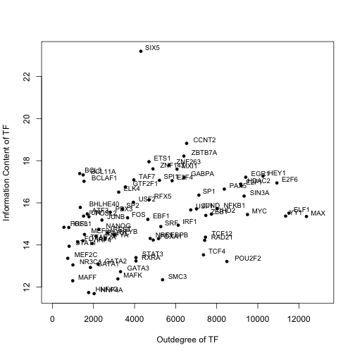
All TF, union of all cell lines, peak method TF network
Correlation p-value
Pearson 0.31 0.0058
Spearman 0.37 0.00086
Notes:
Information content, all TF, union of all cell lines, peak method TF network

