Slide 1
TF motif vs. SNP selection
XJM

Slide 2
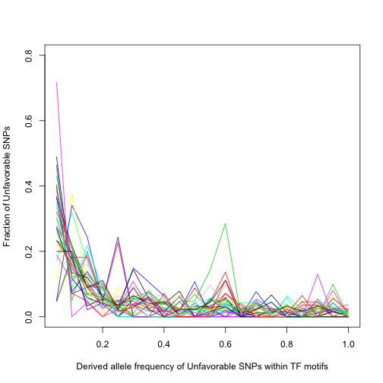
Unfavorable SNPs

Slide 3
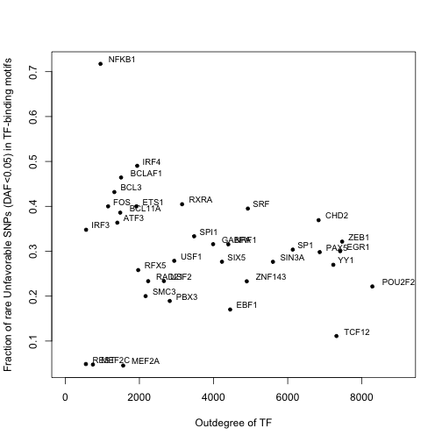
Unfavorable SNPs

Slide 4
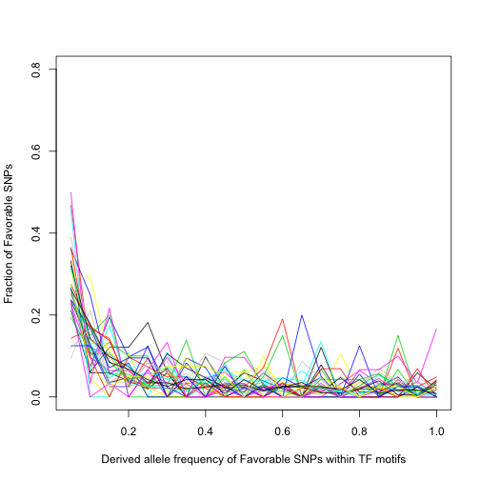
Favorable SNPs

Slide 5
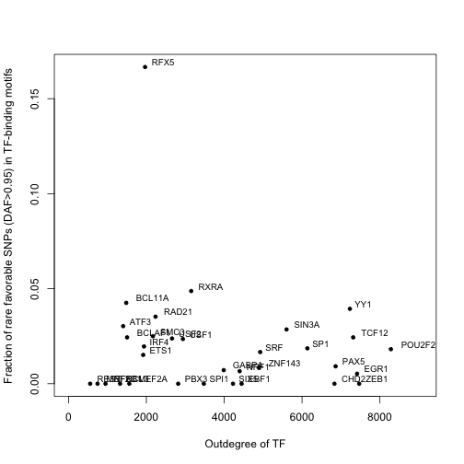
Favorable SNPs

Slide 6
Pearson | Correlation |  | P-value
 | Low-DAF SNP vs. Outdegree | High-DAF SNP vs. Outdegree | Low-DAF SNP vs. Outdegree | High-DAF SNP vs. Outdegree
Favorable SNPs | 0.080 | -0.13 | 0.66 | 0.49
Unfavorable SNPs | -0.14 | 0.014 | 0.42 | 0.94

Slide 7
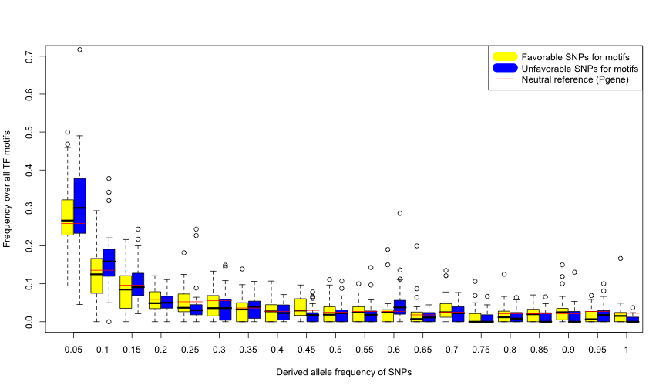

Slide 10
Pearson | Correlation |  | P-value
 | Low-DAF SNP vs. Outdegree | High-DAF SNP vs. Outdegree | Low-DAF SNP vs. Outdegree | High-DAF SNP vs. Outdegree
Favorable SNPs | 0.080 | -0.13 | 0.66 | 0.49
Unfavorable SNPs | -0.14 | 0.014 | 0.42 | 0.94
Spearman | Correlation |  | P-value
 | Low-DAF SNP vs. Outdegree | High-DAF SNP vs. Outdegree | Low-DAF SNP vs. Outdegree | High-DAF SNP vs. Outdegree
Favorable SNPs | 0.093 | 0.023 | 0.61 | 0.90
Unfavorable SNPs | -0.20 | 0.088 | 0.24 | 0.62

