Slide 1
Properties of TF-ncRNA Interactions in Different Hierarchies
Renqiang Min
August 3, 2011

Slide 2
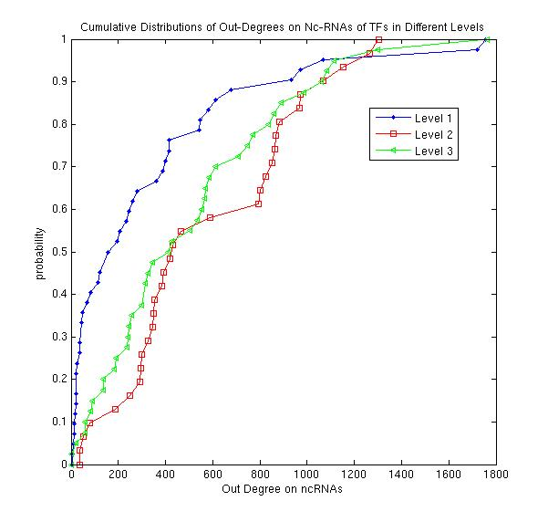
Out-Degrees of TFs on ncRNAs

Slide 3
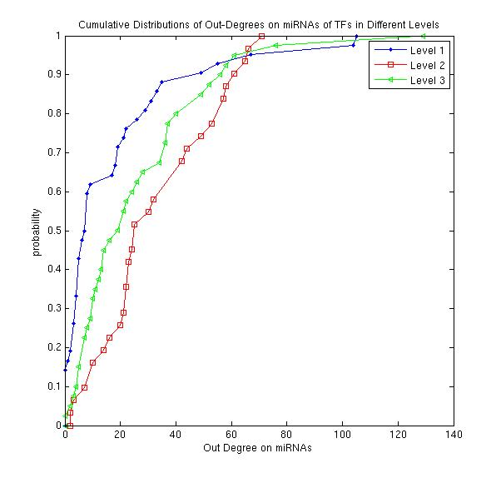
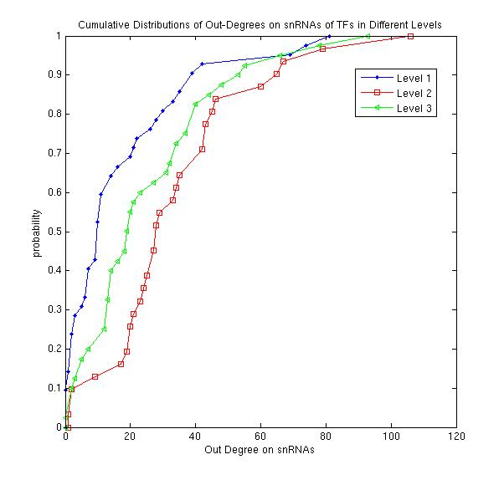
Out-Degrees of TFs on miRNAs and snRNAs

Slide 4
Comparisons of Out-Degrees of TFs between Levels
ncRNA | L1 | L2 | L3
L1 | 331 | 5.40 E-4 | 5.00 E-03
L2 |  | 586 | 0.26
L3 |  |  | 510
miRNA | L1 | L2 | L3
L1 | 18 | 1.46 E-04 | 6.30 E-03
L2 |  | 33 | 0.060
L3 |  |  | 27
snRNA | L1 | L2 | L3
L1 | 17 | 3.16 E-04 | 1.30 E-02
L2 |  | 34 | 5.60 E-02
L3 |  |  | 26
snoRNA | L1 | L2 | L3
L1 | 18 | 2.28 E-04 | 2.30 E-02
L2 |  | 35 | 0.13
L3 |  |  | 26
lincRNA | L1 | L2 | L3
L1 | 71 | 5.28 E-04 | 2.80 E-02
L2 |  | 122 | 0.51
L3 |  |  | 112
Pro_trans | L1 | L2 | L3
L1 | 196 | 9.93 E-04 | 4.70 E-03
L2 |  | 342 | 0.36
L3 |  |  | 304

Slide 5
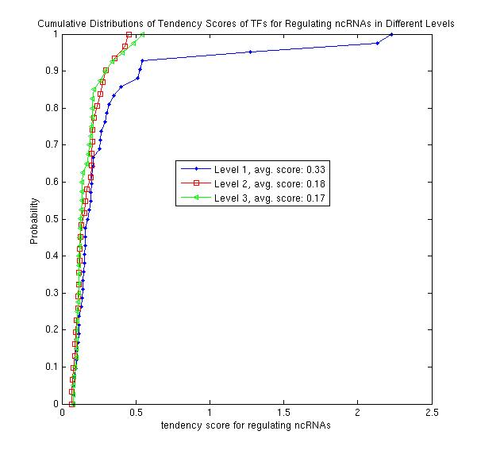
Tendency Scores of TFs for Regulating ncRNAs

Slide 6
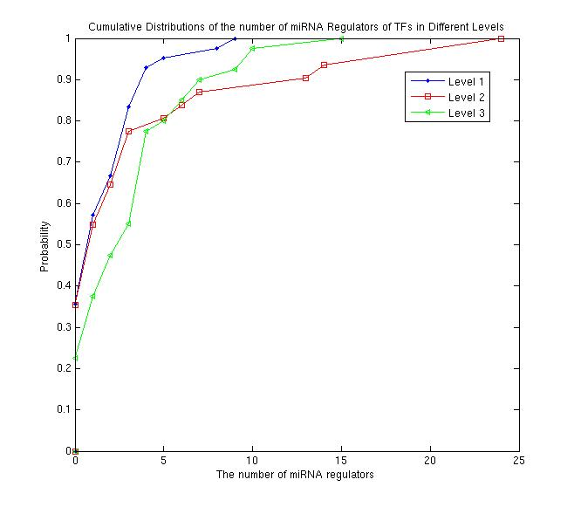
No. of miRNA Regulators

