Slide 1
Selection on TFs and target genes
EK, 28 Jul 2011

Slide 2
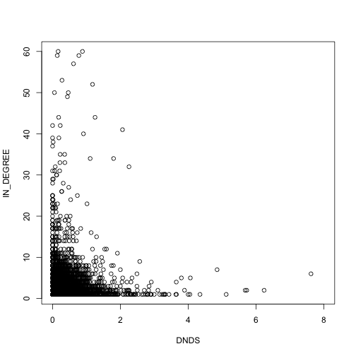
TFs and Target genes included (in-degree > 0)
Spearman corr coeff=-0.05, p value = 7.6 e-06

Slide 3
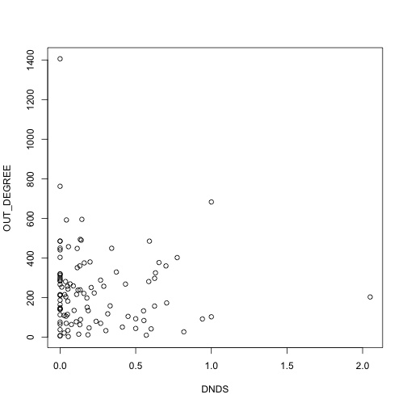
Out-degree > 0
Spearman corr coeff=-0.08, p value = 0.39

Slide 4
TFs contributing most to anti-correlation
TF name | dN/dS | Out-degree
PRDM1 | 0.818 | 27
CTCF | 0 | 1406
RAD21 | 0 | 762
FAM48A | 0.57 | 10
NRF1 | 0 | 485
GABPA | 0 | 485
MEF2C | 0.60 | 42
YY1 | 0 | 450
CCNT2 | 0.94 | 92
SP1 | 0 | 441

Slide 5
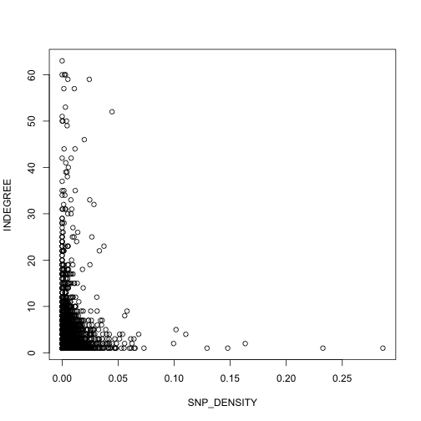
In-degree > 0
Spearman corr coeff = - 0.05, pvalue=3.4e-05

Slide 6
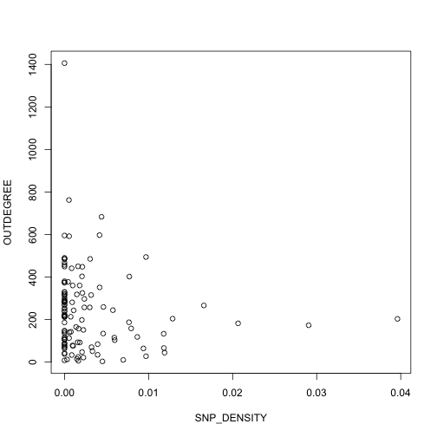
Out-degree > 0
Spearman corr coeff = -0.19, pvalue=0.03

Slide 7
TFs contributing most to anti-correlation
TF name | snp_Density | Out-degree
PRDM1 | 0.009 | 27
XRCC4 | 0.012 | 44
FAM48A | 0.007 | 10
WRNIP1 | 0.005 | 3
ESRRA | 0.012 | 66
CTCF | 0 | 1406
SIRT6 | 0.009 | 64
TAF1 | 0 | 595
FOS | 0 | 490
GABPA | 0 | 485

Slide 8
TFs contributing most to anti-correlation
For dN/dS | For snp density
PRDM1 | PRDM1
CTCF | XRCC4
RAD21 | FAM48A
FAM48A | WRNIP1
NRF1 | ESRRA
GABPA | CTCF
MEF2C | SIRT6
YY1 | TAF1
CCNT2 | FOS
SP1 | GABPA

Slide 9
Old network slides

Slide 10
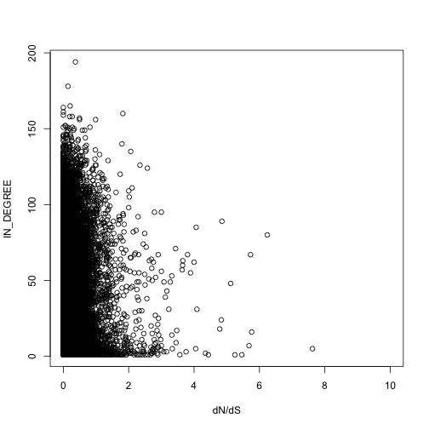
TFs and Target genes included (in-degree > 0)
Targets with more regulators are under higher negative selection (chimp-human comparison)
Spearman corr coeff=-0.12, p value < 2.2e-16
Ekta Khurana

Slide 11
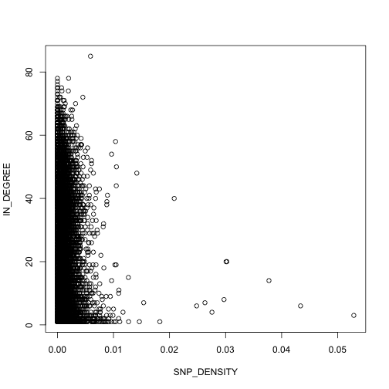
TFs and Target genes included (in-degree > 0)
Targets with more regulators are under higher negative selection (within humans comparison)
Non-synonymous SNPs from 1000 Genomes pilot project
Spearman corr coeff=-0.108, p value < 2.2e-16
Ekta Khurana

