Slide 1
Re-reanalysis of encode models

Slide 2
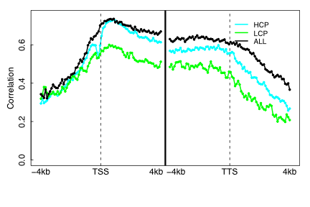
Old HM model

Slide 3
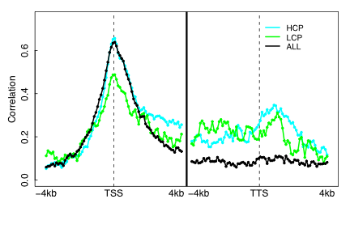
Old TF model

Slide 4
Old vs. New analysis for the encode
RNA-Seq from Wold Lab at Caltech (2 profiles)
Predict expression of transcript
Protein coding genes only
Refseq hg18 → Refseq hg19 → Gencodev3
Encode expression data (267profiles)
CAGE, diTAGS, RNA-Seq
Predict expression of TSS
All TSS from Gencodev7

Slide 5
K562 – histone modifications (19)
[1] "wgEncodeBroadHistoneK562H4k20me1StdAln"
[2] "wgEncodeBroadHistoneK562H3k27acStdAln"
[3] "wgEncodeBroadHistoneK562H3k27me3StdAln"
[4] "wgEncodeBroadHistoneK562H3k36me3StdAln"
[5] "wgEncodeBroadHistoneK562H3k4me1StdAln"
[6] "wgEncodeBroadHistoneK562H3k4me2StdAln"
[7] "wgEncodeBroadHistoneK562H3k4me3StdAln"
[8] "wgEncodeBroadHistoneK562H3k79me2StdAln"
[9] "wgEncodeBroadHistoneK562H3k9acStdAln"
[10] "wgEncodeBroadHistoneK562H3k9me1StdAln"
[11] "wgEncodeBroadHistoneK562H3k9me3StdAln"
[12] "wgEncodeSydhHistoneK562H3k27me3UcdAln"
[13] "wgEncodeSydhHistoneK562H3k4me1UcdAln"
[14] "wgEncodeSydhHistoneK562H3k4me3UcdAln"
[15] "wgEncodeSydhHistoneK562H3k9acbUcdAln"
[16] "wgEncodeUwHistoneK562H3k27me3StdAln"
[17] "wgEncodeUwHistoneK562H3k36me3StdAln"
[18] "wgEncodeUwHistoneK562H3k4me3StdAln"
[19] "wgEncodeBroadHistoneK562H2azStdAln"

Slide 6
K562 –TF binding profiles (69)
[1] "wgEncodeHaibTfbsK562Bcl3Pcr1xAln"
[2] "wgEncodeHaibTfbsK562Bclaf1m33Pcr1xAln"
[3] "wgEncodeHaibTfbsK562E2f6h50V0416102Aln"
[4] "wgEncodeHaibTfbsK562Egr1V0416101Aln"
[5] "wgEncodeHaibTfbsK562Elf1sc631V0416102Aln"
[6] "wgEncodeHaibTfbsK562Ets1V0416101Aln"
[7] "wgEncodeHaibTfbsK562Fosl1sc183V0416101Aln"
[8] "wgEncodeHaibTfbsK562GabpV0416101Aln"
[9] "wgEncodeHaibTfbsK562Gata2cg2Pcr1xAln"
[10] "wgEncodeHaibTfbsK562Hdac2sc6296V0416102Aln"
[11] "wgEncodeHaibTfbsK562Hey1Pcr1xAln"
[12] "wgEncodeHaibTfbsK562MaxV0416102Aln"
[13] "wgEncodeHaibTfbsK562NrsfV0416102Aln"
[14] "wgEncodeHaibTfbsK562Pu1Pcr1xAln"
[15] "wgEncodeHaibTfbsK562Rad21V0416102Aln"
[16] "wgEncodeHaibTfbsK562Sin3ak20V0416101Aln"
[17] "wgEncodeHaibTfbsK562Six5Pcr1xAln"
[18] "wgEncodeHaibTfbsK562Sp1Pcr1xAln"
[19] "wgEncodeHaibTfbsK562Sp2sc643V0416102Aln"
[20] "wgEncodeHaibTfbsK562SrfV0416101Aln"
[21] "wgEncodeHaibTfbsK562Thap1sc98174V0416101Aln"
[22] "wgEncodeHaibTfbsK562Usf1V0416101Aln"
[23] "wgEncodeHaibTfbsK562Yy1V0416101Aln"
[24] "wgEncodeHaibTfbsK562Yy1V0416102Aln"
[25] "wgEncodeHaibTfbsK562Zbtb33Pcr1xAln"
[26] "wgEncodeHaibTfbsK562Zbtb7asc34508V0416101Aln"
[27] "wgEncodeSydhTfbsK562Atf3StdAln"
[28] "wgEncodeSydhTfbsK562Bdp1StdAln"
[29] "wgEncodeSydhTfbsK562bE2f4UcdAln"
[30] "wgEncodeSydhTfbsK562bE2f6UcdAln"
[31] "wgEncodeSydhTfbsK562bGata1UcdAln"
[32] "wgEncodeSydhTfbsK562bGata2UcdAln"
[65] "wgEncodeSydhTfbsK562Smc3ab9263IggrabAln"
[66] "wgEncodeSydhTfbsK562Tal1sc12984IggmusAln"
[67] "wgEncodeSydhTfbsK562Tf3c110StdAln"
[68] "wgEncodeSydhTfbsK562Usf2StdAln"
[69] "wgEncodeSydhTfbsK562Xrcc4StdAln"
[33] "wgEncodeSydhTfbsK562bKap1UcdAln"
[34] "wgEncodeSydhTfbsK562Brf1StdAln"
[35] "wgEncodeSydhTfbsK562Brf2StdAln"
[36] "wgEncodeSydhTfbsK562Brg1IggmusAln"
[37] "wgEncodeSydhTfbsK562bSetdb1MnasedUcdAln"
[38] "wgEncodeSydhTfbsK562bSetdb1UcdAln"
[39] "wgEncodeSydhTfbsK562bTr4UcdAln"
[40] "wgEncodeSydhTfbsK562bYy1UcdAln"
[41] "wgEncodeSydhTfbsK562bZnf263UcdAln"
[42] "wgEncodeSydhTfbsK562bZnf274UcdAln"
[43] "wgEncodeSydhTfbsK562Ccnt2StdAln"
[44] "wgEncodeSydhTfbsK562CebpbIggrabAln"
[45] "wgEncodeSydhTfbsK562CfosStdAln"
[46] "wgEncodeSydhTfbsK562Chd21250IggrabAln"
[47] "wgEncodeSydhTfbsK562CjunStdAln"
[48] "wgEncodeSydhTfbsK562CmycStdAln"
[49] "wgEncodeSydhTfbsK562Gtf2bStdAln"
[50] "wgEncodeSydhTfbsK562Gtf2f1rapIggrabAln"
[51] "wgEncodeSydhTfbsK562Hmgn3StdAln"
[52] "wgEncodeSydhTfbsK562Ini1IggmusAln"
[53] "wgEncodeSydhTfbsK562JundStdAln"
[54] "wgEncodeSydhTfbsK562Mafkab50322IggrabAln"
[55] "wgEncodeSydhTfbsK562MaxStdAln"
[56] "wgEncodeSydhTfbsK562Mxi1bhlhIggrabAln"
[57] "wgEncodeSydhTfbsK562NelfeStdAln"
[58] "wgEncodeSydhTfbsK562Nfe2StdAln"
[59] "wgEncodeSydhTfbsK562NfyaStdAln"
[60] "wgEncodeSydhTfbsK562NfybStdAln"
[61] "wgEncodeSydhTfbsK562Nrf1IggrabAln"
[62] "wgEncodeSydhTfbsK562Rad21StdAln"
[63] "wgEncodeSydhTfbsK562Rpc155StdAln"
[64] "wgEncodeSydhTfbsK562Sirt6StdAln"

Slide 7
K562 expression
[1] PolyA+ K562 Wcell biorep1 RNA PolyA+ K562 Wcell biorep2 RNA
[3] total K562 Chr biorep0 RNA PolyA- K562 Cy biorep0 RNA
[5] PolyA+ K562 Cy biorep0 RNA PolyA+ K562 Cy biorep1 RNA
[7] PolyA+ K562 Cy biorep2 RNA total K562 Nuol biorep0 RNA
[9] total K562 Nupl biorep0 RNA PolyA- K562 Nuc biorep0 RNA
[11] PolyA+ K562 Nuc biorep1 RNA PolyA+ K562 Nuc biorep2 RNA
[13] PolyA- K562 Ps biorep0 RNA total K562 Chr biorep1 RNA
[15] PolyA+ K562 Cy biorep1 RNA PolyA+ K562 Cy biorep2 RNA
[17] total K562 Nuol biorep1 RNA total K562 Nupl biorep1 RNA
[19] PolyA+ K562 Nuc biorep1 RNA PolyA+ K562 Ps biorep1 RNA
[21] short K562 Wcell biorep0 RNA short K562 Wcell biorep1 RNA
[23] short K562 Wcell biorep2 RNA short K562 Chr biorep0 RNA
[25] short K562 Chr biorep3 RNA short K562 Chr biorep4 RNA
[27] short K562 Cy biorep0 RNA short K562 Cy biorep1 RNA
[29] short K562 Cy biorep2 RNA short K562 Nuol biorep0 RNA
[31] short K562 Nuol biorep3 RNA short K562 Nuol biorep4 RNA
[33] short K562 Nupl biorep0 RNA short K562 Nupl biorep3 RNA
[35] short K562 Nupl biorep4 RNA short K562 Nuc biorep0 RNA
[37] short K562 Nuc biorep1 RNA short K562 Nuc biorep2 RNA
[39] short K562 Ps biorep0 RNA PolyA- K562 Wcell biorep1 RNA
[41] PolyA- K562 Wcell biorep2 RNA PolyA+ K562 Wcell biorep1 RNA
[43] PolyA+ K562 Wcell biorep2 RNA total K562 Chr biorep3 RNA
[45] total K562 Chr biorep4 RNA PolyA- K562 Cy biorep1 RNA
[47] PolyA- K562 Cy biorep2 RNA PolyA+ K562 Cy biorep1 RNA
[49] PolyA+ K562 Cy biorep2 RNA total K562 Nuol biorep3 RNA
[51] total K562 Nuol biorep4 RNA total K562 Nupl biorep3 RNA
[53] total K562 Nupl biorep4 RNA PolyA- K562 Nuc biorep1 RNA
[55] PolyA- K562 Nuc biorep2 RNA PolyA+ K562 Nuc biorep1 RNA
[57] PolyA+ K562 Nuc biorep2 RNA

Slide 8
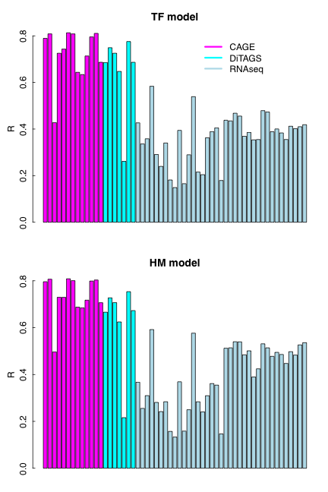
All TSSs vs. protein-coding TSSs

Slide 9
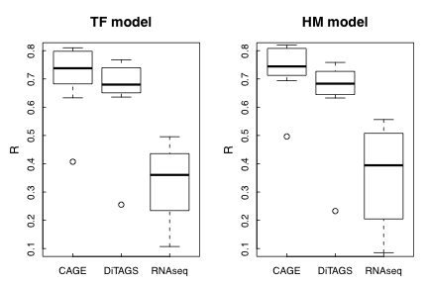
CAGE > RNAseq

Slide 10
One technical issue
Two ways for evaluate the prediction accuracy by CV
- (1) based on all TSSs-- adding 0.03 as pseudcount before taking log
- (2) based on non-zero TSSs only– do not use pseudocount
Example: HM model for predicting TSSs expression (PolyA+ K562 Wcell biorep1 RNA) in K562
R=0.80 for (2);
R=0.64 for (1)
We use (2) in all our previous presentations!

Slide 11
Summary
pseudoCount gives higher R: good or bad?
pseudoCount might affect differently to expression by different technologies: CAGE>RNA-seq?
RNA-seq difference (ENCODE vs. Wold’s data)
Coordinate the HM and TF models-- what to show depends what biological questions to answer.
-- LCP, HCP, gene type, ……

Slide 12
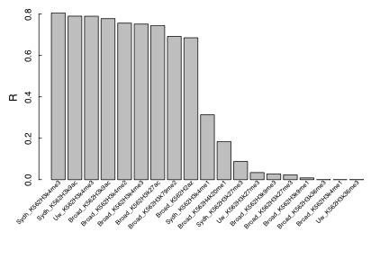
Highly “redundant”

