Slide 1
Click to add turtle
C

Slide 2
All TFs
> Top (27)
BCL11A CTBP2 E2F1 EBF1 ELK4 ESR1 ETS1 HEY1 HMGN3 HNF4G KAT2A NANOG NFYB PPARGC1A RXRA SETDB1 SIX5 SMARCB1 SMC3 SREBF1 SUZ12 TCF12 TCF4 TFAP2C YY1 ZBTB33 ZBTB7A
> mid (59)
BATF BCL3 BCLAF1 BRCA1 CCNT2 CEBPB CHD2 E2F4 E2F6 EGR1 ELF1 FOS FOSL2 FOXA1 FOXA2 GABPA GATA1 GATA2 GTF2B GTF2F1 HDAC2 HNF4A IRF1 IRF3 JUN JUND MAX MEF2A MEF2C MYC NFKB1 NFYA NR2C2 NR3C1 NRF1 PAX5 PBX3 POLR3A POU2F2 RAD21 REST RFX5 SIN3A SIRT6 SMARCA4 SP1 SP2 SPI1 SRF STAT1 STAT2 STAT3 TAL1 TFAP2A THAP1 TRIM28 USF1 ZNF143 ZNF263
> Bot (19)
ATF3 BDP1 BHLHE40 BRF2 CTCFL FOSL1 GATA3 IRF4 MAFK MXI1 NFE2 POU5F1 PRDM1 RDBP SMARCC1 SMARCC2 SREBF2 ZEB1 ZZZ3

Slide 3
All TFs
Top vs. Mid: P= 0.39331
Top vs. Bot: P= 0.165648
Mid vs. Bot: P= 0.129315
Top vs. Mid: P= 0.160448
Top vs. Bot: P= 0.019217
Mid vs. Bot: P= 0.000191
Top vs. Mid: P= 0.129472
Top vs. Bot: P= 0.050739
Mid vs. Bot: P= 1e-05
Top vs. Mid: P= 0.032723
Top vs. Bot: P= 0.00503
Mid vs. Bot: P= 0.094828
Top vs. Mid: P= 0.29793
Top vs. Bot: P= 0.461172
Mid vs. Bot: P= 0.311542

Slide 4
Topology
K562
> sort(top)
BCL3 CCNT2 E2F4 ELF1 ETS1 FOS GABPA HEY1 HMGN3 JUN NFYB SETDB1 TAL1 YY1 ZBTB33 ZBTB7A
> sort(mid)
BCLAF1 CEBPB CHD2 E2F6 EGR1 GATA2 GTF2B IRF1 MYC NFYA NRF1 RAD21 SIN3A SMARCA4 SP1 SP2 SRF STAT1 STAT2 THAP1 TRIM28 USF1 ZNF263
> sort(bot)
ATF3 BDP1 BRF2 CTCFL FOSL1 GATA1 HDAC2 JUND MAX NFE2 POLR3A RDBP SIRT6 SPI1
GM12878
> sort(top)
BCL11A BCLAF1 BRCA1 CHD2 EBF1 ETS1 MEF2C NRF1 PBX3 REST SIX5 SPI1 SRF TCF12 YY1 ZBTB33
> sort(mid)
EGR1 FOS IRF3 NFKB1 POU2F2 RAD21 SIN3A SP1 USF1 ZNF143
> sort(bot)
BATF BCL3 ELF1 IRF4 JUND MAX MEF2A MYC PAX5 RFX5 STAT1 STAT3 ZEB1 ZZZ3

Slide 5
K562
Top vs. Mid: P= 0.08095
Top vs. Bot: P= 0.060233
Mid vs. Bot: P= 0.021943
Top vs. Mid: P= 0.199058
Top vs. Bot: P= 0.338669
Mid vs. Bot: P= 0.381591
Top vs. Mid: P= 0.334569
Top vs. Bot: P= 0.280664
Mid vs. Bot: P= 0.109764
Top vs. Mid: P= 0.257314
Top vs. Bot: P= 0.000708
Mid vs. Bot: P= 0.015092
Top vs. Mid: P= 0.409485
Top vs. Bot: P= 0.390157
Mid vs. Bot: P= 0.313779
Top vs. Mid: P= 0.4874
Top vs. Bot: P= 0.3967
Mid vs. Bot: P= 0.3586

Slide 6
GM12878
Top vs. Mid: P= 0.167698
Top vs. Bot: P= 0.002389
Mid vs. Bot: P= 0.195721

Slide 7
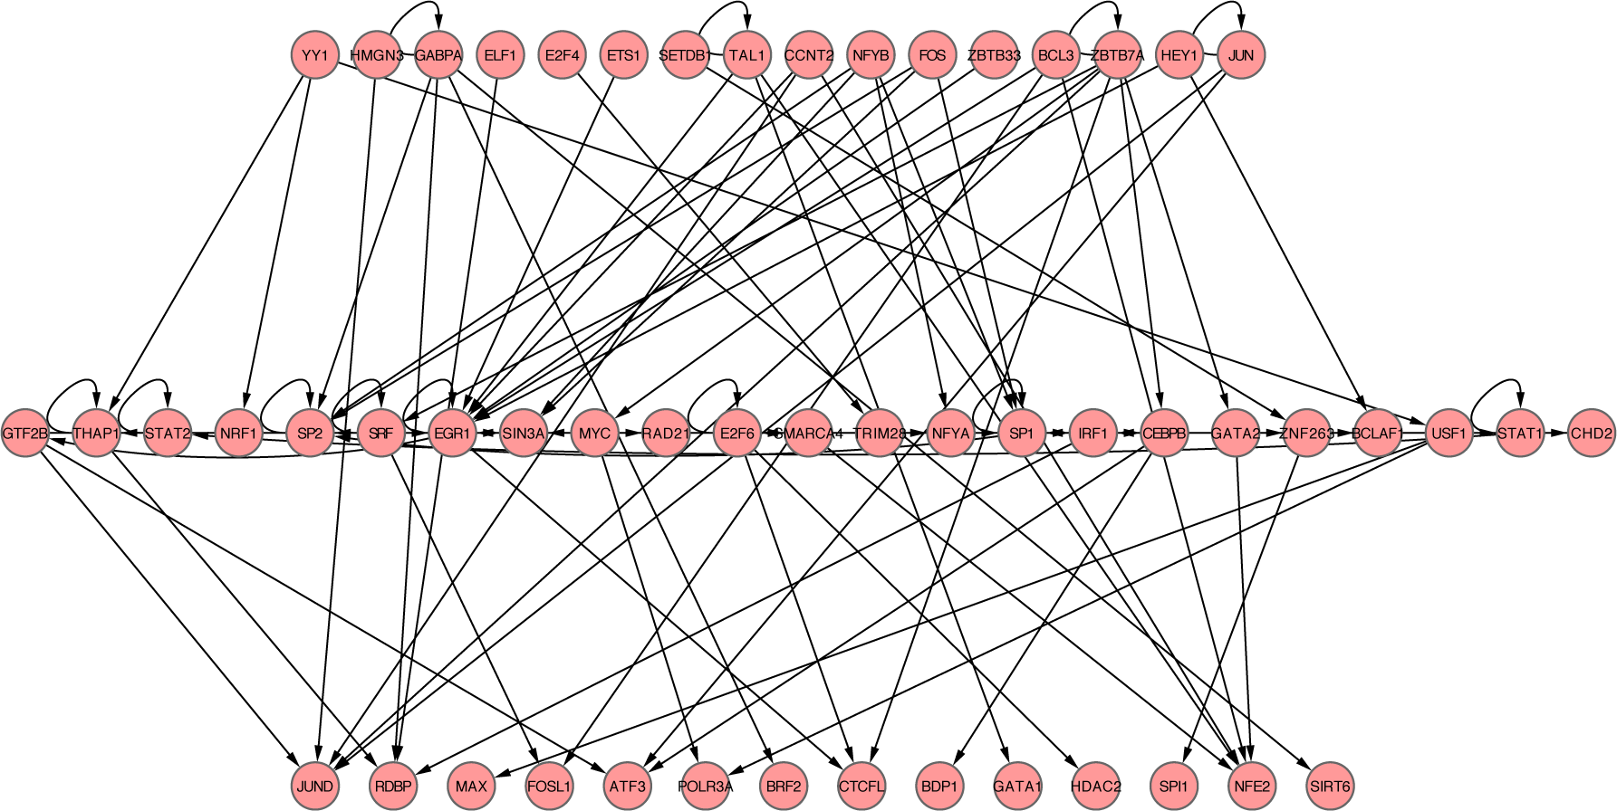
K562

Slide 8
KKY’s method (3-layer net)

Slide 9
K562 –KKY’s 3 Layer net

